Slide 1
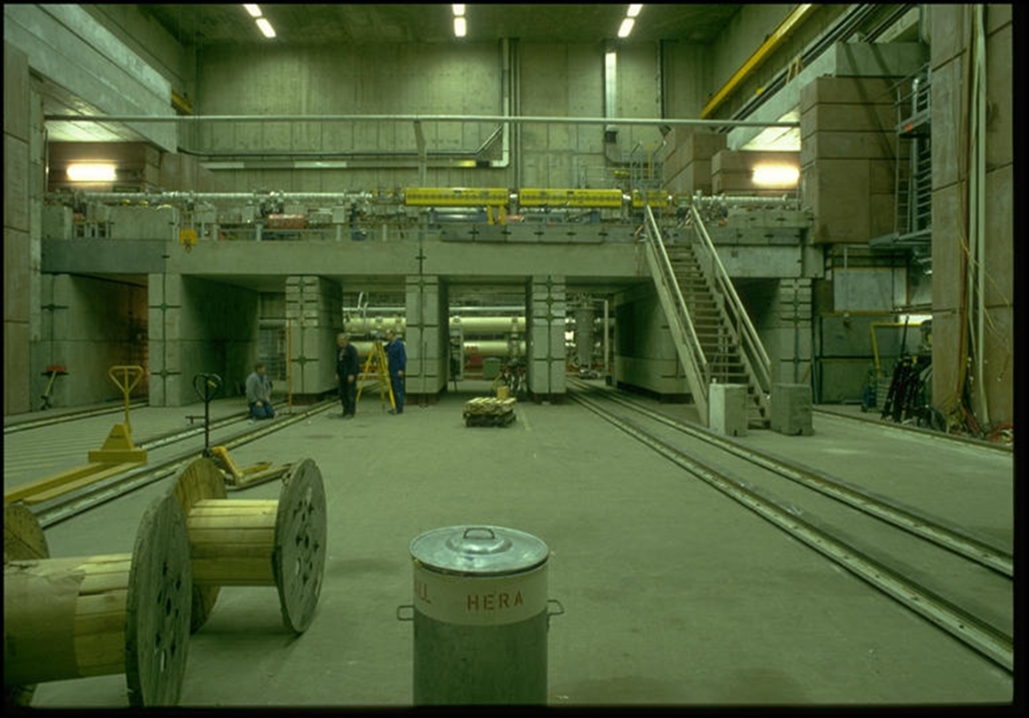
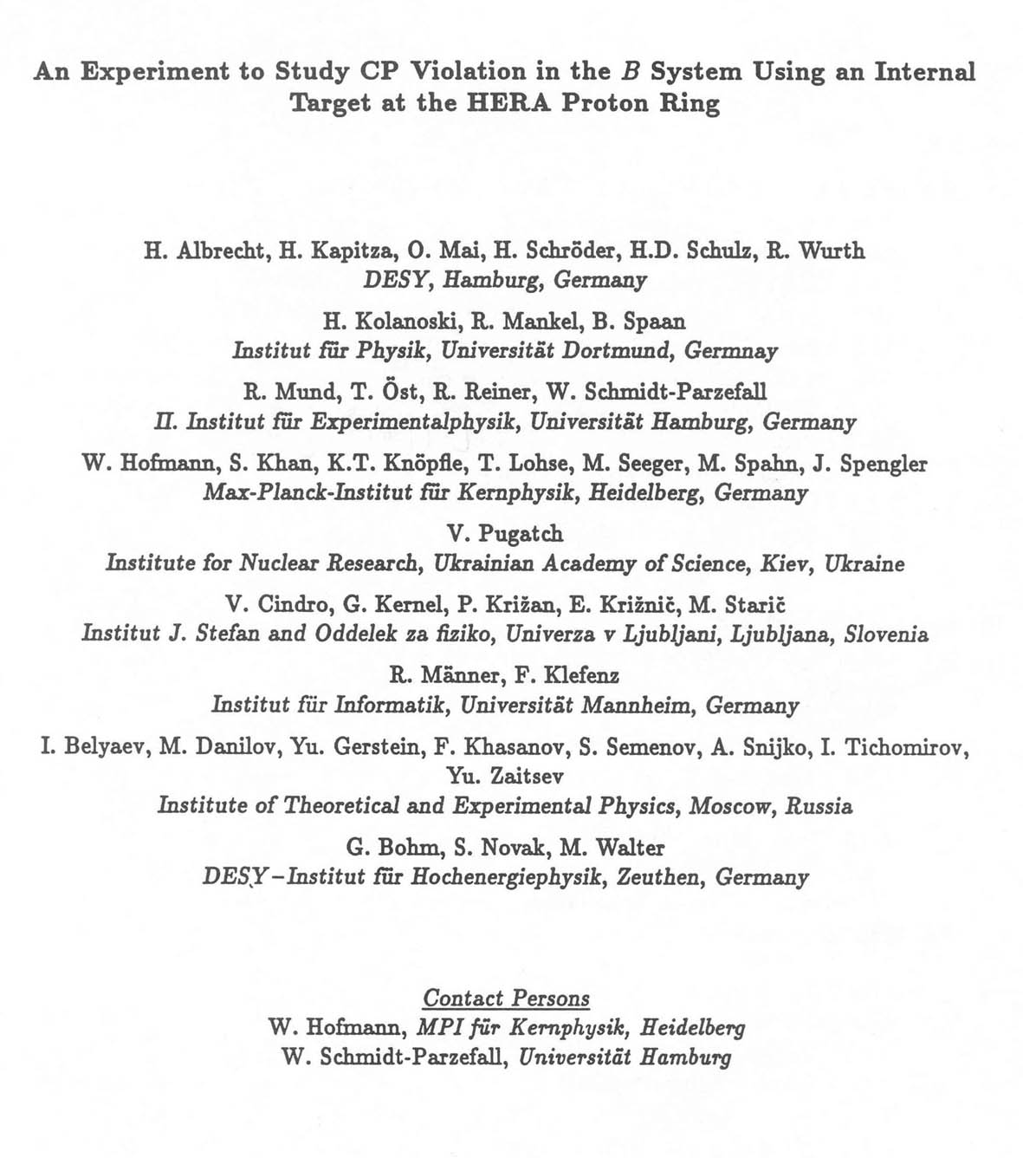
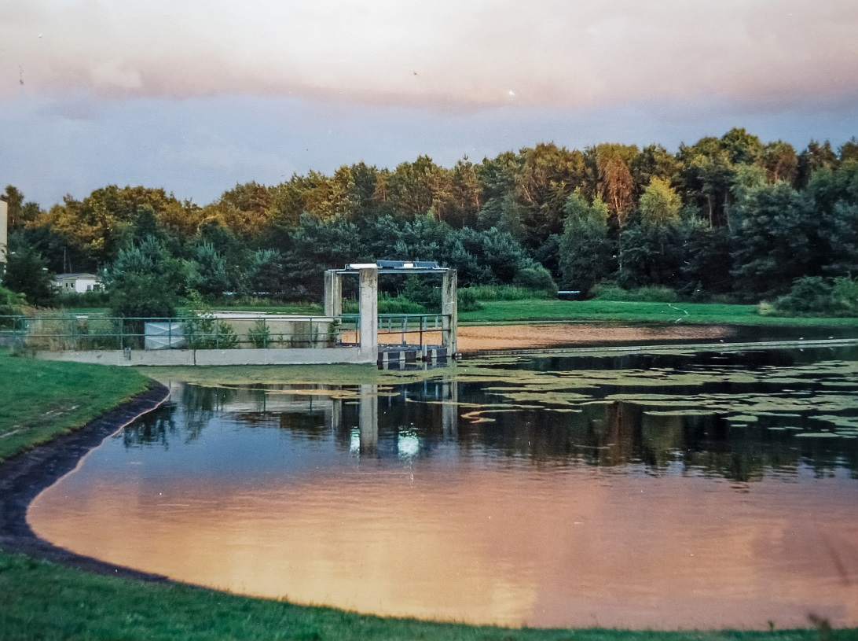
West Hall – before HERA-B
The HERA-B
Experience:
A HERA-B Student’s View
Maxim Titov (CEA Saclay, France)
Next to the ARGUS Bld. 49
(mid-90x …)

Slide 2
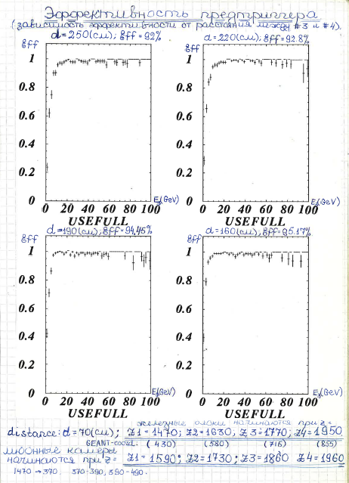
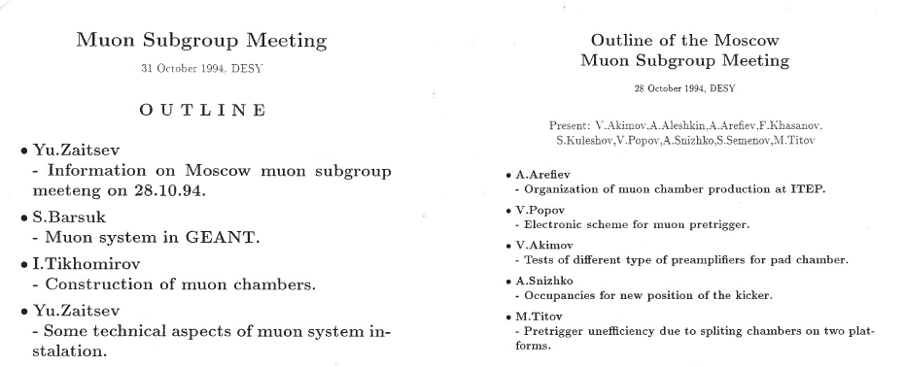
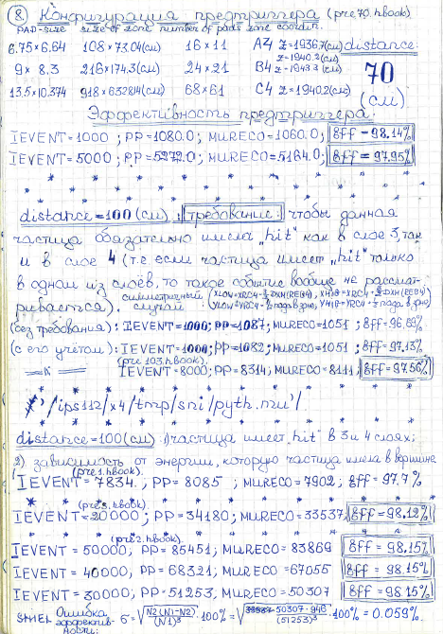
“Beginning of the Electronics Era”: Logbook is Everything
muon pre-trigger efficiency (1994):
Muon SubGroup Meetings at DESY / ITEP Moscow:
Tons of simulations,
layout optimizations,
performance studies …

Slide 3
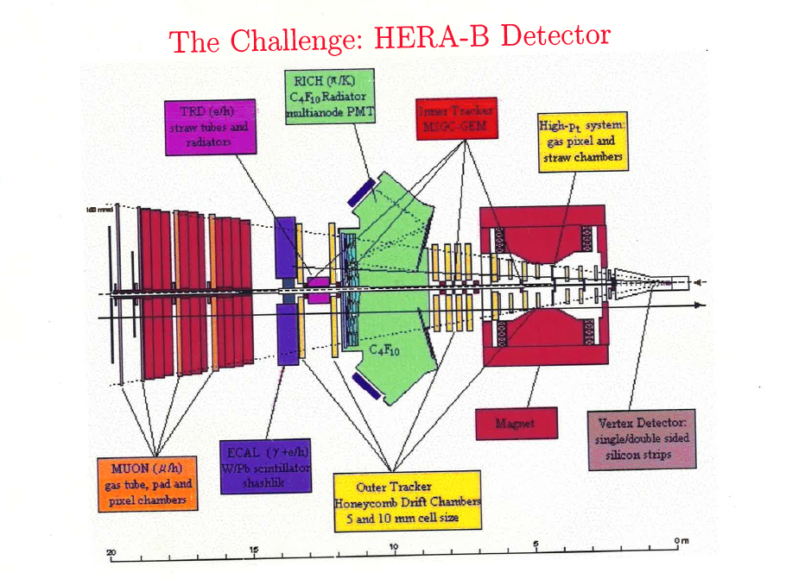
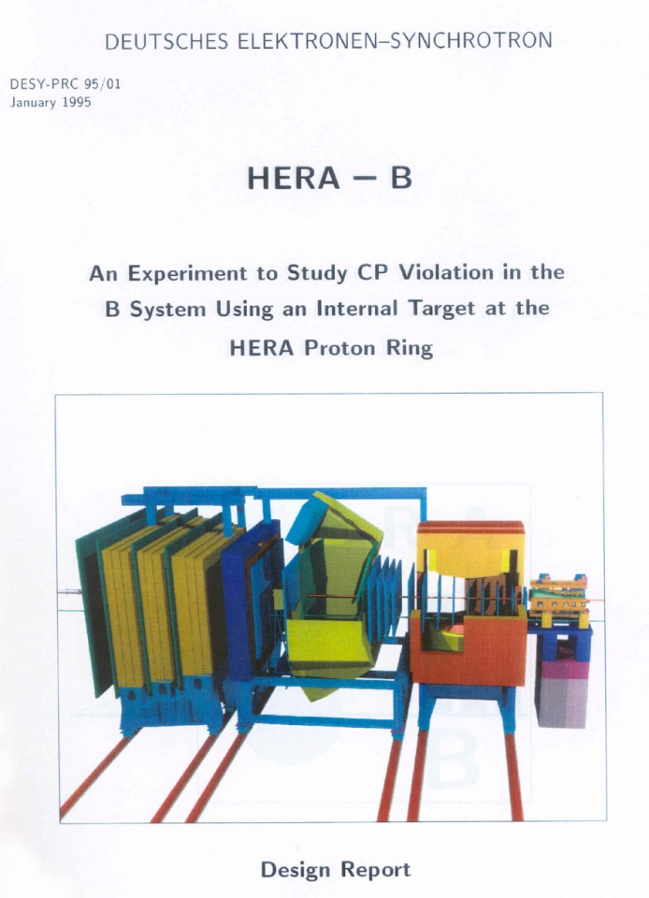
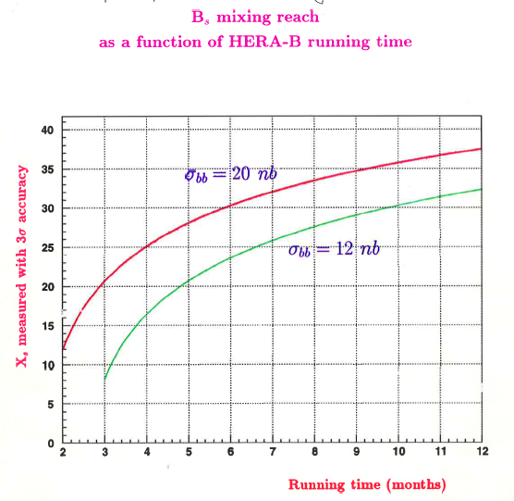
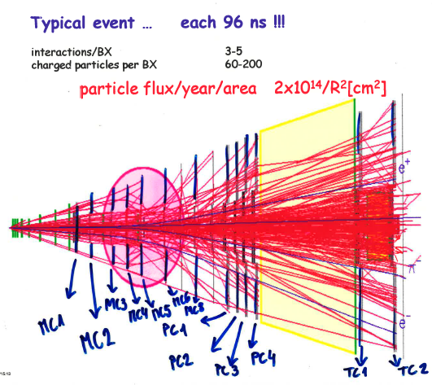
1995: Still on the transparencies … with ambitious physics goals
Becoming
“A Reality”:
Motivation for young
people to join the experiment

Slide 4
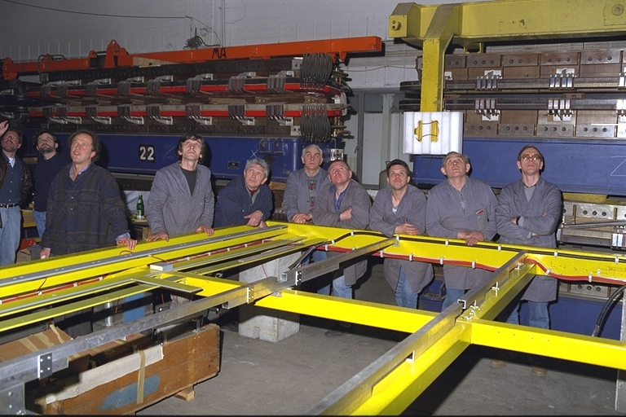
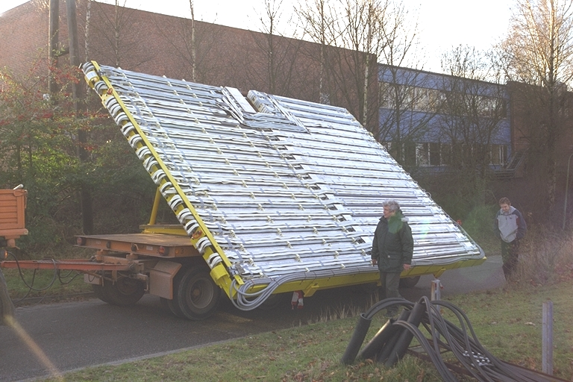
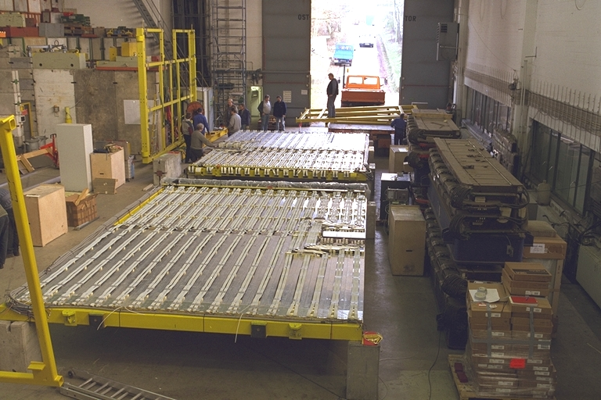
Going into the “Real Life”: Muon Chamber Assembly
Students view: Whatever one plans – everything has a tendency, in principle, to go wrong!
Waiting for the miracle:
But, WORKS at THE END !!!

Slide 5
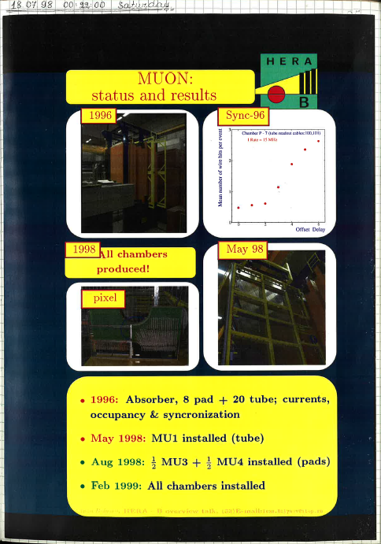
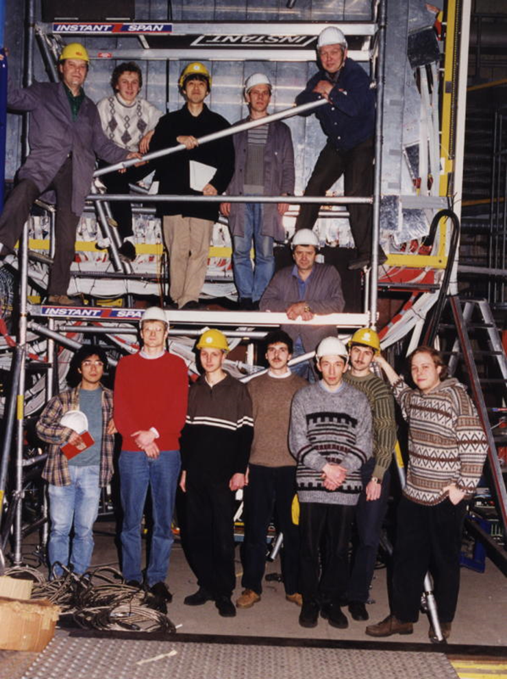
“Final Destination”: Muon System Commissioning
Working in multi-national environment
Addressing common goals
Learning cultures and traditions
… and finally becoming friends …

Slide 6
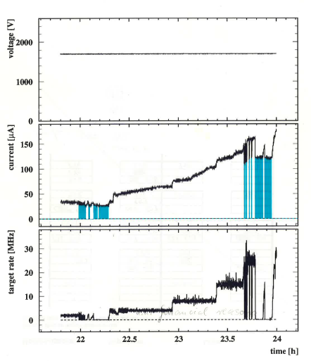
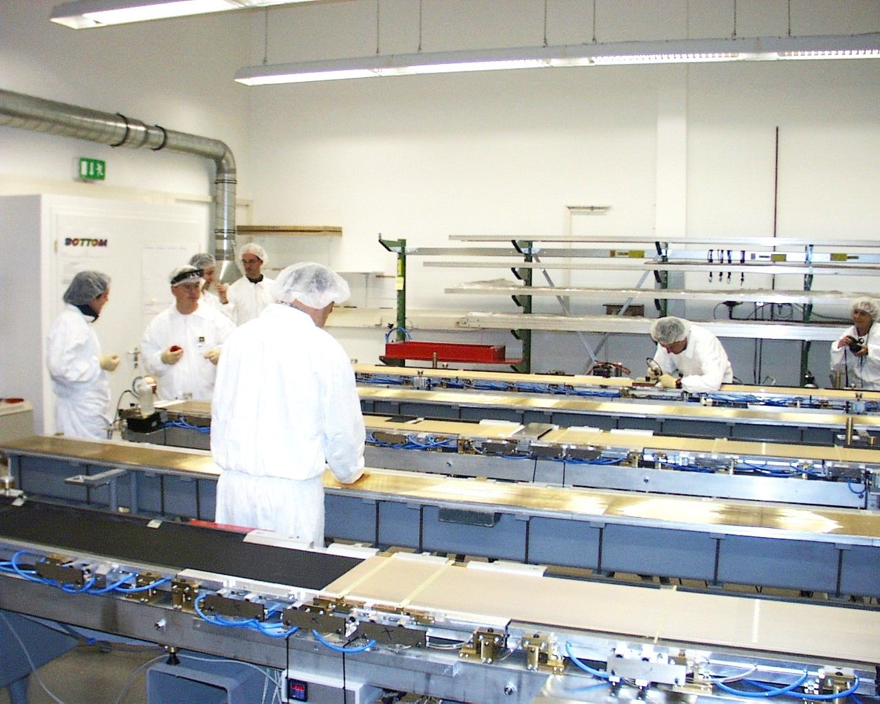
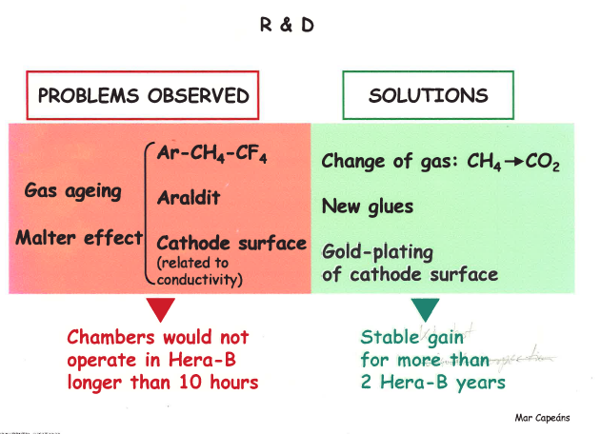
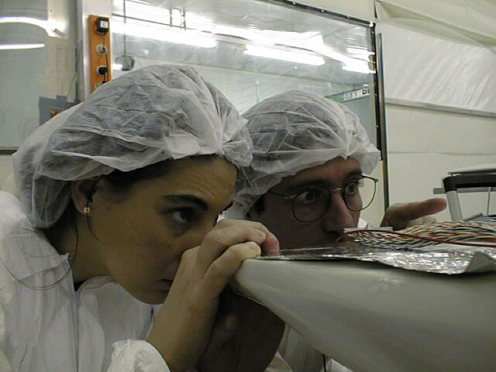
1997: Becoming “THE Reality”: ohhh - no, everything ages …
In the West Hall:
OTR Chambers
in 1-2 hours)
What the hell
is going on
inside this
chamber?

Slide 7
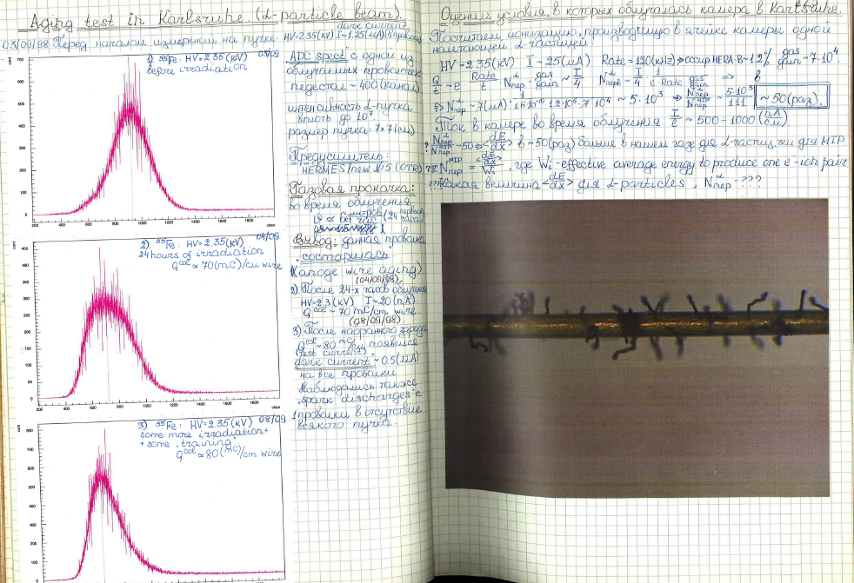
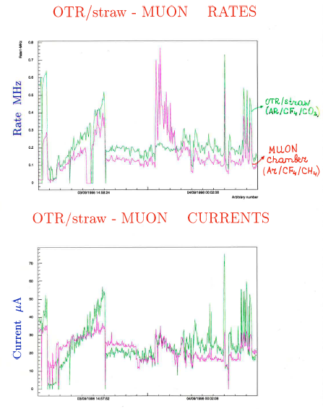
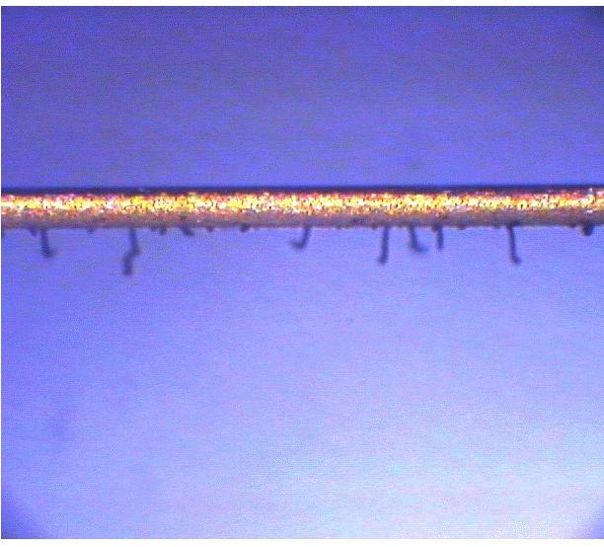
1998: Everything Ages Even in Karlsruhe (α-beam aging studies)
… and Muon Chambers
in less than 3 hours:
Ar/CH₄/CF₄ (74/6/20)
Wire irradiated over half of their cell width
100 MeV alpha-particles

Slide 8
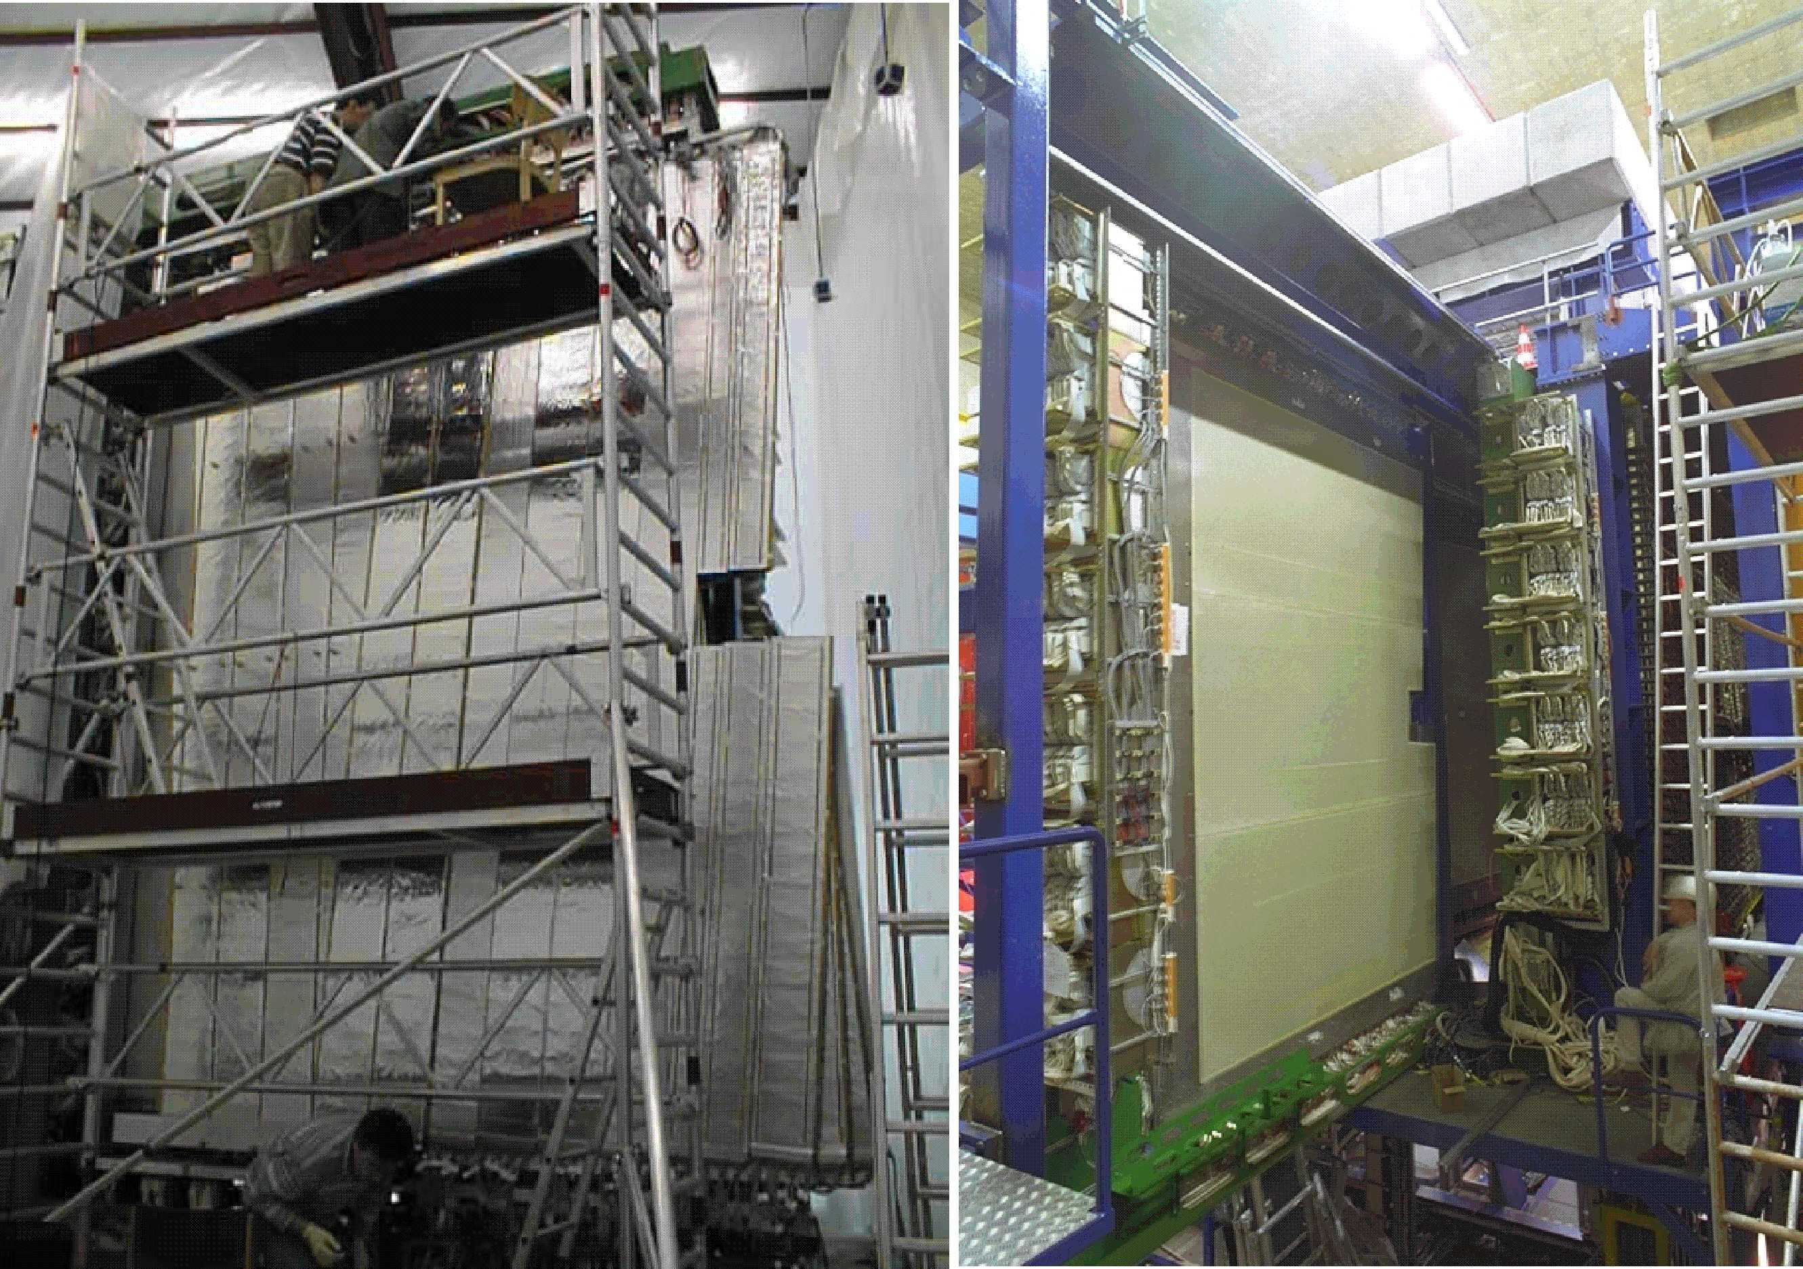
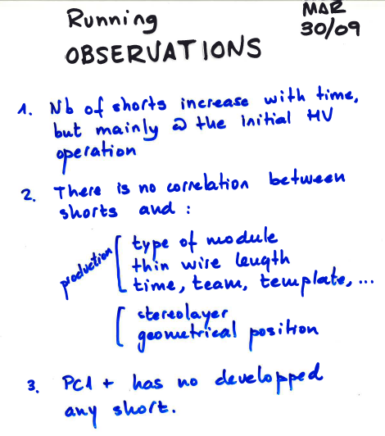
End of 1999: All OTR Superlayers installed by the end 1999

Slide 9
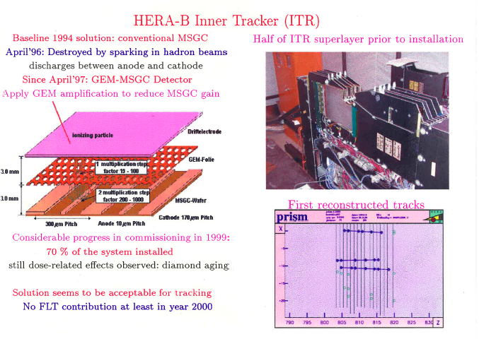
End of 1999: HERA-B Inner Tracker (first large-scale use of MPGD Technology)
Today’s MPGDs (GEM, Micromegas) have opened a new era of state-of-the-art technologies and are the benchmarks for the gas detector developments beyond the LHC

Slide 10
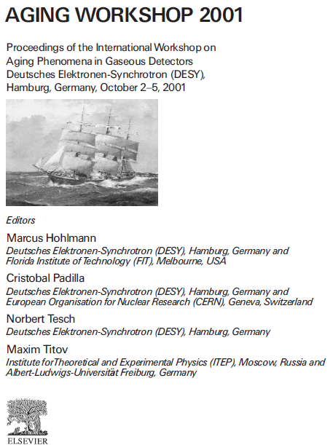
Learning about
“Aging” since
Students Years
The HERA-B Experiment was the first
high-rate experiment, which
addressed SYSTEMATICALLY aging
phenomena in gas detectors
→ Major source of knowledge for
aLL LHC Experiments

Slide 11
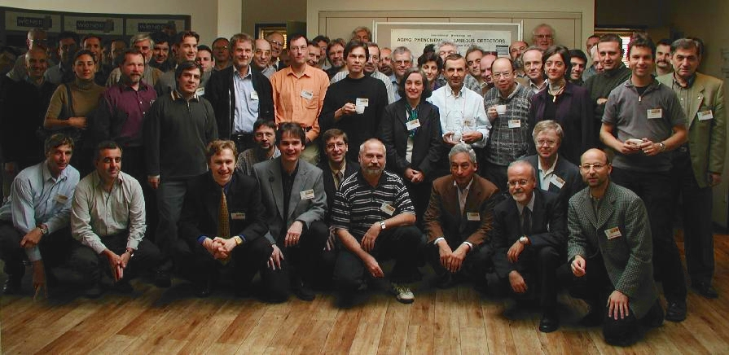
International Workshop on Aging Phenomena in Gaseous Detectors
~ 100 detector
experts
(dominated
by HERA-B
community)
Scientific program: 10 invited talks , 31 contributed talk, 9 posters
J.Va’vra, ``The basics on Aging and the Early Developments since the 1986 Workshop’’
H.Yasuda, ``New Insights into Aging Phenomena from Plasma Chemistry’’
M.Capeans, ``Aging & Materials: Lessons for Detectors and Gas Systems’’
C.Padilla, ``Aging Studies for the Outer Tracker of HERA-B’’
A.Romaniouk, ``Aging Studies for the Transition Radiation Tracker of ATLAS’’
T.Hott, ``Aging Problems of the Inner Tracker at HERA-B’’
V.Peskov, ``Aging in Gaseous Photodetectors’’
D.Marlow, `` Recent Experiences with Aging In Systems of Resistive Plate Chambers’’
F.Sauli, `` Review of Worskhop Results on the Fundamental Understanding of Aging Processes’’
B.Schmidt,``Recomendations for Building and Testing the Next Generation of Gaseous Detectors’’

Slide 12
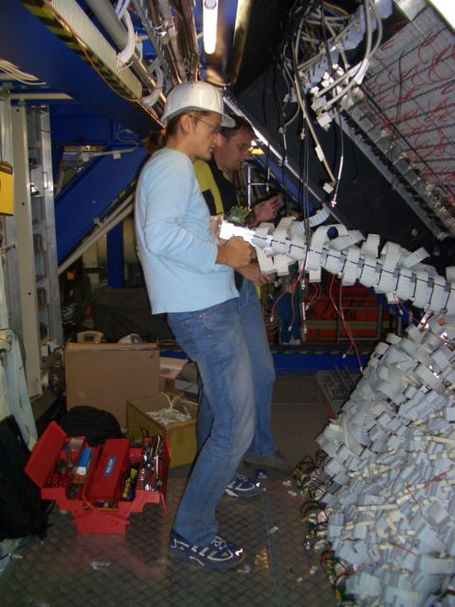
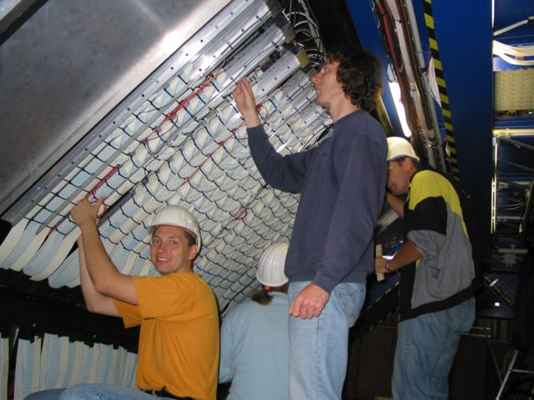
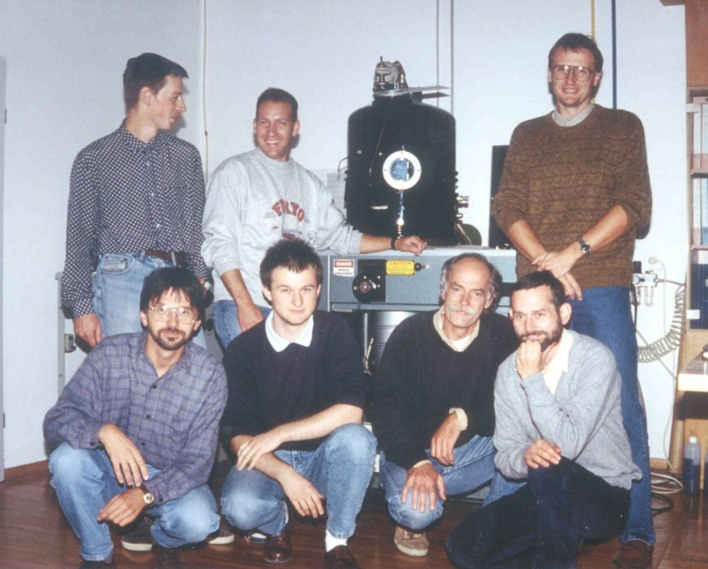
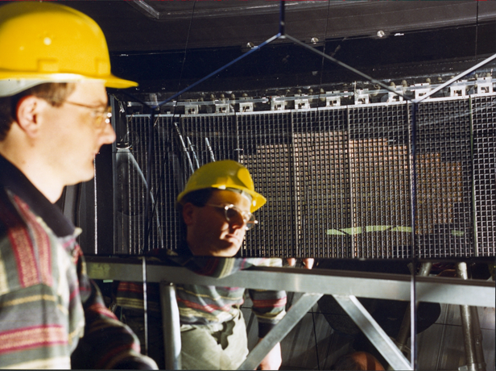
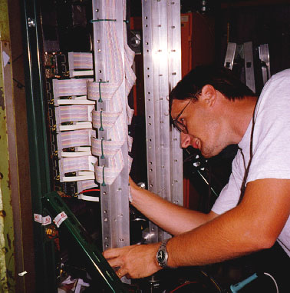
Student View: Sometimes physicists are able to do “good and proper cabling”

Slide 13
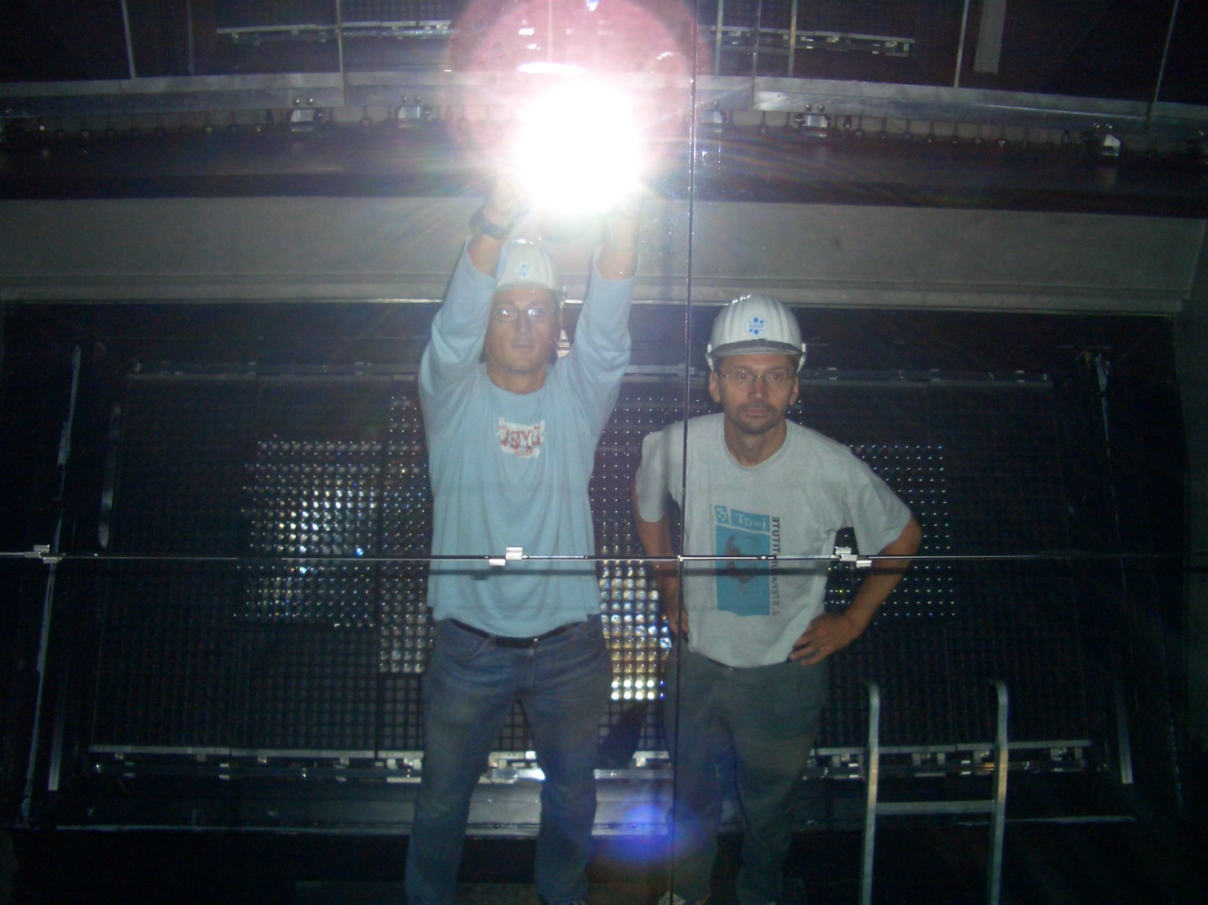
Searching for the “First RICH RING”
Student View: is it the first experiment (?), which reconstructs tracks
(without having tracking system) using Vertex /RICH / ECAL !!!

Slide 14
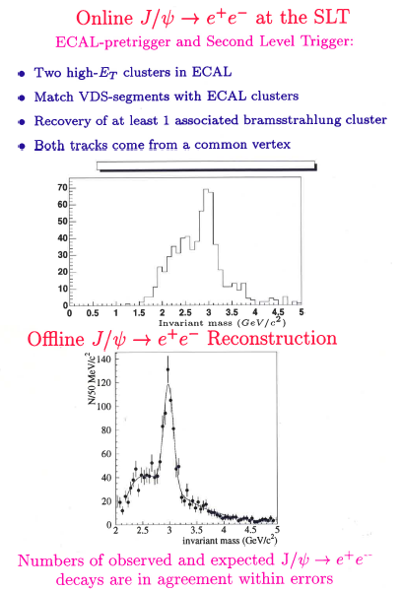
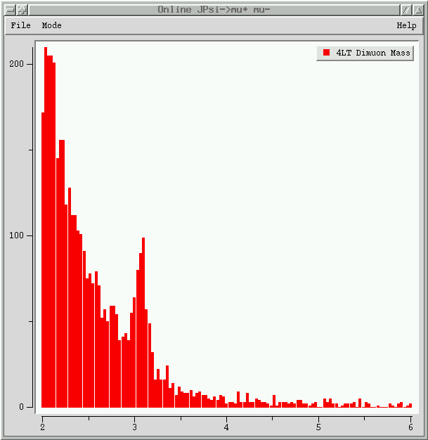
> 1999: “Hunting for Physics” (even if not for the CP –violation)
HERA-B ONLINE J/ψ → μ μ
at SLT (21.09.2002):
(30 minutes of data taking)
THE HERA-B WAS AN EARLY EXAMPLE OF:
Pattern recognition implemented in the
First Level Trigger
Tracking and Vertexing at the Second
Level Trigger
Fast Serial Lines

Slide 15
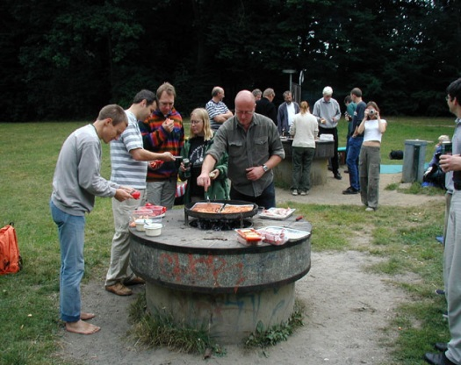
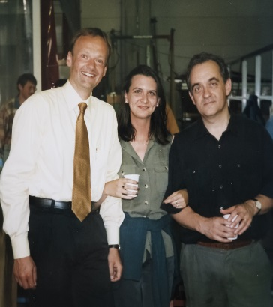
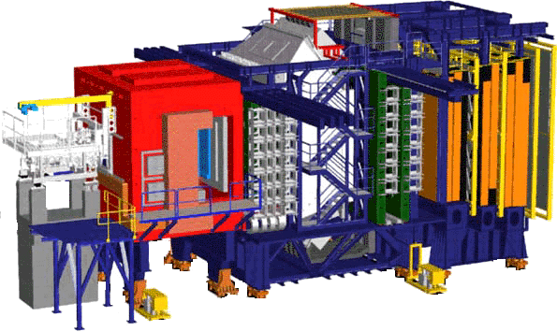
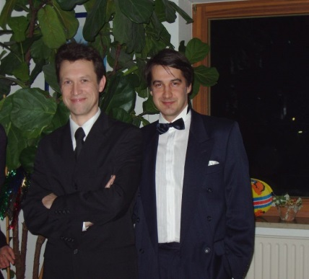
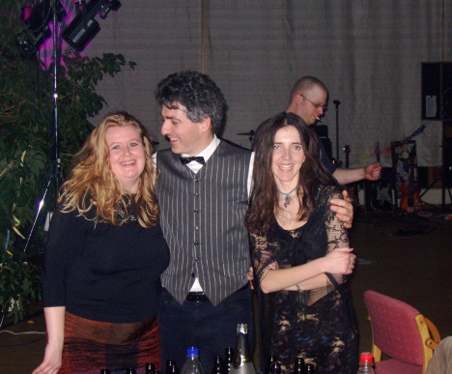
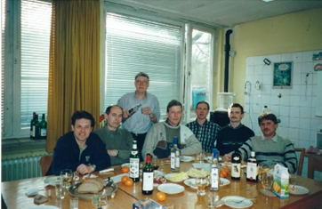
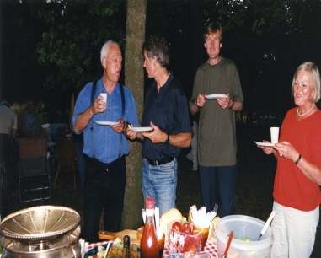
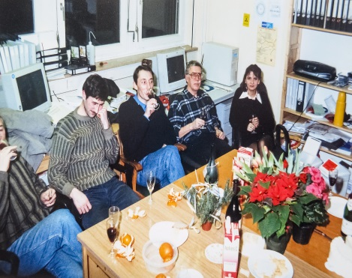
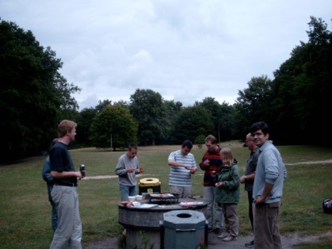
The HERA-B Outlook: A Student’s View
Friendly environment, collaborative spirit
Many senior colleagues ready to support, and, to give major responsibilities in the experiment
Learned a hard way → but obtained fantastic experience
Finding solutions to the problems never tackled before
Combination of detector instrumentation AND physics analysis is very important to grow-up as a HEP expert
→ remarkable number of the younger members of the
collaboration are successfully building their
careers in HEP and related areas
HERA-B Parties and” Russian parties”: learning social an cultural aspects of different nations

Slide 16
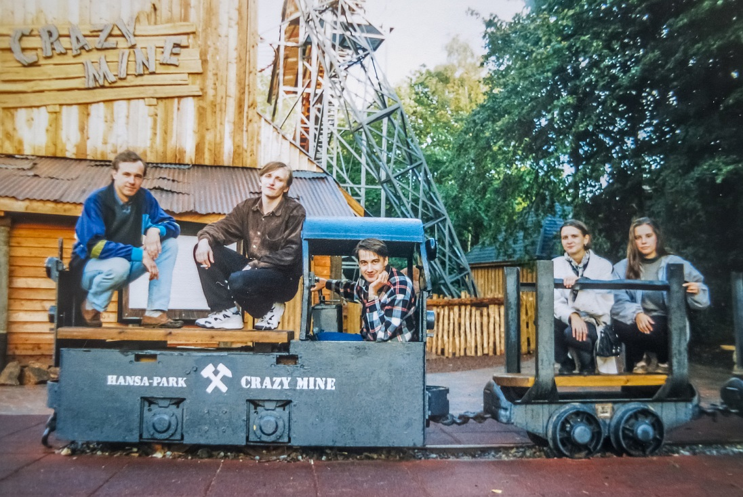
Mid-90x: HERA-B Train into the Future …

Slide 17
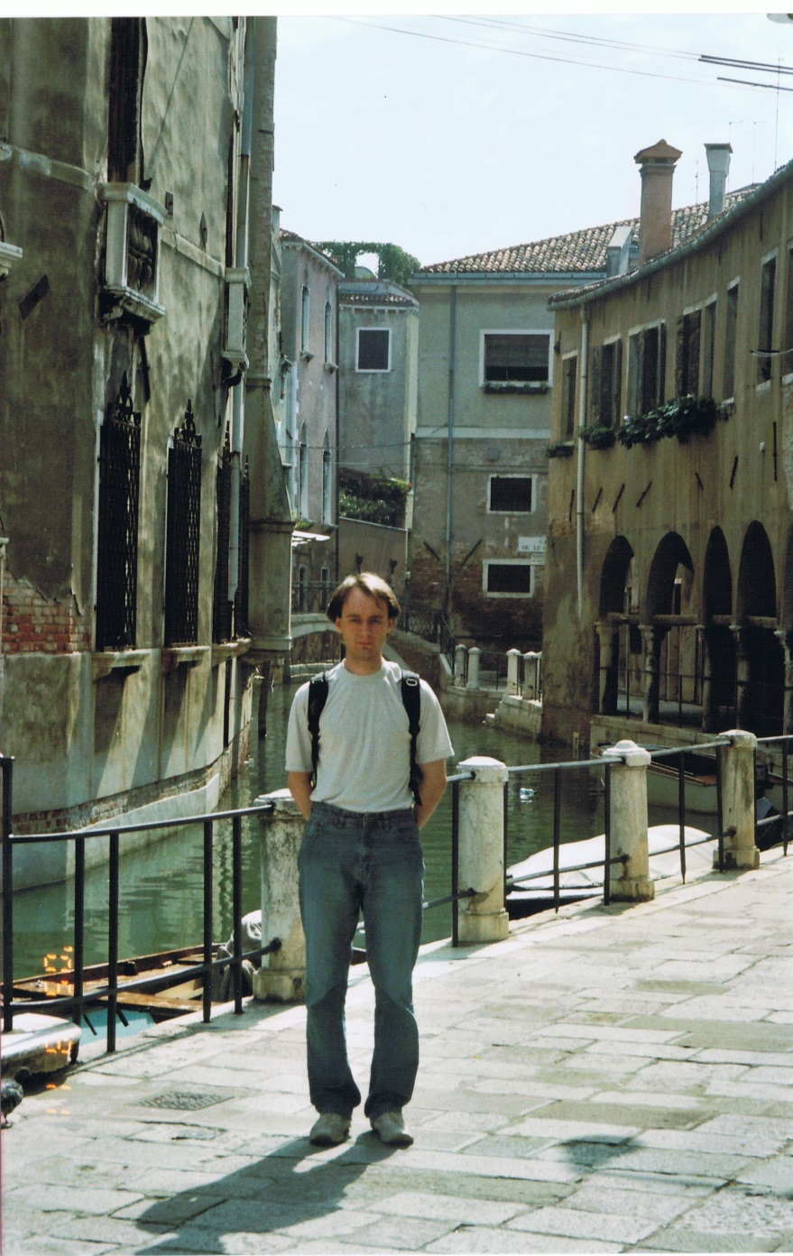
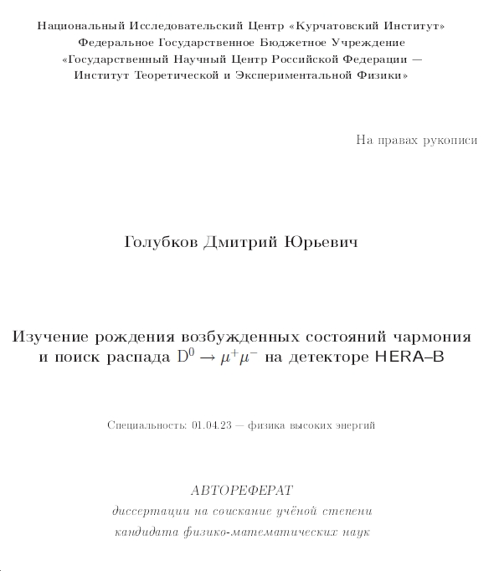
HERA-B: … Still Very Young …
… the last HERA-B PhD defense took place in April 2014 …
2002:
2014:
PhD advisor – V. Egorychev

Slide 18
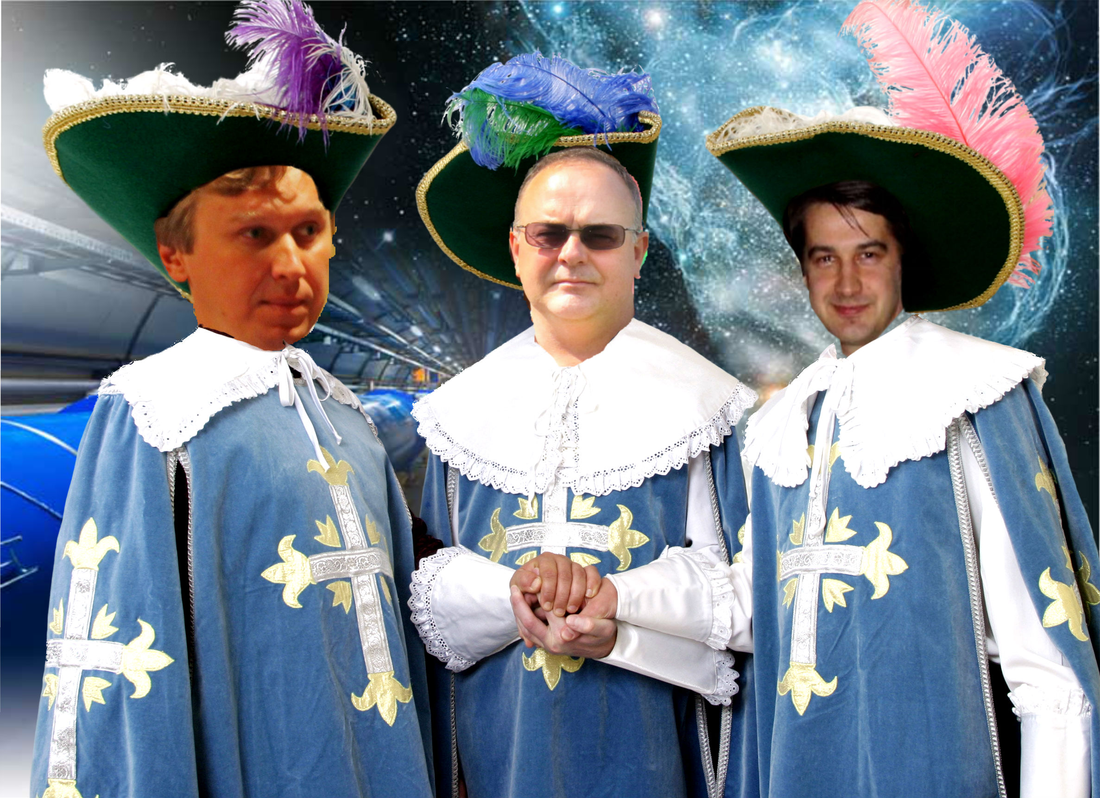
“HERA-B 10 Years Event”: Stay Friends …
First Steps in the Incredible Journey – Towards 10 YEARS HERA-B EVENT
→ “HERA-B BET(2003)”: How many papers HERA-B will publish in the end: 3-7 ; 7-12; > 12)?
Art Work: Victor Egorychev

Slide 19
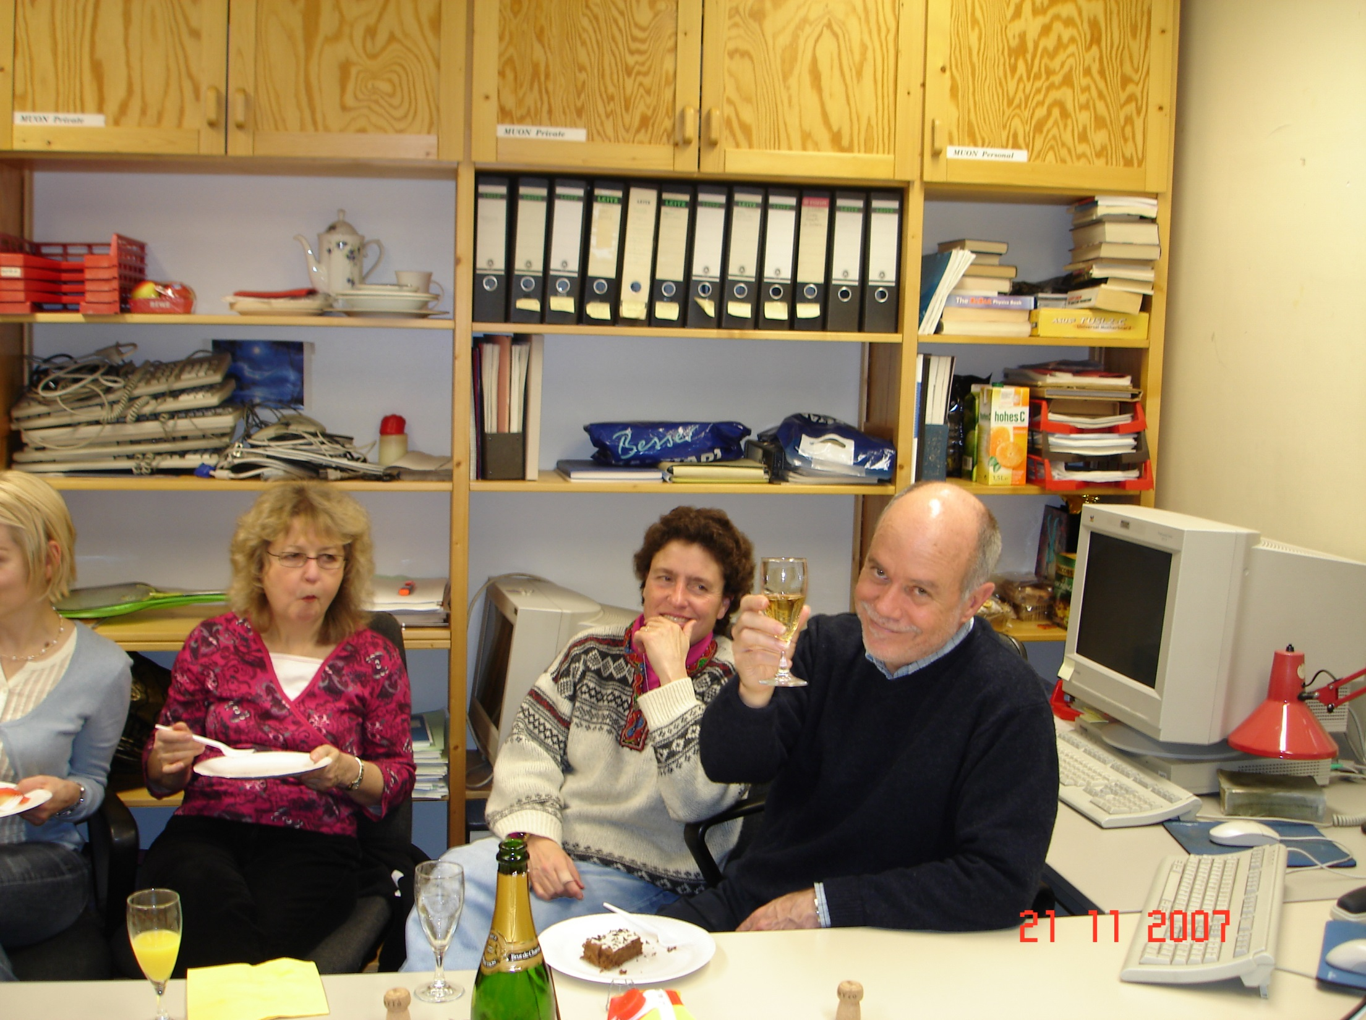
Thank YOU HERA-B for everything you’ve done for us !!!

Slide 20
This event would have been impossible without efforts of the organizing committee:
Mar Capeans Victor Egorychev Michael Medinnis Kendall Reeves Olaf Steinkamp Antonio Zoccoli
… AND WITHOUT YOUR MAJOR FEEDBACK AND SUPPORT !

Slide 21
From: Mikhail Zavertyaev [zav@mail.cern.ch]
Sent: Tuesday, February 17, 2015 7:34 PM
Dear Maksym,
I'm in Moscow right now and will not have a pleasure to see all HERA-B colleagues.
My best wishes to all of you who will celebrate the event tomorrow. Misha --------------------------------------------------------------------------------------------------------------------------------------------------------------------------
From: Kolanoski, Hermann [hermann.kolanoski@desy.de]
Sent: Tuesday, February 17, 2015 3:38 PM
Hi Maksym, in case you can still use some pictures for the slide show,
which was announced earlier, I have put a collection on the web:
http://www-zeuthen.desy.de/~kolanosk/tmp/HERA-B-10-years_after-pictures
Or http://www-zeuthen.desy.de/~kolanosk/tmp/HERA-B-10-years_after-pictures.tar
See you tomorrow, Hermann
------------------------------------------------------------------------------------------------------------------------------------------------------------------------ From: Sergey Furletov [furletov@jlab.org]
Sent: Monday, February 16, 2015 6:21 PM
Privet Max,
my sobrali в кучку все что нашли. качество плохое, но для экрана может пойдет: http://www.9x12photo.com/HERA-B_pict.tar
фотграфии и пленки наверное где то лежат еще, но у нас после переезда еще не все ящики распакованы.
А у вас online трансляция вашей сессии будет ? тогда наверное больше участников было бы. Сергей & Юля ----------------------------------------------------------------------------------------------------------------------------------------------------------------------- From: Ressing (p), Dominik (MSC) [Dominik.Ressingp@msc-technologies.eu]
Sent: Monday, February 16, 2015 10:27 AM
Hi Maxim,
do You know whether I can get a room in the CERN Hostel? Since not being anymore in the “community” I lost the connections
Thanx & Greetings, Dominik

Slide 22
From: Peter Krizan [peter.krizan@ijs.si]
Sent: Sunday, February 15, 2015 11:10 AM
Here it comes: 1) There are several on the web already: http://www-f9.ijs.si/~krizan/herab/photos/pod_richem.jpg
Samo with the prototype: http://www-f9.ijs.si/~krizan/herab/photos/pmt-mechanics/images/cabling1.jpg
Dismounting the RICH: Samo, Rok, Andrej, our technician Jure, myself and
any number of PMTs and cables http://www-f9.ijs.si/~krizan/herab/photos/rich-dismount/, in this list
these are the best
http://www-f9.ijs.si/~krizan/herab/photos/rich-dismount/images/img_1942.jpg
http://www-f9.ijs.si/~krizan/herab/photos/rich-dismount/thumbnails/img_1941.jpg
http://www-f9.ijs.si/~krizan/herab/photos/rich-dismount/images/100_0435.jpg
http://www-f9.ijs.si/~krizan/herab/photos/rich-dismount/images/100_0403.jpg
2) Here come more attached to this email:
- 1994(!) photo take in our lab in Ljubljana
- Escher-like photo of the inside of the RICH
- Andrej and myself in the mirror
Unfortunately, no parties... Hope it help cheer up your slides! Peter ------------------------------------------------------------------------------------------------------------------------------------------------------------------------------ From: Ulrich Uwer [uwer@physi.uni-heidelberg.de]
Sent: Monday, February 09, 2015 9:46 AM
Dear Maksym, unfortunately I will not be able to participate in the HERA-B event. I am sending my warmest greetings to all former colleagues. Cheers, Uli
------------------------------------------------------------------------------------------------------------------------------------------------------------------------------ From: Ehret, Klaus [klaus.ehret@desy.de]
Sent: Sunday, February 08, 2015 1:00 PM
Dear Maxim, thanks a lot for your great initiative.
I am really sorry, but due to other important commitments I am unfortunately not able to join this magnificent 10 Years After event.
It’s a pity – to miss this opportunity to meet lot of our former colleagues, to celebrate our great effort and to argue about our success, importance or failure.
I am quite positive impressed by the fact, that many of our former HERA-B colleagues are still active in the field
- despite the fact, that we had really a hard times at HERA-B.
Best regards to you and all the colleagues - I wish you a great party. Cheers, Klaus

Slide 23
From: Schwitters, Roy F [schwitters@physics.utexas.edu]
Sent: Saturday, February 07, 2015 7:28 PM
Thank you very much for keeping me informed of this event. I would dearly like to attend, but cannot.
Sincerely, Roy Schwitters --------------------------------------------------------------------------------------------------------------------------------------------------------------------- From: Peter Buchholz [buchholz@hep.physik.uni-siegen.de]
Sent: Monday, January 26, 2015 4:29 PM
Dear Maxim,
unfortunately I cannot participate. Nevertheless I like the idea and appreciate the work you put into it and wish all of you a
successfull and nice event! All the best, Peter
-----------------------------------------------------------------------------------------------------------------------------------------------------------------------
From: Walter Schmidt-Parzefall [wsp@mail.desy.de]
Sent: Wednesday, January 21, 2015 2:01 PM
Dear Maksym
Your invitation for a short talk on Feb. 18. I accept with pleasure.
Title: The first Ideas for HERA-B
Abstract: The beginning of HERA-B, from the basic idea in 1992 to the
proposal and its approval in 1995 will be briefly described.
Best regards and see you soon Walter
---------------------------------------------------------------------------------------------------------------------------------------------------------------------
From: Wagner, Albrecht [albrecht.wagner@desy.de] Subject: AW: Invitation to give a talk at the "HERA-B 10 Years After" Event (Feb. 18, 2015) Dear Maksym, many thanks for the kind invitation to attend the HERA-B meeting and to share a few thoughts and observations with you. I accept with pleasure and suggest as title of my small contribution: HERA-B - hopes and challenges revisited Looking forward to seeing you on 18 February at CERN. Yours, Albrecht

Slide 24
From: Spengler Joachim [Joachim.Spengler@desy.de]
Sent: Monday, December 15, 2014 5:38 PM
Dear Maksym,
it’s really a pitty, but the selected date is one of the few dates I`m really unable to attend. The 17th and 18th Feb is foreseen for the yearly meeting of all group leaders of the DESY photons science department to give a report on their activities. There is no excuse accepted except fatal illness.
I wish you and all former members an interesting and nice meeting. With best regards, Achim ---------------------------------------------------------------------------------------------------------------------------------------------------------------------------- From: Gordana Medin [gordana.medin@gmail.com]
Sent: Friday, December 05, 2014 1:41 PM
Dear Maksym,
thank you for invitation for HERA-B party! That is great! For me any date you decide is fine. I only need an official invitation which I have to give to Montenegro University in order to get absence from lecturing. Could you please assist me with it?
Thank you a lot! Kind regards, Gordana Medin
--------------------------------------------------------------------------------------------------------------------------------------------------------------------------- From: Dorothea Samtleben [dosamt@nikhef.nl]
Sent: Friday, December 05, 2014 9:26 AM
Dear Maxim,
just to let you know that I appreciate your great effort to get us all together and I would of course love to join! However, I don't have 'regular business' at CERN and thus it's not clear to me that I anyway can arrange to be there, but I'll try (don't have a real preference for the date though). It's amazing to see the huge response! cheers, Dorothea ------------------------------------------------------------------------------------------------------------------------------------------------------------------------ From: M.Mevius [m.mevius@rug.nl]
Sent: Friday, December 05, 2014 9:02 AM
Hi Maxim et al,
Nice initiative! I probably won't be able to come, having two small kids at home. But keep me informed of the day, you never know... Maaijke

Slide 25
From: thomas [thomas.bauer@nikhef.nl]
Sent: Wednesday, November 26, 2014 11:00 AM
Dear all,
it was nice to hear from you, and i fully support your idea to organize a meeting at a central place. It would be fun to speak
to the colleagues and be up to date on their occupations now.
Unfortunately i do not come any longer on a regular basis to Cern - but for the same reason (retirement) i am relatively free
to organize my trips according to my own priorities. Thus, i have not fille in a date for the doodle - once a day is picked you
and those who still have to work under the eyes of an employer, i will decide whether i can come and join the party.
In any case: HAVE FUN - and hopefully we will see each other. Cheers, Thomas
-------------------------------------------------------------------------------------------------------------------------------------------------------------------------- From: Silvia Masciocchi [s.masciocchi@gsi.de]
Sent: Thursday, November 20, 2014 1:42 PM
Dear Maksym,
I would have not been able to come on December 4, being at a conference in South Africa. But I was so "shocked" by this terrible thing of missing this event, that I had not even written back (sorry for that ... really not a nice behavior). Reading your email now made me JUMP with hope ;-)
So, thanks a lot for organizing all this!!!! I find it a fantastic idea, and I REALLY REALLY hope to be able to come! :-)
Cheers, Silvia ------------------------------------------------------------------------------------------------------------------------------------------------------------------------- From: Peter Krizan [peter.krizan@ijs.si]
Sent: Thursday, November 20, 2014 8:17 AM
To: TITOV Maksym
Subject: Re: HERA-B Party "10 Years After" - CERN, December 4th,2014 17:00 - 21:00
Hi, Maxim,
For me this is certainly the best news for this week!
We all had more or less problems with this date... Yes, we will fill out the doodle pool asap!
See you in Feb/March! Peter

Slide 26
From: Iris Abt [isa@mppmu.mpg.de] Sent: Monday, October 27, 2014 2:09 PM Dear all, Great idea. But CERN is not on my traveling plan. have fun. Cheers, Iris ------------------------------------------------------------------------------------------------------------------------------------------------------------------------ From: Wolfgang Gradl [gradl@kph.uni-mainz.de]
Sent: Monday, October 27, 2014 9:12 AM
Dear Maksym and the whole organising committee,
that is a very good idea indeed! Unfortunately, the date you propose catches me between travel from Beijing to SLAC, so I will not be able to make it to CERN this time. I would be very much interested in a revival (for 15 years? :), though.
I hope there will be lots of people attending and you will have a good time. Best wishes, Wolfgang -----------------------------------------------------------------------------------------------------------------------------------------------------------------------
HERA-B STAYED AS THE COMMUNITY !

