Slide 1
Update on Injector work
F.Brinker
January 21st 2015

Slide 2
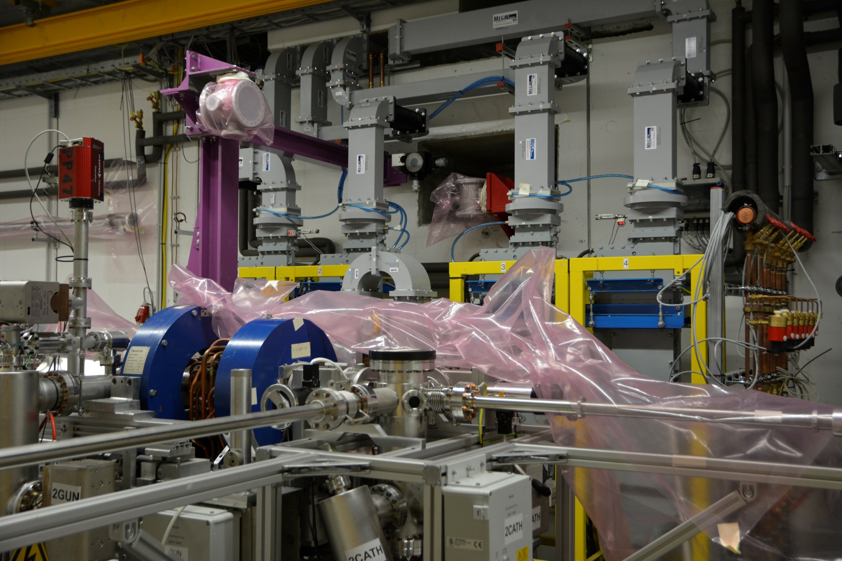
Progress of the past weeks in pictures…

Slide 3
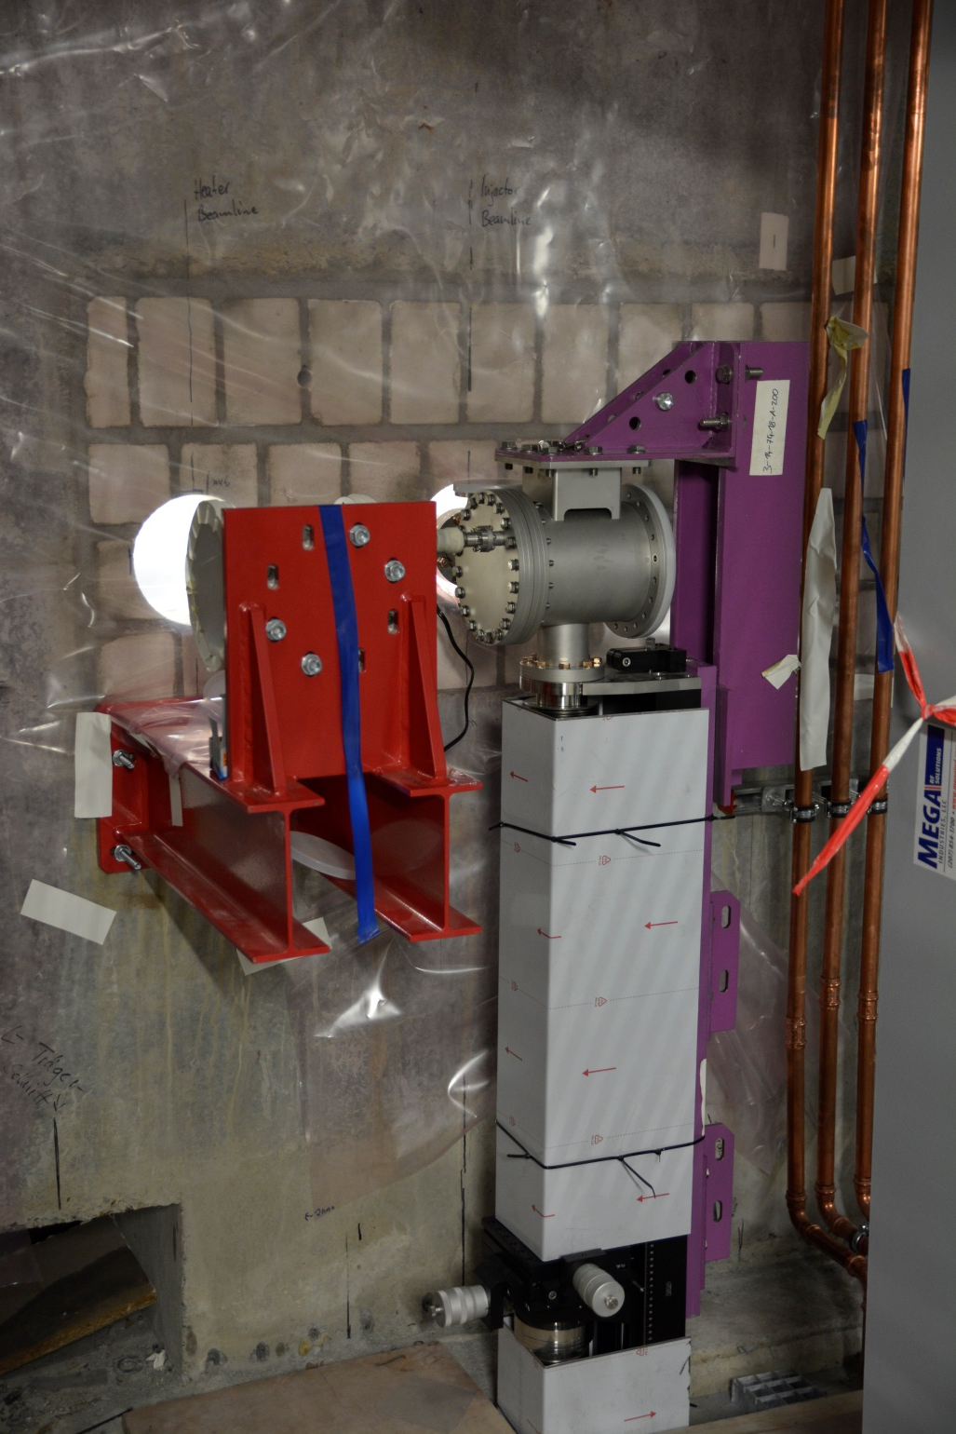
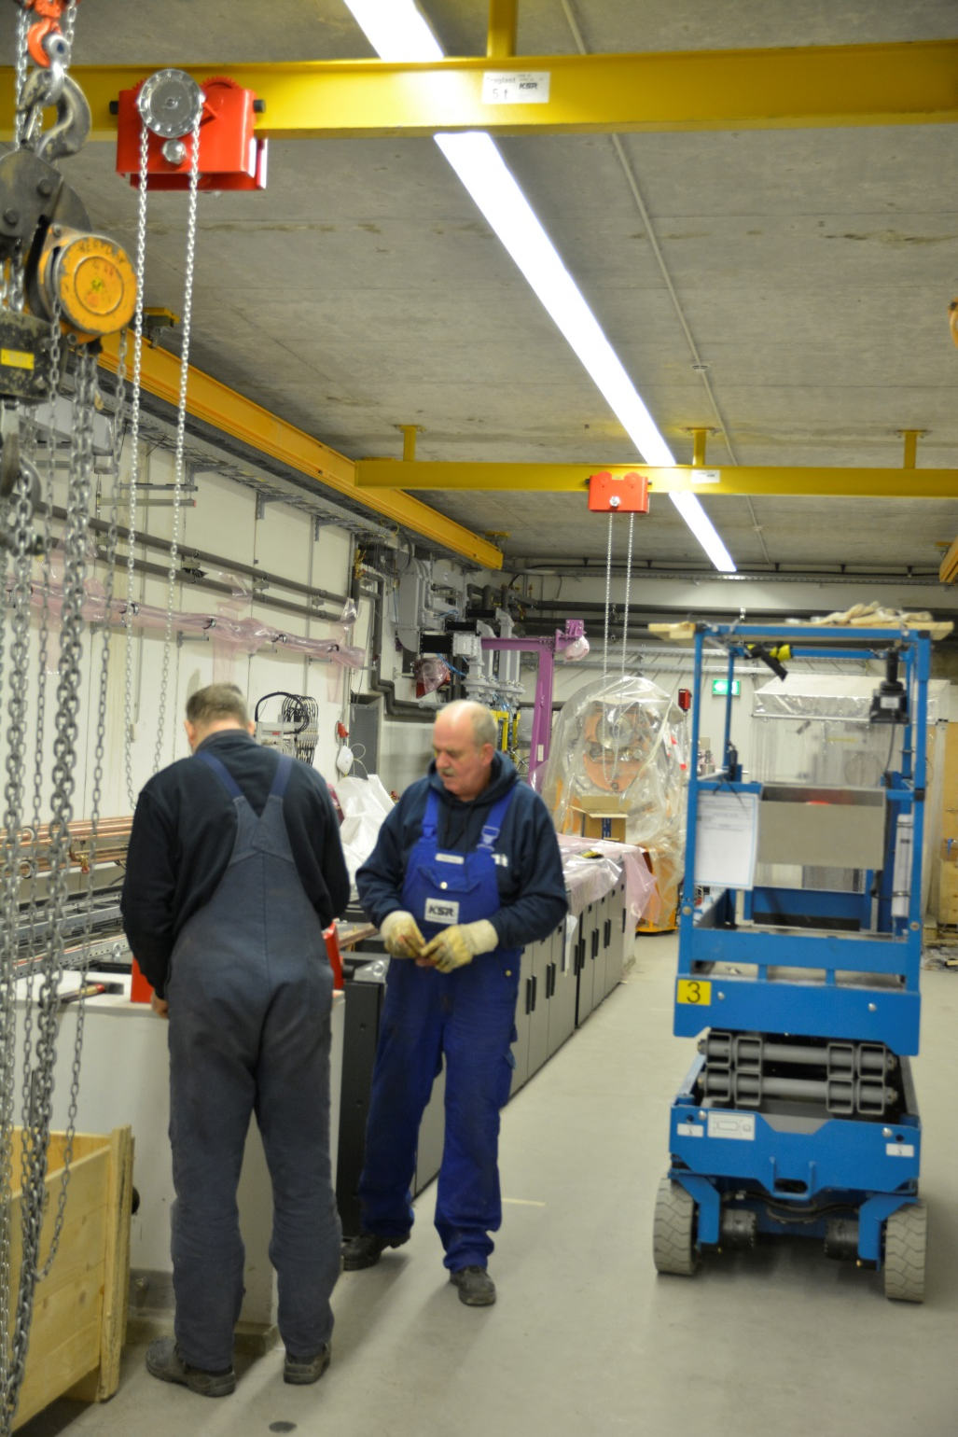

Slide 4
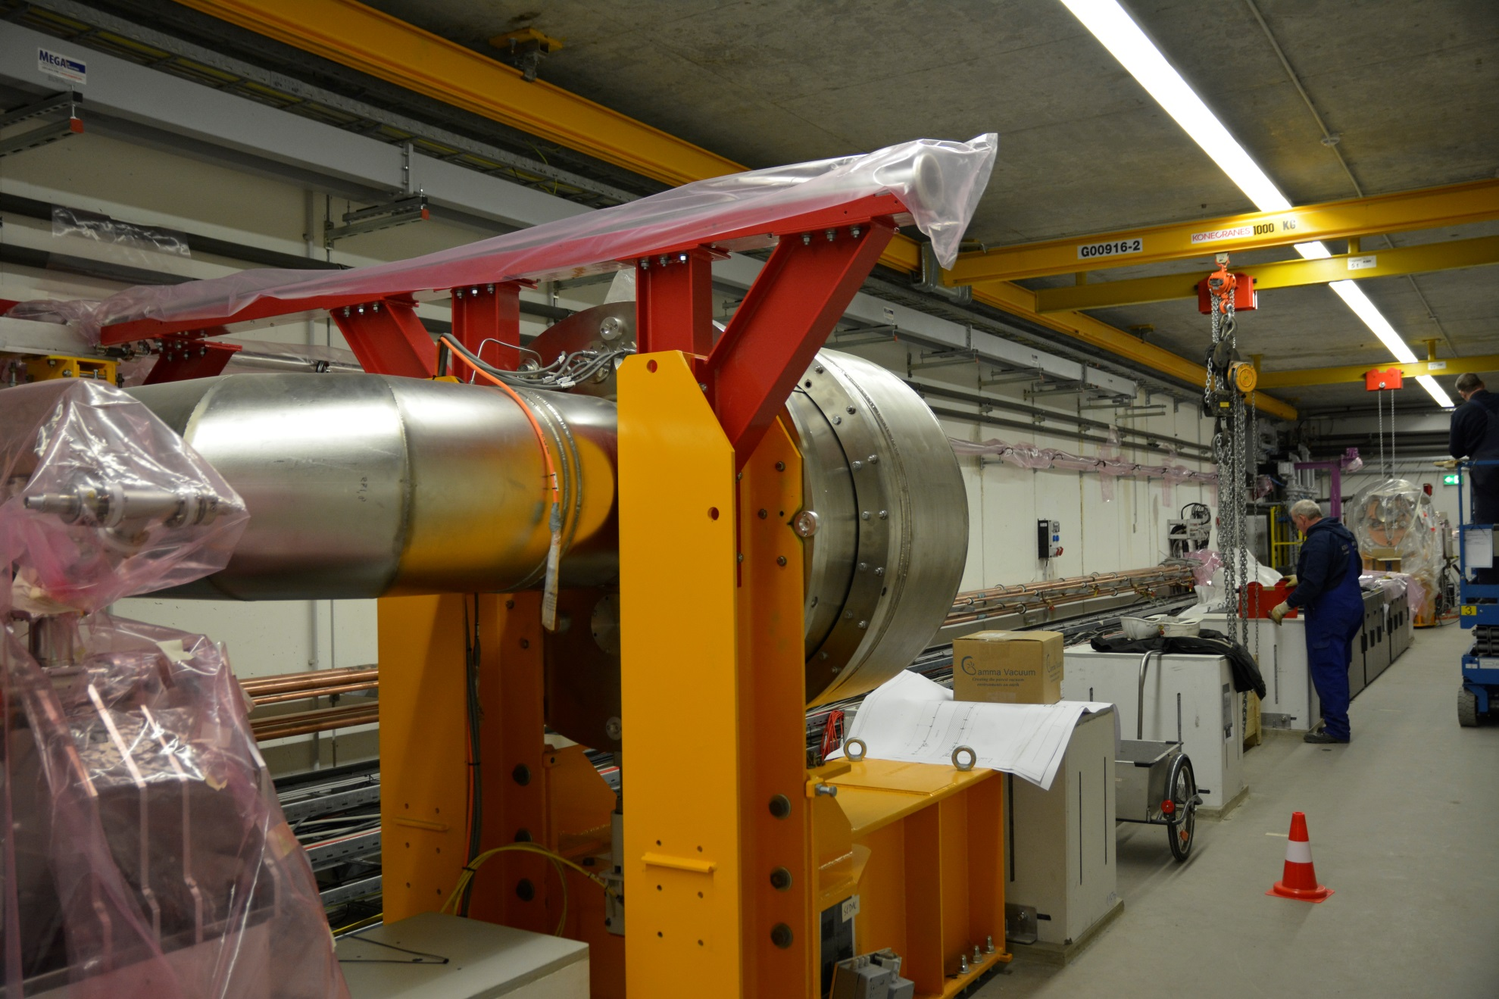

Slide 5
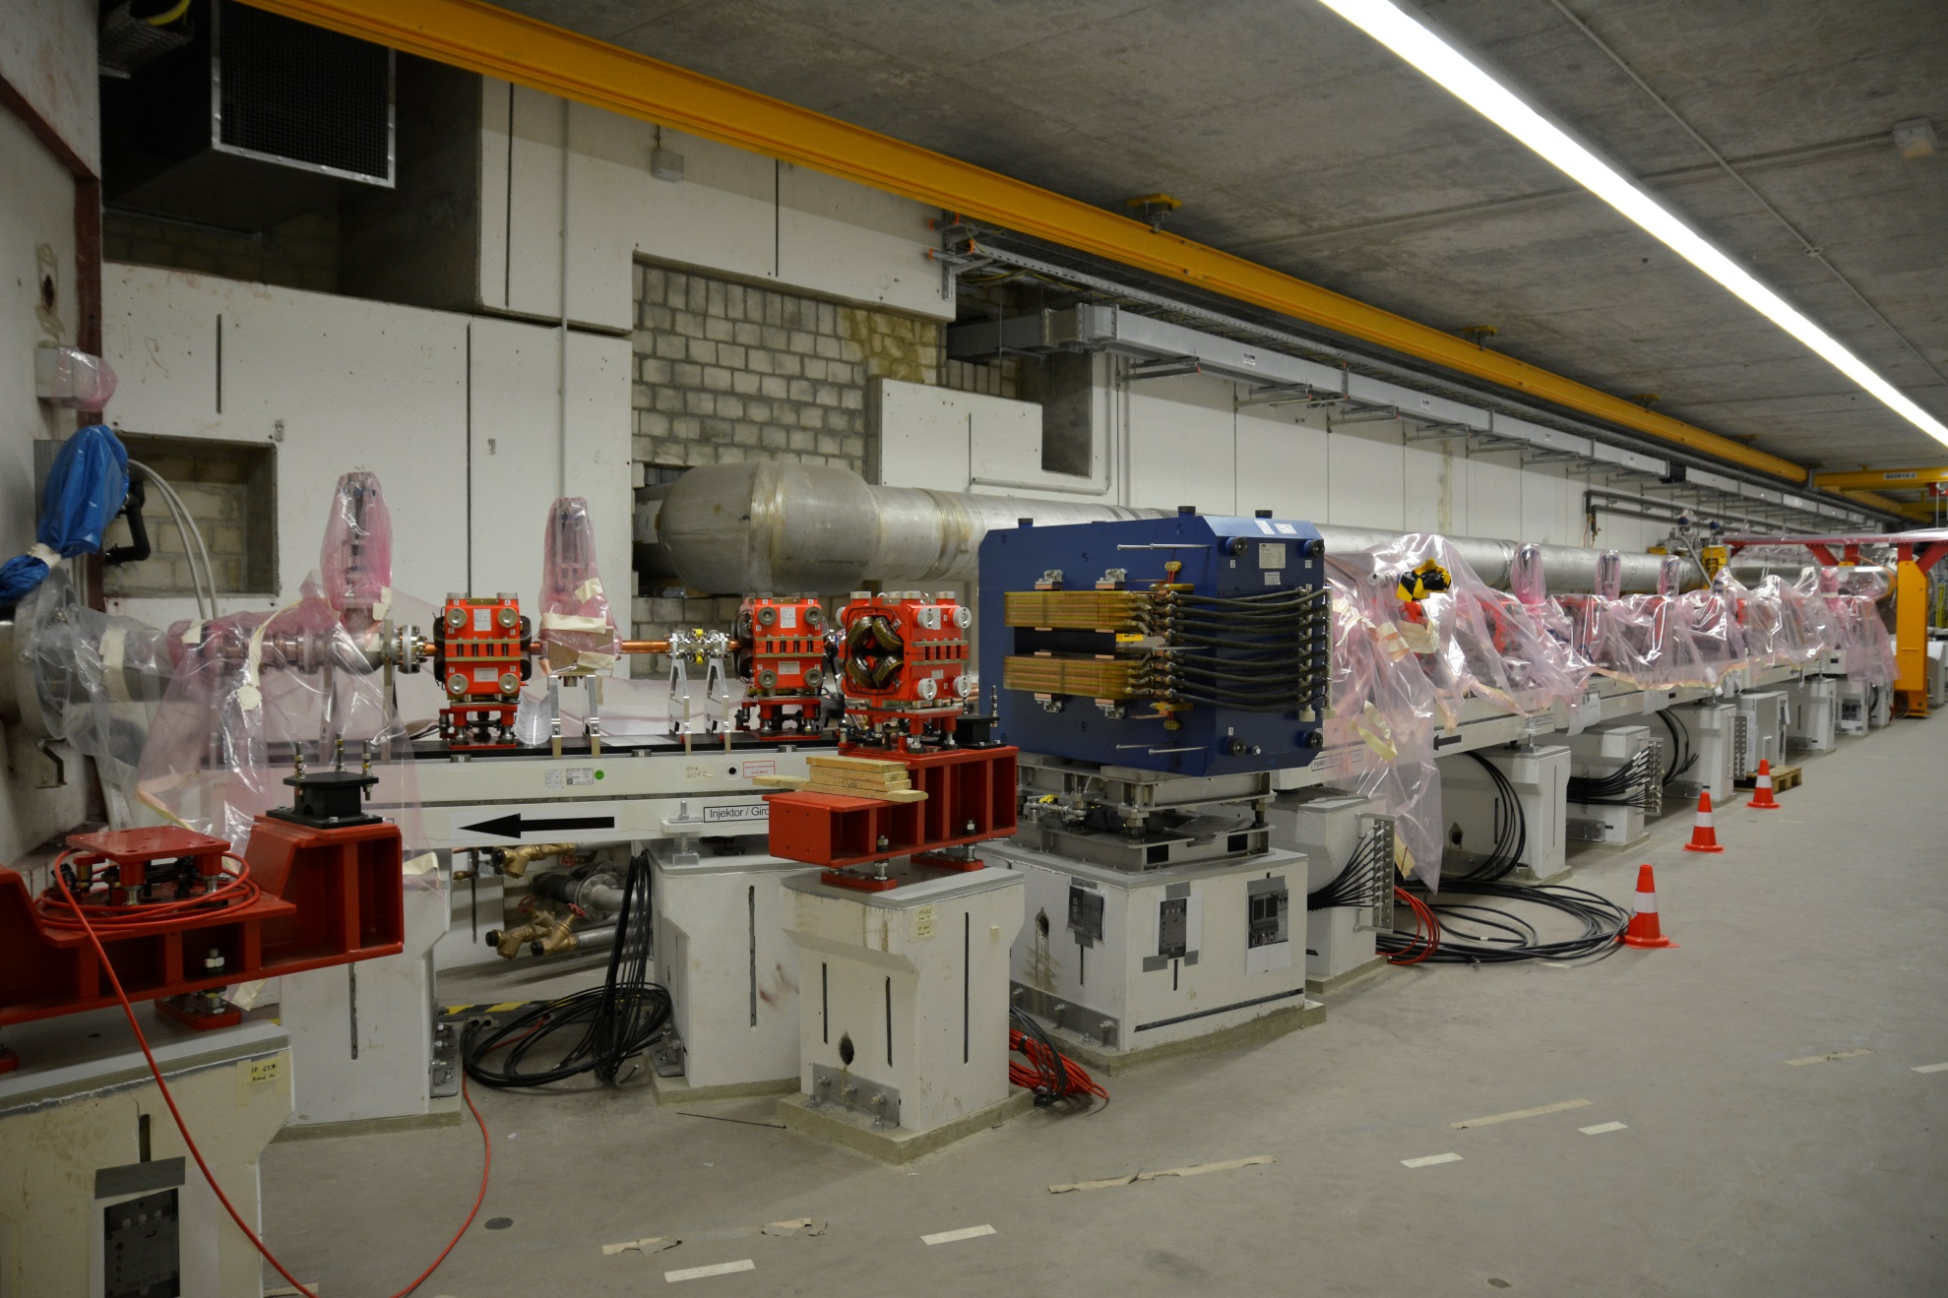

Slide 6
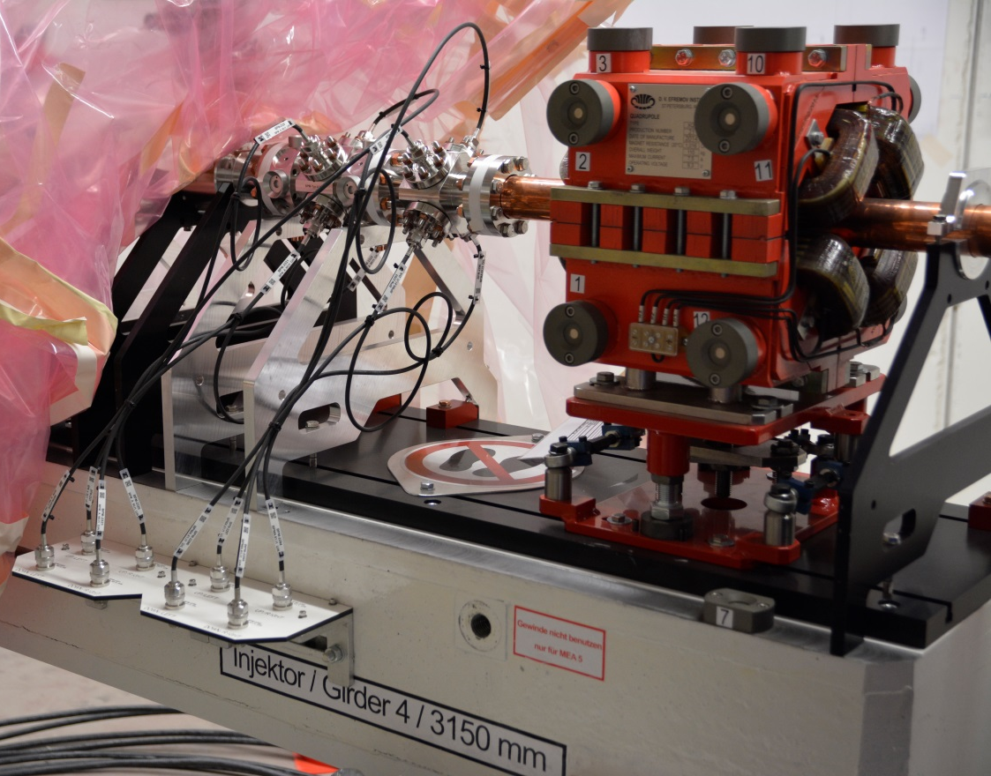
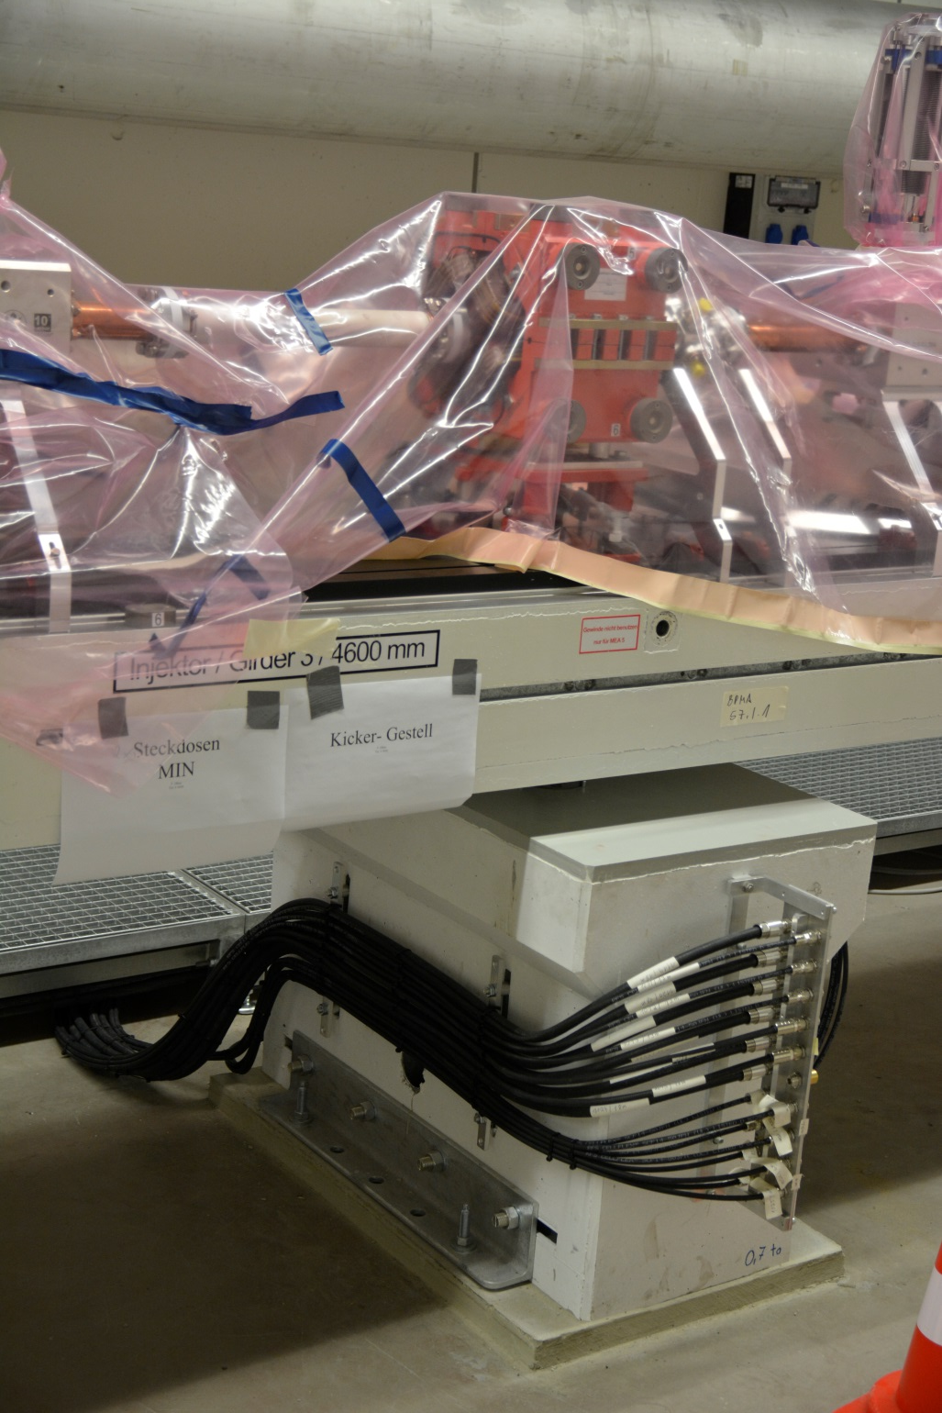
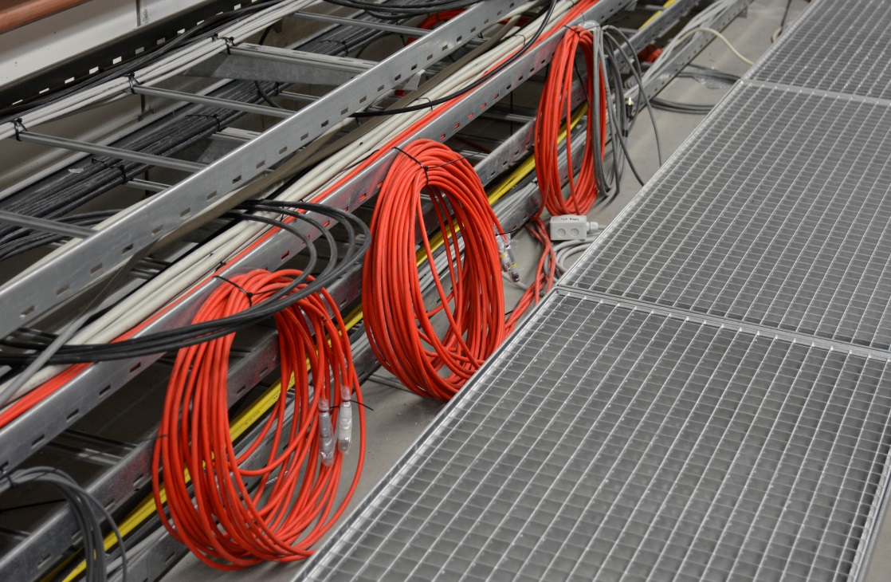

Slide 7
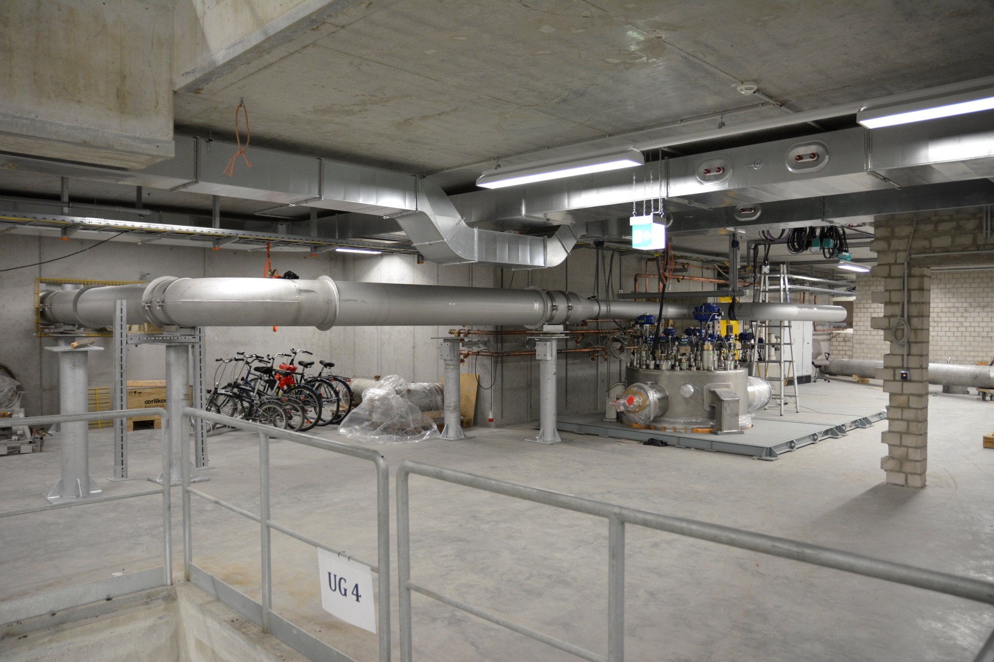

Slide 8
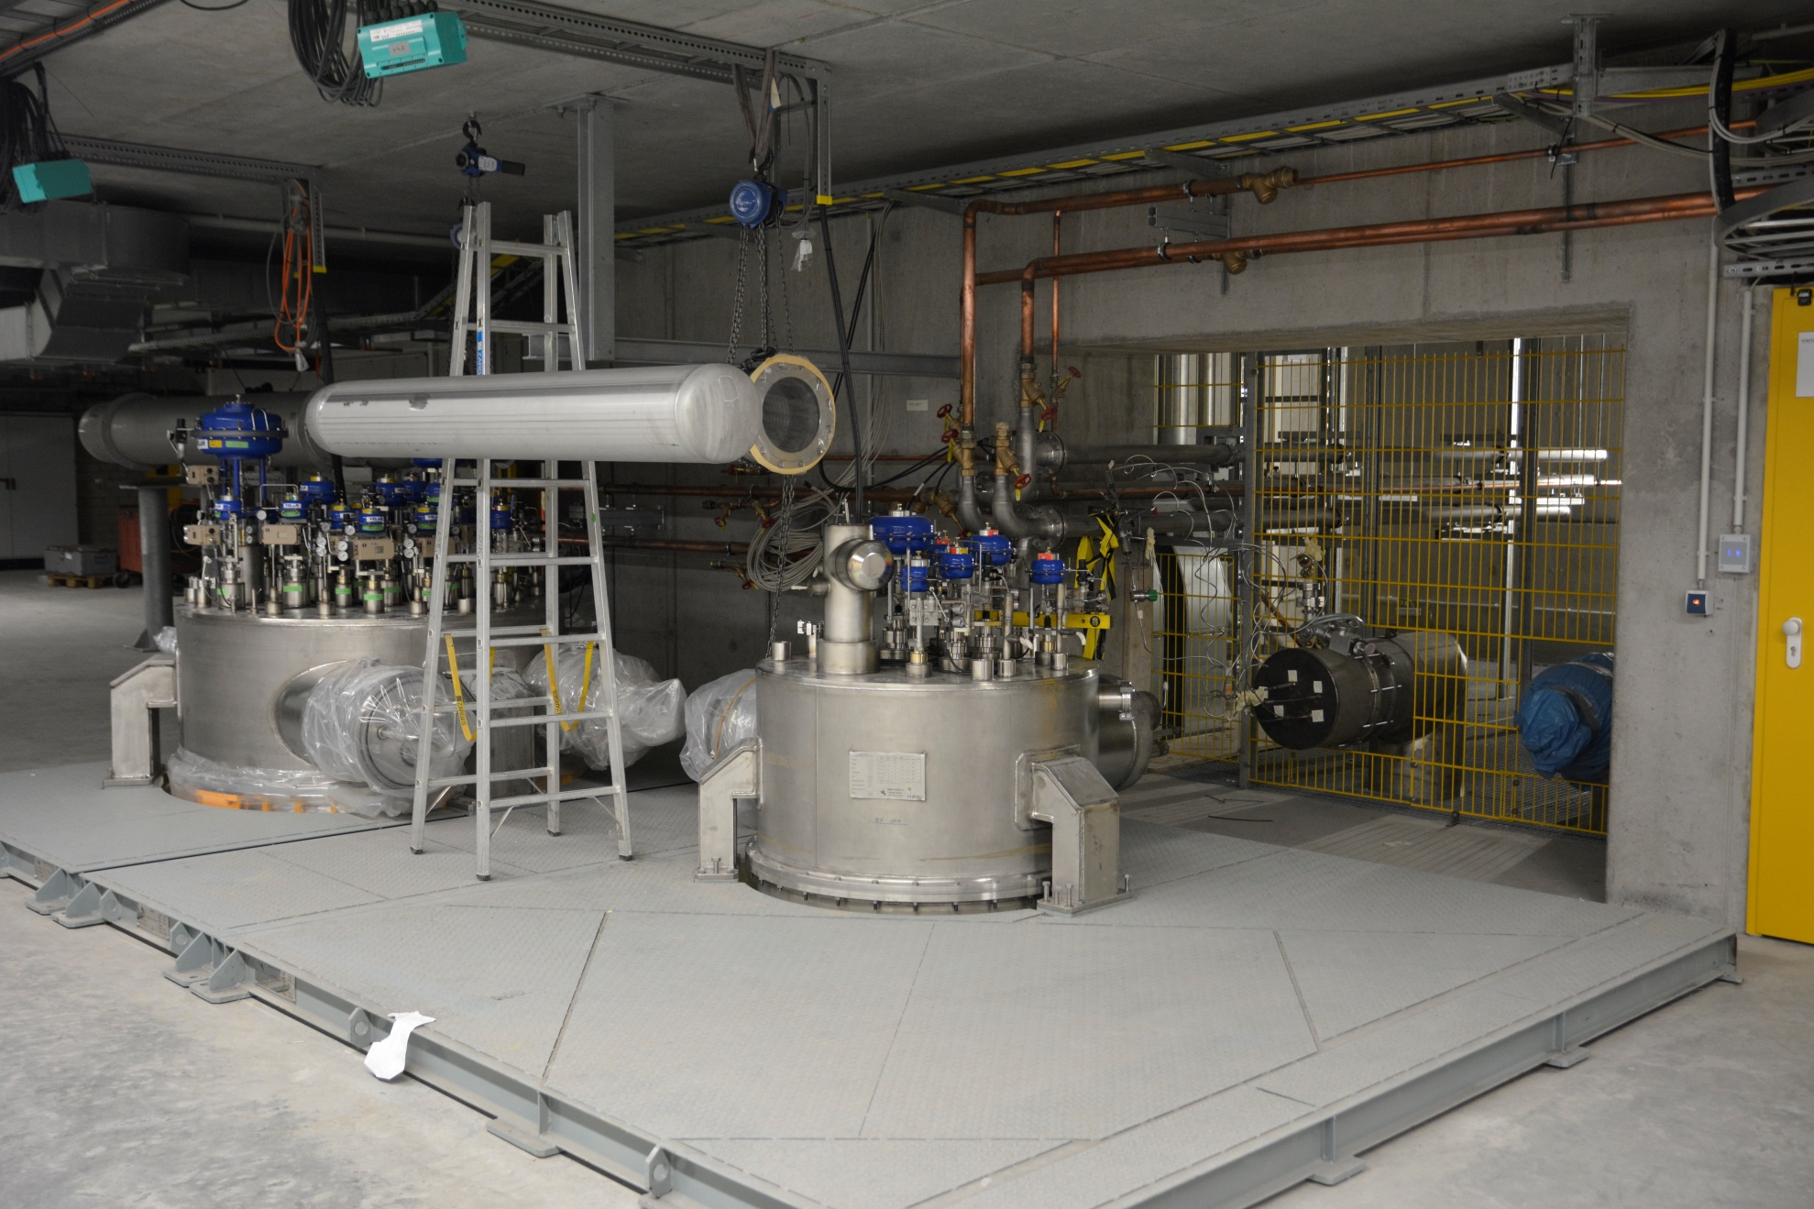

Slide 9
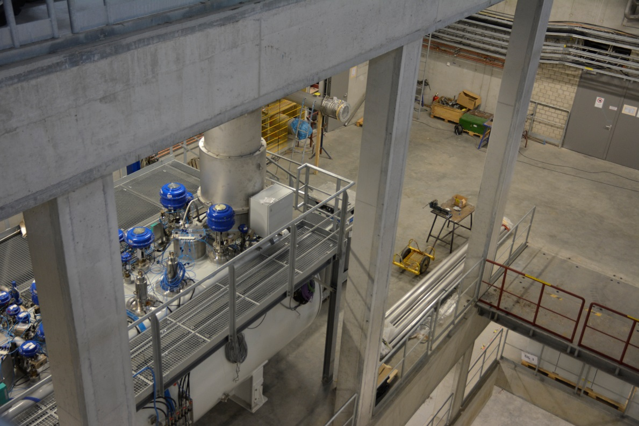
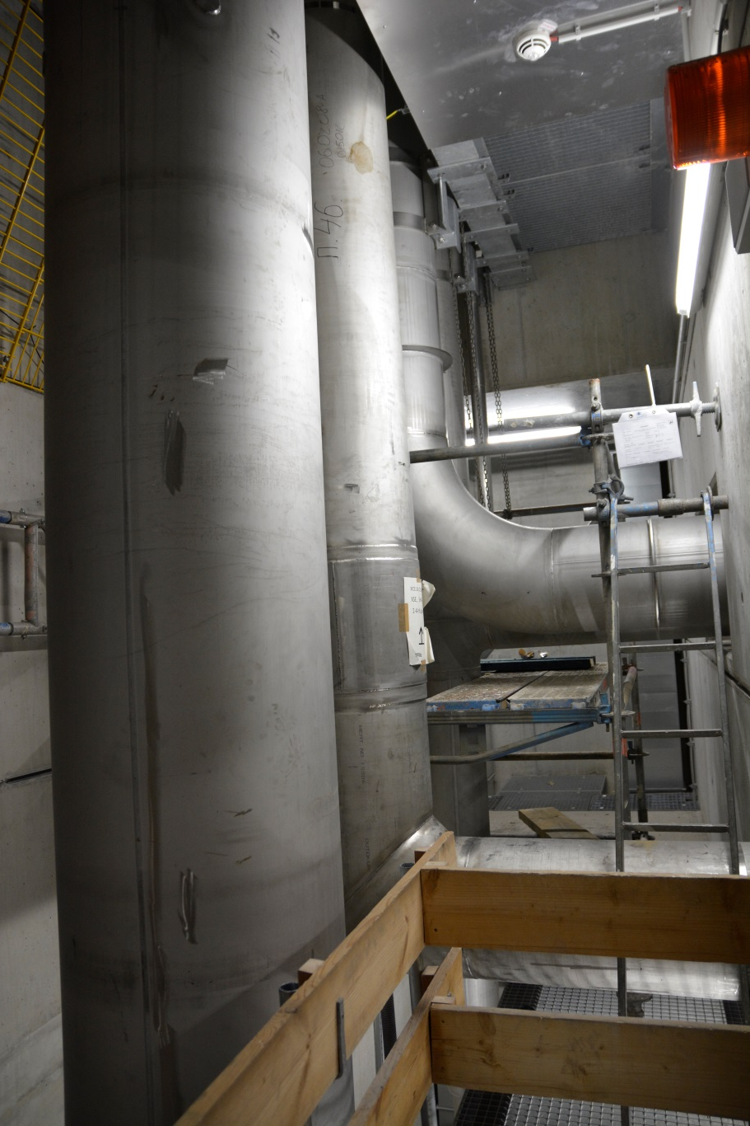
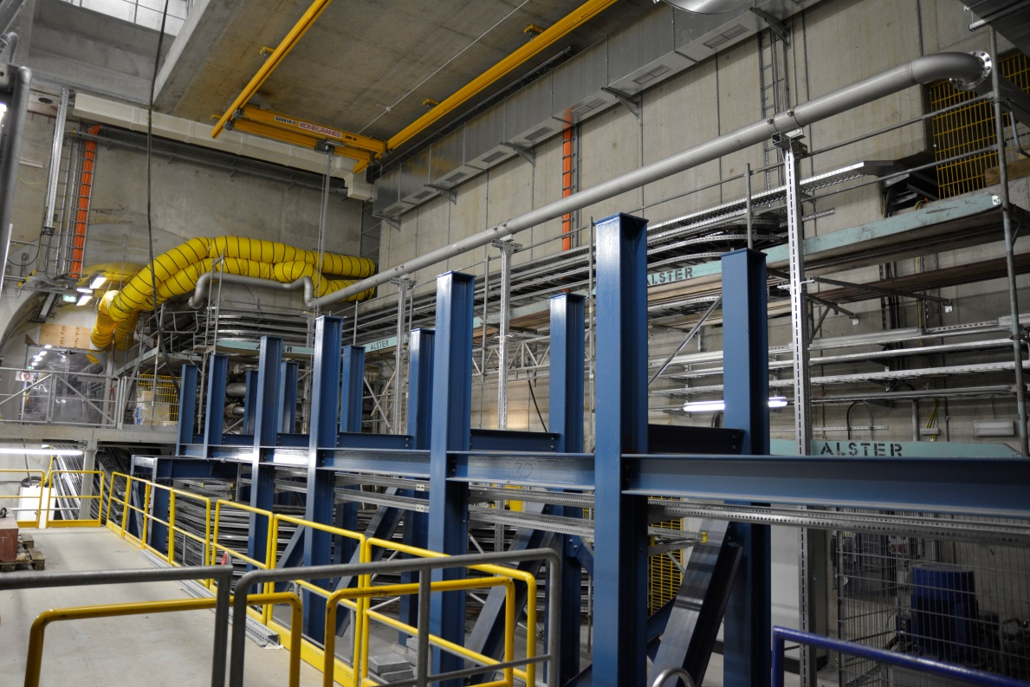

Slide 10
Upcoming work in the injector
Cathode laser alignment and commissioning | January 21st – mid of March
Gun commissioning with beam | End of January – March 9th
Window conditioning ( test stand ) | Until end of January
Exchange of RF window | March ( 3 weeks shutdown )
Installation of electronic racks | “
Cabling work | “
Preparation for module installation | “
Vacuum conditioning of gun | End of March – mid of April
Long pulse commissioning of gun | Mid of April – mid of May
Shutdown for module installation and finalizing the injector | Mid of may – end of June

Slide 11
Work outside the injector until June
Completing the cryo installations
Delivery and installation of last valve box
Finalizing cryo connections
Commissioning
Installation and commissioning of magnet power supplies
Installation and comm. of TDS system
Installation and comm. of electronics
Diagnostics
3.9 GHz controls
Vacuum controls

