Slide 1
Unconventional ideas for axion and DM experiments
F. Caspers
There appears to be growing evidence that very faint photon emissions in living biologic systems (bio-photons) may play and important role in intercellular communication and control of the growth .
Those photon emissions are powered by the metabolism and can be considered as a kind bio-luminescence.
Dead plants or other dead organic material do NOT emit bio-photons.
This kind of “living cell radiation” has been first postulated by A. Gurwitsch nearly 100 years ago and he conducted probably the first
  nearUV light shining through the wall experiment
  On onion roots
Of course everybody was laughing at him at this time.
Around 1970 this kind of very faint radiation on living plants was measured for the first time by F.A Popp in Marburg (Germany) with highly sensitive photodetectors.

Slide 2
Unconventional ideas for axion and DM experiments
And where is the relation to possible DM and axion experiments?
If is true that biological systems (plants , cell cultures etc) can react on very faint photon signals in a measurable way we have two possible observables:
Observation of structure changes under the influence of some DM or axion flux (do we know it and and are we able to control it?)
  And/or
Observation of changes of the bio-photon activity.
With modern highly sensitive photon detectors and cameras the observation of those bio-photon activity is real fun !!!! and rather easy and one see very nicely when e.g. some leaf of a plant is killed by injecting some toxic substance, how the bio-photon activity first strongly increases and then a few seconds to minutes later is dead..(cry before death)

Slide 3
Unconventional ideas for axion and DM experiments
But why should we consider to use plants or cell cultures and not observe such axion and DM related photons directly?
Plants and cell cultures are full of cellular membranes (dielectric double layer with strong internal electric fields) where axions and other DM might convert into mm wave or maybe optical photons which then could have an impact on the biological activity.
Living system are not in thermo-dynamical equilibrium (otherwise they would be dead) and thus may have a very low effective “noise temperature”[some people claim effects like stochastic resonance there]
Remember that an electronic amplifier may be at a noise temperature of say 30 deg when operating at ambient (the typical sat antenna pre-amp for 10 GHz)..also the electronic amplifier is not in thermo-dynamical equilibrium since its connected to a power source.
Perhaps such kind of bio-detectors are much more broadband that our presently used or discussed structures.(and they can be operated also in a strong magnetic field but of course not at cryo.)
There are interesting theories by Fröhlich in biological effects low very low level coherent mm waves in biological systems

Slide 4
Unconventional ideas for axion and DM experiments
F. Caspers
In the 1920s, the Russian embryologist Alexander Gurwitsch reported "ultraweak" photon emissions from living tissues in the UV-range of the spectrum. He named them "mitogenetic rays" because his experiments convinced him that they had a stimulating effect on cell division.
But in the later 20th century Gurwitsch's daughter Anna, Colli, Quickenden and Inaba separately returned to the subject, referring to the phenomenon more neutrally as "dark luminescence", "low level luminescence", "ultraweak bioluminescence", or "ultraweak chemiluminescence". Their common basic hypothesis was that the phenomenon was induced from rare oxidation processes and radical reactions. In the 1970s Fritz-Albert Popp and his research group at the University of Marburg (Germany) showed that the spectral distribution of the emission fell over a wide range of wavelengths, from 200 to 800 nm. Popp proposed that the radiation might be both semi-periodic and coherent. However this view is non generally accpeted..

Slide 5
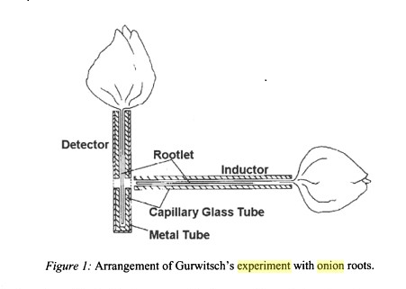
Unconventional ideas for axion and DM experiments
Inductor= transmitter or sender of biophotons

Slide 6
Unconventional ideas for axion and DM experiments

Slide 7
Unconventional ideas for axion and DM experiments
Conclusion ?
Can we propose an experiment in an underground area (in collaboration with biologists)? I understand from discussions with biologists (E. Wagner, Univ Freiburg/Germany) that certain plants are very sensitive. They feel the diurnal VARIATION of the gravitational field (i.e. the tide force)..in a measurable way.
Of course we have to measure and subtract this effect in an underground experiment with plants when looking for axion/ DM effects which also are supposed to have a diurnal variation. But it would already be a nice excuse to convince a funding agency.
Then we could illuminate those plants with a near daylight artificial source (like secret cannabis plantations) in a random pattern but in total say 12 hours per day and then 30 minute after darkness start looking at the biophoton activity with a sort of night vision camera and also check for morphological changes
Obviously we can see axions and paraphotons only after they produced some real photons in the biomatter and hoping that in the milli eV range (for axions) the living plant is better than our conventional detectors. With a combination of Fröhlichs theory and some of the statements /claims of F. Popp this may not be entirely excluded a priori.
All suggestions , corrections ,refutations etc are highly welcome..on request I can provide a number of references..

