Slide 1
SELF Seeding at XFEL.EU
First technical implications
Winni Decking

Slide 2
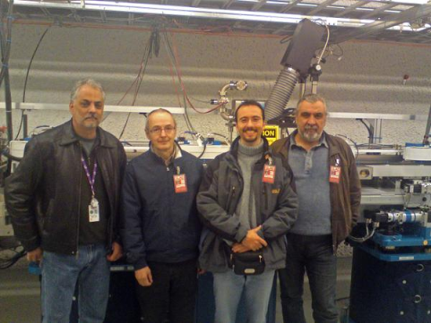
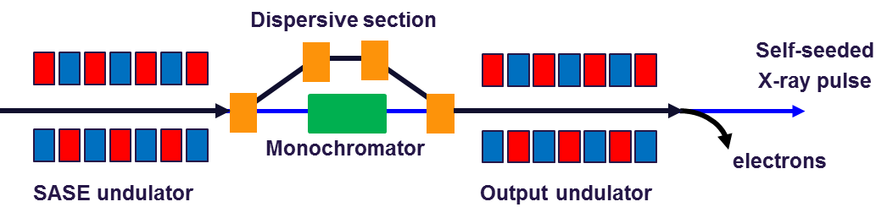
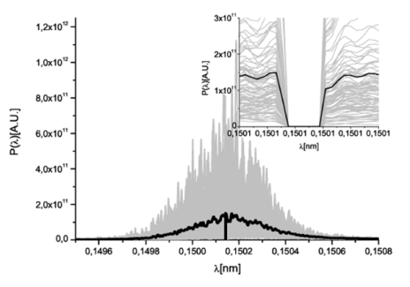
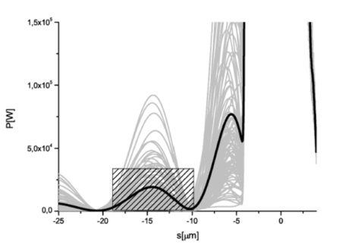
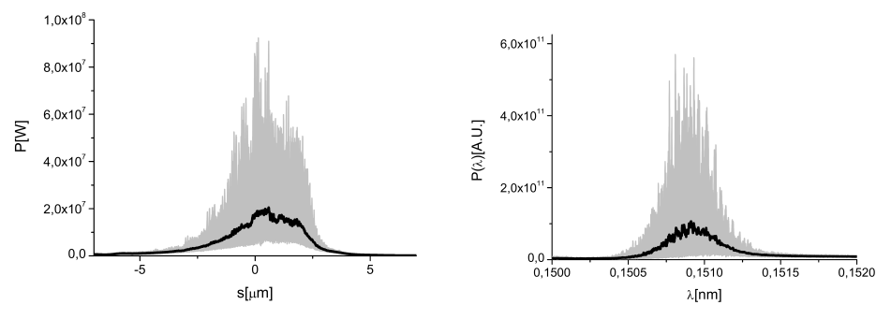
Self Seeding

Slide 3
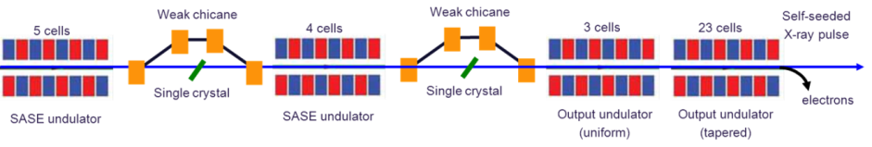

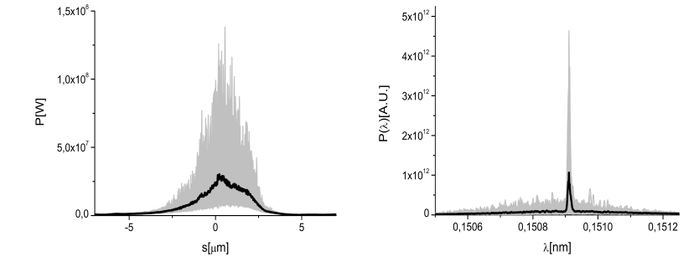
European XFEL: Double Chicane

Slide 4
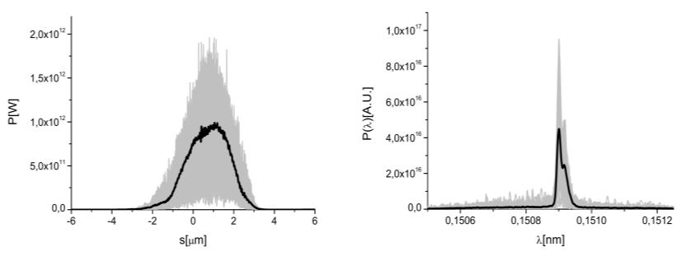
European XFEL: Double Chicane

Slide 5
  Courtesy Paul Emma

Slide 6
  Courtesy Paul Emma

Slide 7
  Courtesy Paul Emma

Slide 8
XFELSEED at European XFEL
Collaboration between
  Technological Institute for Superhard and Novel Carbon Materials (TISNUM), Troitsk
  DESY
  European XFEL GmbH
Jointly funded by
  BMBF (1 MEuro -> DESY)
  Russian Science Ministry (50 MRuble => TISNUM)
Not part of the XFEL construction project
Only 2 chicanes funded in total (i.e. either SA1 and SA2)
Timeline: have chicanes ready for installation in 2017

Slide 9
Strategy
Build chicanes, monochromator and infrastructure for 2 chicanes in SASE 2
Prepare for two chicanes in SASE1
Install chicanes after commissioning and first operation of SASE2
  Minimize commissioning risk
  Optimize chicane placement
Side remark:
MID experiment gets more&more excited about self-seeding possibilities
-> discuss day 1 installation (clashes with schedule and availbale resources

Slide 10
XFEL SEED Organisation
Electron System (DESY) |  |  | Photon System (TISNUM)
W. Decking | G. Geloni | H. Sinn | V. Blank
Electron beam vacuum, magnet chicane, support structure, system integration | Theory and Simulations | Engineering support, system integration support | Monochromator crystals, monochromator chamber

Slide 11
European XFEL: Double Chicane
 | Chicane 1 (up to segment 10) | Chicane 2 (up to segment 20)
SASE1 (TD2) | U40.2293.SA1 2293 m (LA system) | U40.2354.SA1 2354 m (LA system)
SASE2 (TD1) | U40.2255.SA2 2255 m (LA system) | U40.2316.SA2 2316 m (LA system)
Decision XFEL Dir: install at SA2 first, installation at SA1 as soon as funds are availbale

Slide 12
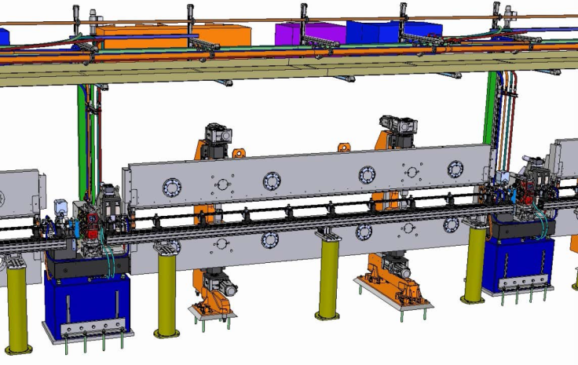
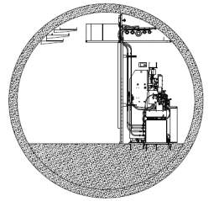
Self-Seeding Implementation
Technical Issues – Chicane
  Define size of monochromator chamber => defines size of chicane and delay-reach
  Design complete set-up to fit on one girder to be able to move in/out easily
  Fit into space constrains given by clima-chamber
Notes:
Before you start editing the slides of your talk change to the Master Slide view:
Menu button “View”, Master, Slide Master:
Edit the following 2 items in the 1st slide:
1) 1st row in the violet header:
Delete the existent text and write the title of your talk into this text field
2) The 2 rows in the footer area: Delete the text and write the information
regarding your talk (same as on the Title Slide) into this text field.
If you want to use more partner logos position them left
beside the DESY logo in the footer area
Close Master View

Slide 13
Self-Seeding Implementation
Technical Issues – Chicane
  Define size of monochromator chamber => defines size of chicane and delay-reach
  Design complete set-up to fit on one girder to be able to move in/out easily
  Fit into space constrains given by clima-chamber
Notes:
Before you start editing the slides of your talk change to the Master Slide view:
Menu button “View”, Master, Slide Master:
Edit the following 2 items in the 1st slide:
1) 1st row in the violet header:
Delete the existent text and write the title of your talk into this text field
2) The 2 rows in the footer area: Delete the text and write the information
regarding your talk (same as on the Title Slide) into this text field.
If you want to use more partner logos position them left
beside the DESY logo in the footer area
Close Master View

Slide 14
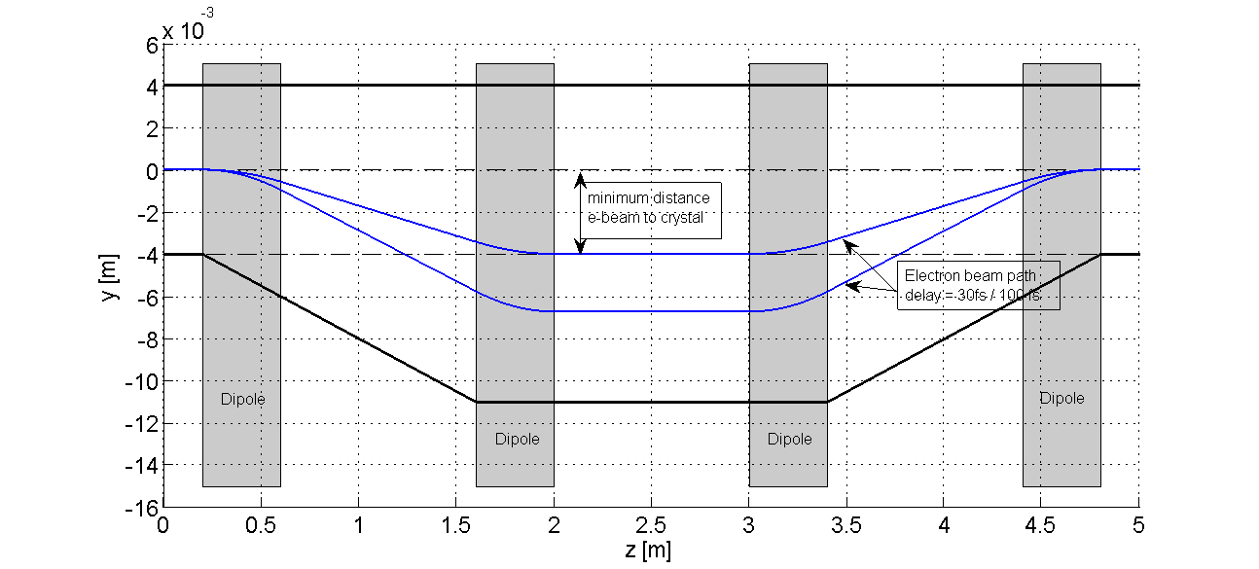
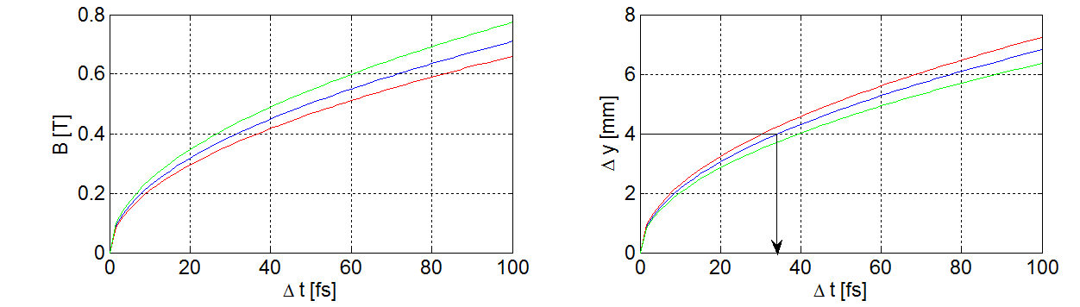
Self-Seeding Implementation
Technical Issues – Chicane – Minimum Delay

Slide 15
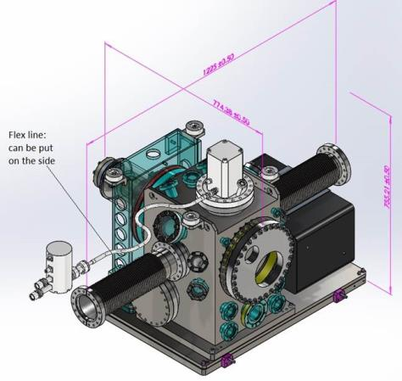
Self-Seeding Implementation
Technical Issues – Vacuum System
  Find solution for phase-shifter chamber
  Design dipole/chicane chamber
  Foresee spare piece for monochchromator
  Monochromator chamber – compatible with e-beam vacuum and physics requirements
Notes:
Before you start editing the slides of your talk change to the Master Slide view:
Menu button “View”, Master, Slide Master:
Edit the following 2 items in the 1st slide:
1) 1st row in the violet header:
Delete the existent text and write the title of your talk into this text field
2) The 2 rows in the footer area: Delete the text and write the information
regarding your talk (same as on the Title Slide) into this text field.
If you want to use more partner logos position them left
beside the DESY logo in the footer area
Close Master View

Slide 16
Self-Seeding Implementation
Technical Issues – Magnet System
  Per chicane:
  Cable and PS:
    1x 200A/60 V
    4 x 10 A / 1V
  About 10 kW additional cooling
Primary Winding
Gap | 16 mm
Max. Field | 1.45 T
Max. Current | 190 A
Volt. Drop | 10 V
Power Loss | 2 kW
Secondary Winding
Max. Field | 0.03 T
Max. Current | 10 A
Volt. Drop | 1 V
Example, no final design exists yet
Notes:
Before you start editing the slides of your talk change to the Master Slide view:
Menu button “View”, Master, Slide Master:
Edit the following 2 items in the 1st slide:
1) 1st row in the violet header:
Delete the existent text and write the title of your talk into this text field
2) The 2 rows in the footer area: Delete the text and write the information
regarding your talk (same as on the Title Slide) into this text field.
If you want to use more partner logos position them left
beside the DESY logo in the footer area
Close Master View

Slide 17
Summary of Infrastructure Requirements
  Magnet Current
SASE1 2256 to 2293 m and 2299 to 2354 m
  Foresee space for two 200 A / 60 V power supply to power 8 XBL type magnets
  Foresee space for eight10 A / 1 V corrector power supplies to power 8 XBL correction coils
  Foresee space for cabling from XS1 to 2293 m and to 2354 m
SASE2 2218 to 2255 m and 2261 to 2316 m
  Two 200 A / 60 V power supply to power 8 XBL type magnets
  Space for eight 10 A / 1 V corrector power supplies to power 8 XBL correction coils
  Install appropriate Cabling from XS1 to 2255 m and to 2316 m
Cabling will be installed on ‘MKK’ cable trays outside of undulator clima chamber & routed into chamber through to be designed feedthroughs

Slide 18
Summary of Infrastructure Requirements
  Magnet Cooling
SASE1 2256 to 2293 m and 2299 to 2354 m
  Foresee up to 20 kW of additional cooling power
SASE2 2218 to 2255 m and 2261 to 2316 m
  Foresee up to 20 kW of additional cooling power
Proposal Ullrich (9.1.15)
  Durchfluss pro Magnet:1,4 l/min
  Temperaturerhöhung: 20 °C ( aus Verlustleistung und Durchfluss)
  Das heißt: Kühlwasser wird auf: 18° + 20° = 38°C aufgewärmt.
  Da diese Wassertemperatur über der Umgebungstemperatur von 25°C liegt, müsste der Magnet thermisch isoliert werden.

Slide 19
Next Steps
Establish collaboration ✓
Decide which SASE beam line -> SASE 2 ✓
Define/hire personnel (ongoing)
Define urgently needed infrastructure requirements/interfaces/boundaries
  Length of monochromator ✓
  Magnet cabling and power consumption ✓
  Other infrastructure requirements

