Slide 1




EUROPEAN UNION
GOVERNMENT OF ROMANIA
Project co-financed by the European Regional Development Fund
Structural Instruments
2007-2013
Sectoral Operational Programme
„Increase of Economic Competitiveness”
“Investments for Your Future”
Extreme Light Infrastructure – Nuclear Physics (ELI-NP)
Energy for Sustainable Science at Research Infrastructures -
Hamburg 29/30 October 2015
Razvan Bataiosu for ELI-NP

Slide 2
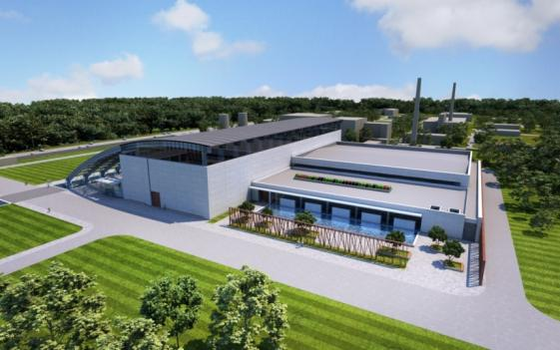
ELI–NP Facility
Gamma building hosting a very intense brilliant monochromatic γ beam with Ev<20 MeV
Laser and Laboratory building hosting High Power Laser System (10PW, 1PW & 100 TW lasers) and Laboratories &Workshops

Slide 3
ELI-NP IN THE WORLD
To be built in Bucharest- Magurele , ELI-NP will be one of the three pillars of ELI - THE EXTREME LIGHT INFRASTRUCTURE, along with the facilities dedicated to the study of secondary sources (Dolni Brezany , near Prague – Czech Republic) and attosecond pulses (Szeged - Hungary).
ELI-NP will create a new European laboratory to consistently investigate a very broad range of science domains, from new fields of fundamental physics, new nuclear physics and astrophysics topics, to applications in material science, life sciences and nuclear materials management.
The “ Horia Hulubei ” National Institute of Research and Development for Physics and Nuclear Engineering is the entity in charge of the implementation of the ELI Nuclear Physics facility

Slide 4
Numbers that speak for the ELI-NP project
Laser and Laboratory Building – Basement + ground
Total area: 7.041 sqm
Gamma Building partial - Basement + ground
Total area: 6.958 sqm
Hotel Building – 2 storey building and canteen
Volume:75.733 cubic meters
Volume:160.034 cubic meters
Office Building - 5 storey building
Total area: 740 sqm
Volume: 20.937 cubic meters
Total area: 1012 sqm
Volume:12.408 cubic meters
This means:
A TOTAL AREA over :21.000 sqm
A TOTAL VOLUME of over 270.000 cubic meters to acclimate

Slide 5
Laser + Laboratory building
Special requirements that need to be met inside the Laser room, in order for the experiments to work:
Room temperature: 22±0.5°C
Relative humidity: 35-50 %
Over-pressure ventilation
Clean room: class 7 (according to ISO 14644)
Examples of some special requirements that need to be met inside the Lab rooms, in order for the experiments to work:
Room temperature: 20±0.5°C
Relative humidity: 30±10 %
Over-pressure ventilation
Clean room: class 6 (according to ISO 14644)

Slide 6
Thermal capacity
Heating power needed:Over 3.2 MW , only HVAC
Cooling power needed: 6 MW
from which:
Technological Cooling Water : 2.2MW
Total installed thermal capacity : higher than 6.10 MW for the entire field of energy.

Slide 7
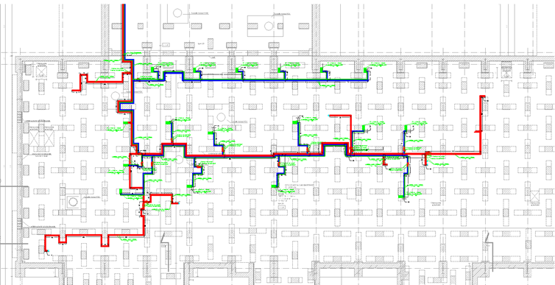
Cooled water distribution
In ELI-NP facility is foreseen a cooled water network that distributes cooled water for the two big systems HPLS and GBS and for experimental areas.
The cooled water is produced in two separate plants one situated in Gamma Building and one Laser Building.
For HPLS and experimental area the cooled water is supplied from the plant in Laser Building.
For GBS the cooled water is supplied from the plant in Gamma Building.
The cooled water are primary agent is delivered at 7 °C.
The cooled water is used by users in customized heat exchangers.
From geothermal pumping system

Slide 8
ENERGY BALANCE OF THE ELECTRIC POWER SUPPLY SYSTEM
5 electrical substations
Two separated distribution lines
Power distribution on BUSBARS
ACCORDING TO PROJECT:
for Laser(kW)=3663
Installed Power
for Gammas and Experiments (kW)=6307
Maximum Absorbed Power per Assembly (kW)=5 624.09, where Simultaneity Coefficient=0.7
Total Installed Power available at Transformer Substations (kW) = 10 016.00 (100% load)
= 8 013.00 (80% load)

Slide 9
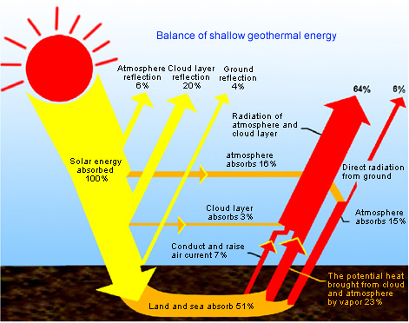
Shallow geothermal energy
Source used to heat/cool the entire complex of buildings is the unconventional geothermal energy captured through boreholes and used by the heat pumps.
Shallow geothermal energy is considered to be renewable energy.
Geothermal Energy is low –temperature heat (compared to energy from soil, sandstone and underground water in thermostat layer) reserved under the surface layer formed under the combined effect of solar energy and heat energy from the earth’s core.

Slide 10
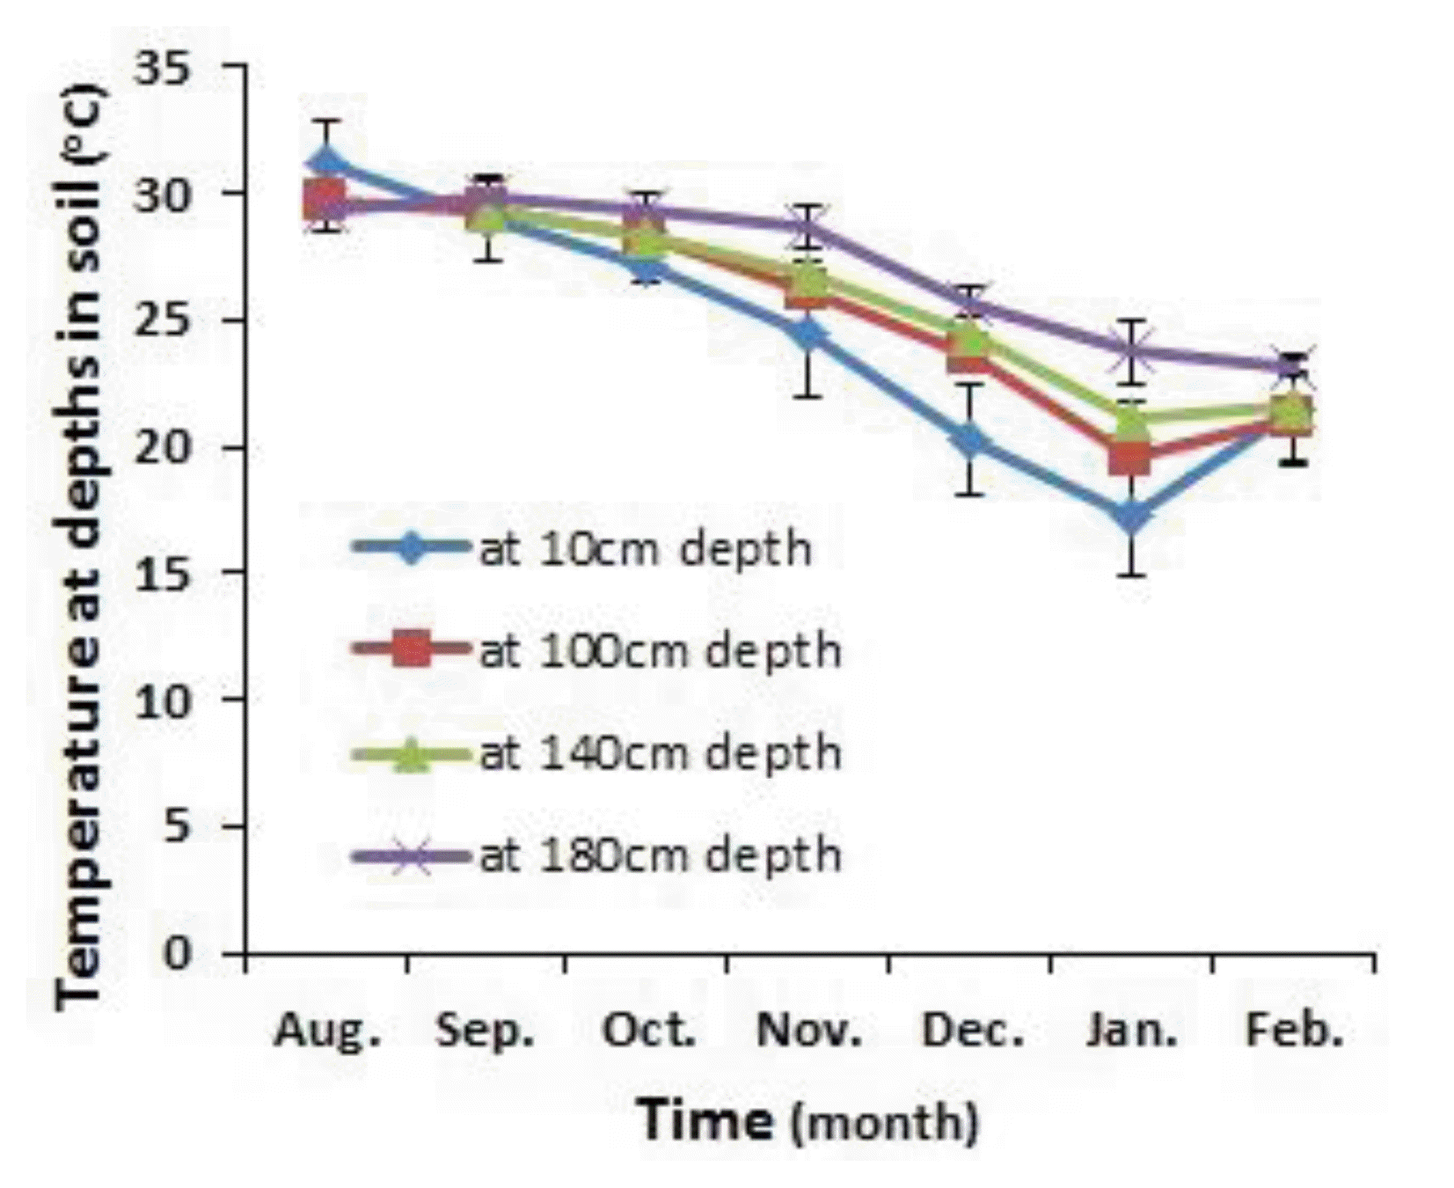
Shallow geothermal energy
Temperature variations at certain depths depending on the season. At a depth of 10 m, undisturbed soil temperature is relatively constant at a value of 12.5º C, increasing by about 1º C every 10 m.

Slide 11
Ground heat exchanger system is a closed geo exchange circuit which consists a total of 1080 geothermal drilling with a depth of 125 m
Drills are grouped each 60 to a manifold.
Each manifold contains a collector and a distributor
From the 18 distributor / collector, leaving a pair of main geothermal pipes (flow / return) to the pumping station , serving to manage the amount of energy extracted from the ground in the cold season, respectively the amount of energy injected into the ground in the warm period.
From pumping station , energy is distributed to each of the 9 substations in the ELI-NP infrastructure.( HVAC plants and technological chilled water plants )
Ground heat exchanger length : 135.0 Km

Slide 12
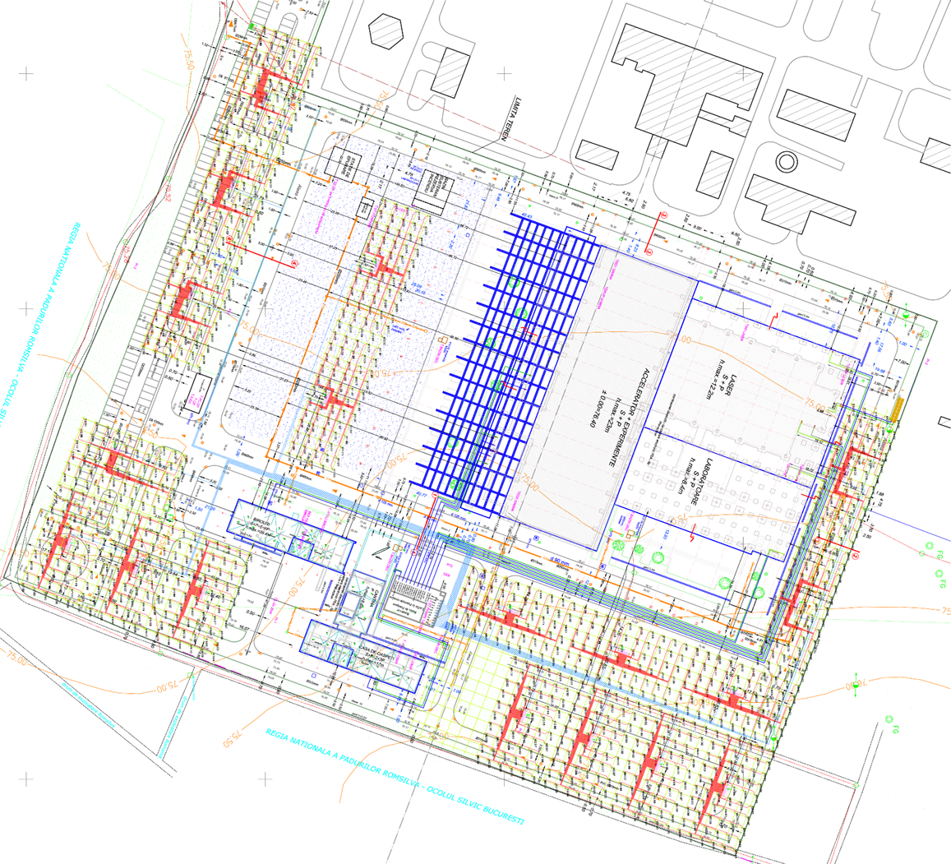
Ground heat exchanger positioning - geothermal drilling and manifolds layout
For predimensioning of GHE we use the following data:
• earth temperature: 12.3 ° C;
• thermal conductivity of the earth: 2.08 W / (Km);
• Thermal earth diffusivity : 0.094 m2 / day;
• cementing material conductivity: 1.7 W / (Km).
Final sizing of ground heat exchanger is done after achieving thermal response tests.

Slide 13
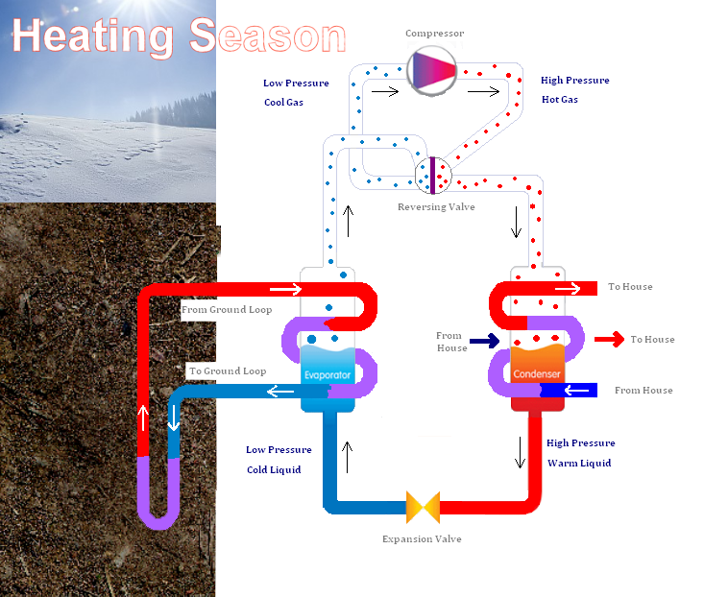
Geothermal heat pumps
Heating system heat pump consists of three different circuits:
The primary circuit or heat source circuit through which heat is extracted from the ground
Heat pump refrigerant circuit
The secondary circuit – heating interior of the building.

Slide 14
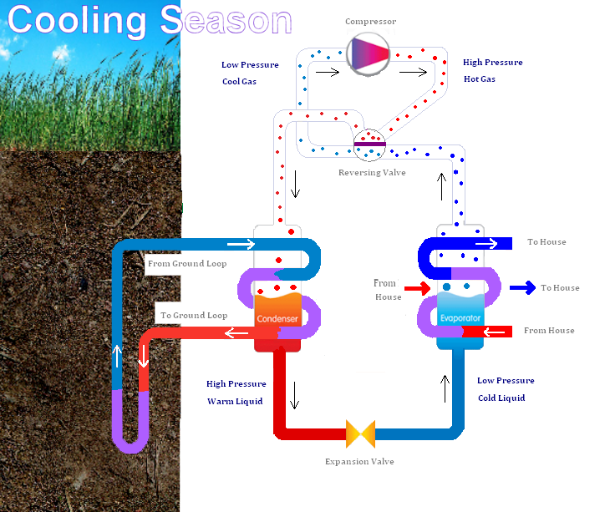
Geothermal heat pumps

Slide 15
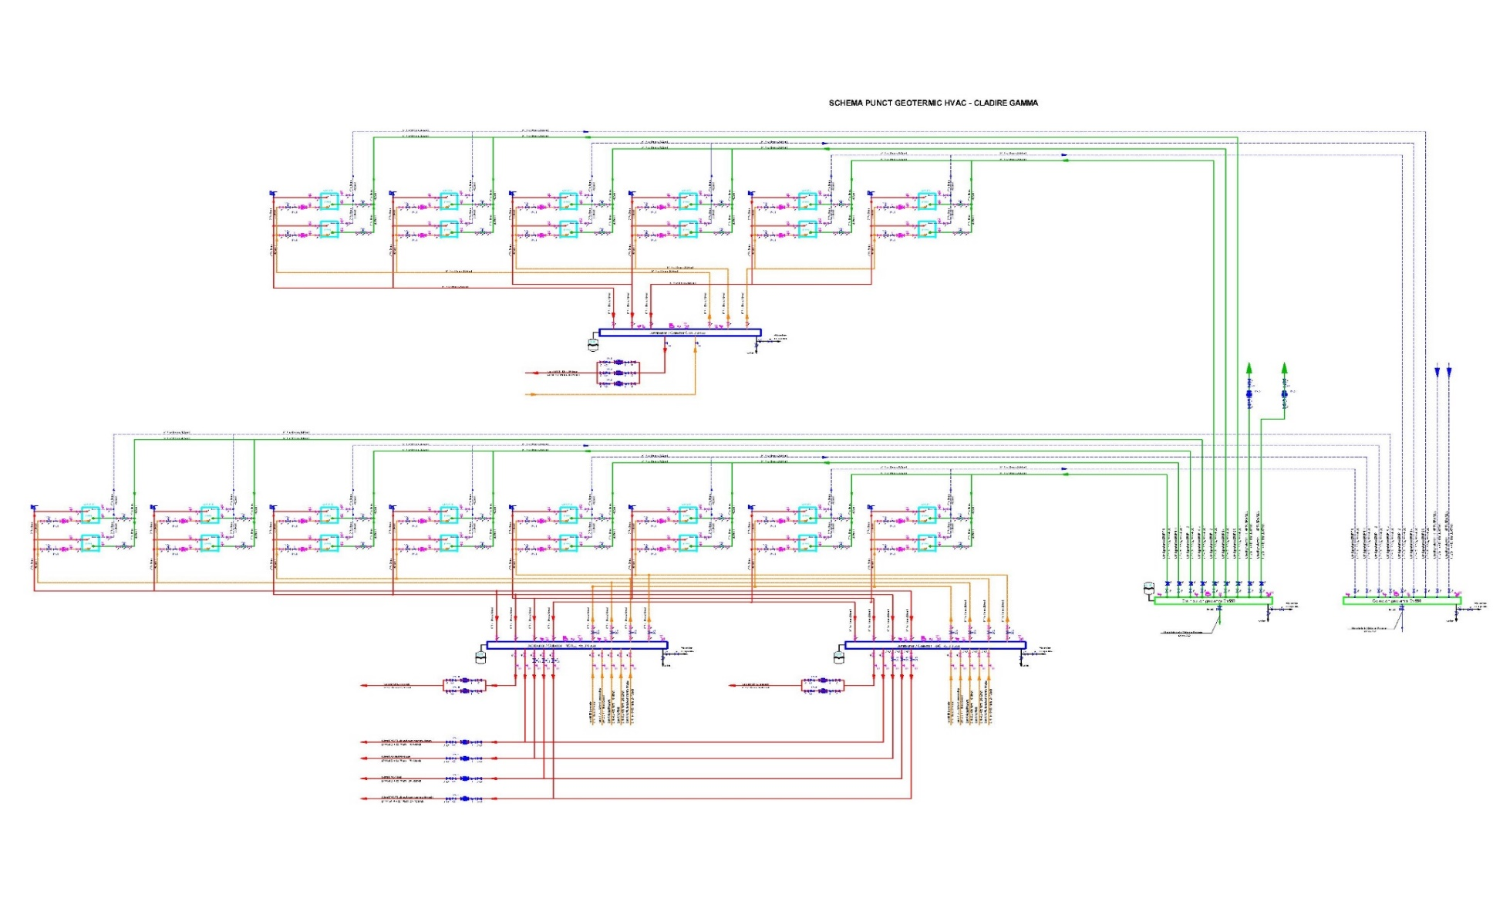
Example of HVAC geothermal point scheme from ELI
From the main geothermal pipes coming from the pumping station is entered geothermal distributor
From these distributor leaving nine circuits as follows:
2 geothermal circuit to air- water heat pumps in the Gamma building
3 geothermal circuit to water - water heat pumps serving the two air handling units of 80,000 m³ / h to ventilate and air recirculation.
4 geothermal circuit to water – water heat pumps for heating /cooling of experimental areas E1-E7

Slide 16
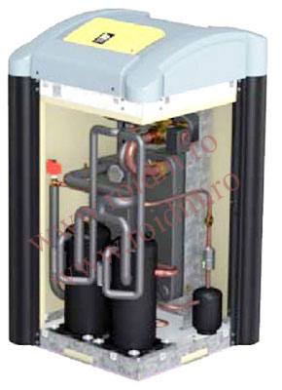
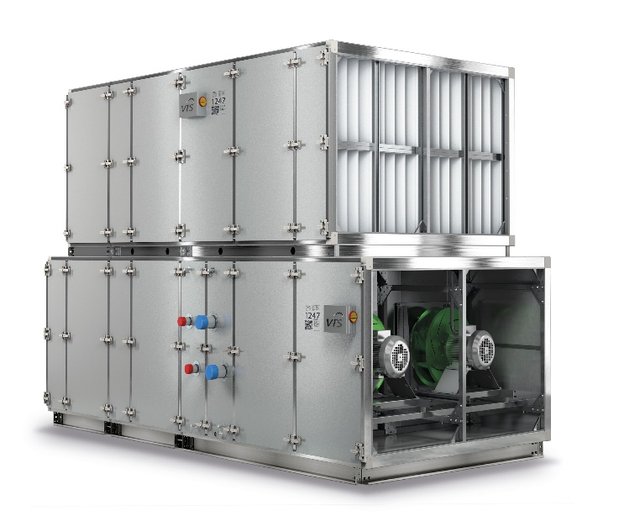
The main HVAC equipment
The number of geothermal heat pumps- 166
-air-water - 43
- water- water - 123
Air handling units Gamma bldg. 2 x 80.000 m3/h
Air handling units Laser + Lab bldg.– 8 x 54.000 m3/h
Fan coil units – 192 pieces
Plate heat recovery – 26 pieces
Destratificators – 16 pieces

Slide 17
DDC
The HVAC system using geothermal source is fully automated with Direct Digital Control System (DDC).
Intelligent microprocessor control system and operated via the Internet , type: Direct Digital Controls (DDC)
An energy management system (EMS) is defined as a fully functional control system. This includes controllers, various communications devices and operational software necessary to have a fully functioning control system.

Slide 22
Framing grid energy efficiency :class " B" - less than
233 kWh / sqm / year
Specific operating cost : less than 5.0 Euro / sqm / year

Slide 23
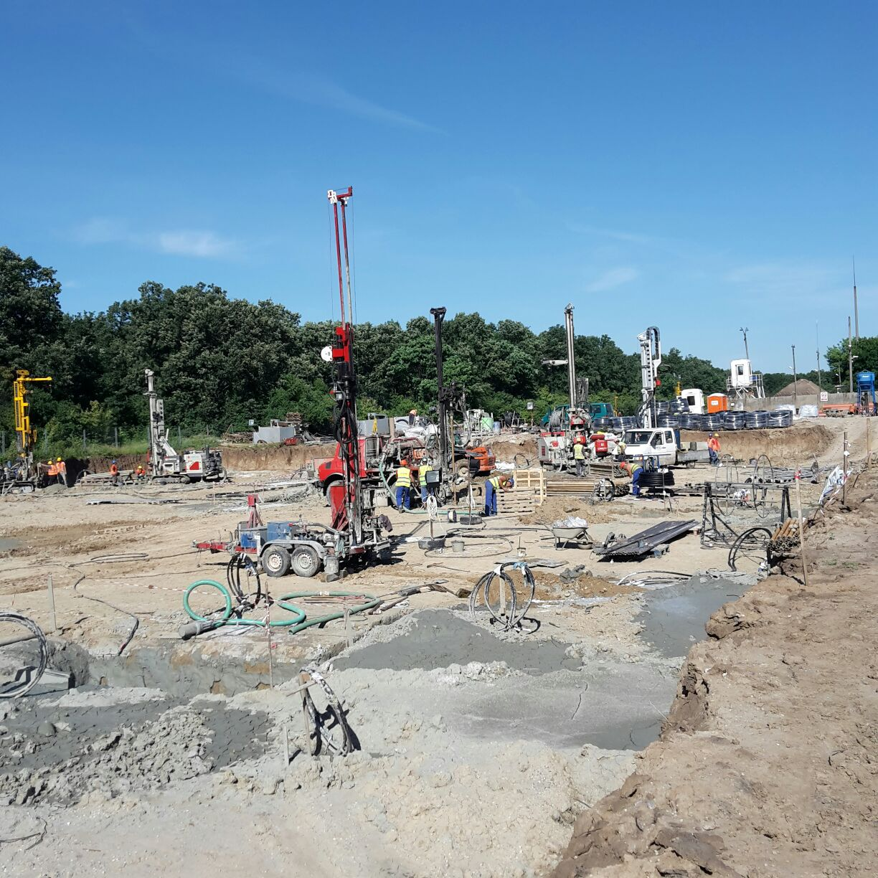
Geothermal drilling and construction photos

Slide 24
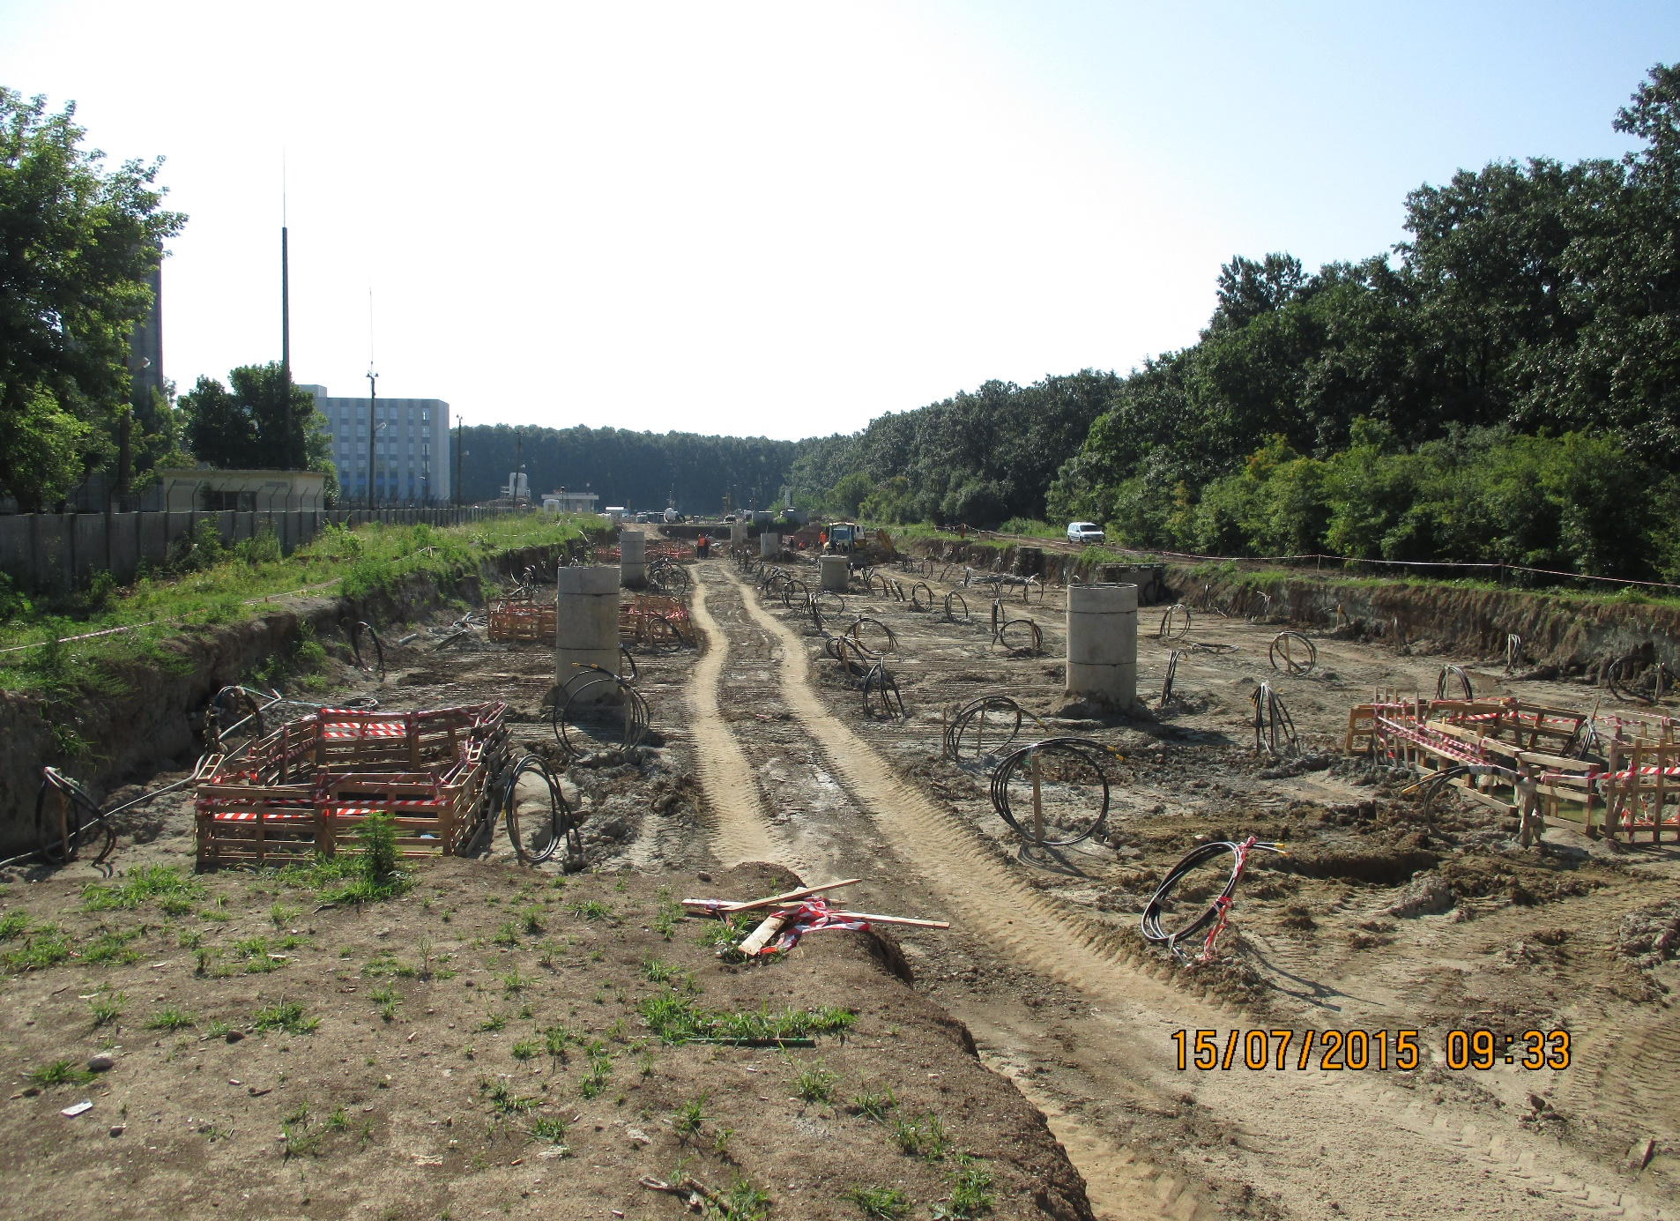
Boreholes are lined up to 5 meters apart on both directions

Slide 25
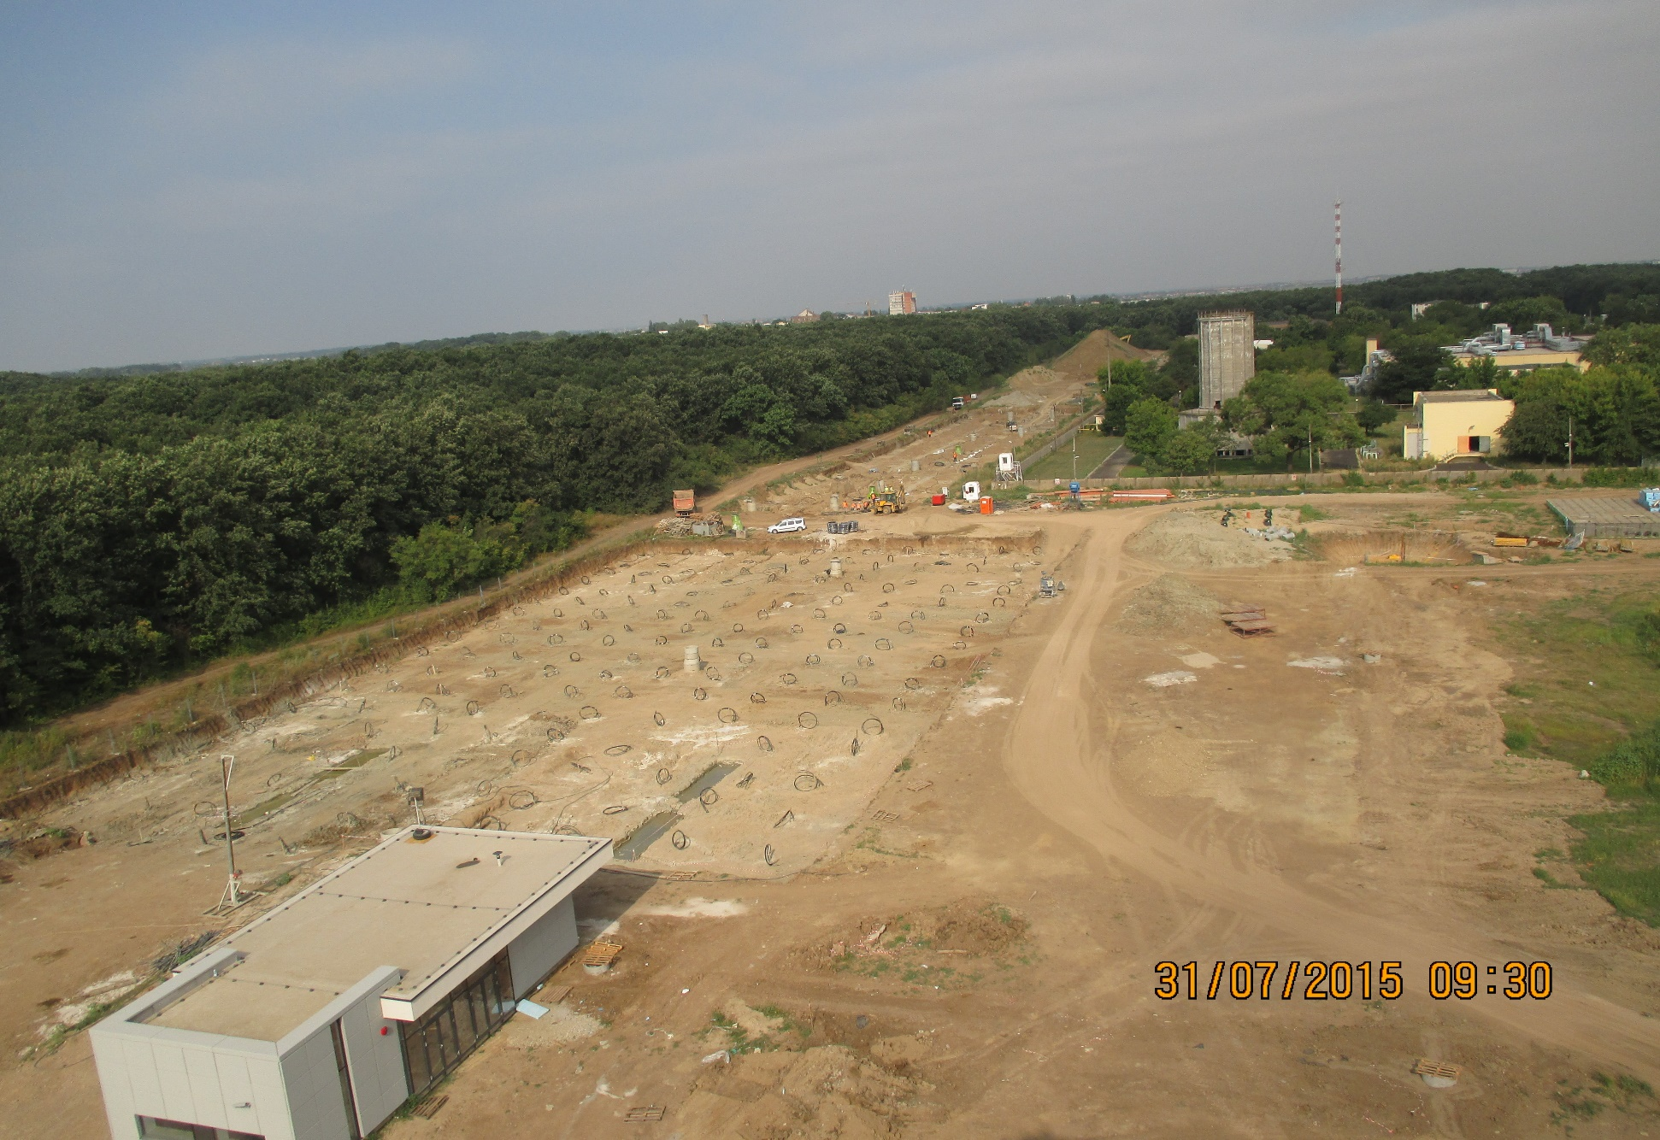
Aerial view on a plot of geothermal drilling

Slide 26
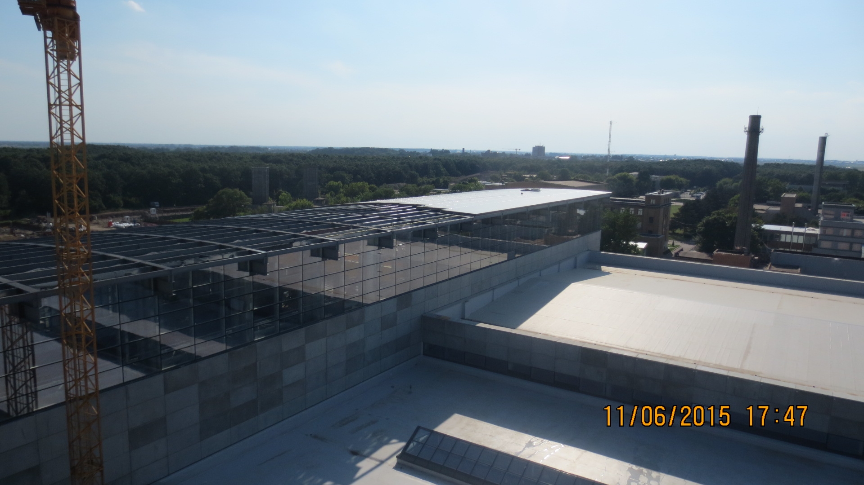
Gamma building – curtain walls and concrete precast

Slide 27
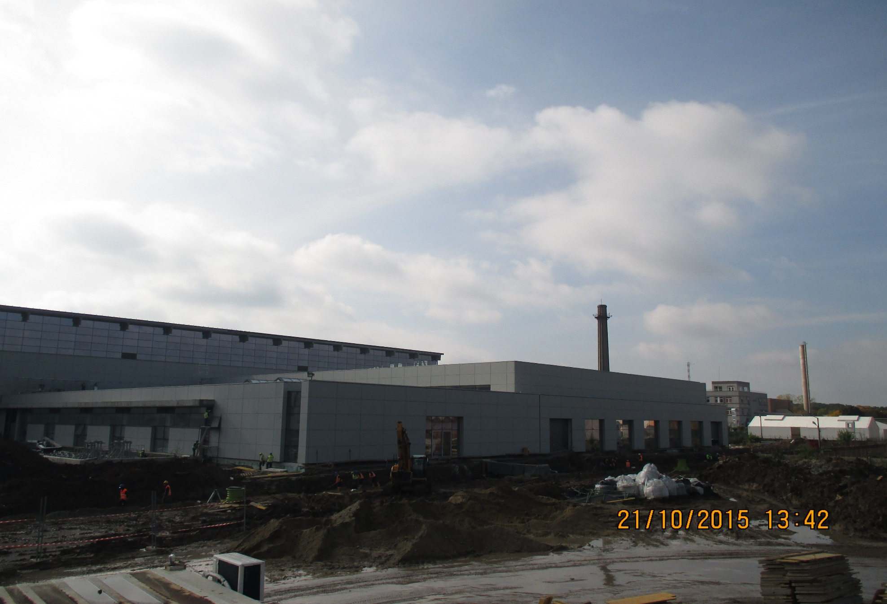
Laser and Laboratory building

Slide 28
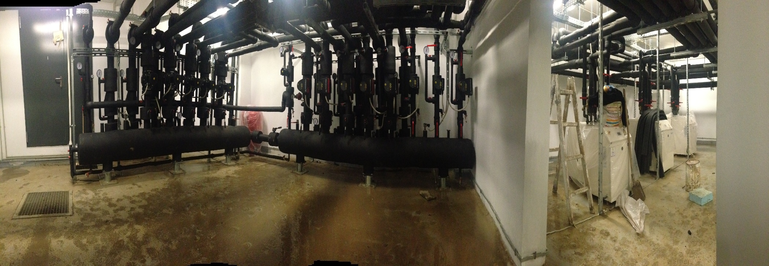
HVAC geothermal plant
Collector and a distributor
Water-water heat pumps

Slide 29
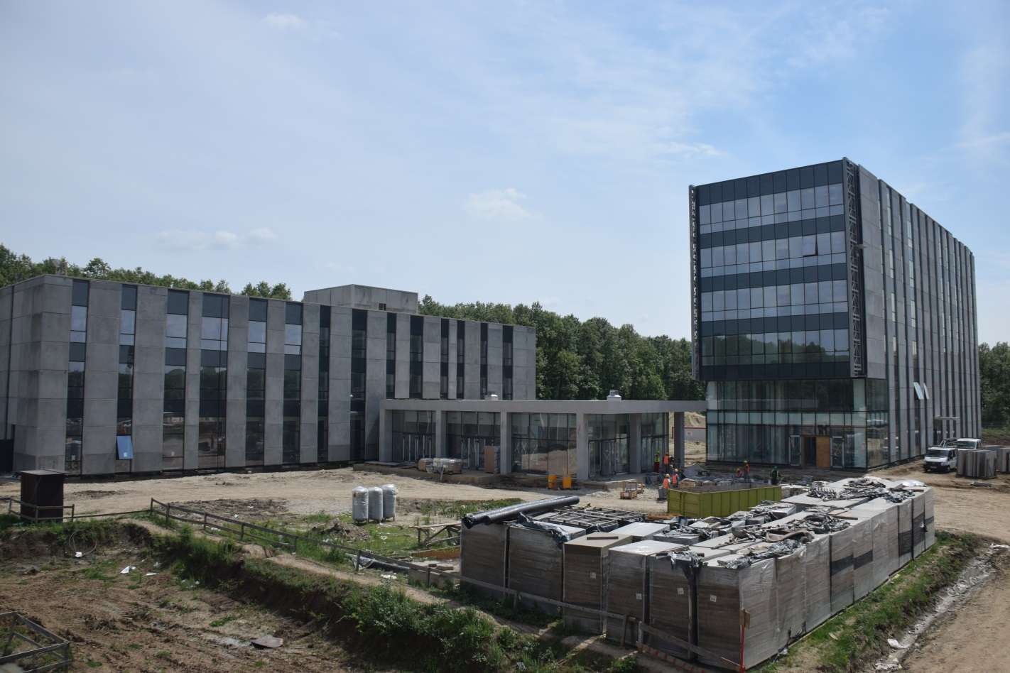
Construction photos
Hotel building
Office building
Gamma building

Slide 30


Thank you!
ELI-NP Team, March 5, 2013

