Slide 1


Report from Parallel Session IIb
Energy Management & Procurement at RIs
Frank Lehner, DESY

Slide 2

Laboratory Survey: Energy Consumption
and Energy Cost
From F. Bordry, Introduction & Goals

Slide 3
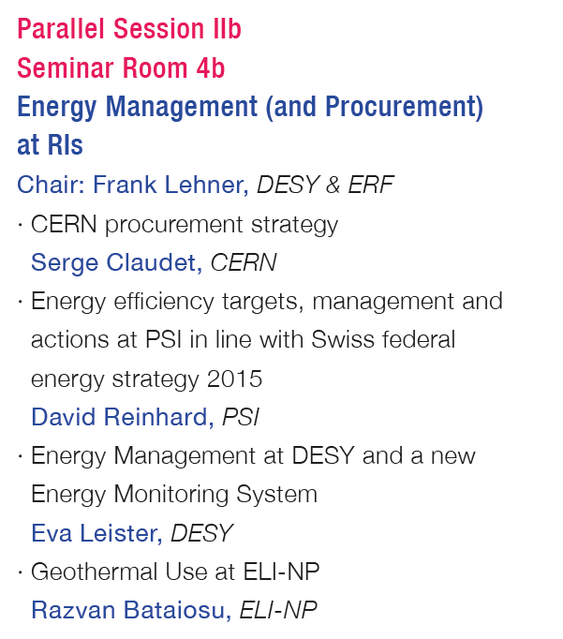
Overview of Talks

Slide 4
Serge Claudet: CERN procurement strategy
CERN energy consumption: 1,3 TWh/a (LHC phase)
  50% for LHC
Move now from regulated tariff to market
Main supply from French Grid => French market based offers
Aim for procurement contract 3+2 years to secure next running phase of LHC

Slide 5
Serge Claudet: CERN procurement strategy
Strategy: find optimal balance between risk versus cost
carefuls preparation how to approach market (incl. Best practice & consulting)
Developped indexed formula for energy price
  Includes peakload/baseload and summer/winter
Provide consumption profile plus information on potential incidents
Provide forecast 2016-2020
Tendering
  Preparation, qualification, pre-tender, tendering:
  Conditions – „best value for money“:
    85% price part
    15% flexibility/quality criteria
Very successful tendering process
signed contract just recently, secured now supply for next three years
Average price 37,5 €/MWh w/o transportation/tax
total volume ~140 M€ for three years

Slide 6
Serge Claudet: CERN procurement strategy
Re-established CERN Energy Management Panel (2nd generation)
  brings together all main energy consumers and stakeholders at CERN together
  Raise awareness of new energy supply contracts and regulations
  Compile estimates of CERN’s projected power and energy consumption
  Manage energy consumption, with regular checks against planned consumption
  Make recommendations to reduce energy bill with minimal impact to operation
  …

Slide 7
Serge Claudet: CERN procurement strategy
Conclusions
  Placing of new contract allows the securing of energy supply to complete LHC Run2
  followed after one year effort learning-preparation-implemention to go from regulated “tariffs” to “market”
  a comprehensive energy management is now being prepared via a “modernised “CERN Energy Management Panel

Slide 8
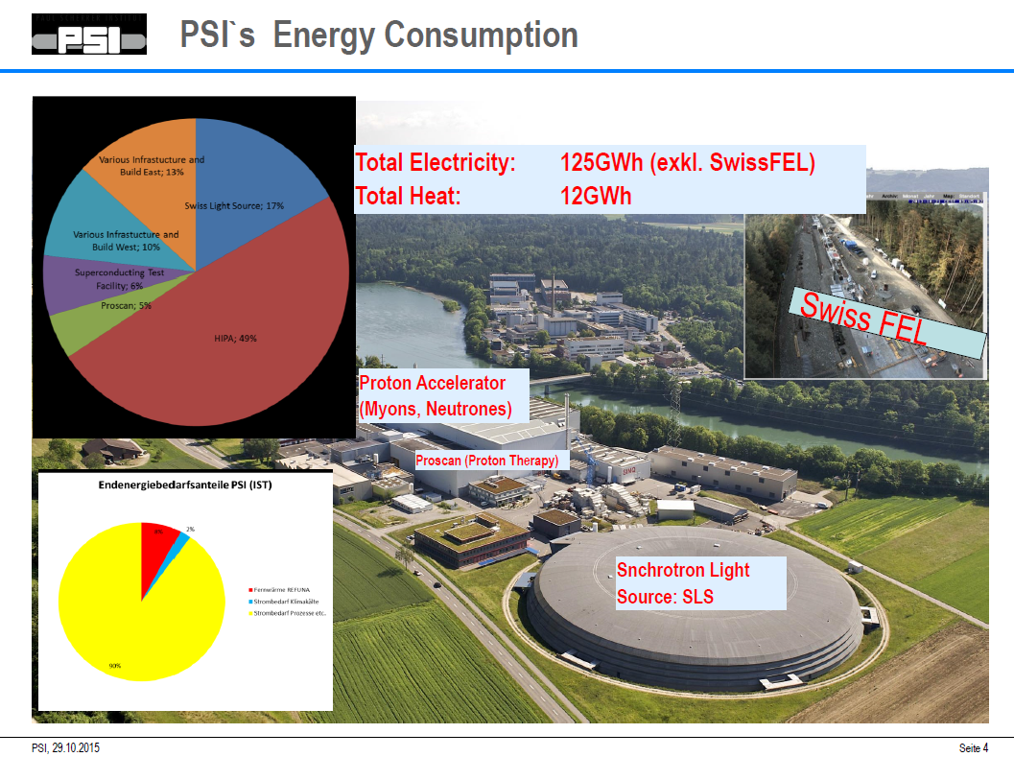
David Reinhard: PSI
Proton accelerator
~50%

Slide 9
David Reinhard: PSI
Energy Strategy 2050 of Swiss Government (in 2007)
  Energy efficiency
  Renewables (25% goal)
  Replacement of large power plants
  Foreign energy policy
  + phase out nuclear (added in 2011)
Impact to PSI:
  Realisation of existing energy efficiency potential
  intensify research for energy
  Role model function of federal government
    Quantitative target +20% from 2006-2020
    Best praxis (buildings & renewables, mobility, green IT)
    Yearly Reporting

Slide 10
David Reinhard: PSI
  Organisational Implementation of Swiss Energy Strategy 2050 at PSI:
  Energy Mission Statement at PSI (http://www.psi.ch/energieleitbild)
  Steering committee energy and environment
  Two working groups:
    WG1 Office & Laboratory
    WG2 Large-Scale RIs
  Approx. 70 technical measures analyzed, 50 identified as being economic
    9 MCHF invest, payback time 10 years
    Mostly building infrastructure, a few from large sclale infrastructures/accelerators

Slide 11
David Reinhard: PSI
Examples were shown on
  Accelerators
    Shutdown subsystems during failures
    Hard to find short- or mid-term optimiztion measures on existing accelerators
  IT infrastructures
  HVAC in nuclear waste storage
  Heat Recovery
    Use heat from existing high T cooling loops
    4MCHF investment
    covers 75% of total heat consumption of campus
  Maximizing utilisation of machines

Slide 12
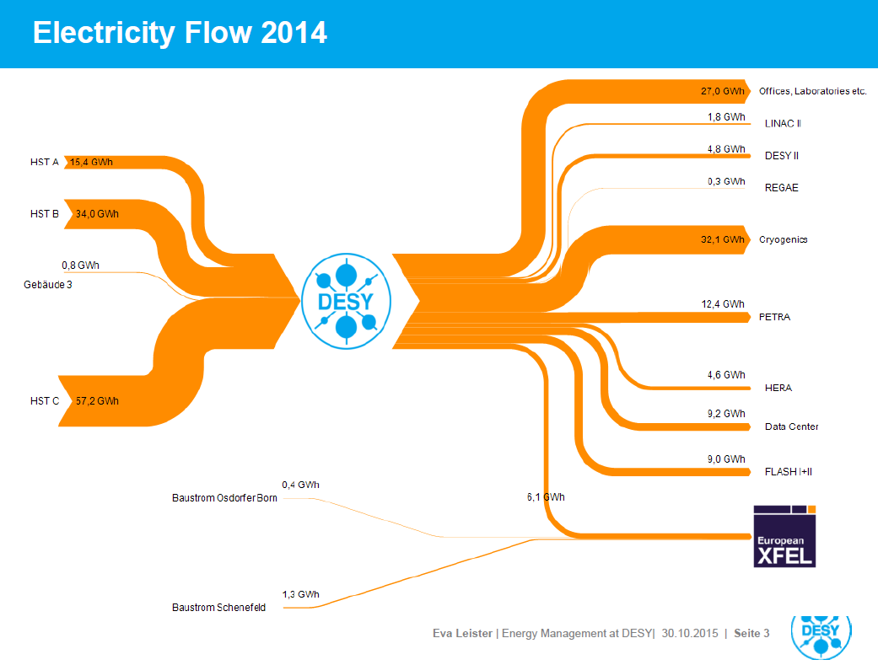
Eva Leister: DESY
Annual energy consumption
  109 GWh el. Energy (in 2014, PETRA III not operational)
  expect 250 GWh el. Energy (w/ XFEL)
  ~21 GWh heat
Talk covered
  new energy data aquisition system / monitoring /metering
  Energy efficiency projects
Electricity Flow 2014

Slide 13
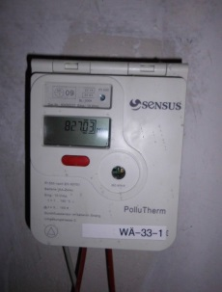
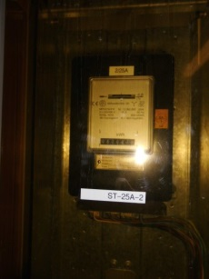
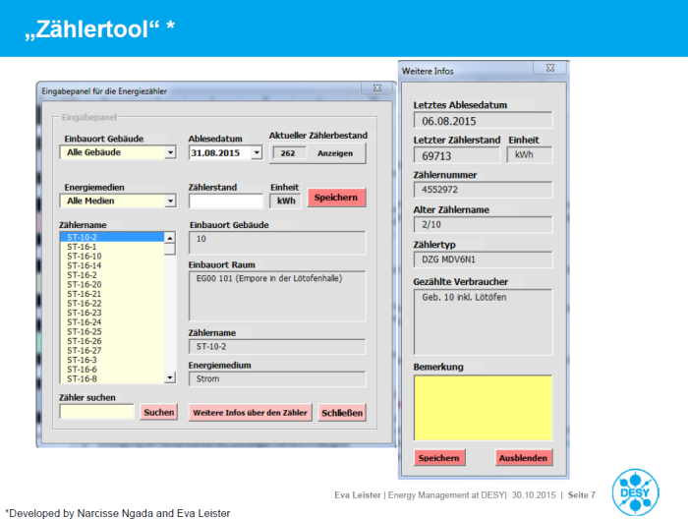
Eva Leister: DESY
Energy Metering/Monitoring
  have to know sub-consumptions to identify saving potential
  have ~10% energy consumption that is not asssigned to consumers
Improve existing old metering system, detailed metering of buildings and large facilities
  now 200 in place and plan for ~200 more
  install a “smart” metering system
New (ORACLE) database to centrally store data plus GUI tools, better data handling
Energy reporting tools
Plan for automated data acquisition

Slide 14
Eva Leister: DESY
new heat recovery system from cryogenic plant
  using oil loop of high pressure compressors - in operation early 2016
  Expected heat recovery: ~ 6800 MWh/a (1/3 of DESY heat consumption)
DESY will finish district cooling ring his year
  Four cooling plants feeding at T=8C
  providing more flexibility & redundancy and supply security at higher efficiency
Other measures/efficiency improvements:
  Direct rack cooling in computing center
  Further improvement in cooling systems
Work on long-term sustainable campus concept

Slide 15
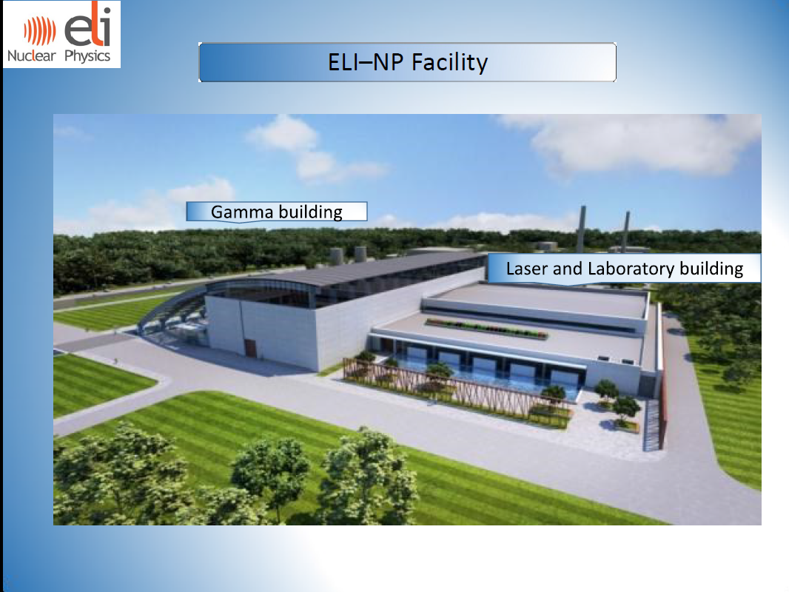
Razvan Bataiosu: geothermal use at ELI-NP
ELI-NP – one of the three pillars of the Extreme Light Infrastructure
  Wide range of science applications using high power lasers and brilliant gamma-rays
  in Bucharest- Magurele
  Co-financed by EU structural funds
Demands:
  Heating power: over 3,2 MW HVAC
  Cooling: 6 MW
  Electrical: ~10 MW

Slide 16
Razvan Bataiosu: geothermal use at ELI-NP
use so-called shallow geothermal heat/ground-coupled heat exchange
earth as a heat source (in the winter) or a heat sink (in the summer)
Temperature variations at certain depths depending on the season. At a depth of 10 m, undisturbed soil temperature is relatively constant at a value of 12.5º C, increasing by about 1º C every 10 m

Slide 17
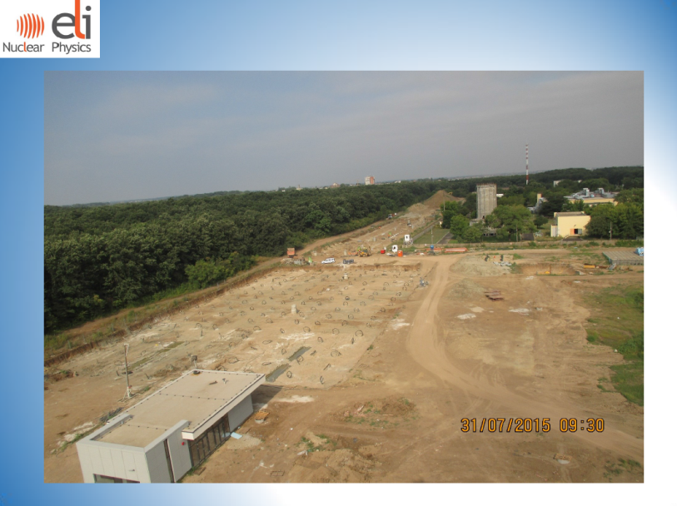
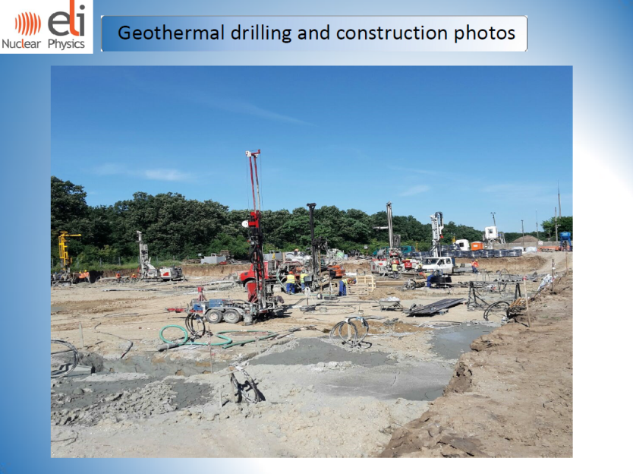
Razvan Bataiosu: geothermal use at ELI-NP
Vertical ground heat exchanger system as closed geo exchange circuit to capture heat from and/or dissipate heat to the ground
  1080 geothermal drillings at 125m depth
  Ground heat exchanger length: 135 km
  166 geothermal heat pumps
Largest project of its kind in Europe

Slide 18
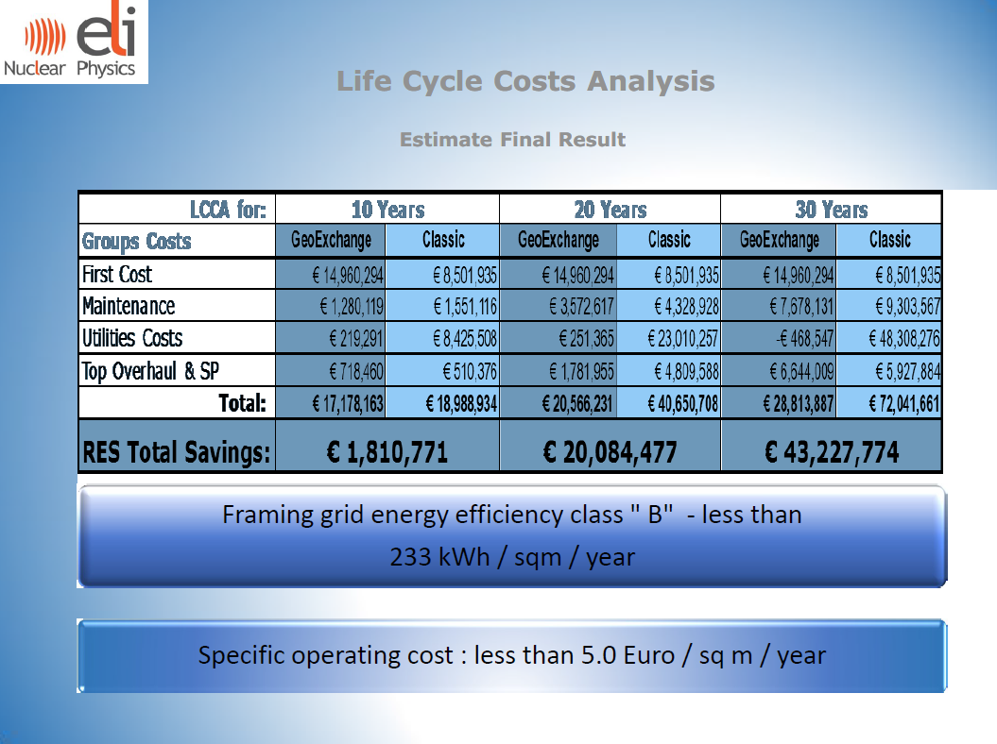
Razvan Bataiosu: geothermal use at ELI-NP
Iife Cycle analysis

