Slide 1
Definition der Anforderungen
Kabelpritschen und Verkabelung
Planung der weiteren Arbeiten
Notes:
Before you start editing the slides of your talk change to the Master Slide view:
Menu button “View”, Master, Slide Master:
Edit the following 2 items in the 1st slide:
1) 1st row in the violet header:
Delete the existent text and write the title of your talk into this text field
2) The 2 rows in the footer area: Delete the text and write the information
regarding your talk (same as on the Title Slide) into this text field.
If you want to use more partner logos position them left
beside the DESY logo in the footer area
Close Master View

Slide 2
Definition der Anforderungen
Strom
Unterverteiler, Elektrant, Schrank
Kabelpritschen und Verkabelung
Kabel und Stecker
Kabelarbeiten, Kabelkonfektionierung: MDI-Kapazitäten und Reihenfolge
Hohlleiter-Heizungskabel
Planung der weiteren Arbeiten
LLRF: Timing-signal, Master Oszillator XTIN/UG05
Vakuum: Verkabelung zum Injektor, Tech.Interlock
Personen Interlock / Not AUS
Wasser: Hohlleiter, Schränke
Nebellöschanlage
Notes:
Before you start editing the slides of your talk change to the Master Slide view:
Menu button “View”, Master, Slide Master:
Edit the following 2 items in the 1st slide:
1) 1st row in the violet header:
Delete the existent text and write the title of your talk into this text field
2) The 2 rows in the footer area: Delete the text and write the information
regarding your talk (same as on the Title Slide) into this text field.
If you want to use more partner logos position them left
beside the DESY logo in the footer area
Close Master View

Slide 3
Cold Magnet Power Cables
“some questions”
Feb. 13, 2015
H. Brueck
DESY, Hamburg, Germany
XFEL Project working group WP 11

Slide 4
General Info
Each cryo module is equipped with 3 magnets (1 quad, 2 correction dipoles)
In L1 all 3 magnets powered
In L2, L3 only 2 magnets
One rack with power supplies is used for a group of 4 modules
  Cables from this rack to the modules
    4 (6 for L1) up to 60m long
    10 or 16 mm²
    1 signal cable for potential wires
One box at each module, close to the current lead tower. Used to connect short cables (~3-4m) from the lead tower to the long cables from the Racks and to connect the potential wires
  The reason here is, the lead tower at the modules can hardly be accessed, because of the RF and other installations in front of it, see pictures at the end. Especially the protection cover is very difficult to dismount.
  Therefore we want to connect shorter cabled to the lead tower before the RF assembly already at AMTF.

Slide 5
Modules and Power Supply Racks

Slide 6
Questions to the Cabling
Responsible for cabling and racks is MKK (J. Eckoldt)
A meeting at L1 with some responsible persons showed many open questions
  Which cable tray is foreseen for the cables
    Main cable tray at the tunnel side or
    Cable tray, foreseen to be close to the modules, not yet existing
  How to cross the tunnel, if the main cable tray is used
  Conditions if the second cable tray can be used
  Where can the connection box be mounted to the module

Slide 7
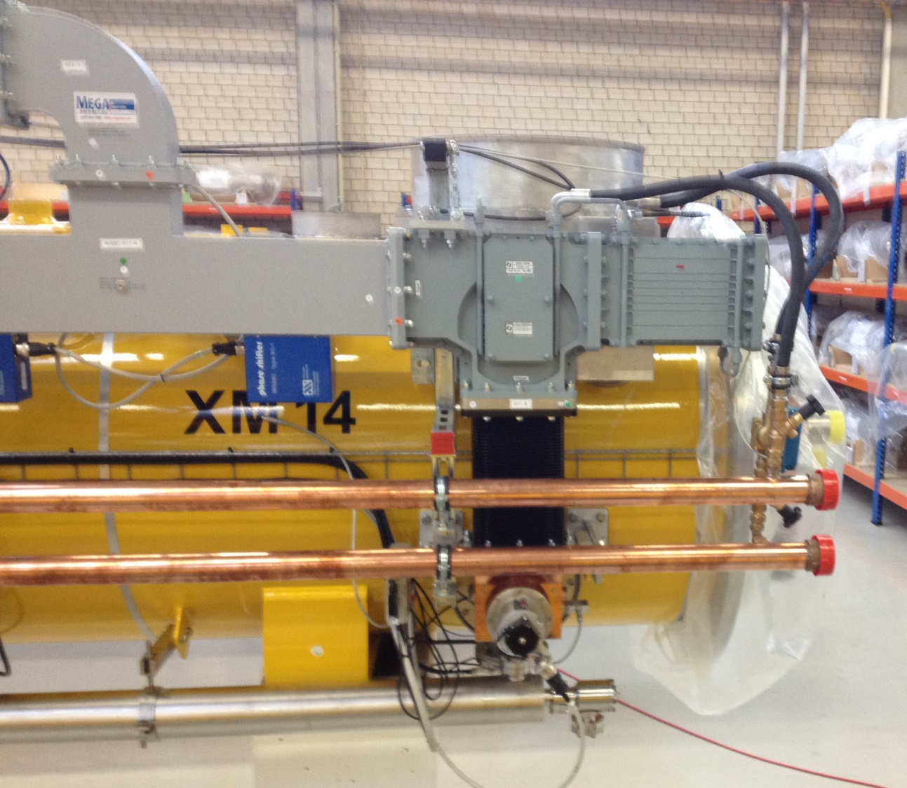
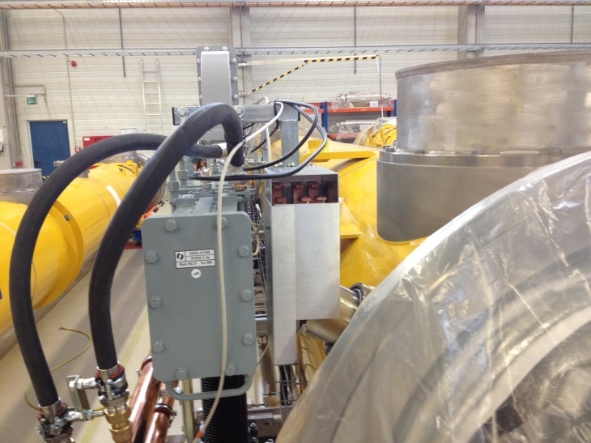
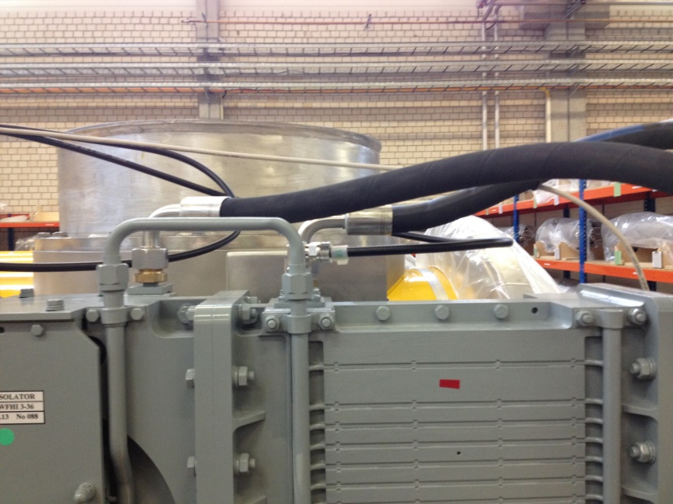
Box to connect the cables coming from the lead tower to the cables coming from the power supply, must be installed in AMTF already

Slide 8
Kabelpritschen und Verkabelung

Slide 9
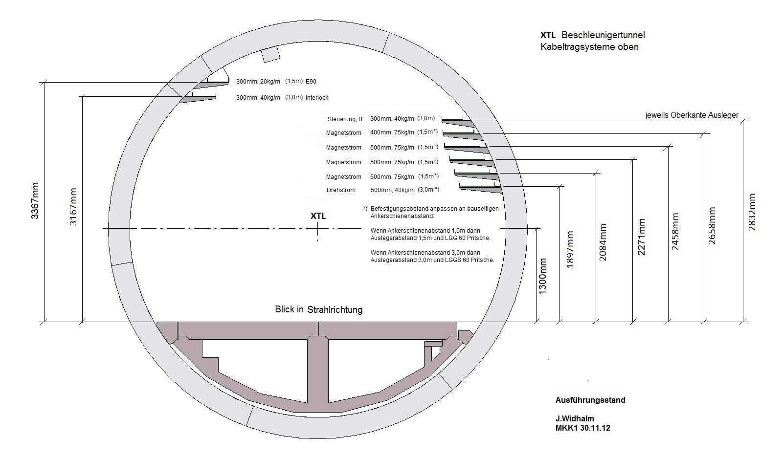
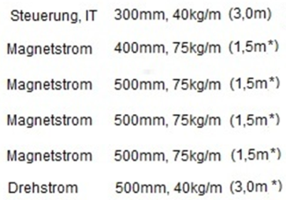
Kabeltragsystem

Slide 10
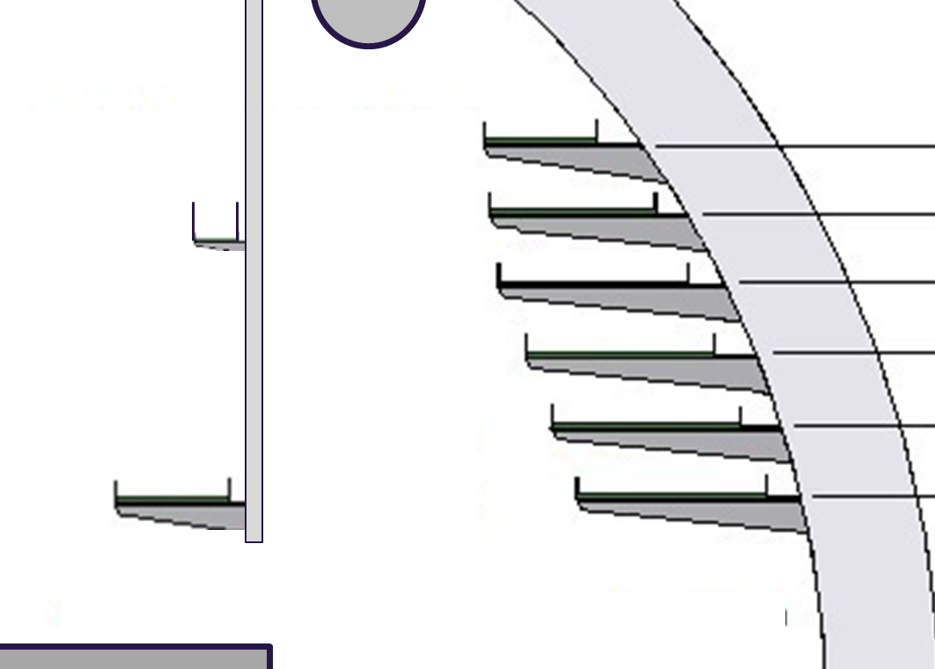
Kabeltragsystem
A
B

Slide 11
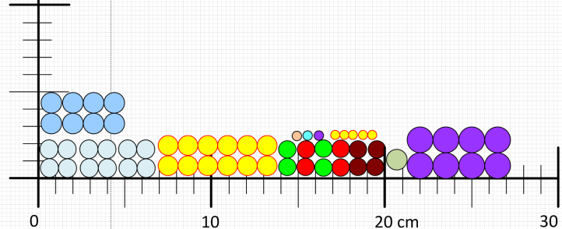
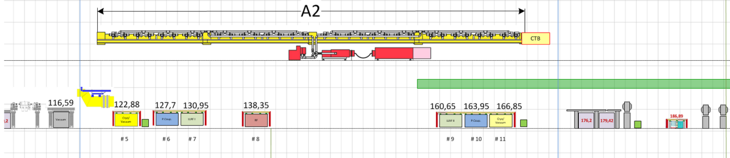
Kabeltragsystem
Cold Magnet Power Cables
Worst case

Slide 12
Kabelpritschen und Verkabelung

Slide 13
Kabelpritschen und Verkabelung

Slide 14
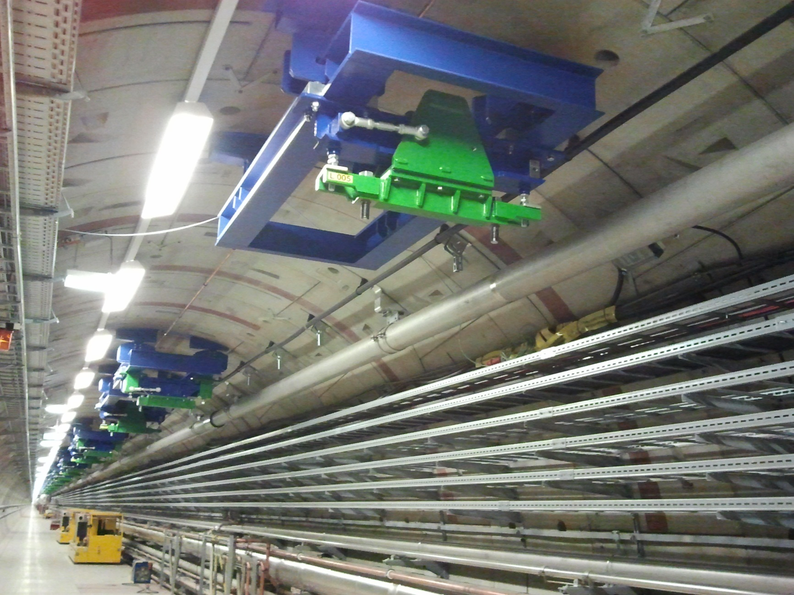
Kabelpritschen und Verkabelung

Slide 15
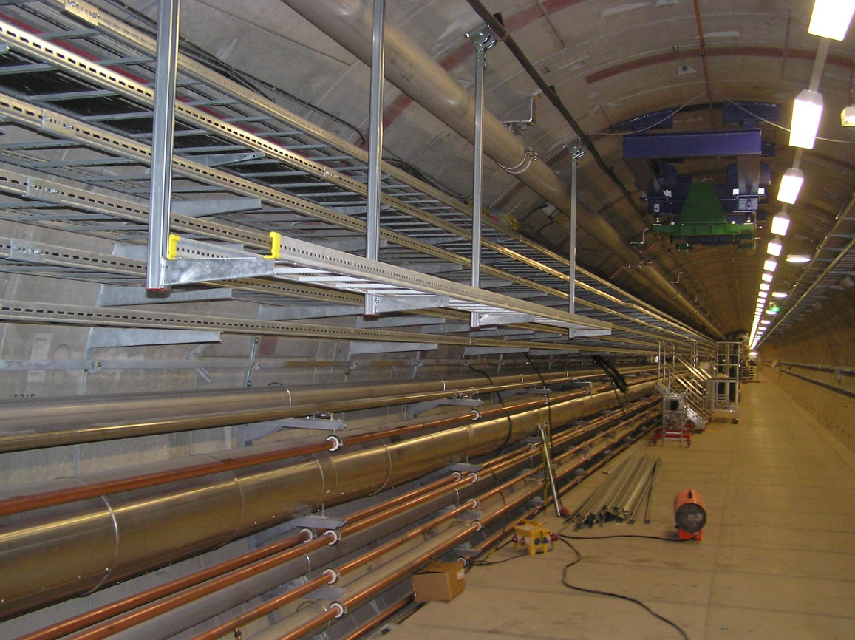
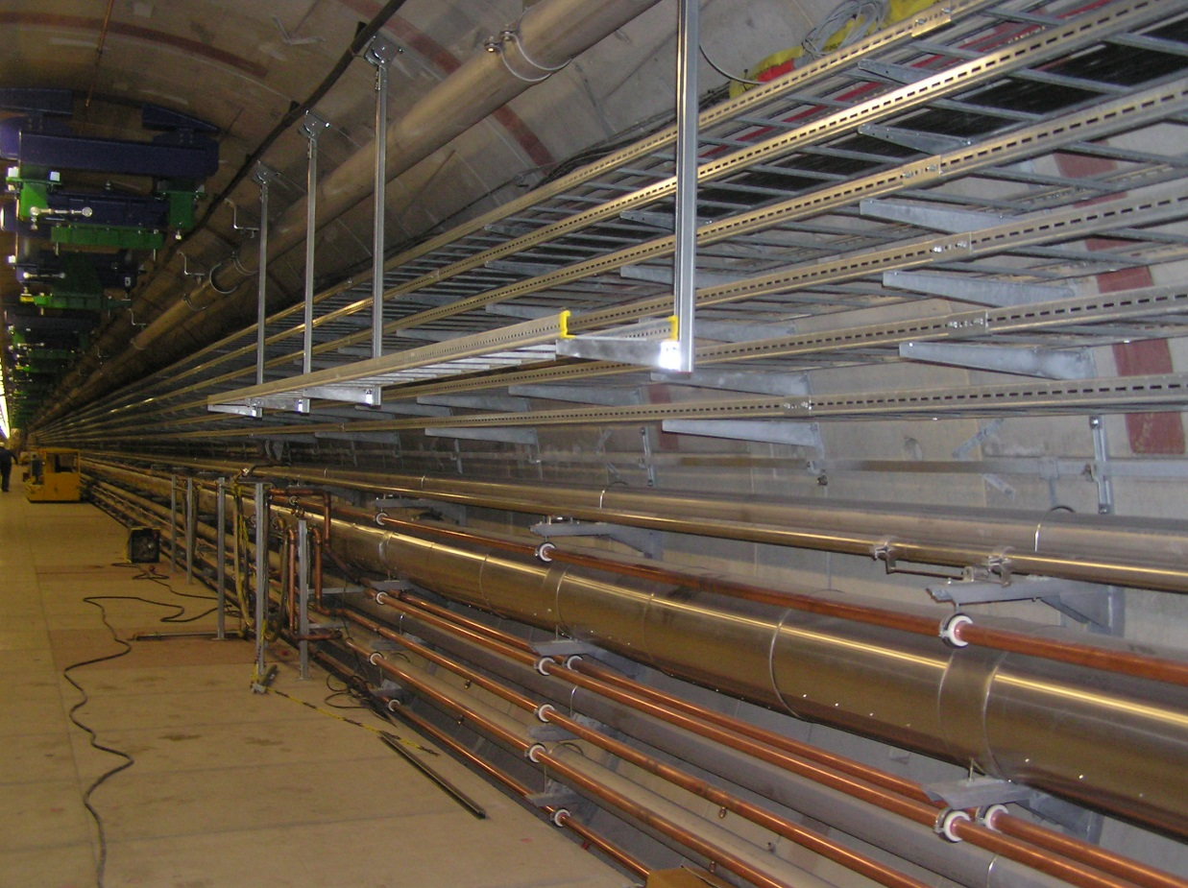
Kabelpritschen und Verkabelung

Slide 16
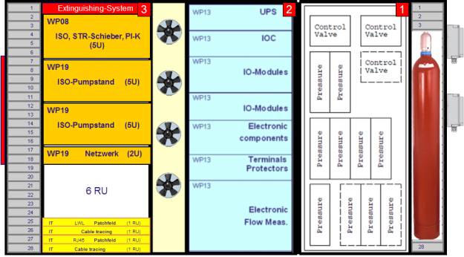
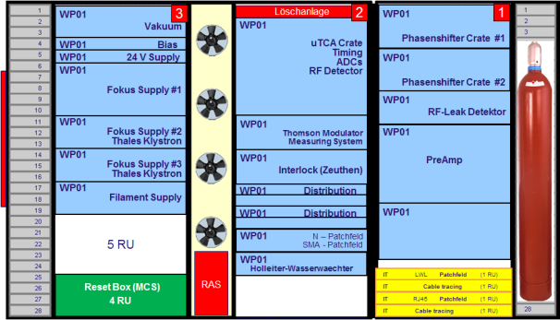
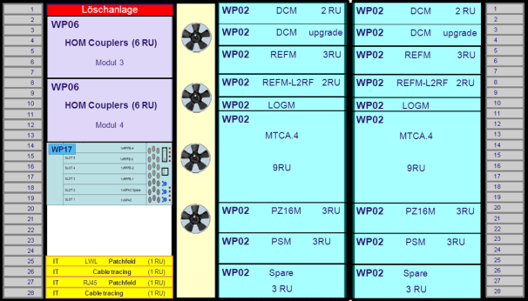
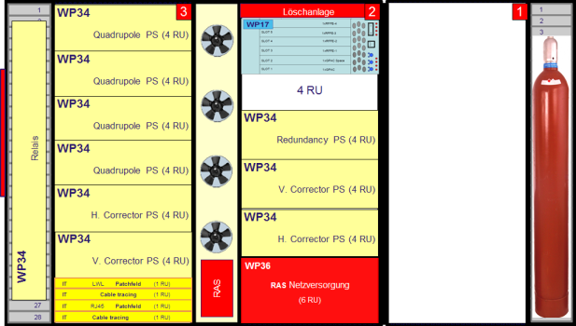
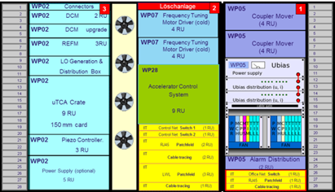
Definition der Anforderungen
RF
LLRF
Power Couplers
HOM Couplers
Diagnose
Spezial Diagnose
Vakuum
Kryo
Magnete
Dumps
IT, Strom, Wasser
Löschanlage

Slide 17
Lagerplatz in Elmshorn

