Slide 1
Status of test kit 3 March 2015
J. J. John with help from many others

Slide 2
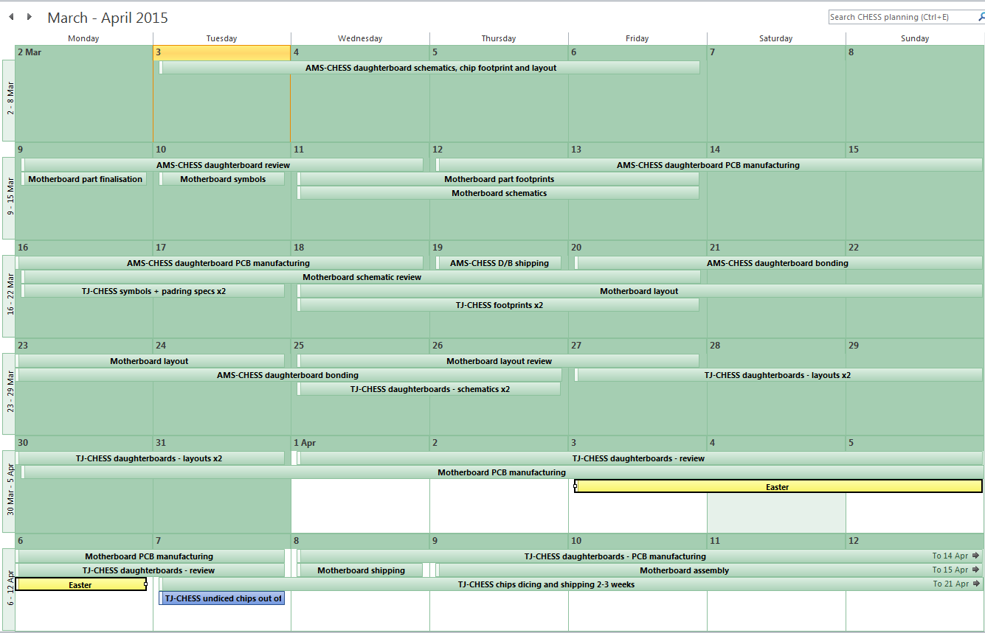
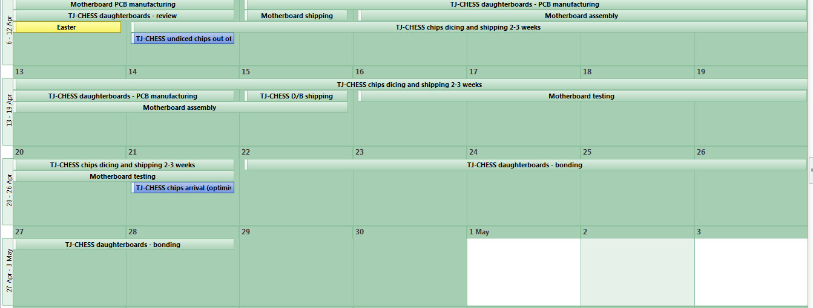
Draft schedule

Slide 3
CHESS-1 interface – pin arrangement motherboard – daughterboard connector
pin no. | Use on motherboard | pin no. | Use on AMS-CHESS-1 daughterboard | pin no. | Use on TJ-CHESS-1 daughterboards
1 | Ground | 1 | GND | 1 | GND
2 | VDD3V3 | 2 | VDD3V3 | 2 | VDD3V3
3 | VDD1V8 | 3 | (no connect) | 3 | VDD1V8
4 | Bias DAC 1 | 4 | Casc | 4 | Bias_GR1
5 | Bias DAC 2 | 5 | VPload | 5 | Bias_GR2
6 | Bias DAC 3 | 6 | iBias | 6 | vPreAmpCascN
7 | Bias DAC 4 | 7 | iFB | 7 | vShaperCascN
8 | Bias DAC 5 | 8 | iNSF | 8 | iBias_SF
9 | Bias DAC 6 | 9 | iN | 9 | iBiasPreAmp
10 | Bias DAC 7 | 10 | (no connect) | 10 | iBiasShaper
11 | Ground | 11 | GND | 11 | GND
12 | High voltage / substrate bias | 12 | HV sub | 12 | SUB
13 | Ground | 13 | GND | 13 | GND
14 - 94 | Analogue output lines (81) | 14 - 85 | Active array pixel outputs (72) | 14 - 94 | Analogue outputs (81)
 |  | 86 - 92 | Outputs of isolated fast amplifiers (7) |  | - identity depends on wire-bonding
 |  | 93 - 94 | (no connect)
95 | Common analogue input to amplifiers | 95 | Common input to amplifiers | 95 | Common input to amplifiers
96 | Ground | 96 | GND | 96 | GND
97 | Digital input to pixels | 97 | (no connect) | 97 | preRstInt_in
98 - 99 | Daughterboard flavour pins | 98 - 99 | "01" | 98 - 99 | "10" PonN or "11" PonP
 | (fixed "outputs" of daughterboards)
100 | spare for future | 100 | (no connect) | 100 | (no connect)
100 | Total pins allocated | 94 | Total pins used for AMS-CHESS | 99 | Total pins used for TJ-CHESS
Allocation of different signal/bias types on connector
Signal use on AMS-CHESS daughterboard
Signal use on TJ-CHESS daughterboards

