Slide 1

RBI:
Present,
Short term future,
Long term future
T. Anticic director
Sep 2015

Slide 2
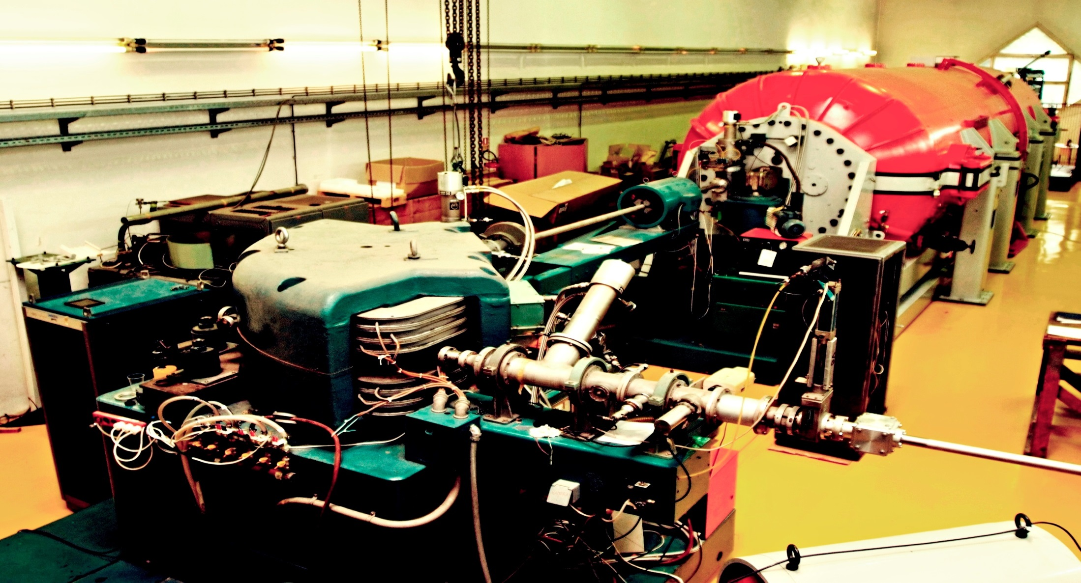

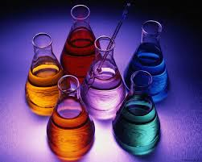
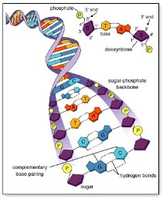


PHYSICS
CHEMISTRY
LIFE SCIENCES
ENVIRONMENT
ICT
Rudjer Boskovic Institute (RBI) – largest Croatian institute
MULTIDISCIPLINARY science institute
130,000 m² area
82 research laboratories
14 research divisions
850 EMPLOYEES
OVER 500 RESEARCHERS AND SCIENTISTS
(6% of Croatian scientists)
SESSION 7
Financing challenges, possibilities and synergies between financing instruments
09.22.2015

Slide 3
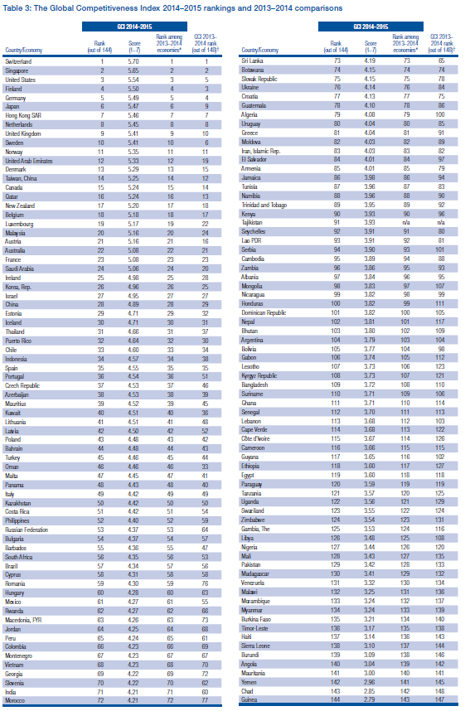
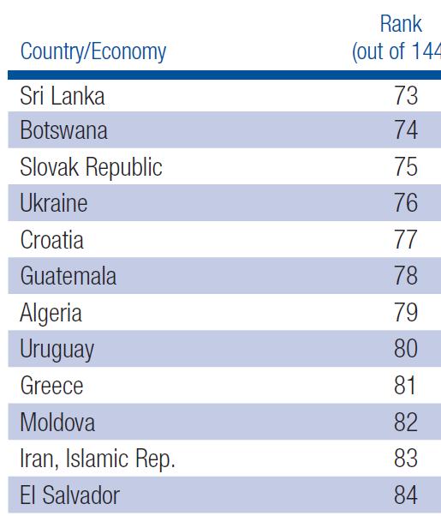
The world will likely change more in the next few decades than it has in the past several hundred years
Global Competitiveness Index 2014-2015 Rankings
Urgent and radical measures needed if one wants to avoid irrelevance
Notes:
Ima ideje kako dramatično podići komeptitvnost u znanosti, sa istim ulaganjem, ali to nije tema danas

Slide 4




RBI has a long-term strategy, and is implementing it - culmination of the process right now
Structural
funds
Statut
Ustroj
2015
Encouraged
applications to
Horizon 2020 and
other external
projects
International
projects
criteria for getting
leadership
positions
Prostor
Oprema
Laboratoriji
Sadašnjost i budućnost
IRB-a
International
excellence
criteria
for hiring and
promotion
Encourage
cooperation with
industry:
patents,
leadership
positions
Napredovanje
Intelektualno vl.
Ustroj radnih mj.
Evaluacija/
restrukturiranje
laboratorija i zavoda
Informatisation,
Simplification of
administrative
procedures
mobility and
new staff/
Brain gain
focus
Open
Infrastructure,
Flexibility of
space and
structure

Slide 5
The policy already producing results
Possibly a significant increase by the end of 2015:
Centres of excellence
Contres of competence
Horizon 2020
Within past year two new ERC-s (Croatia has a total of 4), both expats
Croatian projects
10
5
0
FP7/Horizon 2020
Other Croatian scientific institutions
RBI
New projects, millions of Euros
2010
2011
2012
2013
2014
2015
Percentage of Horizon2020 funding for all Croatian scientific institutions

Slide 6
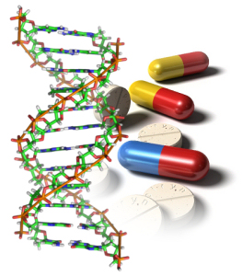
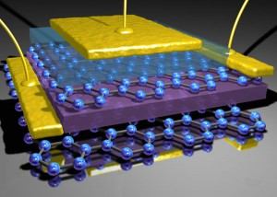
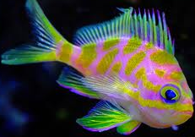

Open Scientific Infrastructural Platform For Innovative Applications in The Economy And Society: O-ZIP
60 million Euro project that will enable the Croatian industry to be based on science and innovation
Part of the Operational programme
2014 - 2020
BIOMEDICINE
ADVANCED MATERIALS
ENVIRONMENT AND SEA
ICT
Basis for a huge brain gain to RBI and all of Croatia

Slide 7
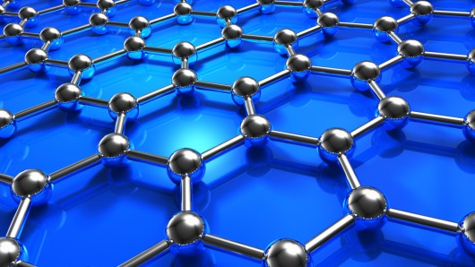
Centres of Excellence - Croatia has 4 such Centres
one of them is lead by RBI (jointly with Institute for Physics): Center of excellence for advanced materials and sensors
RBI part of two more, and negotiations are underway for RBI become part of the fourth Centre of Excellence in Croatia.
Only center of excellence in Croatia in fundamental sciences
Expect about 5 million Euros
a) photonics and quantum optics,
b) graphene and related 2D structures
c) new functional materials
d) ion beam physics
SESSION 7
Financing challenges, possibilities and synergies between financing instruments
09.22.2015

Slide 8
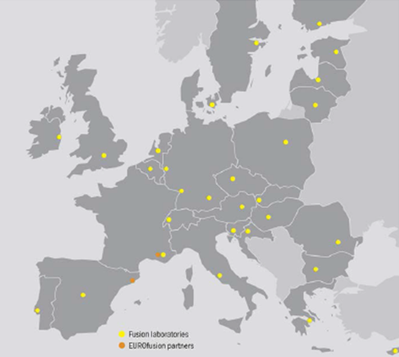
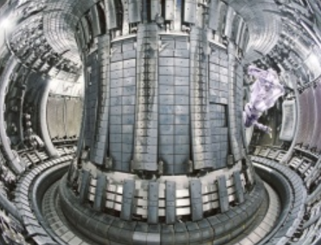


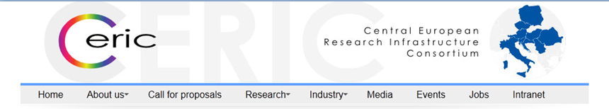

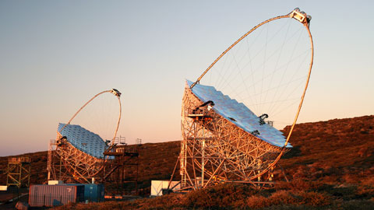
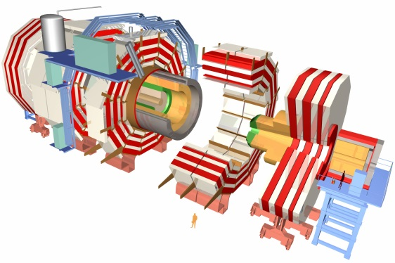
Active in physics related large collaborations
SESSION 7
Financing challenges, possibilities and synergies between financing instruments
09.22.2015

Slide 9

RBI well on its way to significantly increase its world-wide research impact
Strategic partnerships outside Croatia
Brain gain from Croatian expatriates
Influx of top scientists from region
In 10- 20 years: on a competitive footing with top 50 world science institutions, with a significant amount of funding from industry

