Slide 1
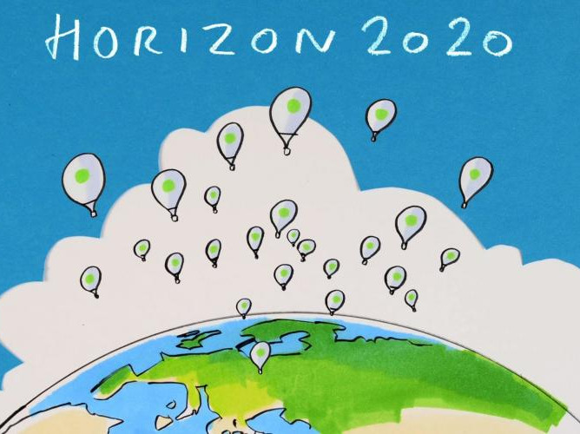

Slide 2
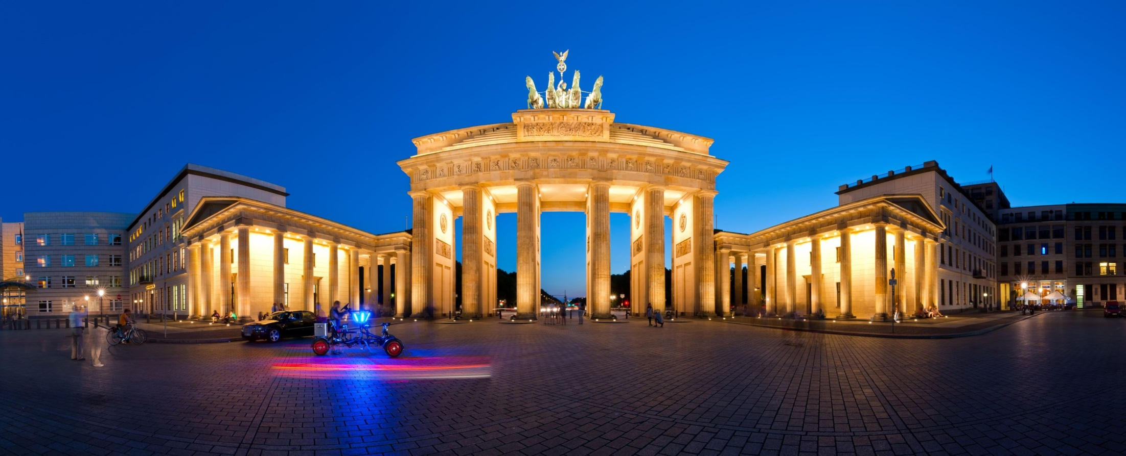

November 2013, DESY/Zeuthen
APPEC
Einstein Telescope, …
February 2014, Paris
APPEC
Underground labs, …

Slide 3

APPEC, 29-30 September 2015, Zagreb
Analyse and discuss the experience of the first two years of Horizon 2020 and give advice on how to prepare successful proposals in future calls.
Inform about the upcoming funding opportunities and support the community in preparing their proposals for the calls.
Prepare with the community astroparticle infrastructure related activities and collaborative actions to be discussed with the European Commission as topics of future work programs (2019 and beyond).

Slide 4
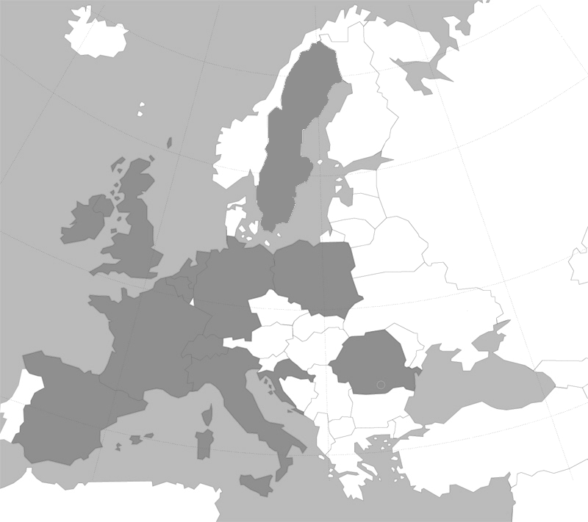

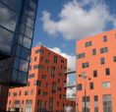
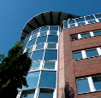
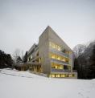
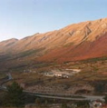
APPEC organisation
APPEC
functional centers
AstroParticle Physics European Consortium
STFC - UK
DESY - Hamburg/D
Outreach
Management, Computing & Industry
APC - Paris/F
Roadmapping, Common Calls, Interdisciplinary
LSC - Canfranc/S
Web pages
LNGS - L'Aquila/I
Networking, Theory, Graduate Schools

Slide 5
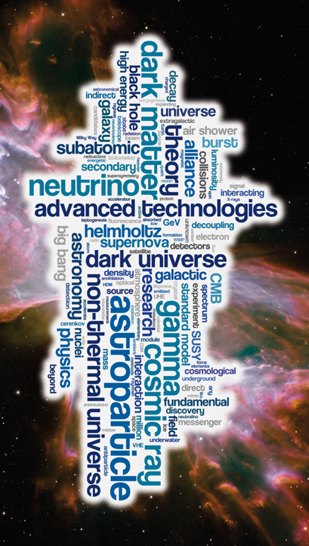
APPEC finances
70-80 k€/year …
+ manpower
€
The good news:
EU-FAs spending ∼70 M€/yr
The “bad” news:
We (=you) want more

Slide 6
APPEC impact …
Direct investment subsidies: none, sorry
Nevertheless: APPEC members represent or
have access to national funding agencies
Indirect support:
  Roadmapping (in my opinion: very important … if done right)
  Inter-agency discussions on investment funding (roadmap)
  APPEC common calls i.e. people
  Workshops aimed at funding opportunities (e.g. H2020)
  Support letters
Collaboration & inter-agency discussions become essential once investments needs exceed 10-20 M€
  Collaboration size: sets scale of overall annual investment
Suggestions to improve APPEC operations are welcome

Slide 7
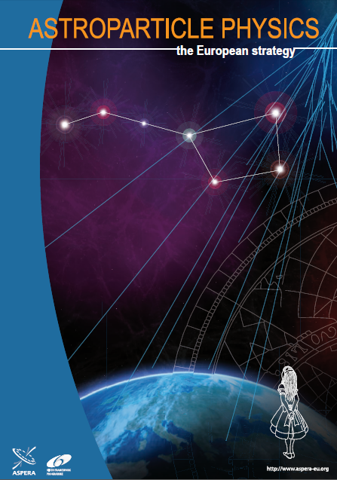
APPEC roadmapping
2008

Slide 8
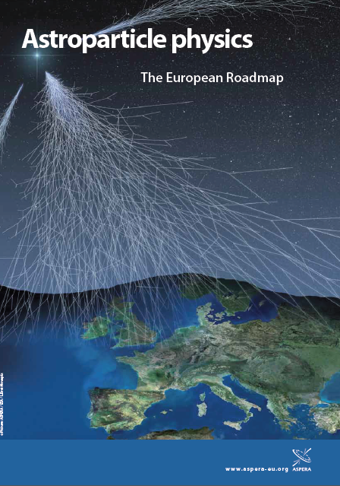
APPEC roadmapping
2008
2011

Slide 9
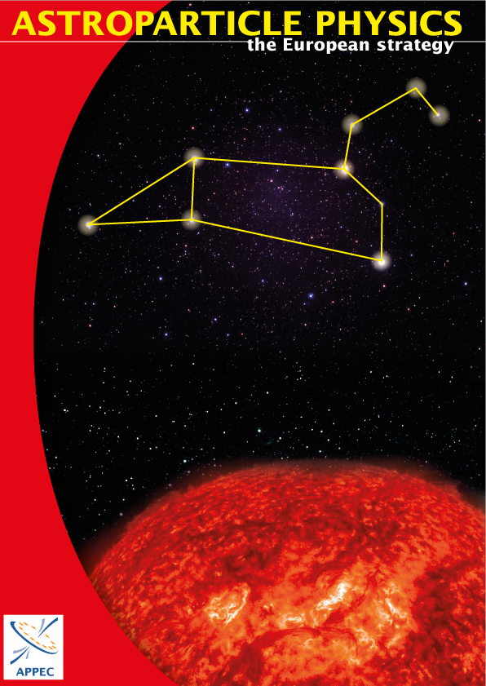
APPEC roadmapping
2008
2011
2016?

Slide 10
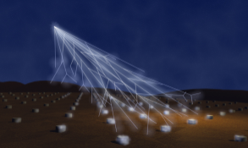
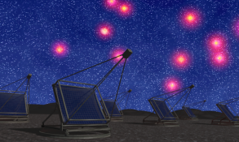

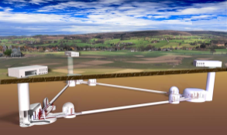
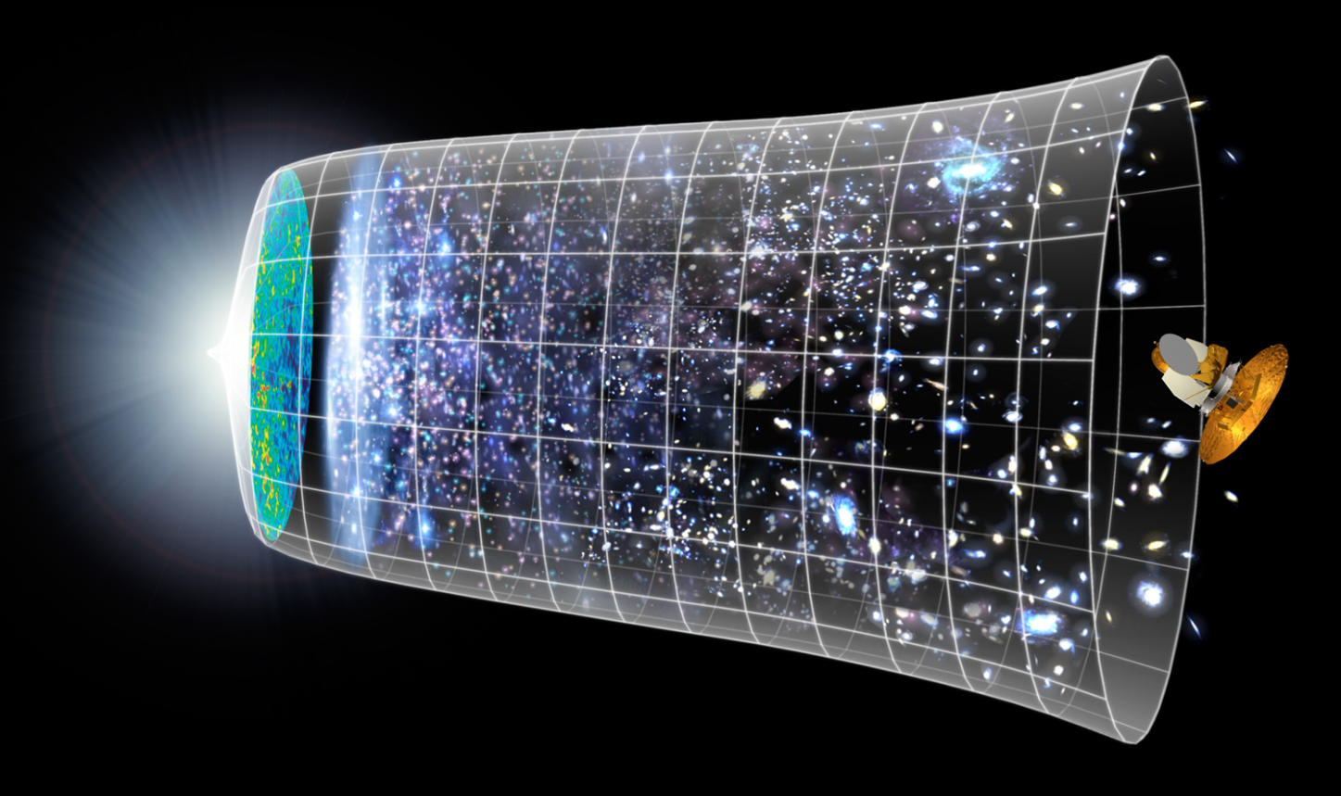
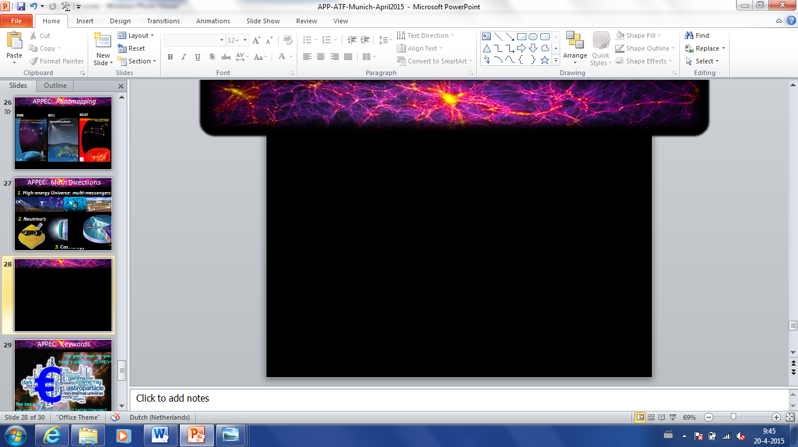
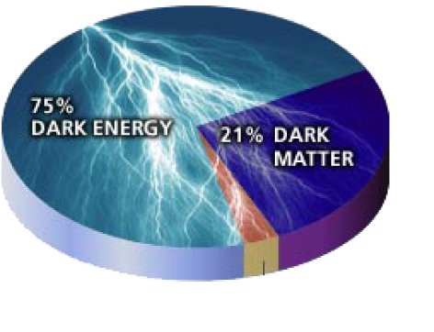

APPEC research themes
1. High-energy Universe: multi-messengers
CR
γ
ν
GW
2. Neutrino’s
CMB
3. Cosmology

Slide 11
APPEC roadmap: contents/timeline
SEP
Executive summary
Introduction
Research themes (3)
Theory, R&D, Computing
EU APP community
Global aspects
Societal relevance
Inter-disciplinary aspects
Organizational aspects
Recommendations
2015
OCT
NOV
draft roadmap
DEC
SAC & APPEC-GA
JAN
FEB
MAR
2016
APR
town meeting
MAY
anyone interested
=you!
JUN
JUL
→final roadmap
AUG
SEP
roadmap
……
2017
implementation!

Slide 12
As important as the research themes
Theory
EUTHECA theory postdoc network, …
Computing
white paper, EU-T0/APPEC workshop early 2016?, …
Detector R&D
FET-OPEN proposal(s), …
Industry/Societal relevance
muon tomography? multi-sensor networks, …
Outreach:
cosmic rays @ (high) schools (EUROCOSMICS), …

Slide 13
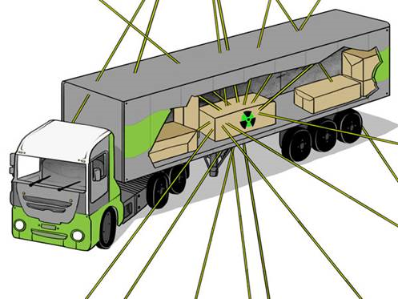
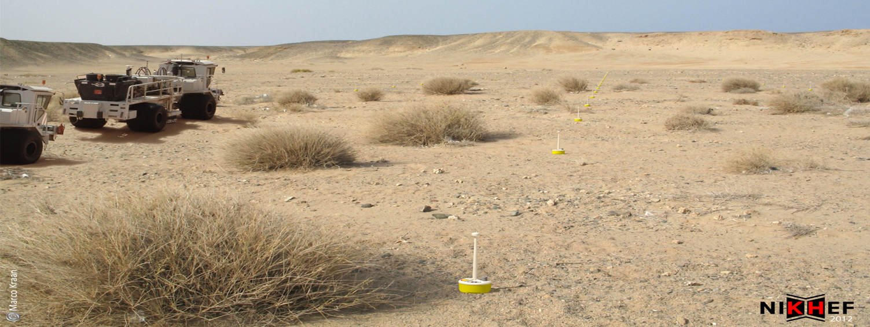
Muon tomography:
Homeland security
Volcanic plumes
Steel burning furnaces
…
Sensor networks:
Oil exploration
Perimeter security
Earth quake monitoring
….

Slide 14
Equally important as research themes
Theory
EUTHECA theory postdoc network aplpication, …
Detector R&D
FET-OPEN proposal(s), ATTRACT, …
Computing
white paper, EU-T0/APPEC workshop early 2016, …
Industry/Societal relevance
muon tomography? multi-sensor networks, …
Outreach:
cosmic rays @ (high) schools (EUROCOSMICS), …

Slide 15
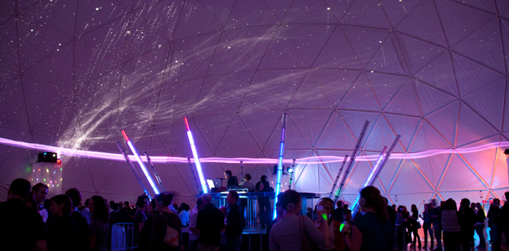
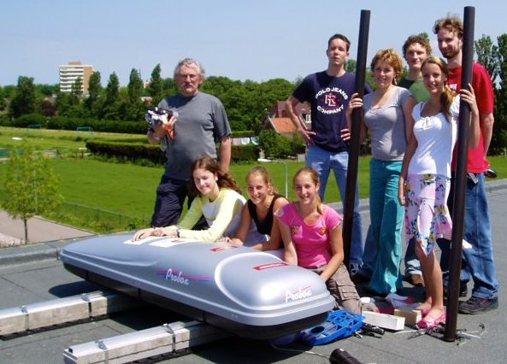
“Cosmic sensation”:
cosmic-ray driven
dance event
High-school curriculum:
cosmic-ray showers
(muon) lifetime
speed of light & of muons
…
EUROCOSMICS (IPPOG?)

Slide 16

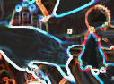
My goals:
Find matches
Forge consortia
Attract EU €’s!
→ Boost astroparticle
physics

