Slide 1
APPEC Horizon 2020 Workshop
September 29/30, 2015 - Zagreb

Slide 2
APPEC Horizon 2020 Workshop – Zagreb 2015
Is a continuation of a series of APPEC workshops
What to achieve with this meeting:
Analyse and discuss the experience of the first two years of Horizon 2020 (2014/15) and give advice on how to prepare successful proposals in future calls.
Inform about the upcoming funding opportunities (2016/17) and support the community in preparing their proposals for the calls.
Prepare with the community astroparticle infrastructure related activities and collaborative actions to be discussed with the European Commission as topics of future work programs (2018 and beyond).

Slide 3
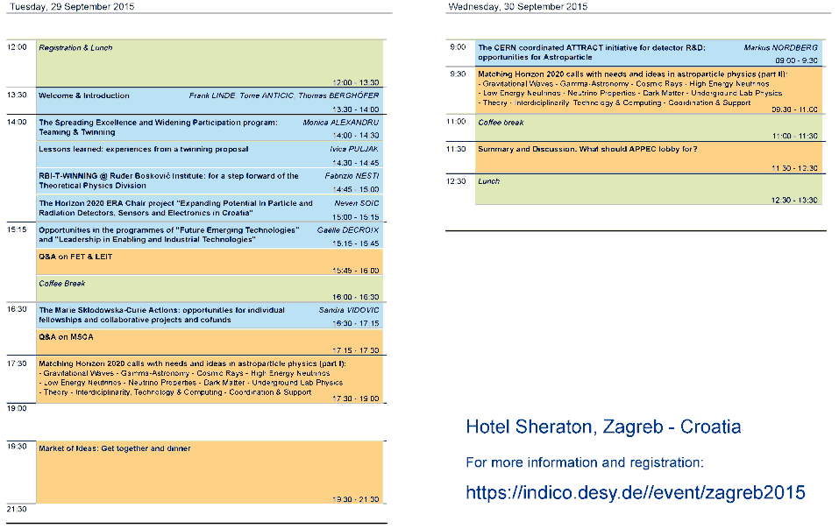

Slide 4
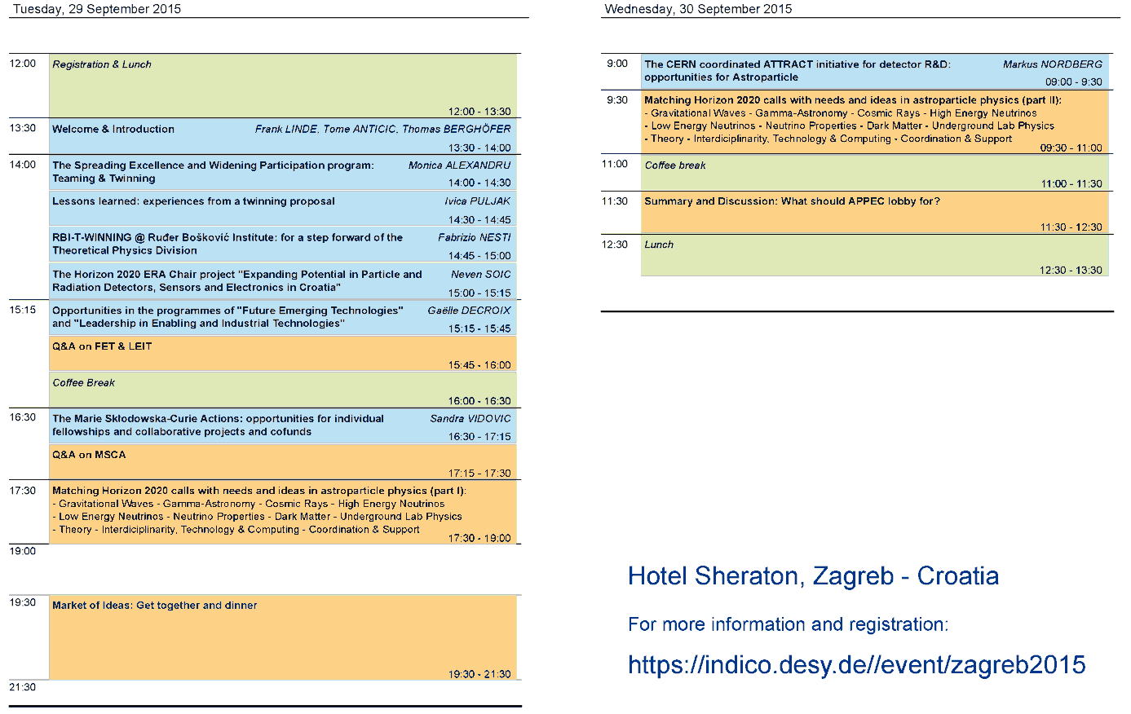

Slide 5


Slide 6
APPEC Horizon 2020 Workshop – Zagreb 2015
Thanks for your intention
and
let us have a productive meeting!

