Slide 1
Study of Surface Conditions due to Fixed Oxide Charge Between N-wells
J. Segal
March 5, 2015

Slide 2
Simulation Parameters
Simulated surface between n-wells for nominal n-well spacing of 40um
0V to 120V bias
22ohm-cm, 130ohm-cm and 1000ohm-cm substrate
Surface charge:
2e10/cm2, 4e10/cm2, 1e11/cm2 (un-irradiated silicon should have 1e10-1e11, 1e11 is worst case)
1e12/cm2 estimated surface charge after irradiation

Slide 3
Conclusion
For 22 ohm-cm and 130 ohm-cm substrate:
1e11 surface charge has no inversion layer for >= 24V bias. 1e12 results in inversion layer even at 120V
2e10, 4e10 negligible inversion layer @0V bias
For 1000 ohm-cm, both 1e11 and 1e12 surface charge cause in inversion layer even at 120V

Slide 4
22ohm-cm Substrate
1e11 0V
1e11 24V – No inversion layer
1e11 60V – No inversion layer
1e12 0V
1e12 24V
1e12 60V
1e12 96V
1e12 120V
Its hard to see in this picture, but even at 120V there is still an inversion layer for the 1e12 case

Slide 5
22 ohm-cm Inversion layer: Electron Density Cross section through center of plots shown on previous page
Zero bias, 1e11 and 1e12 surface charge
Both 1e11 and 1e12 surface charge gives inversion layer at Zero bias, but for 1e12 there is still an inversion layer at 120V
1e12 surface charge for 24V, 60V, 96V, and 120V

Slide 6
22ohm-cm Substrate: 2e10 and 4e10 Surface charge, 0V
Negligible inversion layer (4e10 results in 7 orders of magnitude less electron density than 1e11)

Slide 7
130 ohm-cm Substrate
1e11 0V
1e11 24V – No inversion layer
1e11 60V – No inversion layer
1e12 0V
1e12 24V
1e12 60V
1e12 96V
1e12 120V
Similar to 22ohm-cm, but inversion layer is more obvious at 120V for 1e12
Surface charge

Slide 8
130ohm-cm substrate: Results similar to 22ohm-cm case but higher electron density
Zero bias, 1e11 and 1e12 surface charge
1e12 surface charge for 24V, 60V, 96V, and 120V

Slide 9
130ohm-cm substrate: Plot Electro-static potential instead of electron density
1e11 0V
1e11 24V – No inversion layer
1e11 60V – No inversion layer
1e12 0V
1e12 24V
1e12 60V
1e12 96V
1e12 120V
This is another way of looking at the inversion layer, could also think of its as lack of potential barrier

Slide 10
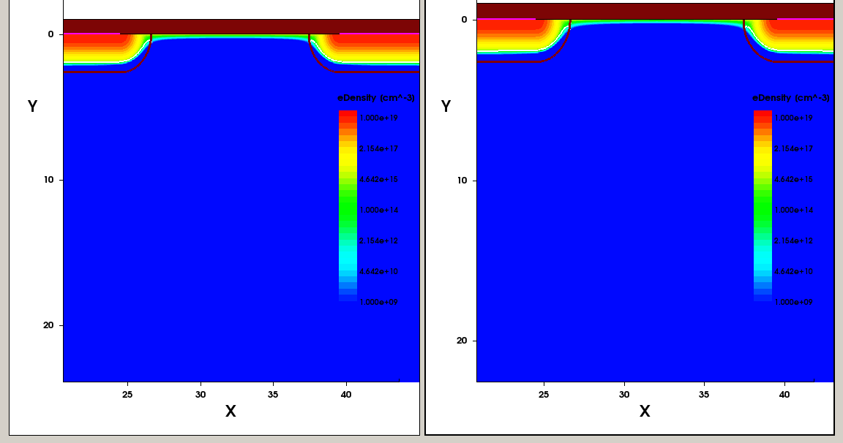
1000 ohm-cm substrate
Both 1e11 and 1e12 surface charge gives inversion layer at 120V bias
1e12 120V
1e11 120V

Slide 11
1000 ohm-cm substrate: Electro-static potential
1e12 120V
1e11 120V

Slide 12
Inter-pixel Resistance from Electron Charge density in Simulation
This value verified with IV simulation

