Slide 1
N-well Corner/Edge Electric Field Simulation
March 5, 2015
J. Segal

Slide 2
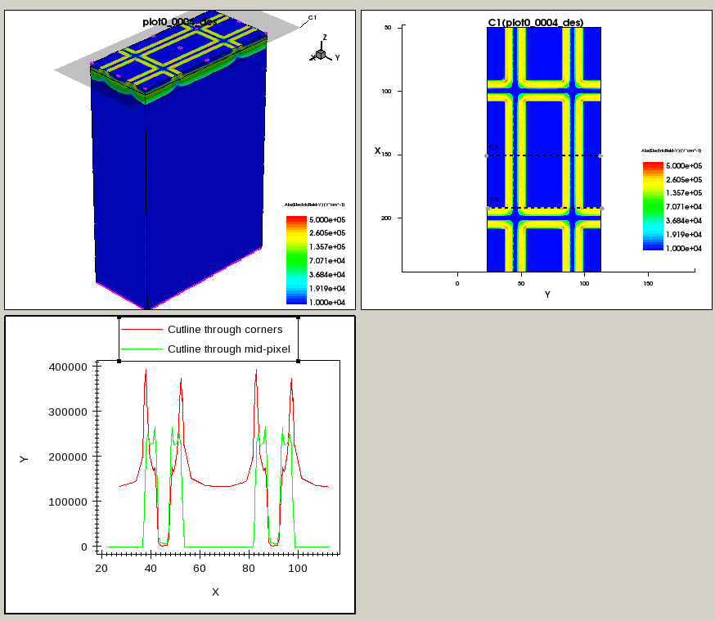
“Baseline” AMS35 High Voltage Process: best guess at what we have in test chip
22 ohm-cm substrate
120V Substrate Bias
N-well corners are “drawn” as right angles
  “Rounding” effect is due to well implant diffusion
Peak field in corner ~4e5V/cm, peak field at edge ~2.5e5V/cm
  Corner rounding would reduce peak field

Slide 3
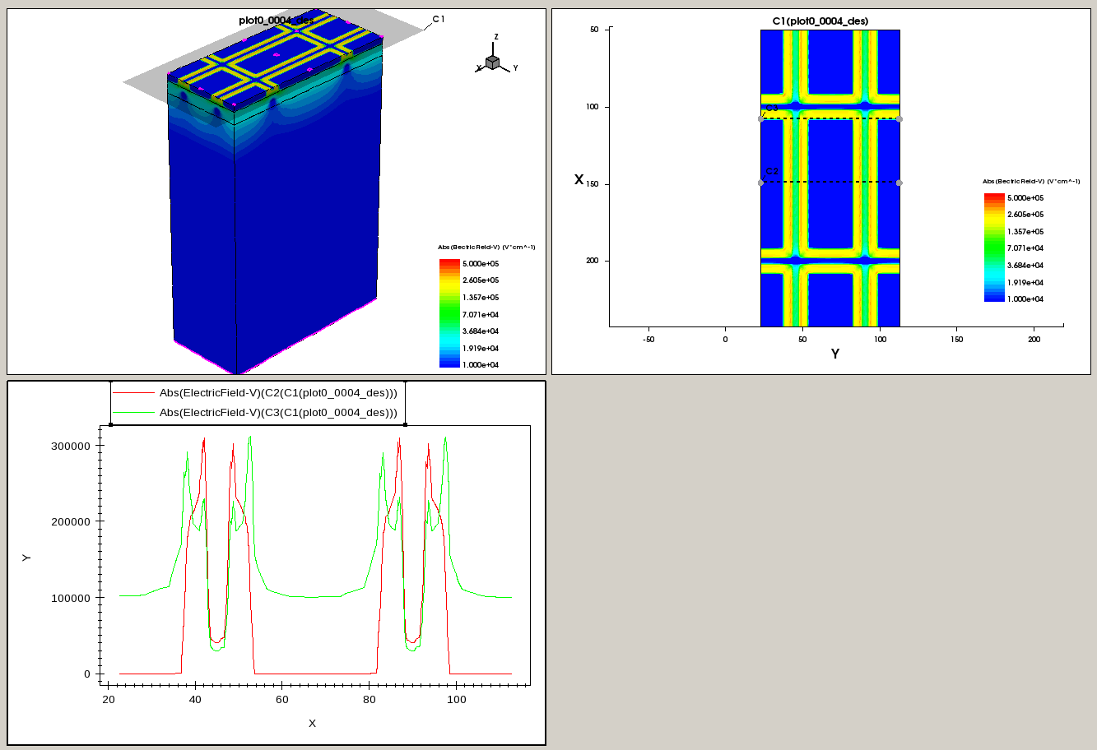
Same as previous, but 1000 ohm-cm substrate
Higher resistivity gives lower peak field
In this case, the peak field location is “pushed-out” to the guard ring edge, so corners are no longer highest
  No benefit of corner rounding in this case
Peak field ~3e5 V/cm

