Slide 1
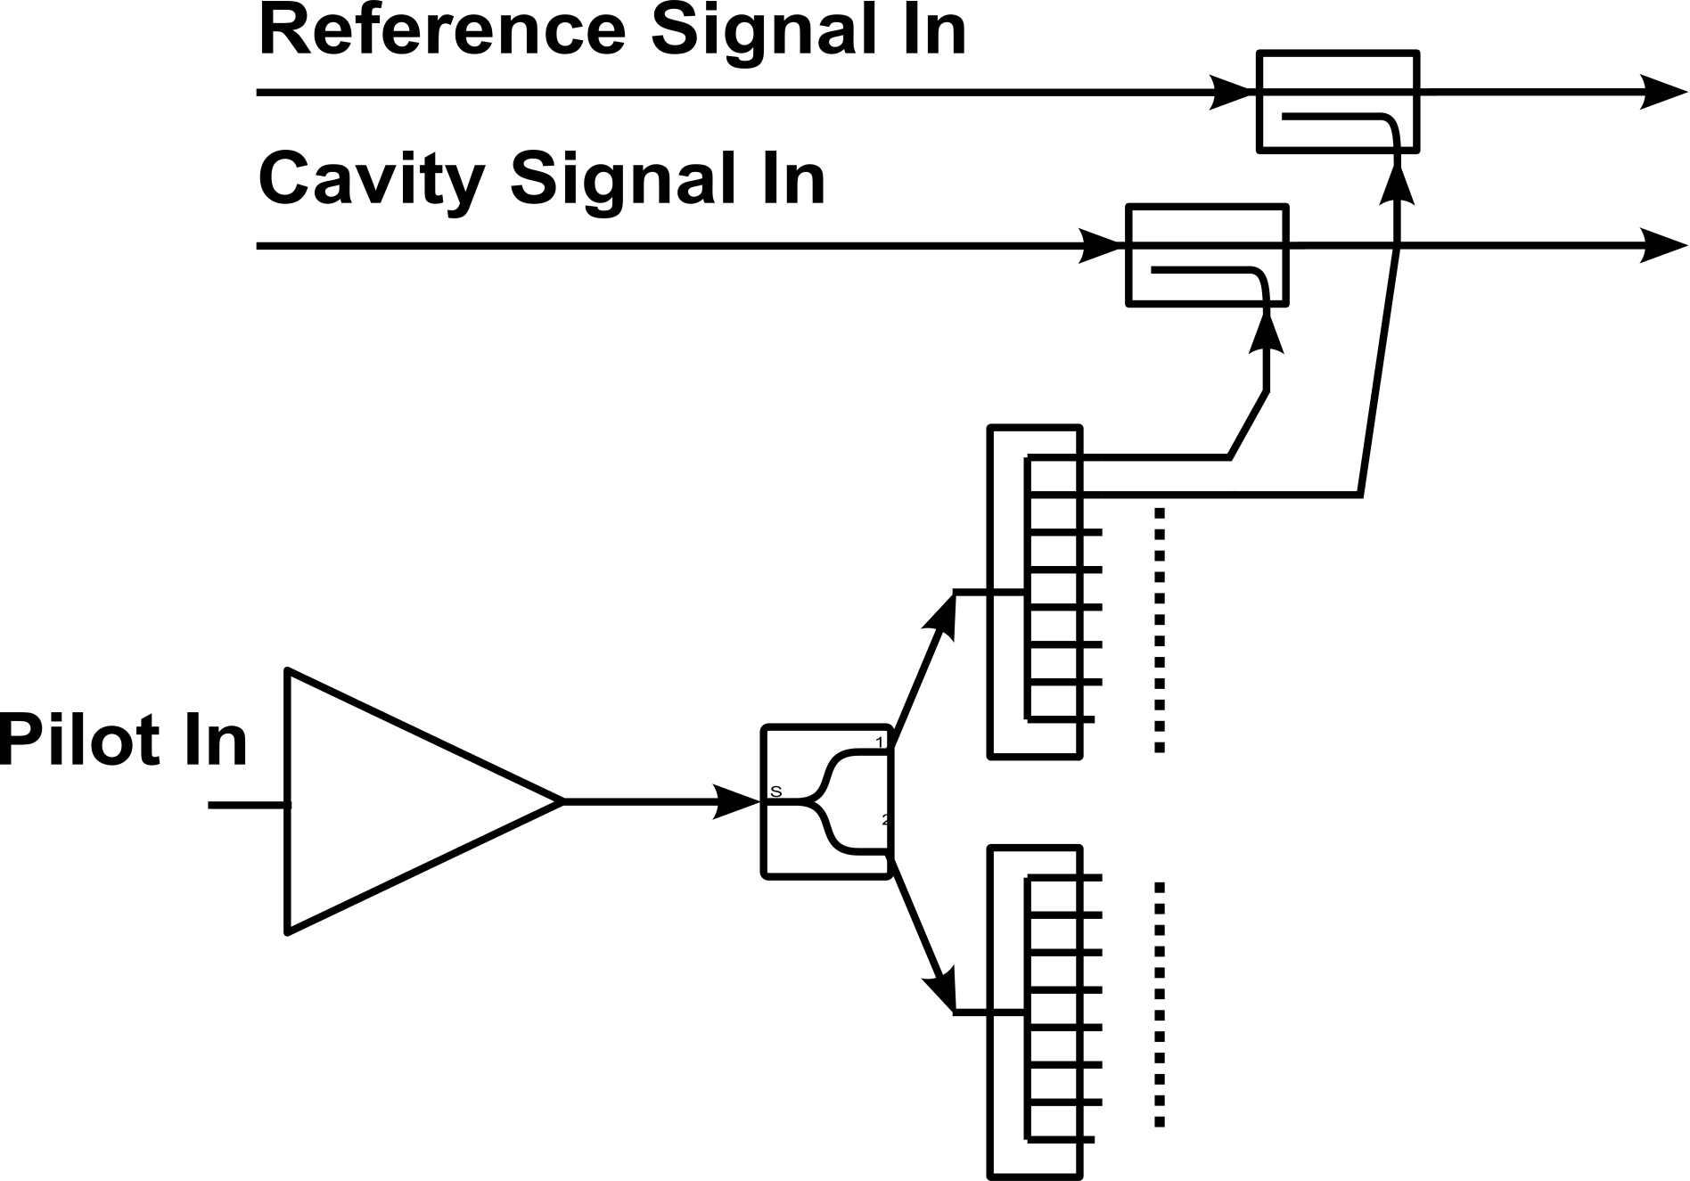
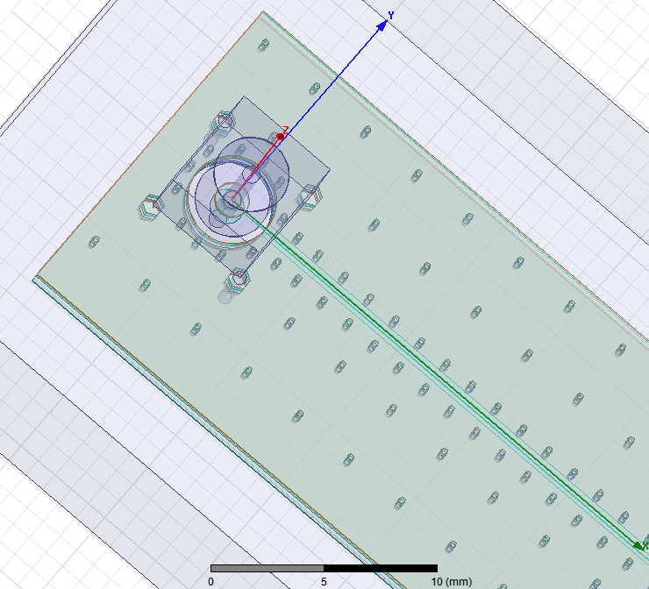
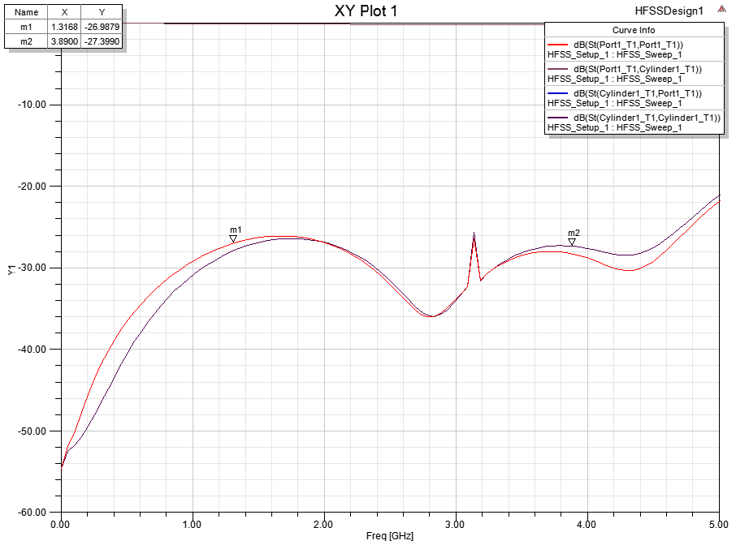
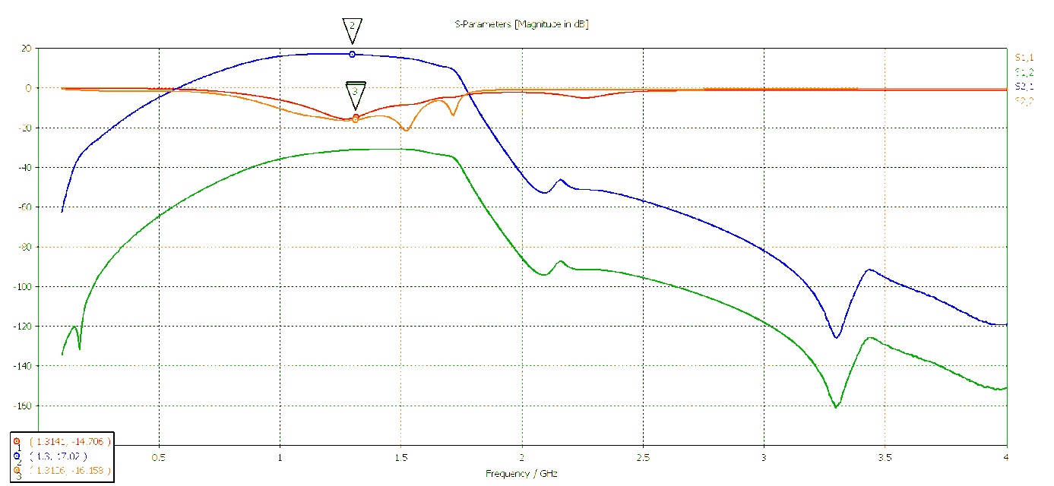
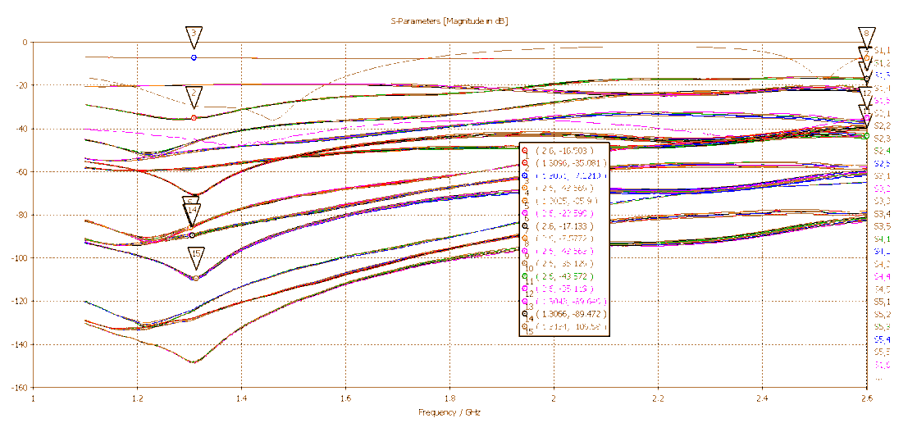
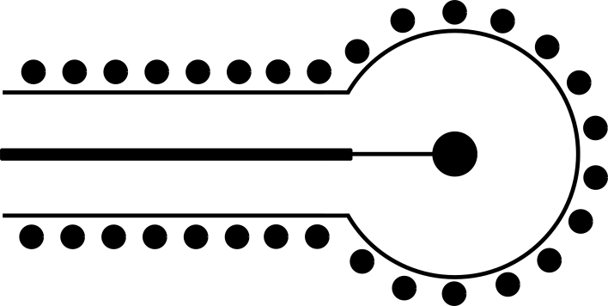
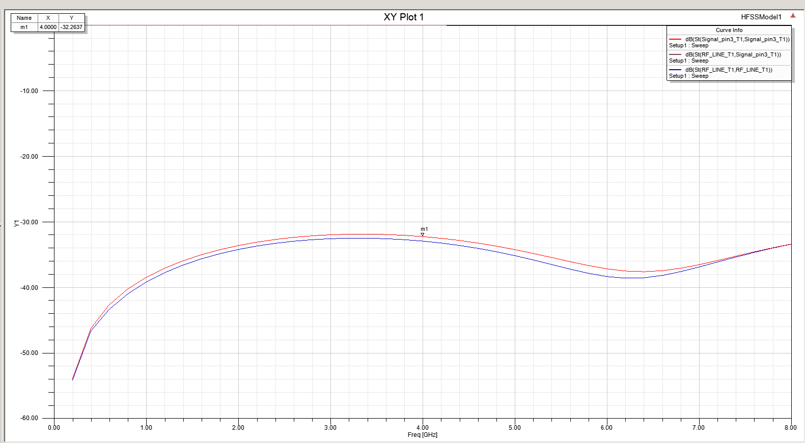
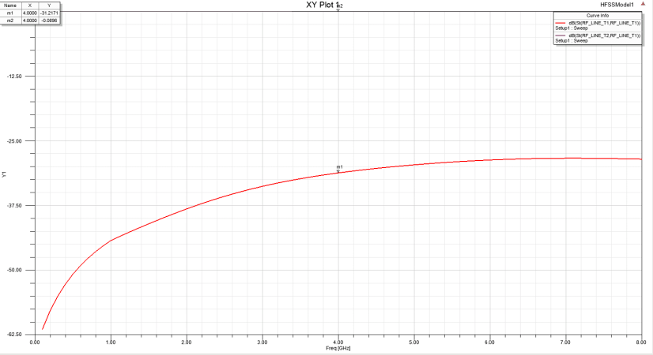
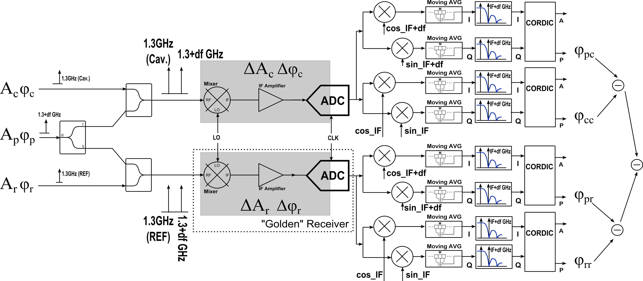
Module for Compensating Environmental Influences for CW Field Detection on fs Scale.
U. Mavrič, F. Ludwig, H. Schlarb, DESY
J. Piekarski, T. Leśniak, ISE-WUT
Abstract
Implementation
The drift calibration module mitigates the influence of the environmental changes on the detection of amplitude and phase of the RF fields. This is of particular interest in application such as the RF field control (LLRF) in RF cavities. The poster summarizes a scheme where a second tone is introduced to the signal. Based on a set of measurements of amplitude and phase of the two tones and applying the proper mathematical expression, the drift of amplitude and phase can be measured and therefore accounted for.
RF Interfaces
16 x N type connectors for RF input signals (cavity signals) - 2 are used for the reference channel. The mechanical design allows for stiff cables to be connected directly to the module.
16 output FBM connectors.
1 SMA input connector for the pilot.
1 SMA input for the reference input.
Features
Integrated Management board (TMCB) that includes:
Voltage monitoring
Active temperature regulation
Temperature and humidity monitoring
Interfacing the control over SFPs
Further Improvements
-30 dB
-6 dB
-6 dB
-7 dB
-7 dB
FBM Connector Matching:
Optimization for bandwidths up to 4 GHz.
The goal is S11 better than -20dB.
Pilot Generation
A vector modulator with IQ at df (~ 1MHz) will be used
Lower side band can not be filtered out
Lower side band to be included in the calculations
-30 dB
-3 dB
-3 dB
Coupling cell:
Optimize isolation between channels. For this reason good matching of intermediate stages is needed.
Two possible variants. With couplers or splitters.
RF+df
-40 dB
RF-df
RF
Signal
(RF)
-20 dB
Pilot
(RF + df)
Output (signal+pilot)
Pilot Pre-Amplifier
Gain 17 dB.
S11 and S22 in the -15 dB range.
+5 V single supply voltage
Requested output power +28 dBm
Good S22 is required in order to minimize coupling between channels
Quality of pilot is not critical
New
Old
SMA launch optimization:
Optimization for bandwidths up to 6 GHz.
RF via optimization:
Optimization for bandwidths up to 6 GHz.
Step in line width.
-20 dB
-20 dB
New
Old
References
T. Berenc et al. : SPX Workshop, LLRF R&D, July, 2011
H. Ma et al. : A New Digital Low-Level Radio Frequency Control System Implementation Based on Multi-carrier Frequency Division Multiplexing Communication Model with Pilot-Tone Channel Compensation, LLRF Workshop 2011
G. Huang et al. : Signal processing for high precision phase measurements, BIW10, 2010
Basic Principle of Operation
Drifty detection electronics.
$$φ_{r}+∆φ_{r}=φ_{rr}$$
$$φ_{p}+∆φ_{r}=φ_{pr}$$
$$φ_{c}+∆φ_{c}=φ_{cc}$$
$$φ_{p}+∆φ_{c}=φ_{pc}$$
- Reference passing through the reference channel.
- Pilot passing through the reference channel.
- Cavity signal passing through the cavity channel.
- Pilot passing through the cavity channel.
Pros
The quality of the pilot is not the main concern since it subtracts out.
Calibration possible during the pulse
Cons
Double the number of receivers
One receiver needed only for reference detection.
Intermodulation of the 2 tones.
$$=φ_{c}− φ_{r}$$
Non-compensated section.
$${(φ}_{cc}−φ_{pc})−{(φ}_{rr}−φ_{pr})=φ_{c}+∆φ_{c}−φ_{p}−∆φ_{c}− φ_{r}−∆φ_{r}+φ_{p}+∆φ_{r}$$
$$=φ_{c}− φ_{r}$$
Calibration of Amplitude Drifts :
$$A_{r}∙∆A_{r}=A_{rr}$$
$$A_{p}∙∆A_{r}=A_{pr}$$
$$A_{c}∙∆A_{c}=A_{cc}$$
$$A_{p}∙∆A_{c}=A_{pc}$$
- Reference passing through the reference channel.
$$\frac{A_{cc}}{A_{pc}}∙\frac{A_{pr}}{A_{rr}}=\frac{A_{c}∙∆A_{c}}{A_{p}∙∆A_{c}}∙\frac{A_{p}∙∆A_{r}}{A_{r}∙∆A_{r}}=\frac{A_{c}}{A_{r}}$$
- Pilot passing through the reference channel.
- Cavity signal passing through the cavity channel.
- Pilot passing through the cavity channel.

