Slide 1
Module for Compensating Environmental Influences for CW Field Detection on fs Scale.
U. Mavric, F. Ludwig, H. Schlarb, DESY
J. Piekarski, T. Lesniak, ISE-WUT
3rd ARD ST3 Workshop, 15-17 July 2015, KIT

Slide 2
Poster Summary.
Motivation : Minimize the influences of the environment on detection electronics to a fs scale.
Basic principle of operation of the device
Implementation details
Discussion about limitations

Slide 3
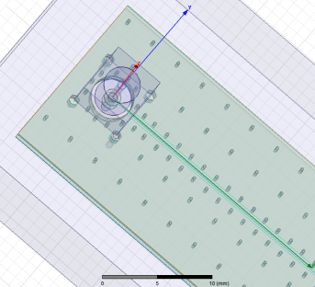
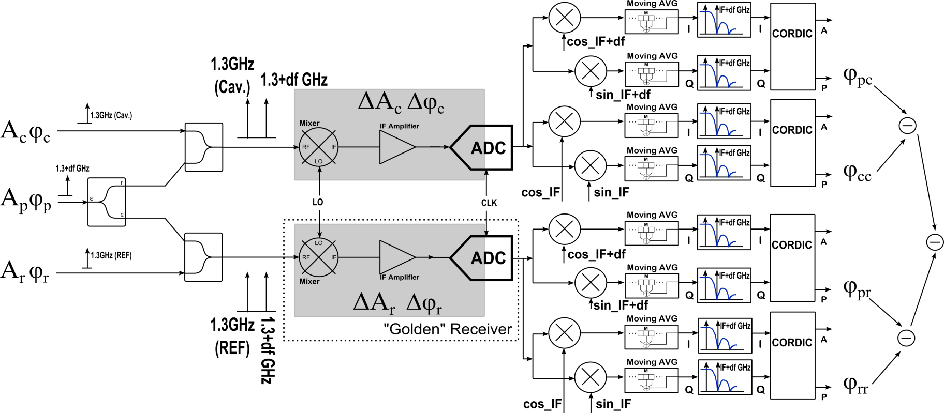
Basic Principle of Operation.
$$=φ_{c}− φ_{r}$$

