Slide 1
Latest LLRF Developments.
SRF & NRF Control @ FLASH
Sven Pfeiffer for the LLRF team
The 3rd ARD ST3 Workshop
Karlsruhe, 16.07.2015

Slide 2
Content
MicroTCA.4 Operation @ FLASH
Overview – SRF Control
Statistics 2014
FLASH1/2(/3)
NRF GUN Regulation
Concept - single cavity regulation
Achievements so far
Disturbance sources and noise
Frequency control

Slide 3
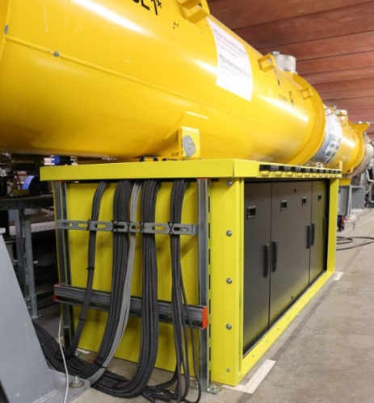
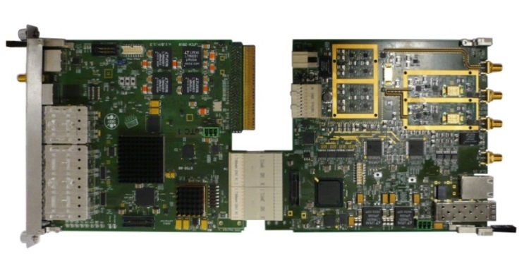
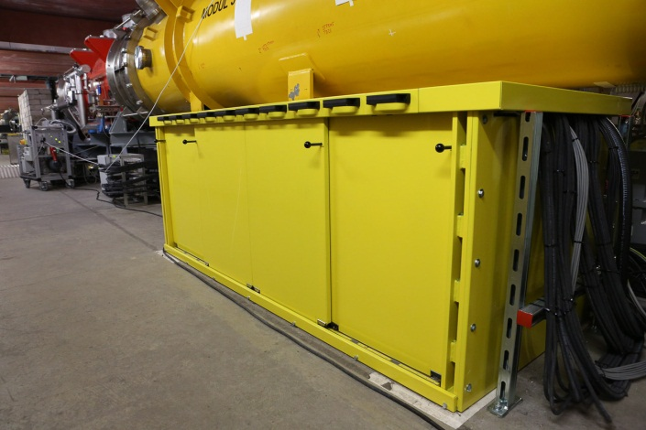
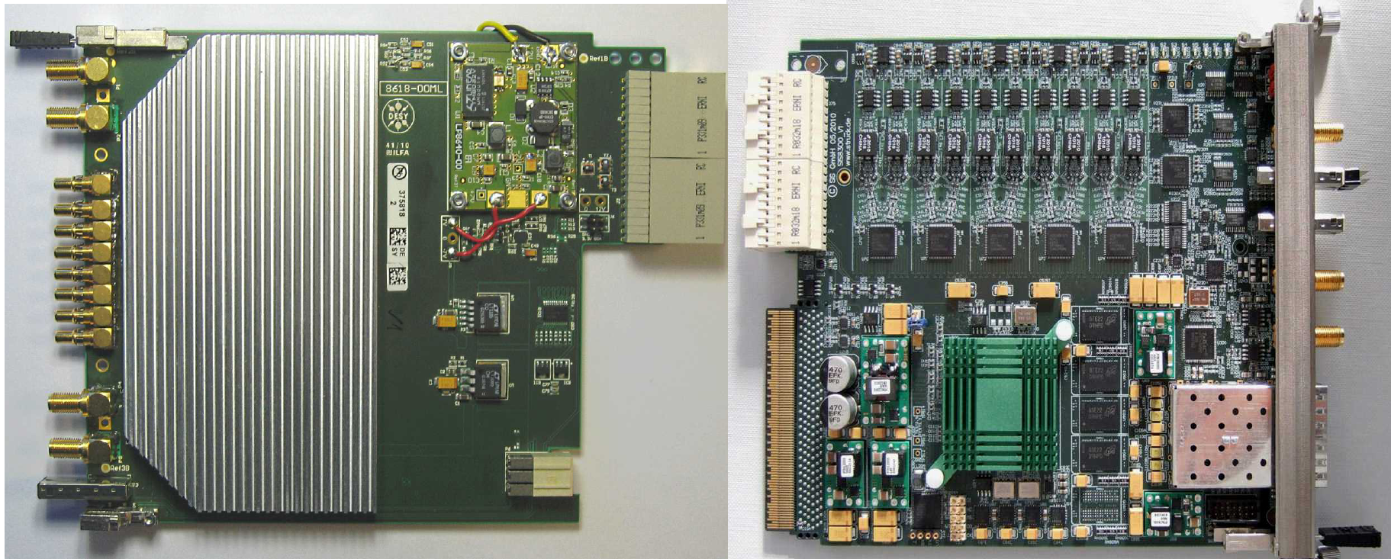
MicroTCA.4 @ FLASH
Since ~ 2 years (8/2013) in standard operation for all SRF nodules
Mainly software problems at beginning
Switched 3x back to VME based backup system
Factor 4-5 improvement to VME system
Achieved XFEL specifications
dA/A < 0.01%, dφ < 0.01 deg.
Vector Modulator (uVM)
LLRF Controller (uTC)
Down Converter (DWC)
Digitizer (uDAQ)

Slide 4
Operation Statistics 2014 - Downtime
RF-gun temperature stabilization
RF-3
Other RF-stations
Total downtime
352 h = 4.5%
RF-gun interlocks
RF-stations water
Others
RF-39
12.2 %
LLRF
43 h
Photon beamlines
0.55 %
Operating
Magnet PS
Operation hours
7791 h
Cryogenics
Controls
Power glitches
Timing
Infrastructure
RF-Gun water stabilization
Downtime (%)
Week

Slide 5
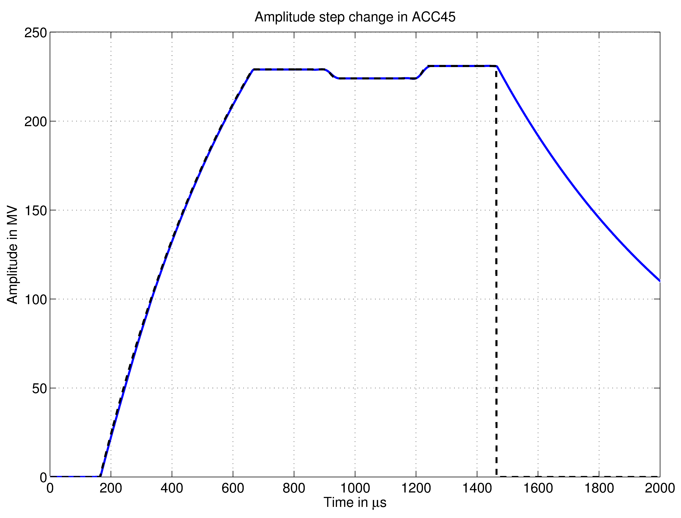
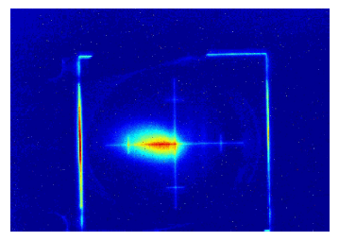
Multi Beamline Operation - FLASH1/2 (/3)
First lasing FLASH2
20.08.2014
Variation in Amplitude and Phase
Restricted transition time
Large step → more time needed due to limited Klystron power

Slide 6
Content
MicroTCA.4 Operation @ FLASH
Overview – SRF Control
Statistics 2014
FLASH1/2(/3)
NRF GUN Regulation
Concept - single cavity regulation
Achievements so far
Disturbance sources and noise
Frequency control

Slide 7
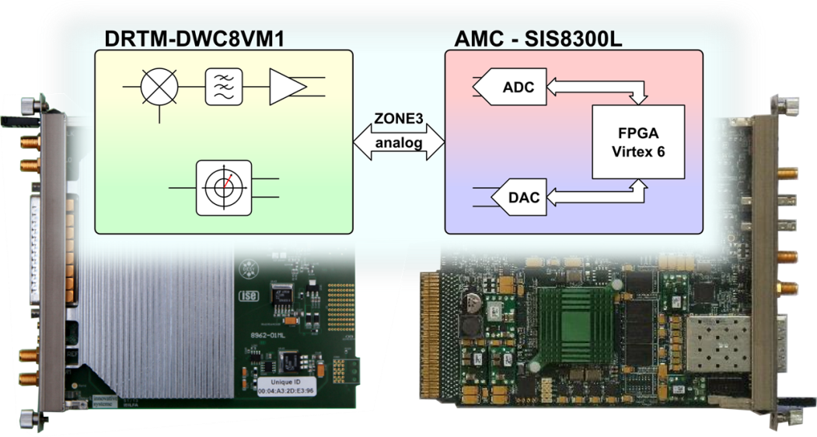
RF GUN Regulation @ FLASH
MicroTCA.4 operation since 01/2015
Single cavity regulation by 2 boards with MicroTCA.4 standard
DWC8VM1
SIS8300L
NRF cavity with bandwidth ~ 60 kHz
Latency reduced < 1100 ns
FPGA code optimization/clean-up
Latency since 05/2015 @ 700 ns
Feedback loop
HV
MO
VM
Pre-
Ampl.
Klystron
RF GUN
Forw
Refl
ADC
DAC
ADC
DAC
ADC
ADC
clk
1.3 GHz + IF
ADC’s
1.3 GHz
to Pre-ampl.

Slide 8
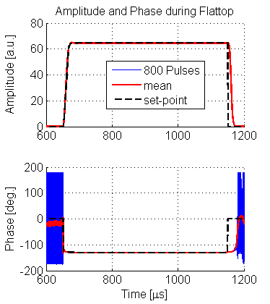
RF GUN Regulation @ FLASH
Goal: dA/A<0.01%
dφ<0.01 deg. (rms)
Regulation Concepts
Adapted from SRF regulation
1) Output Vector Correction (OVC)
Drift compensation
2) Learning Feedforward (LFF)
→ Pulse to pulse FF adjustment
3) MIMO Controller (FPGA - FB)
→ Intra-pulse feedback
Currently: PI – like feedback
Limitation: Loop-delay ≈ 1.1 μs
→ Limits feedback gain!

Slide 9
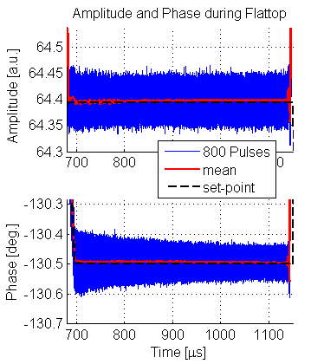
RF GUN Regulation @ FLASH
Goal: dA/A<0.01%
dφ<0.01 deg. (rms)
PI Regler

Slide 10
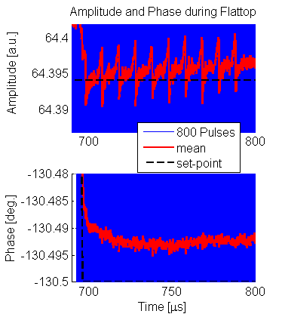
RF GUN Regulation @ FLASH
Average of 800 RF pulses
Beam transient (10 Bunche@100kHz)
Pk2pk ~ 0.008 ~ 0.01% or 0.1‰
PI Regler

Slide 11
RF GUN Regulation @ FLASH
Goal: dA/A<0.01%
dφ<0.01 deg. (rms)
VME (1MHz)
MTCA.4 (9MHz→1MHz)
0.01%
Factor 3-4 improvement necessary
0.01deg.
PI control

Slide 12
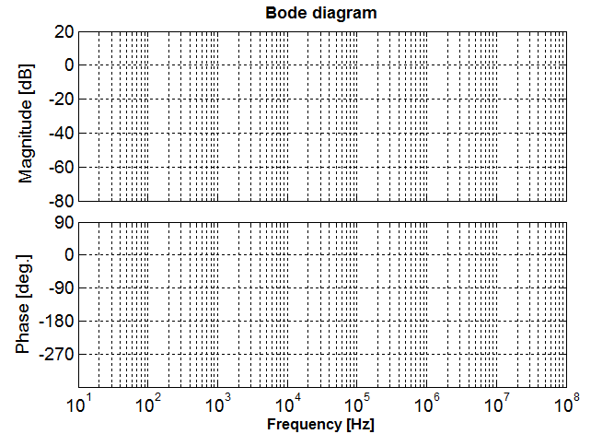
Control Loop @ SRF and NRF cavities
Plant: SRF
Pulsed mode (~1 ms)
Half Bandwidth ~ 200 Hz
Latency ~ 2 μs
Plant: NRF
Pulsed mode (~ 1 ms)
Half Bandwidth ~ 65 kHz
Latency ~ 1.1 μs
GM = 9 dB
K_{P} = 2.8
x325
K_{P} = 100
Open loop
~ x 1/2
$K_{P}$ = 100
Error suppressed
by 1+K_{P} = 101
$K_{P}$ limited to ~ 2.8
Error suppressed
by x3.8
PM ≈ 60 deg.
NRF cavity regulation:
Low noise subsystems
Small errors (disturbances and noise)
d_{P}(t)
d_{u}(t)
Plant
d_{y}(t)
r(t)
e(t)
Controller
u_{i}(t)
u_{r}(t)
Pre-Amp,
Klystron,…
Cavity
y_{i}(t)
y_{r}(t)
Delay
n(t)

Slide 13
Disturbances and Noise - Fast and Slow Distortions
Disturbance to plant input - d_{u}(t)
DAC, vector modulator, temperature & humidity (PCB)
Disturbance to plant - d_{P}(t)
Pre-amplifier, Klystron, HV modulator, cavity length (water regulation), Beam (beam loading and multi bunch effects)
M. Hoffmann – Meas.@REGAE
Noise – n(t)
ADC distortions, noise, quantization noise, temperature & humidity (PCB)
Other:
Aging, switching in electronics (e.g. vans), ground motion and vibrations, faults in devices and components, thermal heating within macropulse, …
Electromagnetic interference (EMI)
F. Ludwig - Tutorial 2
Drifts
Talk: K. Shafak – Opt. synchronization
C. Sydlo – Timing distribution XFEL
M. Tikberidze - Laser2RF
U. Mavric – CW DCM
Many poster with focus on improvement
of subsystems and drift compensation
schemes
d_{P}(t)
d_{u}(t)
Plant
d_{y}(t)
r(t)
e(t)
Controller
u_{i}(t)
u_{r}(t)
Pre-Amp,
Klystron,…
Cavity
y_{i}(t)
y_{r}(t)
Delay
n(t)

Slide 14
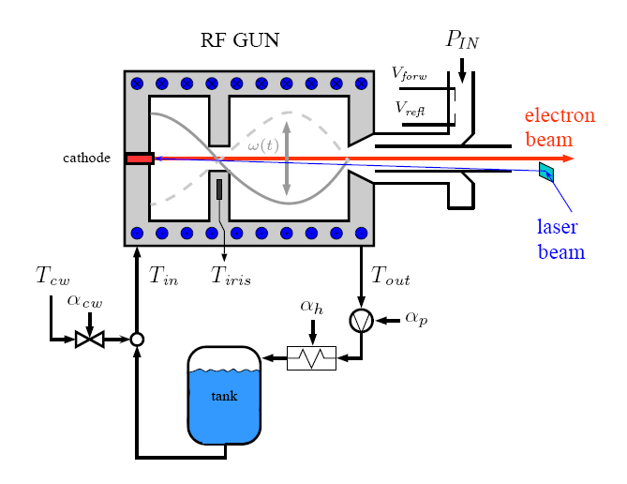
RF GUN Frequency Control @ FLASH
2 Control schemes
Water regulation (slow loop – sub-Hz)
PI Control
Sensor: IRIS Temp. (LP characteristic)
Actuator: valve for cold mixing water
LLRF (fast loop - MHz)
MIMO controller
Sensor: virtual probe (V_{forw} and V_{refl})
Actuator: input to Klystron
→ Cascaded regulation scheme
Goal: Fast compensation of temperature drifts
→ fast actuator
→ fast sensor with high temperature resolution

Slide 15
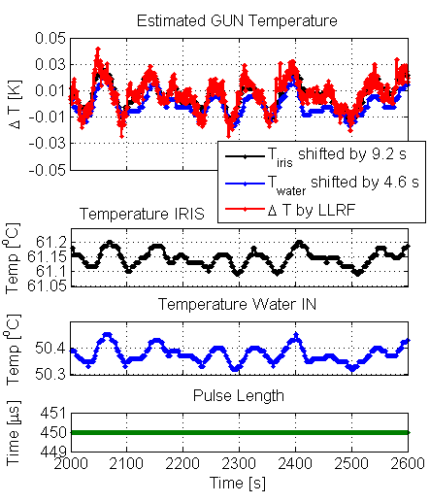
RF GUN Frequency Control @ FLASH
Idea: Estimate temp. by LLRF signals
LLRF based temp.
Resolution ~ 0.1 mK
T_{IRIS} and T_{IN} are time delayed
Temperature estimation using LLRF highly suitable for control
→ Frequency control by pulse width change

Slide 16
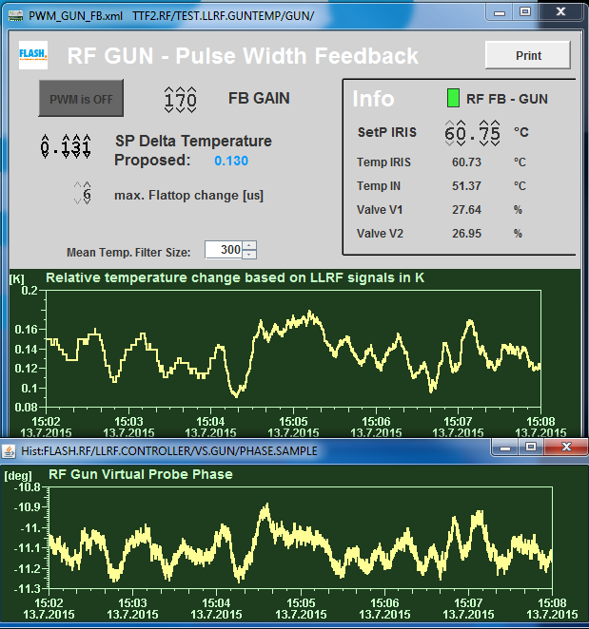
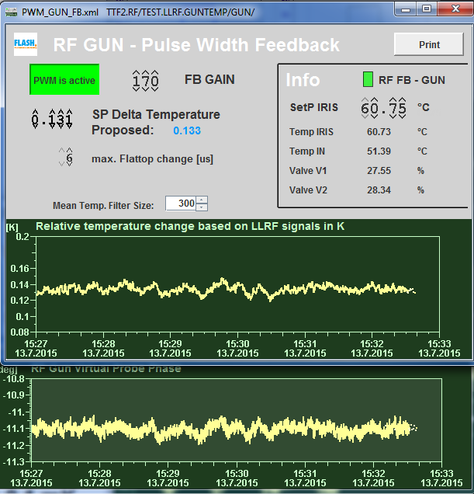
RF GUN Frequency Control @ FLASH
NRF cavity as heater @ FLASH
Same y-scaling for both panels
Pulsed mode
Pulse Width Modulation
to keep cavity on resonance
Factor > 3 improvement
$ΔT$ [K]
Pk2pk ~ 0.1K
$ΔT$ [K]
Pk2pk ~ 0.03K
PWM off
PWM on
$Δφ$ [deg.]
Pk2pk ~ 0.4º
$Δφ$ [deg.]
Pk2pk ~ 0.17º
Detuning: $ψ=φ_{P}−φ_{F} ; ΔT=\frac{\tan{ψ⋅f_{0}}}{2Q_{L}K_{f/T}}$
K_{f/T} = 21 kHz/K
Q_{L} = 10.000
f₀ = 1.3 GHz
Extremely precise frequency control is essential for all NRF cavities due to limited FB gain!
Resolution ~ 0.1 mK
(Sub-mK)

Slide 17
Question?
Thank you for your attention!
NRF cavity as heater @ FLASH
Same y-scaling for both panels
Pulsed mode
Pulse Width Modulation
to keep cavity on resonance
Factor > 3 improvement
$ΔT$ [K]
Pk2pk ~ 0.1K
$ΔT$ [K]
Pk2pk ~ 0.03K
PWM off
PWM on
$Δφ$ [deg.]
Pk2pk ~ 0.4º
$Δφ$ [deg.]
Pk2pk ~ 0.17º
Detuning: $ψ=φ_{P}−φ_{F} ; ΔT=\frac{\tan{ψ⋅f_{0}}}{2Q_{L}K_{f/T}}$
K_{f/T} = 21 kHz/K
Q_{L} = 10.000
f₀ = 1.3 GHz
Extremely precise frequency control is essential for all NRF cavities due to limited FB gain!
Resolution ~ 0.1 mK
(Sub-mK)

