Slide 1
Status of accelerator facilities & ARD activities at DESY.
and overview who is doing what …
Holger Schlarb
3rd ARD – ST3 Workshop
KIT, 15-17.07.2015

Slide 2
Content
FLASH - Free electron LASer at Hamburg FLASH
  sFLASH
  FLASH II
  FLASHForward
European XFEL
  AMTF
REGAE - Relativistic Electron Gun for Atomic Exploration
  LUX & LPWA@REGAE
SINBAD & ATHENAe → see talk from Barbara
AXSIS (not covered this time)
PETRA III (not covered this time)

Slide 3
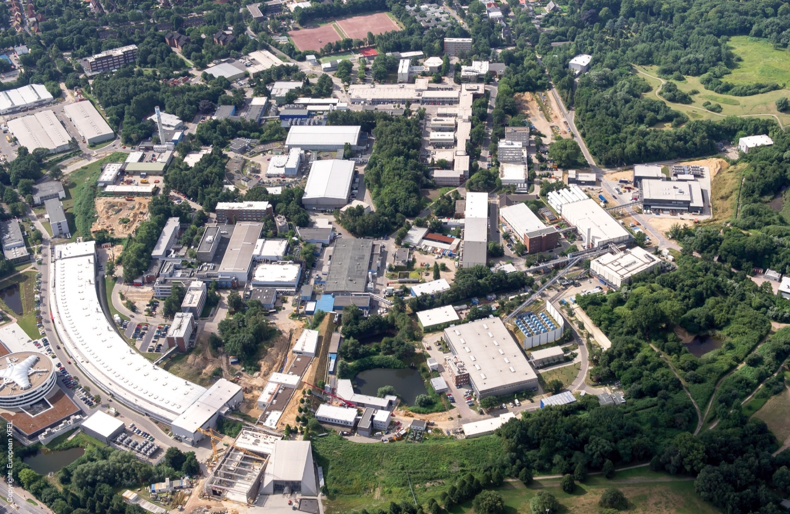
DESY activities : birds view …
PETRA Extension E
DESY II
XFEL
REGAE
CSSB
FLASH
SINBAD
CMTB
PETRA III
nanoLab
AMTF
CFEL
FLASH2
PETRA Extension N

Slide 4
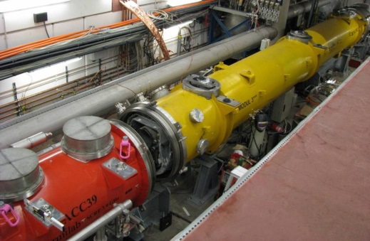
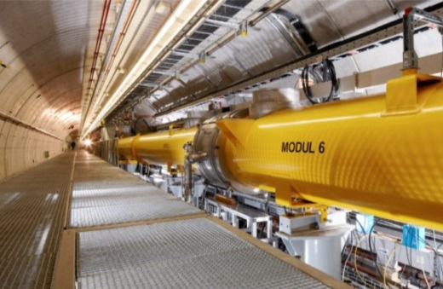
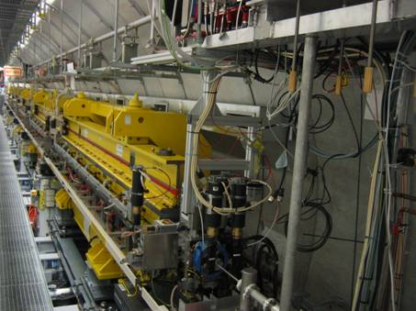
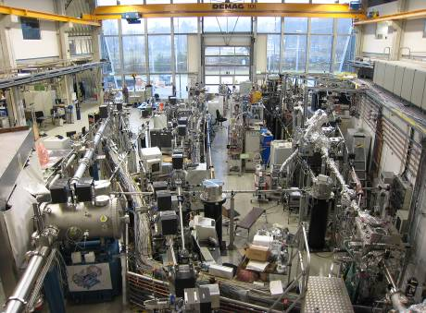
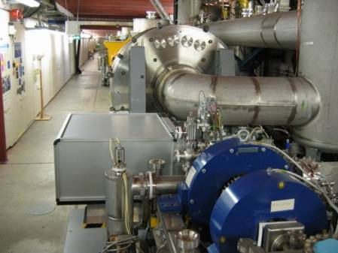
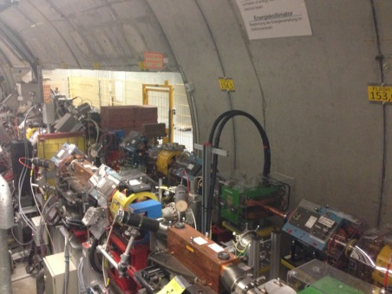
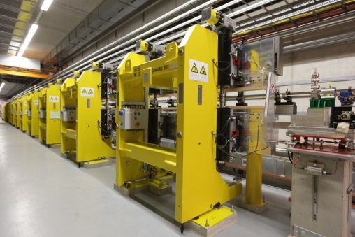
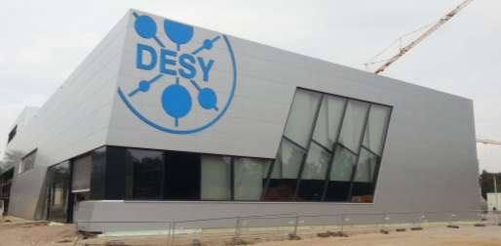
FLASH Layout
FLASH.
Free-Electron Laser
in Hamburg
3rd harmonic sc module 3.9 GHz
TESLA type superconducting accelerating modules 1.3 GHz
FLASH1 fixed gap undulators
FLASH1 Experimental Hall
Albert Einstein
315 m
Soft X-ray Undulators
RF Stations
Accelerating Structures
sFLASH
Photon Diagnostics
FLASH1
THz
RF Gun
Bunch Compressors
FLASH2
Lasers
5 MeV
150 MeV
450 MeV
1250 MeV
Beam Dump
FEL Experiments
Kai Siegbahn
Normal conducting 1.3 GHz RF gun
Ce₂Te cathode
Two Nd:YLF based ps photocathode lasers
Extraction to FLASH2
FLASH2 variable gap undulators
FLASH2 Experimental Hall

Slide 5

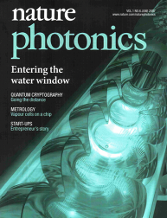
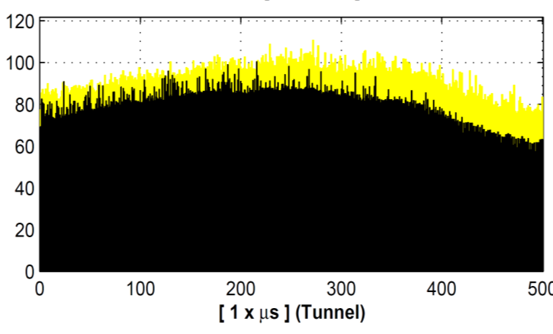
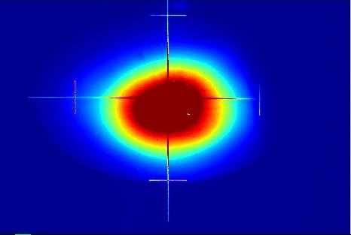
FLASH1 Parameters 2014 / 2015
FLASH.
Free-Electron Laser
in Hamburg
FEL Radiation Parameters
Wavelength range (fundamental) 4.2 – 52 nm
Average single pulse energy 10 – 500 µJ
Pulse duration (FWHM) < 50 – 200 fs
Peak power (from av.) 1 – 3 GW
Pulses per second 10 – 5000
Spectral width (FWHM) 0.3 - 2 %
Photons per pulse 10¹¹ – 10¹³
Average Brilliance 10¹⁷ – 10²¹ B*
Peak Brilliance 10²⁹ – 10³¹ B*
* photons/s/mrad²/mm²/0.1%bw
Energy (µJ)
Bunch number
more than 200 publications on photon science at FLASH, many in high impact journals

Slide 6
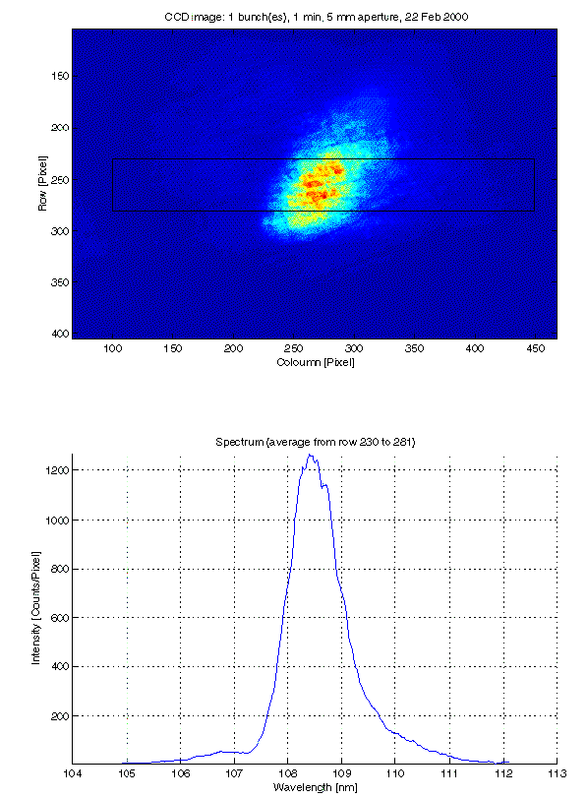
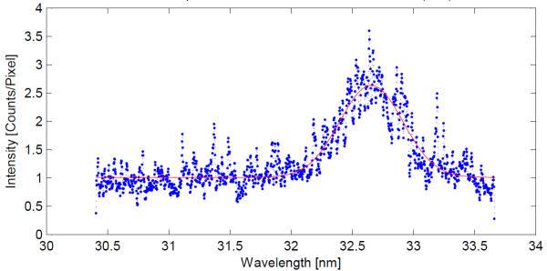
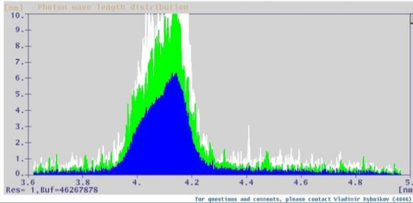

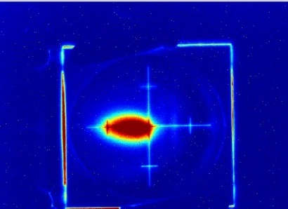
FLASH 2015: Year of Celebrations
FLASH.
Free-Electron Laser
in Hamburg
15 years of FEL lasing at DESY
  First lasing (109 nm) of Tesla Test Facility on Feb-22, 2000
10 years of SASE at FLASH
  First lasing (32 nm) of FLASH on Jan-14, 2005
10 years of FEL user operation at FLASH
  User operation started in summer 2005 as the first
  FEL user facility in VUV wavelengths worldwide
5 years of SASE in the water window at FLASH
  Lasing at 4.12 nm on Sep-25, 2010
1 year of simultaneous operation
  First lasing of FLASH2 (~ 40 nm) on Aug-20, 2014,
  FLASH1 lasing simultaneously with 250 pulses

Slide 7
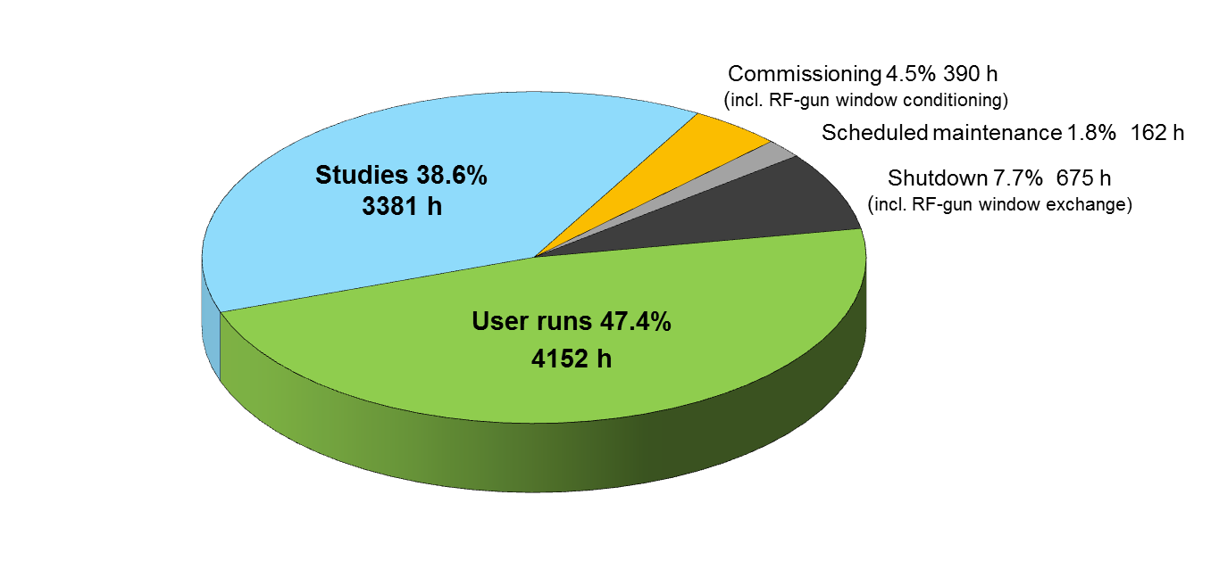
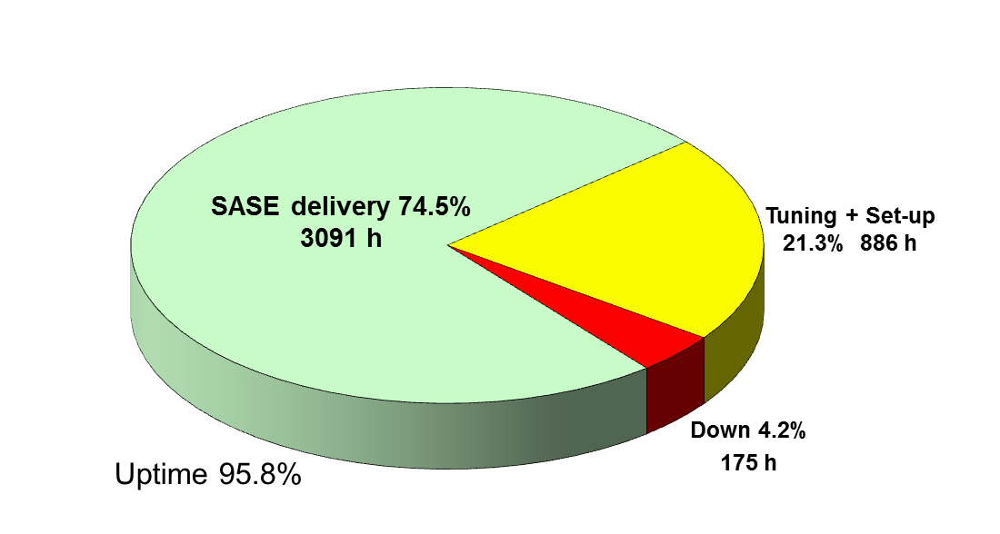
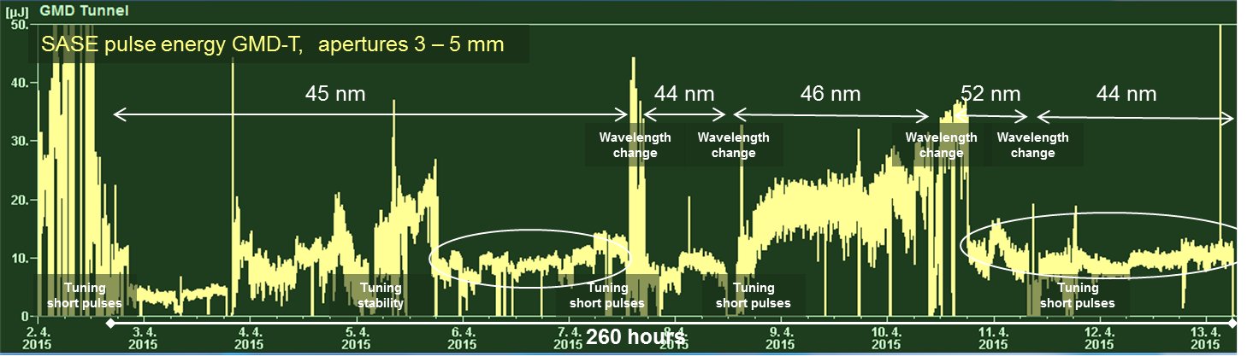
FLASH: main issues & specialties & critical items
FLASH.
Free-Electron Laser
in Hamburg
Availability and Reliability …statistics from 2014
Very frequent changing operation conditions (wavelength / pulse length / No bunches)
Experiment over 260h: SASE deliver 97%, tuning 11%, Down 2%
New 2016: 10% of total beam time → ARD

Slide 8
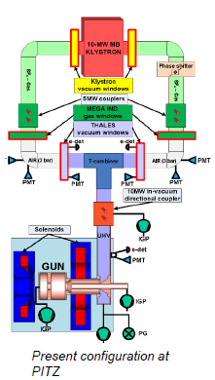
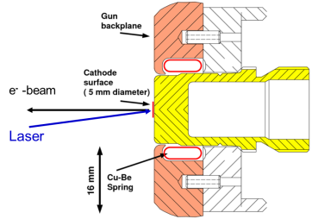
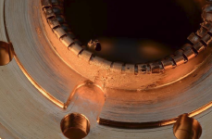
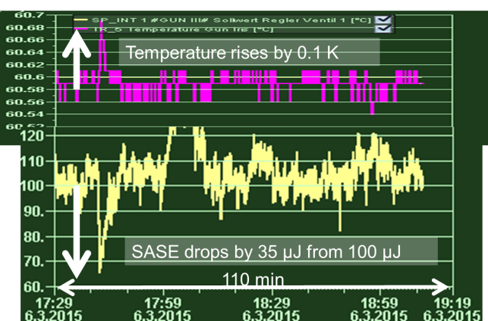
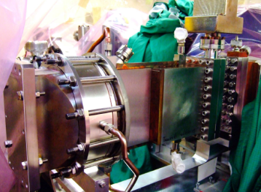
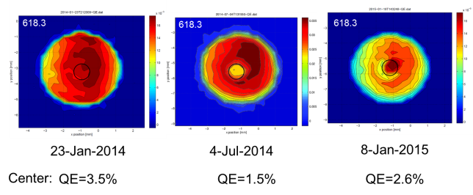
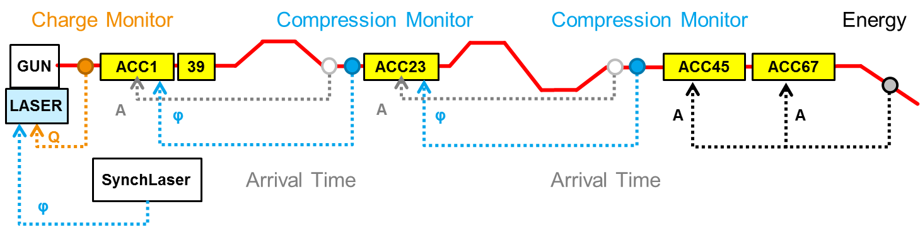
FLASH: main issues & specialties & critical items
FLASH.
Free-Electron Laser
in Hamburg
RF gun & RF window & gun temp. stability
Beam feedbacks to stabilize operation (mandatory!!!)
Critical area
Required temp. stability <0.01°
Critical
windows
Quantum Efficiency of cathode over time

Slide 9
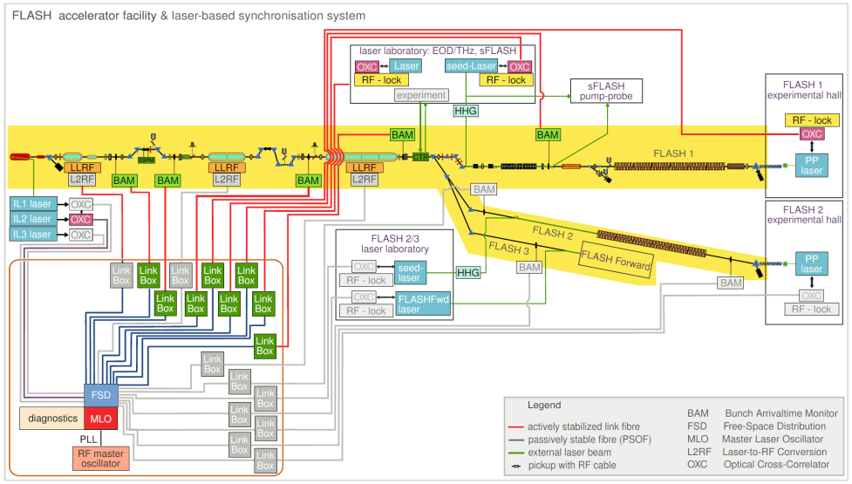
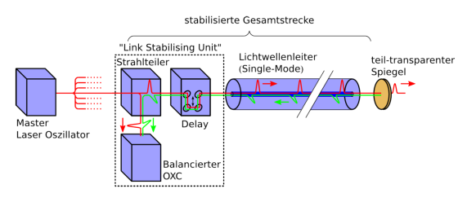
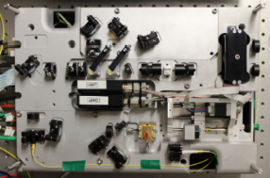
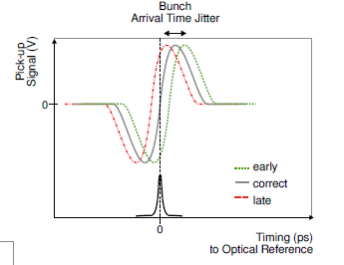
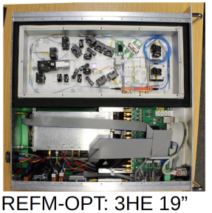
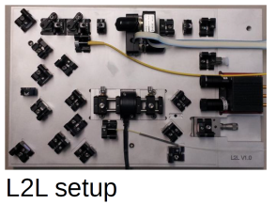
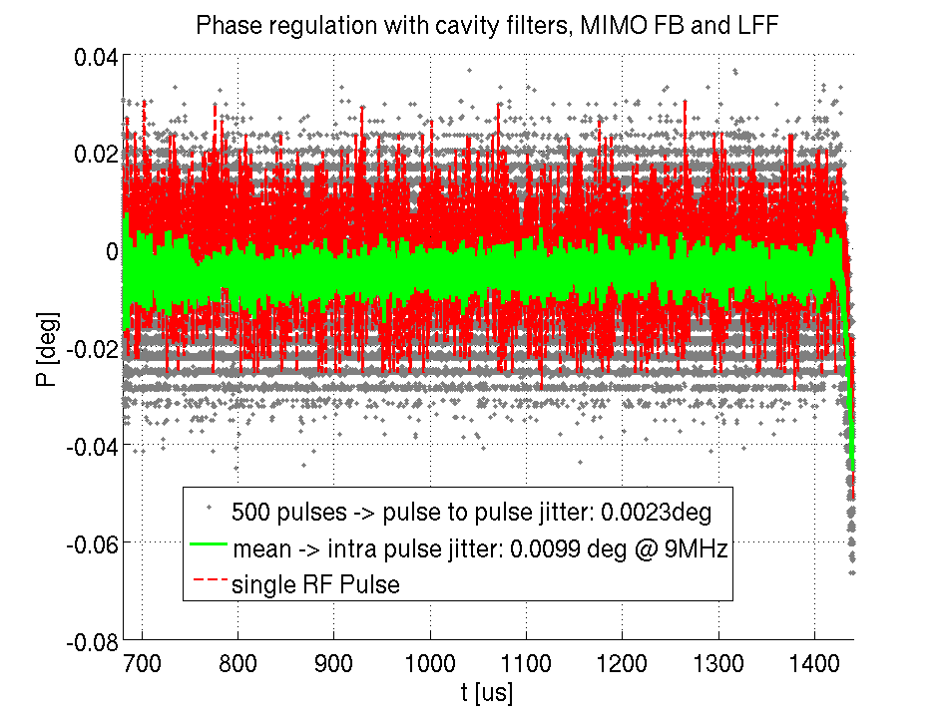
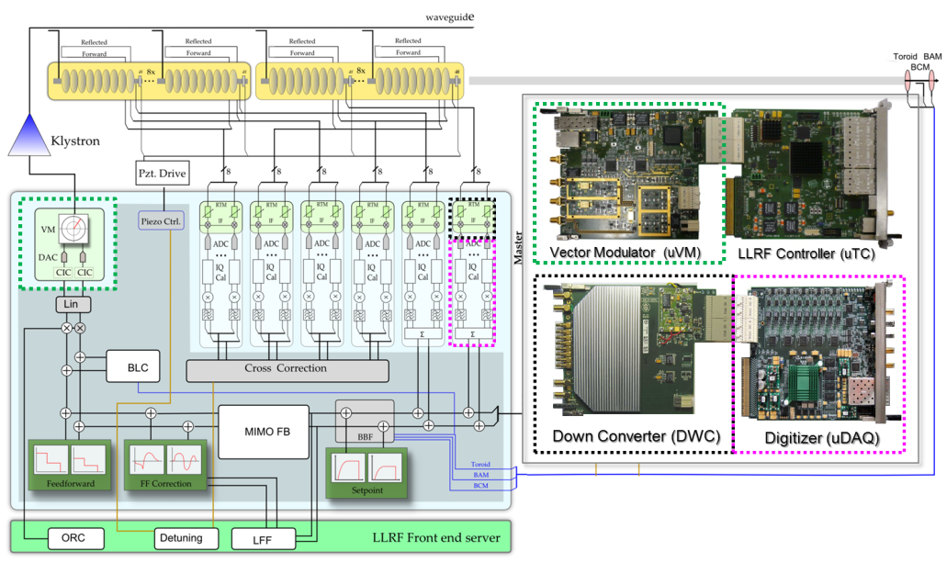
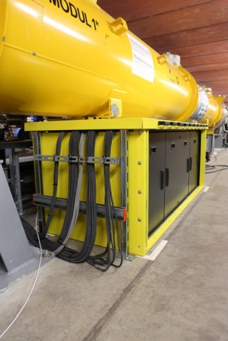
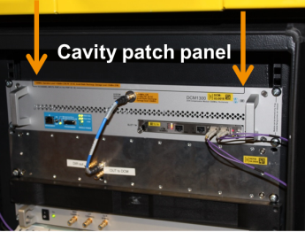
FLASH: main issues & specialties & critical items
FLASH.
Free-Electron Laser
in Hamburg
Femtosecond stable optical reference distribution
Low Level RF System → MicroTCA
Link setup
BAM

Slide 10
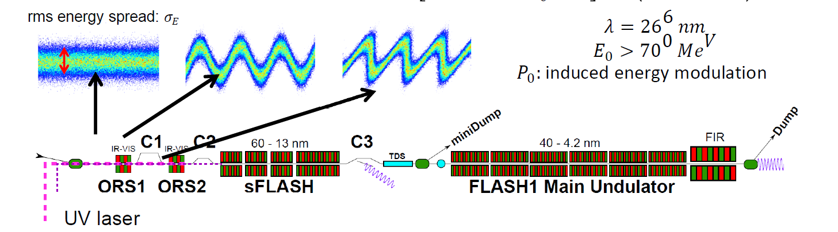
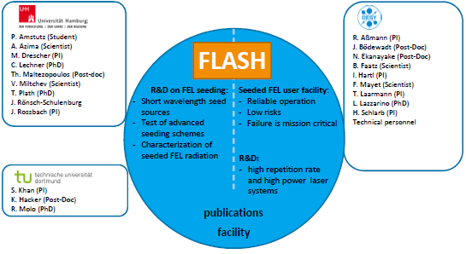
Seeded FLASH: sFLASH
FLASH.
Free-Electron Laser
in Hamburg
HGHG Seeding at FLASH
Photon Diag.
Exp. hutch
External laser at UV (266nm) is used to seed FEL radiation in a single stage HGHG configuration
➔ Improve longitudinal coherence and control of radiation
First step: 7th harmonics ➔ 38 nm
Second step: Echo Enabled Harmonic Generation down to 12nm

Slide 11
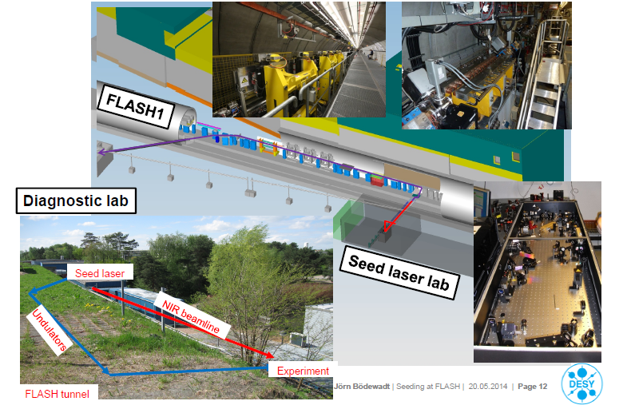
Seeded FLASH: sFLASH
FLASH.
Free-Electron Laser
in Hamburg

Slide 12
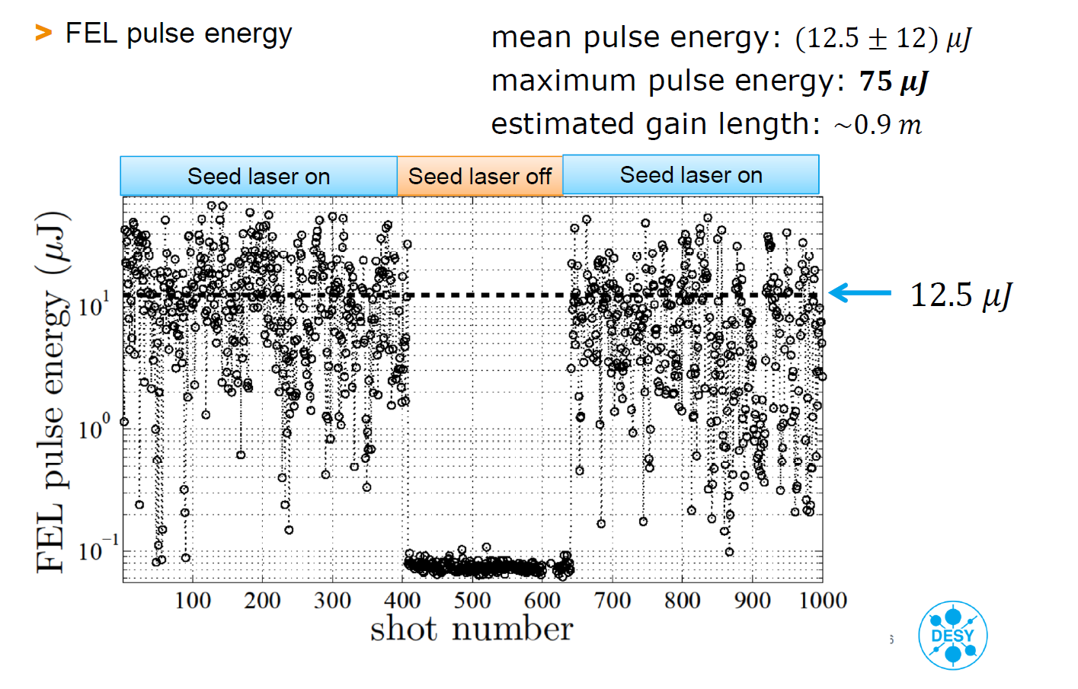
Seeded FLASH: sFLASH
FLASH.
Free-Electron Laser
in Hamburg
Courtesy: J. Bödeward

Slide 13
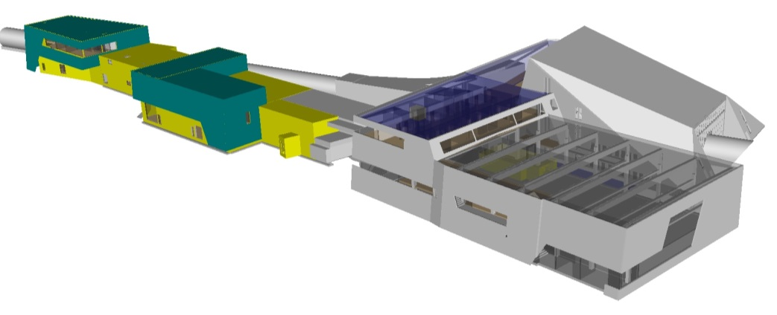
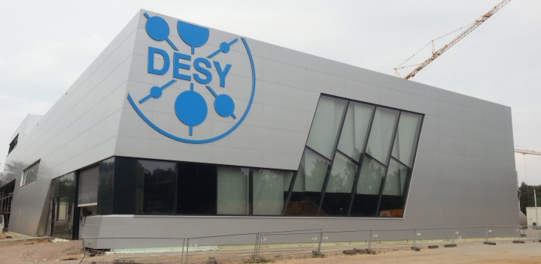
FLASH2
FLASH.
Free-Electron Laser
in Hamburg
Extends user capacity: bunch train is shared between the two beamlines
Existing FLASH infrastructure up to last accelerating module used
Second undulator beamline and additional experimental hall constructed
Variable gap undulators allow wavelength changes at FLASH2
with a fixed electron beam energy
Expected FLASH2 Radiation Parameters
Wavelength range (fundamental) 4 – 60 nm
Average single pulse energy 10 – 500 µJ
Pulse duration (FWHM) < 50 – 200 fs
Pulses per second 10 – 7000 *
* part of bunch train to FLASH1

Slide 14
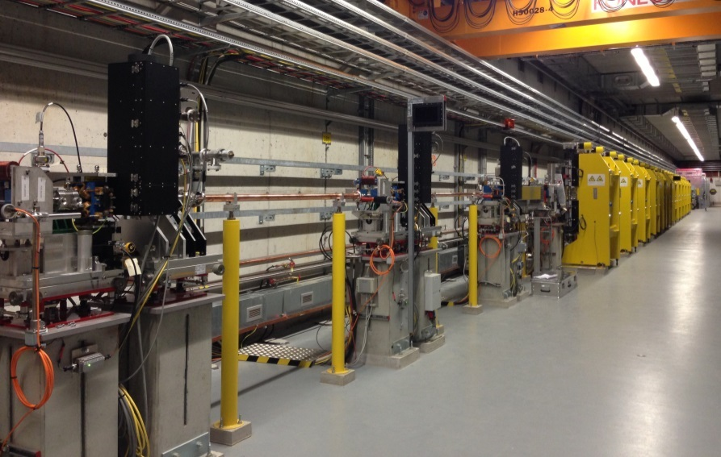
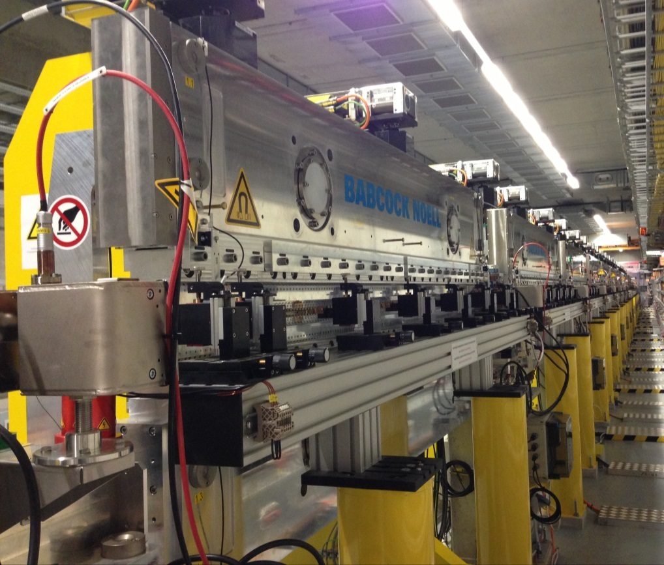
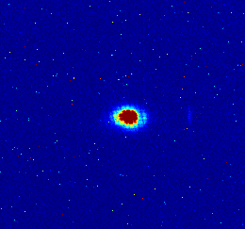
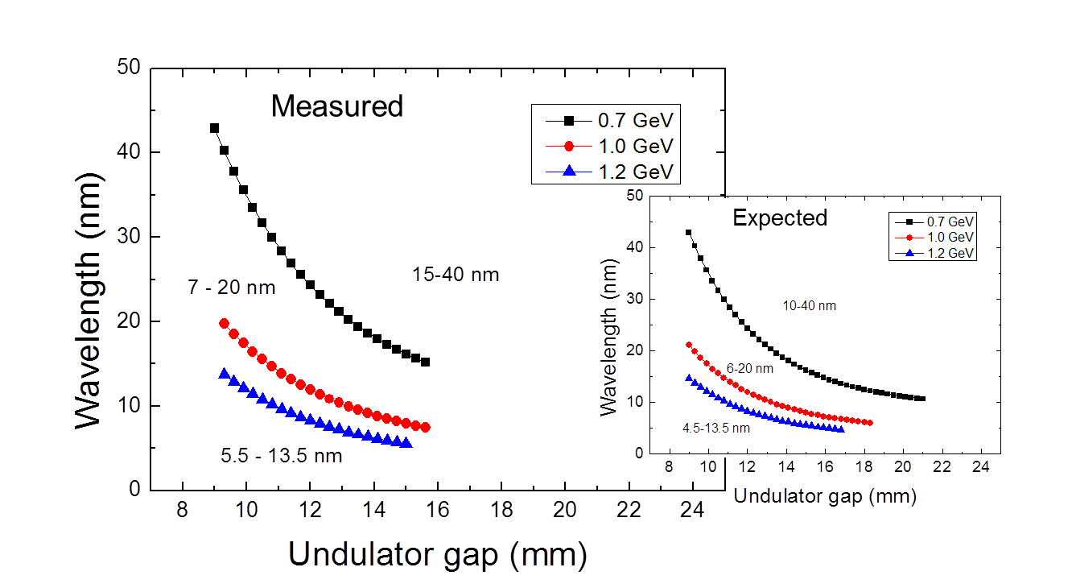
FLASH2: Undulator Beamline
FLASH.
Free-Electron Laser
in Hamburg
12 variable gap undulators
  period 31.4 mm
  K-value 0.5 – 2 (rms)
  segment length 2.5 m

Slide 15
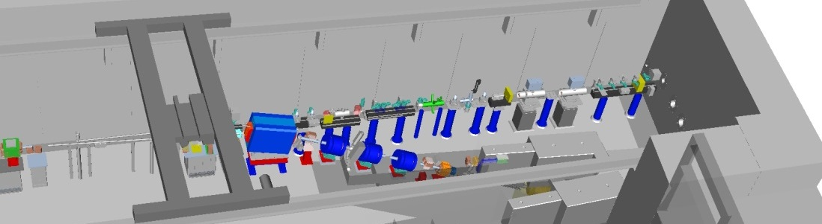
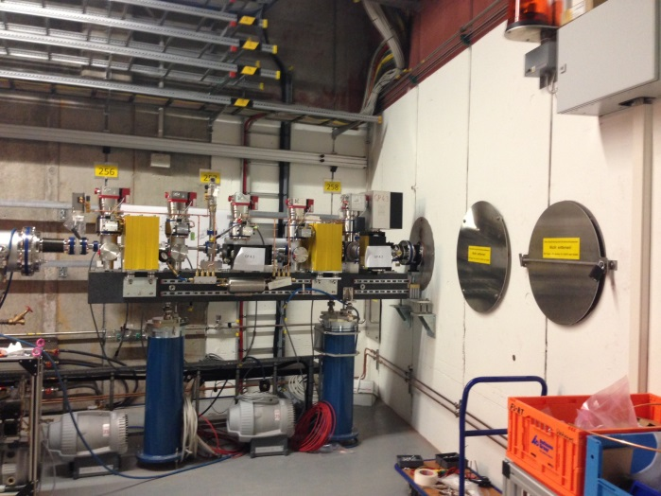
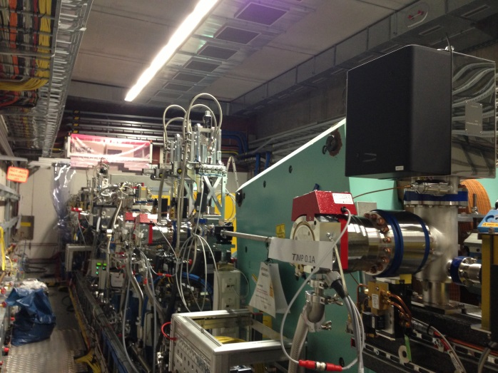
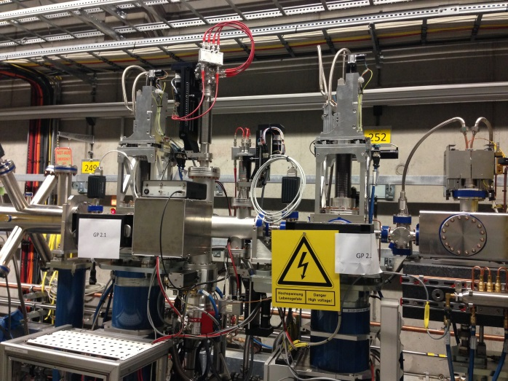


FLASH2: Photon Diagnostics Beamline & Exp. hall
FLASH.
Free-Electron Laser
in Hamburg
Final version of photon diagnostics beamline in FLASH2 tunnel installed
Experimental Hall
Intensity
Beam Position
Spectrum
Profile
Beam position

Slide 16




FLASH2: Challenge by simultaneous operation
FLASH.
Free-Electron Laser
in Hamburg
Fast kicker and Lambertson septum to extract a part of bunch train to FLASH2
Two injector lasers: FLASH1 and FLASH2 bunch pattern
and bunch charge selected independently
Flexible RF-system: amplitude and phase adjusted
- in certain limits - independently for FLASH1 and FLASH2
FLASH2
FLASH2
FLASH1
99 ms (10 Hz rep.rate)
FLASH1
30 μs
(kicker)
RF-pulse flat-top 800 μs
RF-pulse amplitude
FLASH1
FLASH2
300 μs
450 μs

Slide 17

FLASHForward
Notes:
DCM
SIS8300L2
REFM, RF Interferometer (?)
Smith Predictor
Decoupling of GUN/Buncher

Slide 18

FLASHForward
Notes:
DCM
SIS8300L2
REFM, RF Interferometer (?)
Smith Predictor
Decoupling of GUN/Buncher

Slide 19

FLASHForward
Notes:
DCM
SIS8300L2
REFM, RF Interferometer (?)
Smith Predictor
Decoupling of GUN/Buncher

Slide 20


European XFEL at a Glance
17.5 GeV superconducting linac, almost 1 MW beam power
27000 pulses per second in 10 Hz burst mode
Three moveable gap undulators for hard and soft X-rays
Initially 6 equipped experiments
Experimental Hall
Photon Beam Lines
Beam Dumps
Electron Beam
Undulators
Distribution
Collimation
Linear Accelerator
Bunch
Compressors
Injector
Notes:
Before you start editing the slides of your talk change to the Master Slide view:
Menu button “View”, Master, Slide Master:
Edit the following 2 items in the 1st slide:
1) 1st row in the violet header:
Delete the existent text and write the title of your talk into this text field
2) The 2 rows in the footer area: Delete the text and write the information
regarding your talk (same as on the Title Slide) into this text field.
If you want to use more partner logos position them left
beside the DESY logo in the footer area
Close Master View

Slide 21

Electron Beam Parameters / Photon energies
Quantity | Value
pulse repetition rate | 10 Hz
beam pulse length | 600 μs
bunch repetition frequency within pulse | 4.5 MHz
electron bunch length after compression | 2 – 180 fs (FWHM)
bunch charge | 0.02 – 1 nC
slice emittance | 0.4 - 1.0 mm mrad
slice energy spread | 4 – 2 MeV

Slide 22








Many accelerator components produced

Slide 23



… and installed
Gun conditioned at PITZ/DESY
RF operation at XFEL December 2013

Slide 24

Finished first accelerator section (L1)

Slide 25

Finished first accelerator section (L1)

Slide 26





Production now on full speed …
High power RF couplers
Accelerator Module Test Facility (AMTF)
Accelerator Modules Production & Delivery
21 day, now
14 days

Slide 27


Photon systems
August 2013

Slide 28


Undulator Production and Tuning
Total 91 segments
> 95% measured and tuned
Installation SASE 1: 12/2015

Slide 29







Detectors and Laser systmes
Have to fit to time structure
500
LPD
Detector
  development
4.5 MHz
DSSC
200
AGIPD
Pixel Size [μm]
75
50
30
pnCCD
MCP
GotthardV2
Fast CCD
200
1
2
10
20
Photon Energy [keV]
Each SASE equipped with one pump-probe laser
  R&D to overcome lack of commercially available systems
  All essential features met: pulse length & power, pulse pattern and random pulse selection, wavelength tuning, diffraction-limited laser beam

Slide 30


Beam Commissioning and Parallel Operation
2015
2016
2017
2018
First e-beam out of RF gun installed at XFEL
Injector cooldown
Linac cooldown
SA1
SA3
SA2
Start user operation
Full TDR performance
1st lasing possible
e⁻
Gun and injector laser com.
Injector com. up to full XFEL performance (varying charges and bunch patterns)
Initial linac com. with reduced performance
Continued accelerator com. to full performance (high beam power, bunch length flexibility, multiple bunch properties per rf-pulse, full wavelength tuneability, ….)
γ
Beam line and experiment com.
. First user operation

Slide 31




REGAE - Relativistic Electron Gun for Atomic Exploration
Electron source for time resolved electron diffraction experiments Prof. Dwayne Miller, CFEL
  Coherence length of electron
  Typical diffraction pattern
  In pump-probe configuration
ε_{n} ~ 10 nm
Lc ~ 10 nm for solid states
Lc ~ 30 nm length for proteins
Dwayne Miller et al. Nature 468, Nov. 2010
External injection in plasma bubble:
  Laser Plasma Wakefield Acceleration
  Florian Grüner und Andreas Meyer CFEL

Slide 32




REGAE stability: Temperature control of acc. structures
Velocity bunching
7 fs
RF-Gun Cavity
3 GHz S-Band
Gradient on cathode
≥ 110MV/m
50 Hz rep Rate
~5 µs pulse length
Buncher Cavity
3 GHz S-Band
4-cells
average gradient
~15-20 MV/m

Slide 33






REGAE - Relativistic Electron Gun for Atomic Exploration
Stability requirements
dA/A < 0.01 %
dφ < 0.01 deg.
RF System
LLRF
dφ _{rms} < 10mdeg achieved for RF gun!
Cooling system for cavities
New!
T_{rms}~380uK rms

Slide 34





REGAE – LUX & LPWA@REGAE
Incoupling
High power laser
LUX beamline schematics
REGAE

Slide 35
Thanks for your attention
Notes:
DCM
SIS8300L2
REFM, RF Interferometer (?)
Smith Predictor
Decoupling of GUN/Buncher

