Slide 1
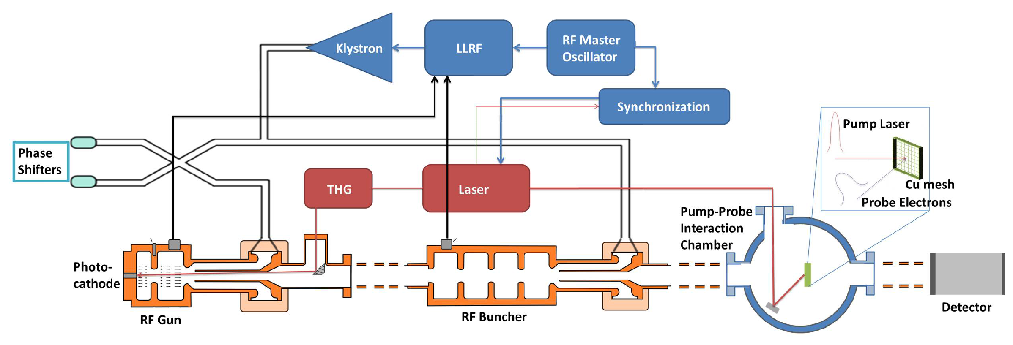
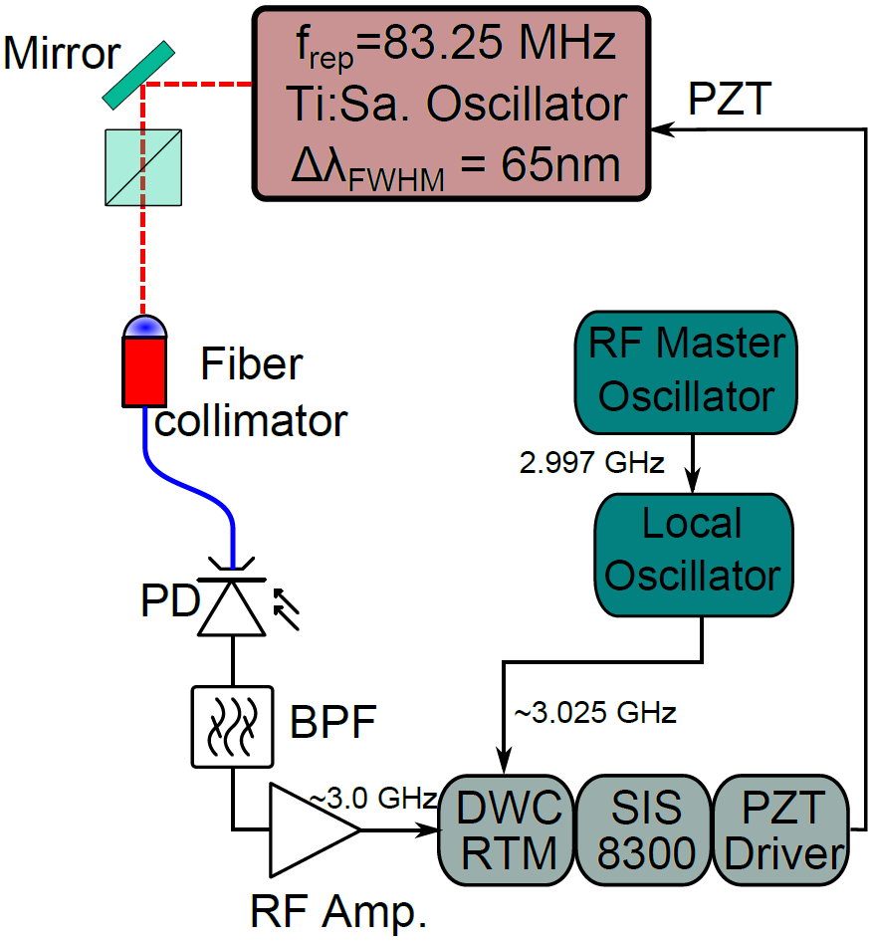
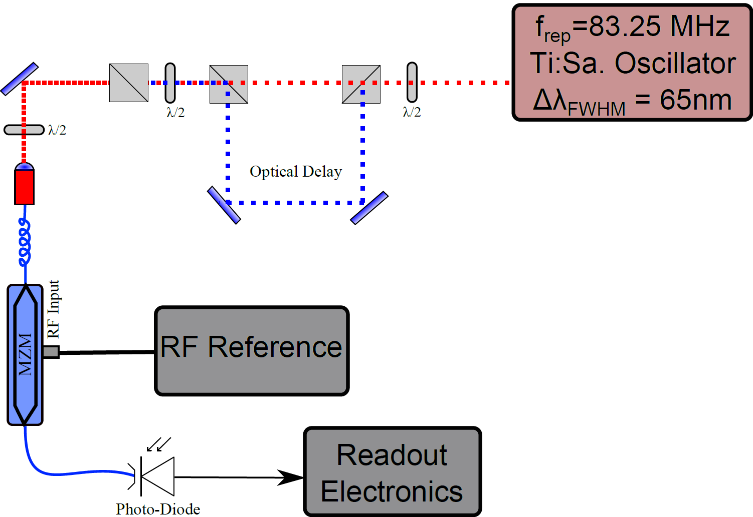
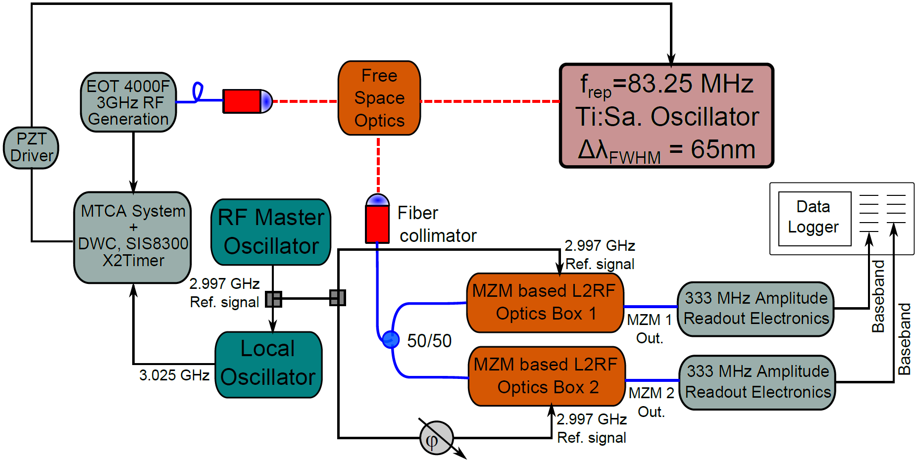
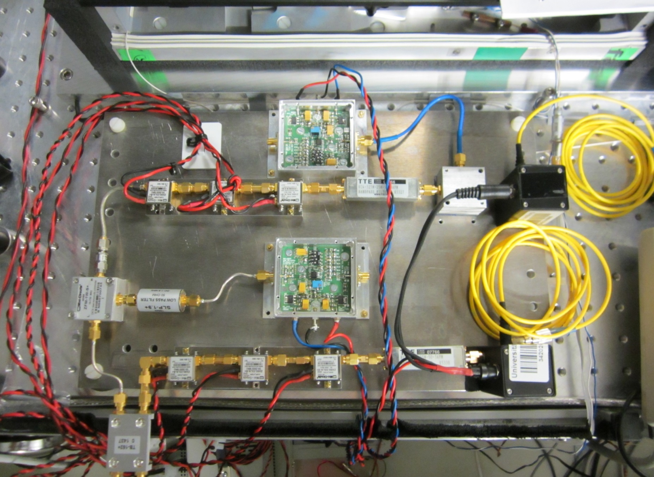



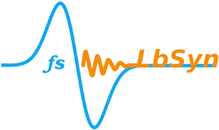
Laser-to-RF conversion for Titanium Sapphire Lasers.
M. Titberidze, F. Grüner, B. Zeitler, University of Hamburg, CFEL, Hamburg, Germany H. Schlarb, M. Felber, T. Lamb, C. Sydlo, DESY, Hamburg, Germany
General Layout of REGAE Facility
Average Beam Energy | 5.6 MeV
Energy Spread | 20 keV
Bunch Charge | 100 fC
Bunch Length | 7 fs (rms)
Transverse Beam Size | 3.2 μm
Transverse Emittance | 30 nm
Relativistic Electron Gun for Atomic Exploration (REGAE) is an S-band normal conducting RF Accelerator which generates ~ 10 fs duration electron bunches.
Currently, REGAE is used for Ultrafast Electron Diffraction (UED) experiments and will be used for planned Laser driven plasma acceleration experiments.
Both experiments require very precise Laser-to-RF sub-50 fs long term timing stability.
Current DWC based synchronization system.
New MZM based synchronization system.
Long term performance of the DWC based synchronization setup is in the order of several ps.
It is limited by AM/PM effects and influenced by environmental conditions.
The idea is, to take the incoming laser pulse train and to split it into two beams.
After splitting, a time delay is introduced to one of the pulse trains.
Laser pulses should arrive on opposite slopes of the RF.
In this particular case the time delay T=T_{laser}/8 ~ 1.5 ns.
Using MZM any phase error is converted to amplitude modulation which can be detected.
It is virtually optical power fluctuation insensitive and eliminates AM to PM conversion.
Measurement setup of MZM based L2RF Synchronization System & Results.
Intrinsic detector stability without RF T_{rms} = 4.1 fsec
contact: mikheil.titberidze@desy.de
3rd ARD ST3 workshop

