Slide 1
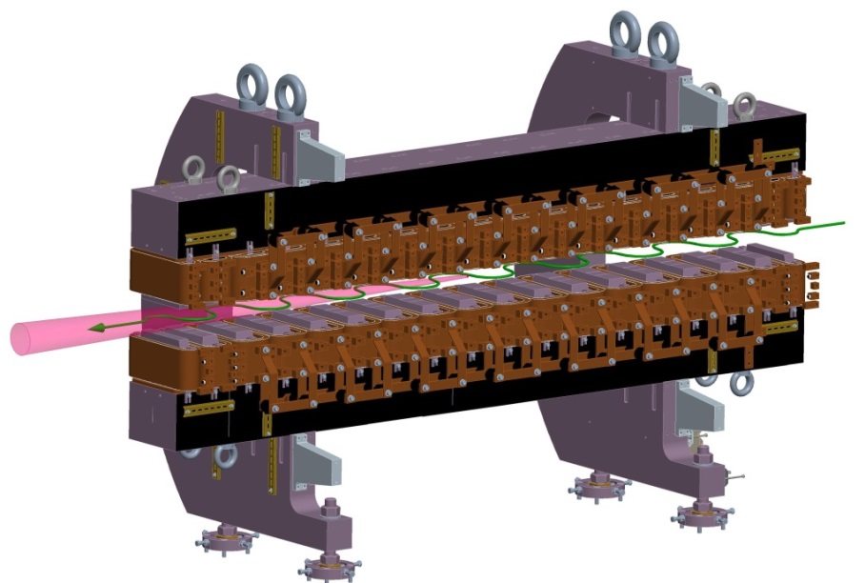
Superradiant Undulator Radiation
undulator at TELBE
GOAL: tunable, narrow bandwidth
in the THz
2 facilities worldwide = in Germany
-> FLASH & TELBE
Status and future Developments
are presented
THz
e⁻
8 periods
electro-magnetic
20% BW

