Slide 1
LLRF device inventory management
for the European XFEL
Julien Branlard, for the LLRF team
LLRF device inventory and management
DESY, 14.10.2015

Slide 2
PROBLEM STATEMENT / TALK OVERVIEW
Low level radio frequency system (LLRF) for the European XFEL
complex subsystem essential to the accelerator operation
comprises over 2000 main electronic boards and modules (> 10k components)
all of them undergoing production, testing, installation and maintenance life cycles
Asset management is required
labelling and book-keeping of these components is essential
during the installation, commissioning and operation phases of the accelerator
Current implementation and outlook
Mix of tools
Backed-up hard drive
DESY's Kabel DokumentationsSystem (KDS)
XFEL’s Electronic Document Management System (EDMS)

Slide 3
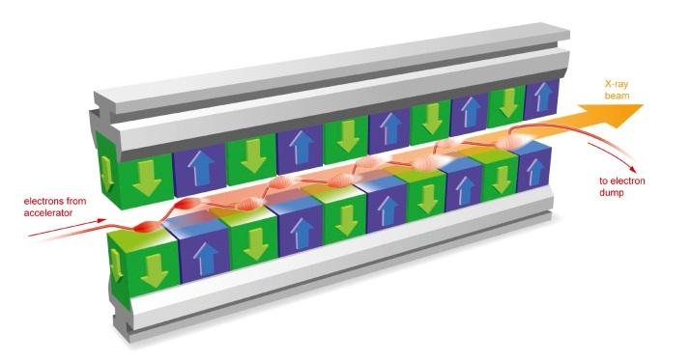
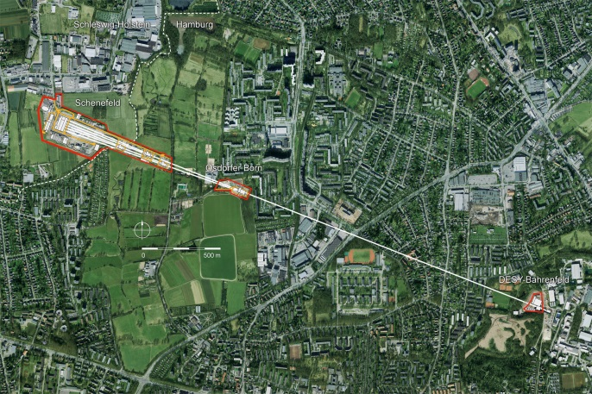
XFEL and DESY
European X-ray Free Electron Laser (XFEL)
Pulsed superconducting 17,5 GeV accelerator + variable gap undulator lines
Delivering ultra short X-ray flashes (27,000 / sec)
Construction 2009 – 2016
User facility 2017
http://www.xfel.eu/
Deutsches Elektronen Sychrotron (DESY)
In kind contribution from DESY
Low-level radio frequency system (LLRF)
Controls the RF field to accelerate the electron beam
Design, production, installation, commissioning and operation
http://www.desy.de/
see talks from
M. Bieler
S. Haid
B. List

Slide 4
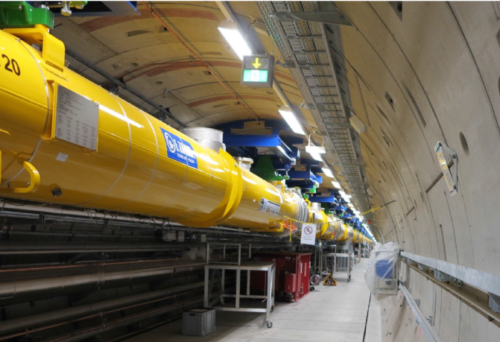
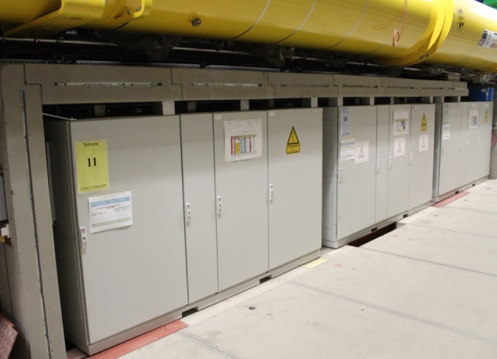
The European X-ray Free-Electron Laser (XFEL)
808 superconducting 1.3 GHz TESLA RF cavities
101 cryomodules (8 cavities)
25 RF stations (4 cryomodules)
1 LLRF system / RF station (i.e. per klystron)
BEAM
CM1
CM2
CM3
CM4
LLRF master
KLYSTRON
LLRF slave

Slide 5
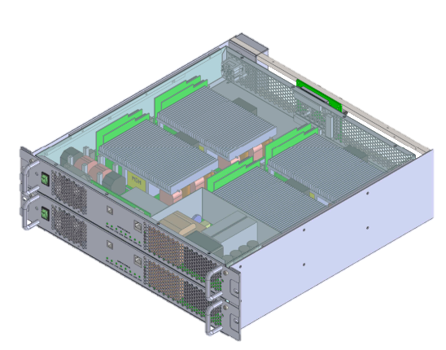
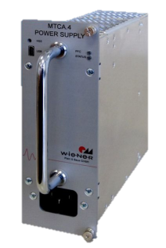
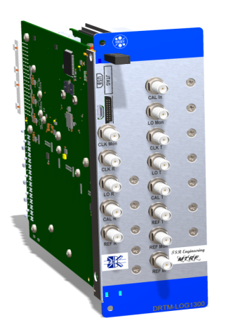
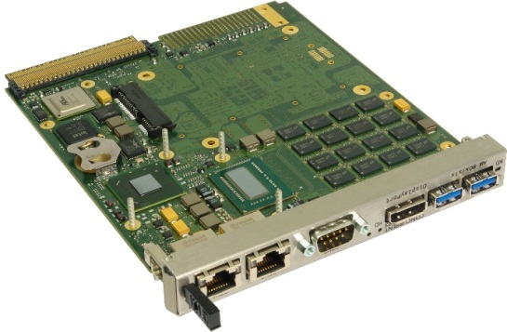
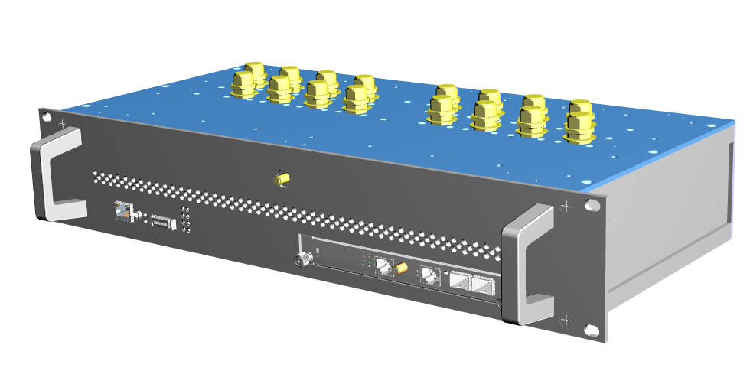
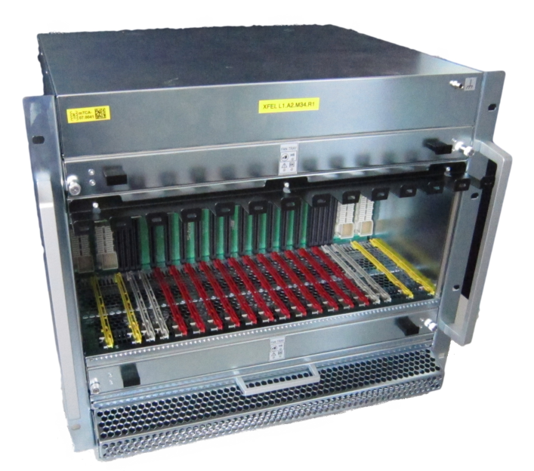
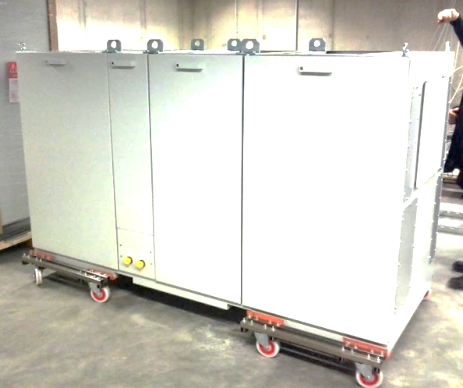
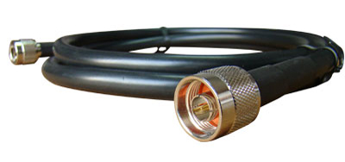
The XFEL LLRF System

Slide 6
R&D versus MASS PRODUCTION
R&D life cycle
Documentation in N: drive (backed-up),
Living files in SVN (version tracking): HW, FW, SW source files
Failure reports, meeting minutes, tracked via RedMine
Ad Hoc solutions: Google Docs, Dropbox, USB stick, Personal Computer etc…
Mass production life cycle
Hard drive solution (unsatisfactory)
KDS
EDMS
Database (AMTF, XFEL)
Mass Production
R&D
Production
QA&QC
Installation
Operation
Decommission

Slide 7
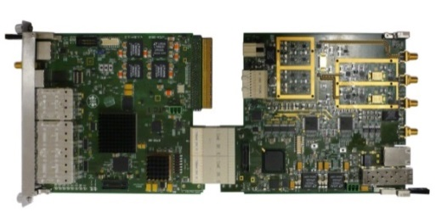
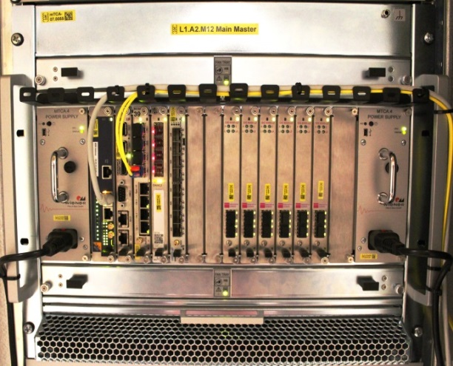
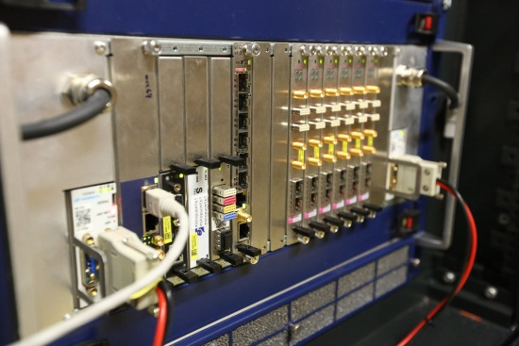
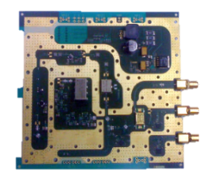
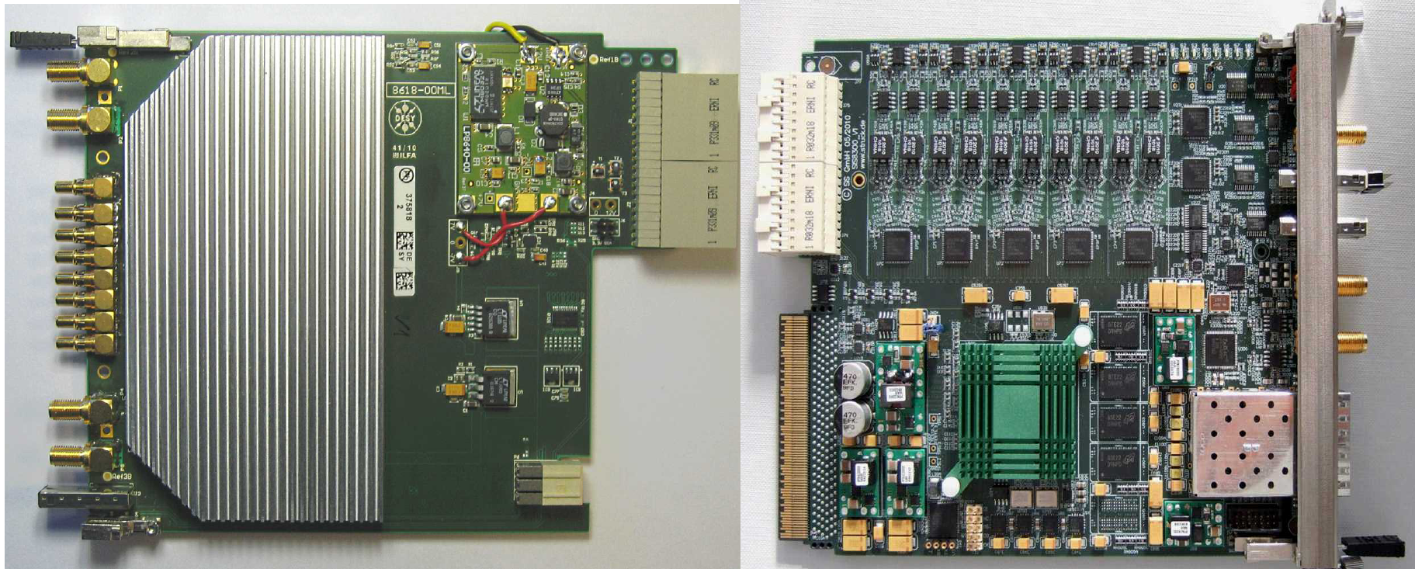
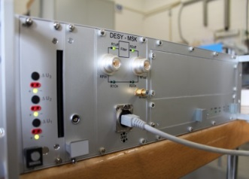
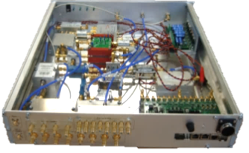
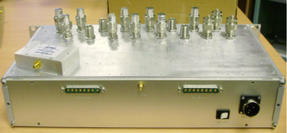
The XFEL LLRF System
VM
TC
CRATE
PM
uLOG
DWC
MTCA
ADC
PSM
PZ16M
CPIM
RACK
LOGM
DCM
MTCA

Slide 8
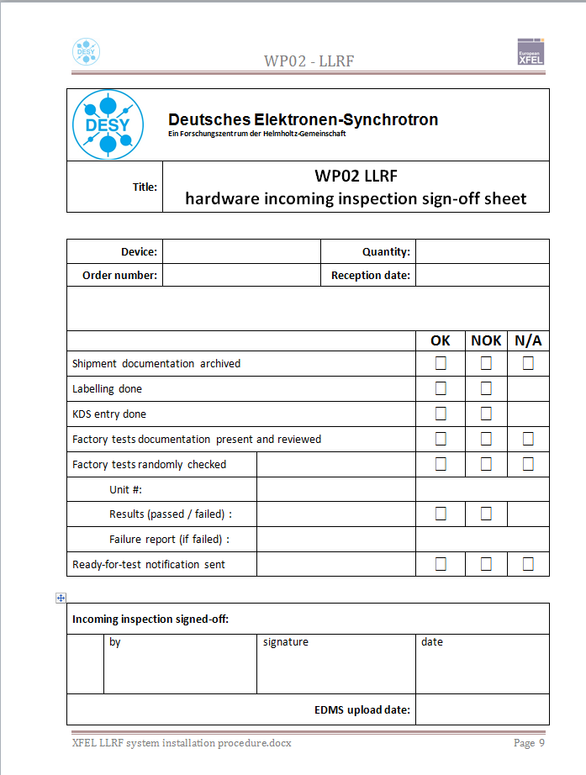
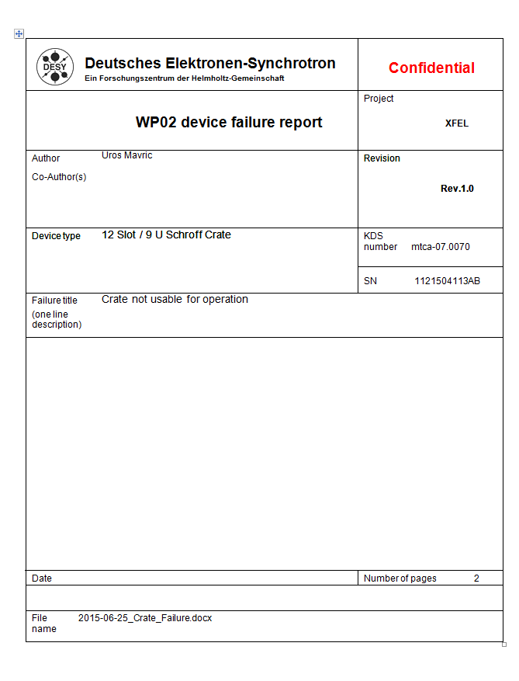
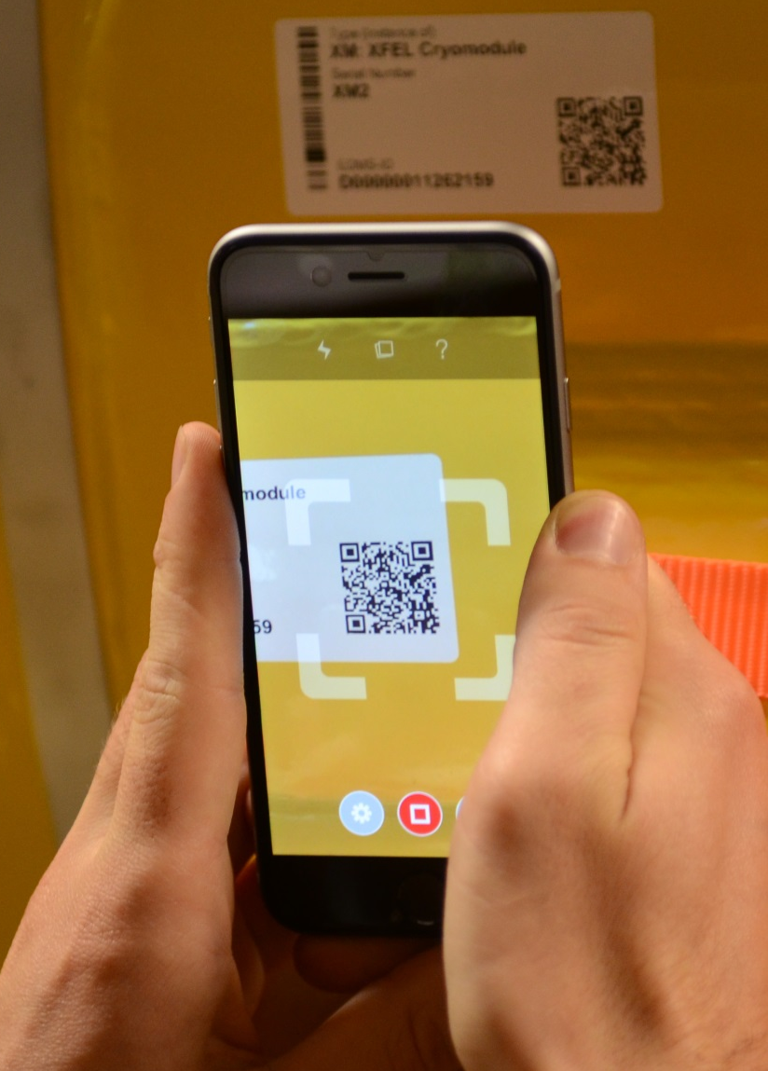
The XFEL LLRF System: ASSET OVERVIEW
Incoming inspection
Delivery
Shipping documentation
Device labelling
Entry in database (KDS)
Random verification of company tests
Acquisition documentation (invoice, manufacturers test)
Incoming documentation (failure / test reports)
Virtual device in database
New device in storage

Slide 9
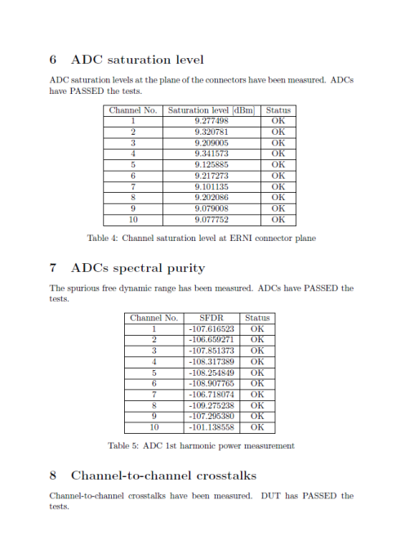
The XFEL LLRF System: ASSET OVERVIEW
Incoming inspection
Device test
For selected device, dedicated tests in test stand
Test report is generated and stored
Device is marked as tested / approved (sticker)
Test documentation
Templates
Instruction for test stand use (bugs, calibration…)
Test reports (passed, failed, non-conformity report)
Patch description
Tested devices
Inventory / storage
History

Slide 10
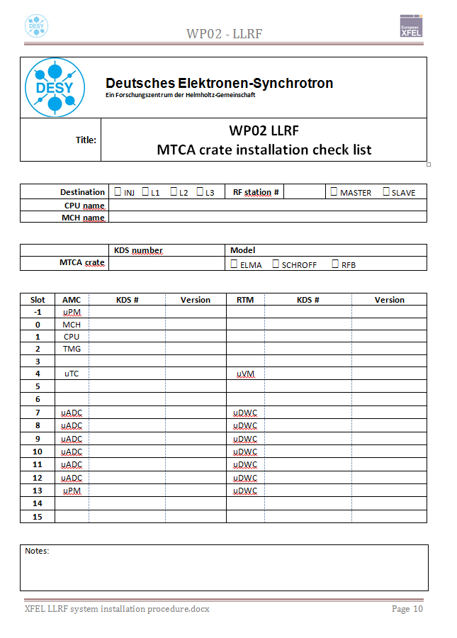
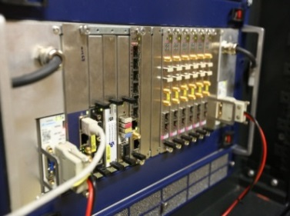
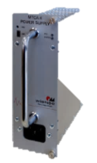
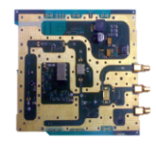
The XFEL LLRF System: ASSET OVERVIEW
Incoming inspection
Device test
Crate installation
Selection of components from storage
Upload configuration in database (KDS)
Installation of firmware, servers
Basic functionality checks
Fill-in crate assembly checklist report
MTCA
Installation and commissioning documentation
Template
Reports
Checklists, …
Virtual equipped crate
Stored equipped crate

Slide 11
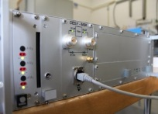
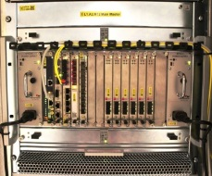
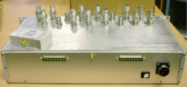
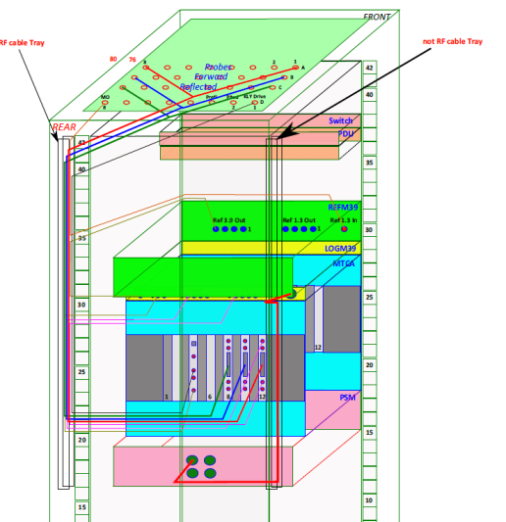
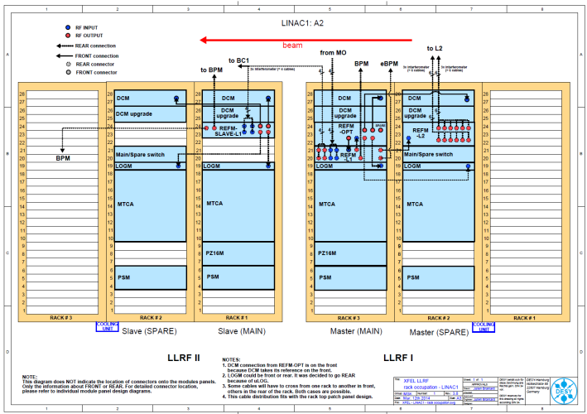
The XFEL LLRF System: ASSET OVERVIEW
Incoming inspection
Device test
Crate installation
Rack installation
Module installation
Inner-rack cabling
Integral tests
Storage, ready for tunnel installation
PSM
PZ16M
CPIM
LOGM
DCM
MTCA
Installation and commissioning documentation
Template
Reports
Checklists, …
Virtual equipped rack
Stored equipped rack
cabling instructions
rack occupation plans

Slide 12
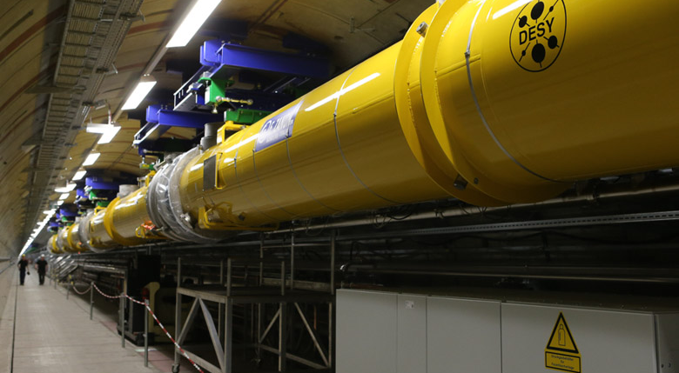
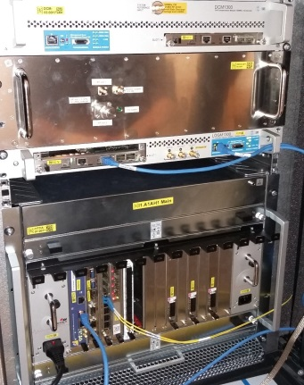
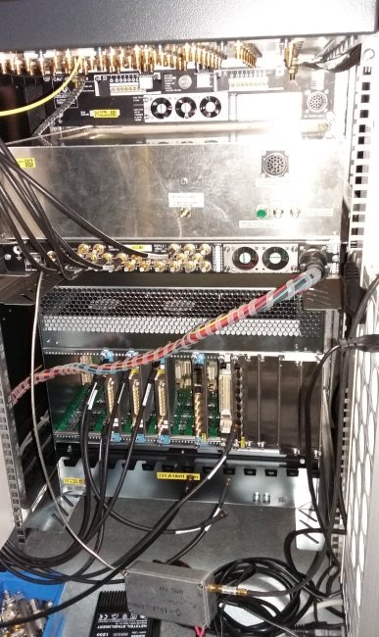
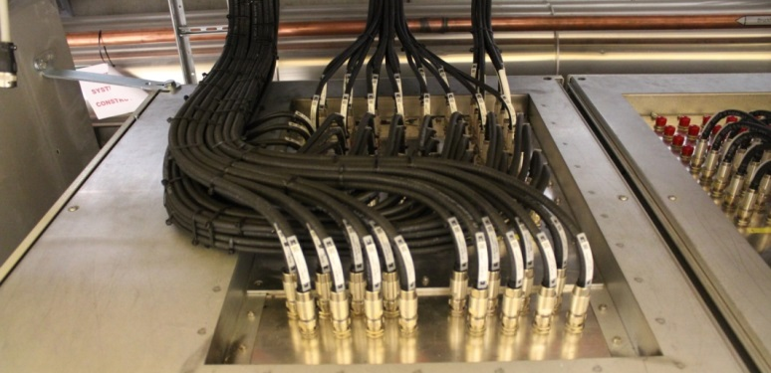
The XFEL LLRF System: ASSET OVERVIEW
Incoming inspection
Device test
Crate installation
Rack installation
Tunnel installation
Cabinet transport
RF cabling (outer rack)
Connections to mains, water and Ethernet, fibers
Commissioning checklist
Installation and commissioning documentation
Template
Reports
Checklists, …
Virtual LLRF system
Installed LLRF system

Slide 13
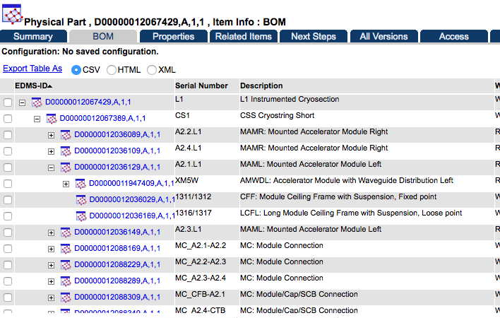
Current Solution and Outlook
Mixed use of tools
KDS
is required for cabling plans
is the database for LLRF device tracking
offers nice GUI interface
EDMS
is the XFEL official documentation system
is supported and maintained by DESY
has automatic import tools
external 19” module
Rack occupation
graphical representation
exploit existing links to get best of both worlds
equipped
MTCA crate
Avoid data duplication
Minimize manual effort

Slide 14
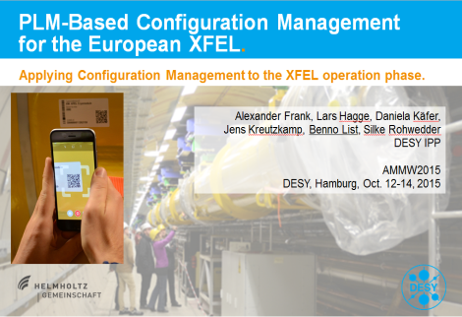
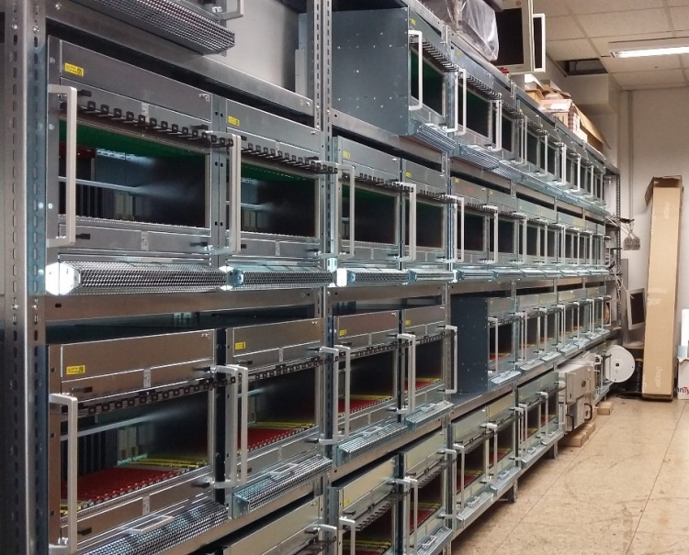
Current Solution and Outlook
This talk
Benno List’s talk
How to:
upload
browse the data
use
1:1
“What we need”
“What DESY offers”
Fault tracking
Currently: from machine operation + internal book keeping
Hope is to get more reliable data + statistics from EDMS
Lessons learnt from GIS (radiation prone environment)
Stock management
Useful for risk assessment
Use EDMS to help us better manage our device inventory?

Slide 15
Current Solution and Outlook
Finding the data: “if it’s easy, people will use it”
Multiple entry points (ease of navigation)
Fast database queries
Keywords / smart indexed searches
Web access (hidden security)
Training
Maintenance: “asset information is only useful if it is up-to-date”
validity of data
should be easy
Installation → Operation: “moving from a snapshot to a living database”
Include operation parameters (calibration files for ex.)
Include system health statistics? (temp., fan speed, CPU usage, etc…)
…
relies on QA/QC administrator relies on self discipline from users how can we improve what we do ? how can tools help us ?
as little work overhead as possible automatic tools to update information

Slide 16
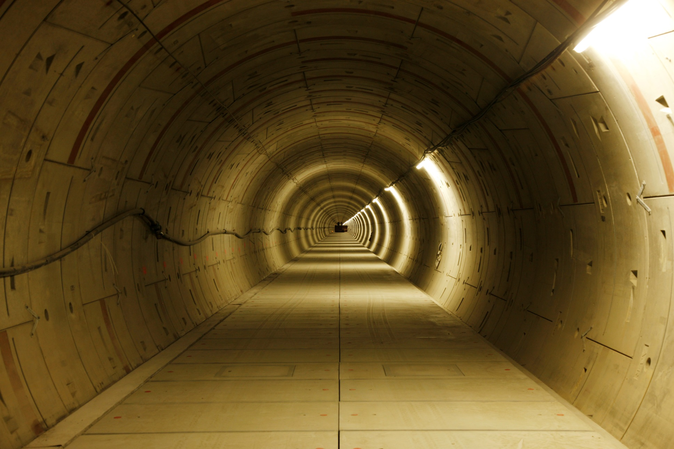
QUESTIONS ?
THANK YOU VERY MUCH FOR YOUR ATTENTION!

