Slide 1
Initial results of Proton irradiated HVStrip1 chip – MB04
B. Todd Huffman for
G.O.R.
(Glasgow, Oxford, RAL groups and also QMUL and Cambridge)

Slide 2
Reminder of B’ham Radiation and the State of Play
Two chips irradiated.
MB03 is no longer viable; problem when testing passive pmos structure
MB04 working and subject of these tests
27 MeV protons
~8.0E+14 n/cm² for MB04
Device has remained at less than -10 deg. C.
Most of the time @ -20 deg. C.
All bias voltages @ -60V

Slide 3
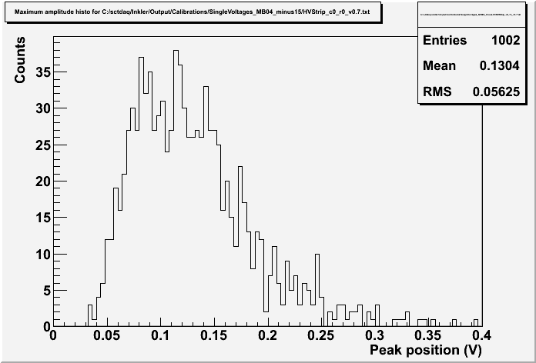
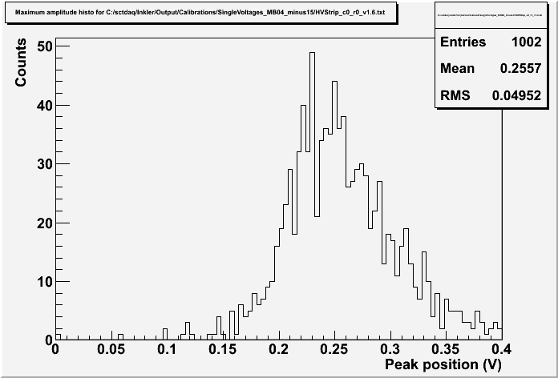
After Radiation chip very noisy
VNFB = 5
V injected = 60mV
Charge injection plots here →
V injected = 150mV
Ivan explained that one of the set-up DAC’s should be changed. It sets a feedback level in the shaper of the amplifier. (VNBF)

Slide 4
Also on unirradiated chip – MB01
Volts
Volts
There are several global DAC’s on HVStrip1 set-up.
Are there any others we should be playing with?

Slide 5
Fe55 on Cold, unannealed MB04
There is clearly a signal here, but the Fe55 peak is hidden inside the noise even when VNFB is reset. Conclusion: Situation is improved, but still noise dominated.

Slide 6
MIPS attempts
DESY testbeam time – Thanks Marcel Stanitski!!
March 9-15; 3, 4, and 5 GeV electrons
MB01 and MB02 placed in beam
Self-triggered data and small amount of data triggered by the beam.
R. Plackett, L. Vigani (Ox), J. Dopke (RAL), K. Kanisaukas (Glasgow), K. Hayrapetyan (QMUL)
Cold, 208MBq ⁹⁰Sr at Cambridge – Thanks Bart Hommels!
⁹⁰Sr Source, Scint. & PMT trigger, DUT in between.
In freezer capable of -45 deg. C. (running @ -40)
Trigger using a LeCroy Waverunner Scope
Only scope we found that could do a true dual channel coincidence trigger.
J. Dopke, T. Huffman, L. Vigani, M. Arratia (Cam.), B. Hommels (Cam.)
Both cases low trigger rates.
Desy 2-3 Hz
Cambridge 2-3 per minute.

Slide 7
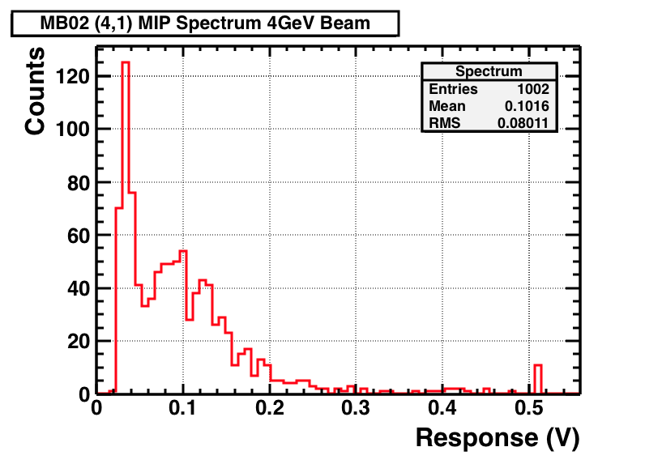
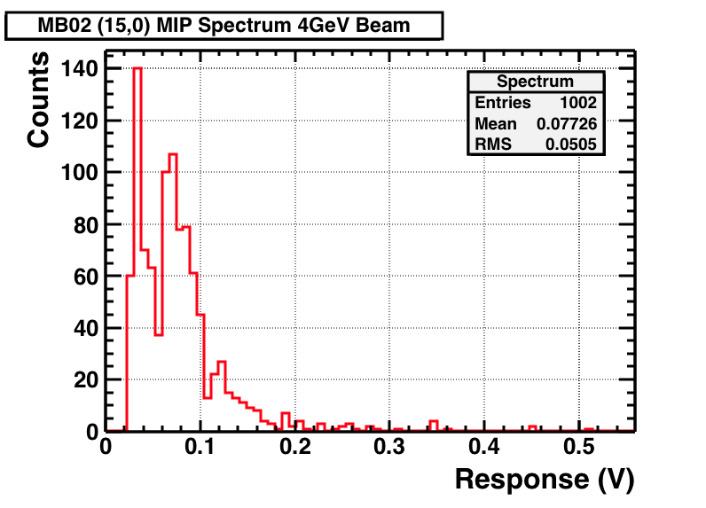
@DESY - MB02 Full Pixel Matrix Scan
High Gain Pixel
Low Gain Pixel
Trigger on analogue output at 25mV
1000 events were acquired for each pixel (DAQ rate ≈ 1Hz)
MB02 was not calibrated beforehand, therefore, response presented in volts

Slide 8
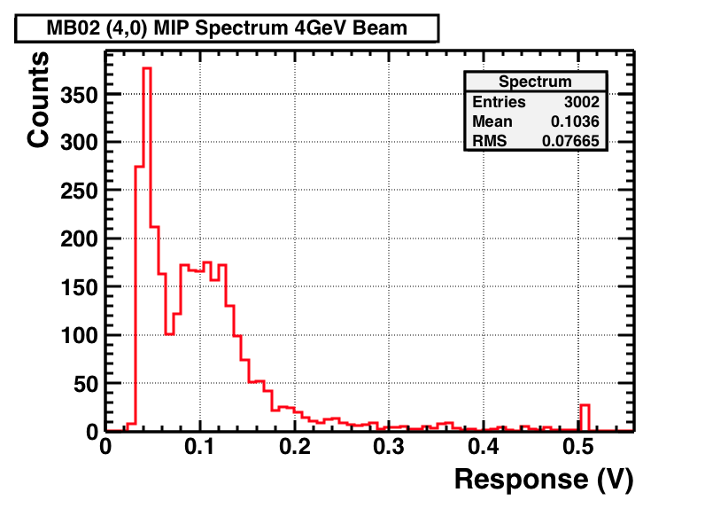
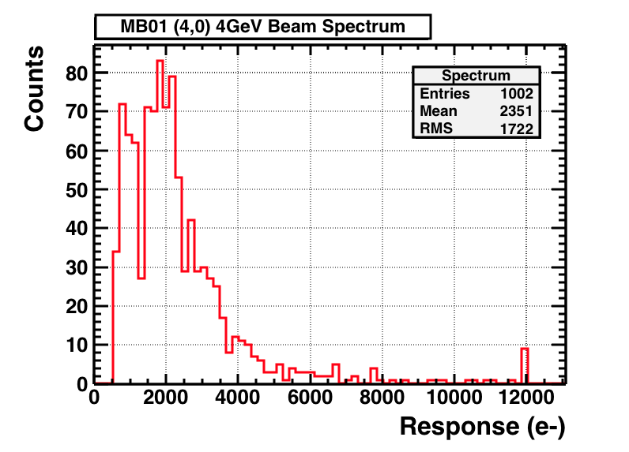
@DESY - Single Pixel Scan
One high gain pixel (4,0) of MB02 was selected for larger number of samples acquisition (3000 events)
Threshold was set 25mV as before
Resulted in more clearly distinguished features on histogram

Slide 9
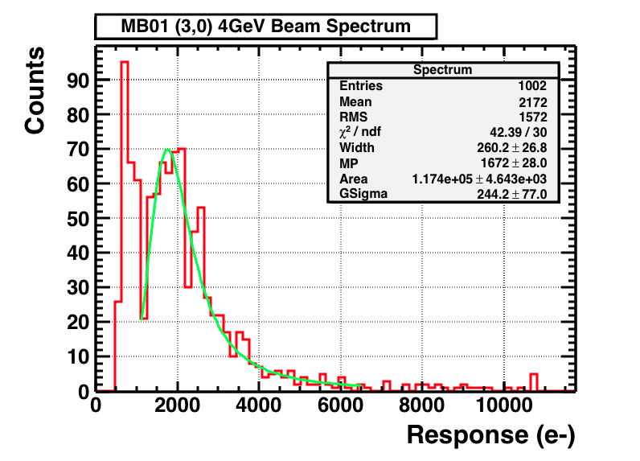
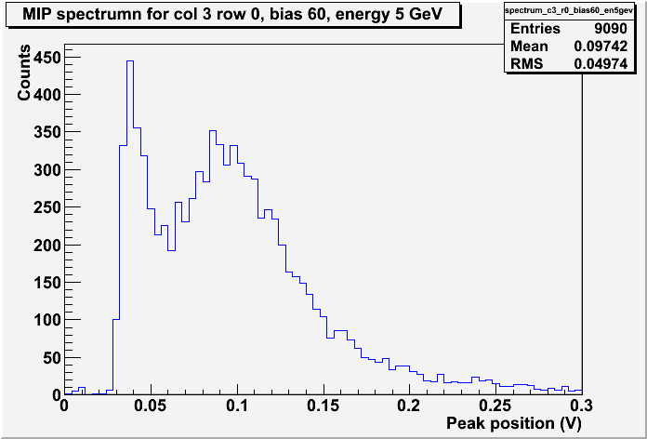
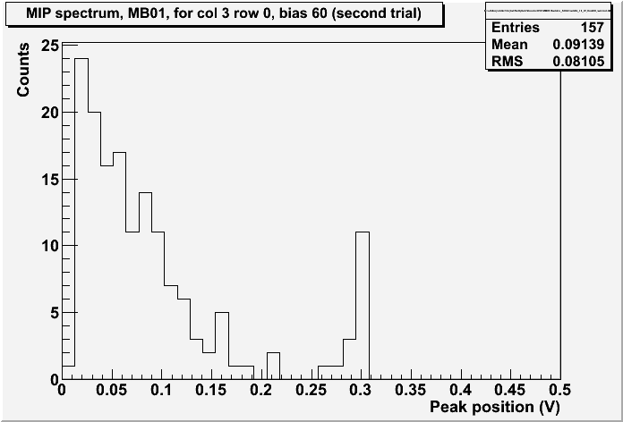
MB01 @ DESY & Cambridge
From fit, MP = 1672±28.0
overflows

Slide 10
@Cambridge Triggered ⁹⁰Sr Source
Irradiated chip MB04 →
DESY chip MB01 unirradiated
Enough Statistics; no obvious MIP maximum visible.
Overflows
Need more statistics on unirradiated devices. Left one back at Cambridge.

Slide 11
Some thoughts
Difficult to get MIP signals but we are having some success.
The 60V limitation on current Mother Boards is giving us less signal to MIPS than we could have.
May get 1.4 times MIP signal @ 120V bias.
Time to start replacing that big capacitor On Mother boards.
If changing VNFB can have such a dramatic effect, what do the other global settings do?
Any updated documentation available?
MB04’s performance, prior to annealing, is not great.
No ⁵⁵Fe peak observed; No MIP maximum seen
Even @ -40º C.

Slide 12
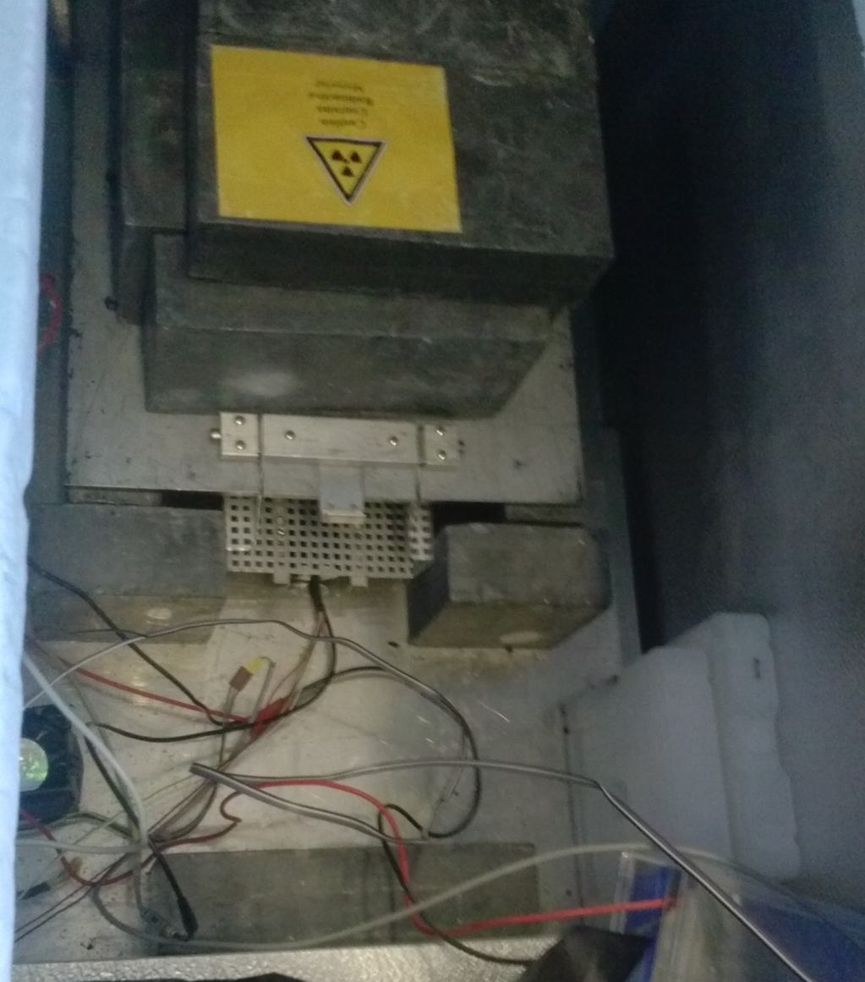
Current short-term plans
Bart, Miguel to anneal MB04 – today!
Collect ~24 hours data on Channels 3,0 and 17,1
Switch back to an unirradiated chip (MB06?)
Collect high MIP statistics.

Slide 13
Massive Thanks!
Marcel Stanitzki – DESY
Adrian Bevan, Karen Hayrapetyan – QMUL
Bart Hommels, Miguel – Cambridge
Kestutis Kanisauskas – Glasgow
Luigi Vigani, Richard Plackett – Oxford
Jens Dopke – RAL
A lot accomplished so far, more to do!

Slide 14
Backup slides

Slide 15
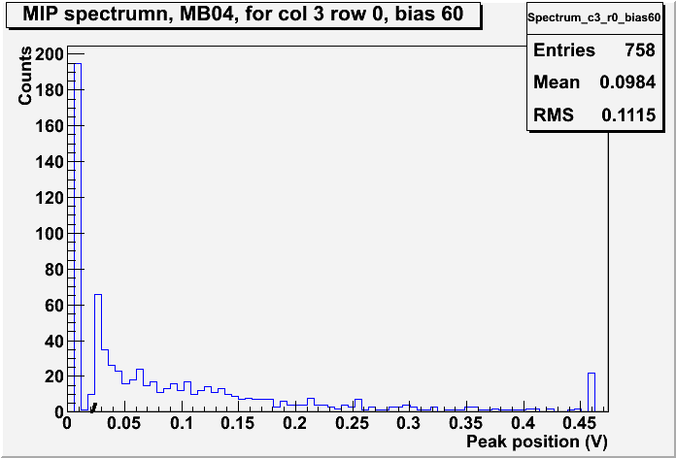
MB04 @ Cambridge

Slide 16
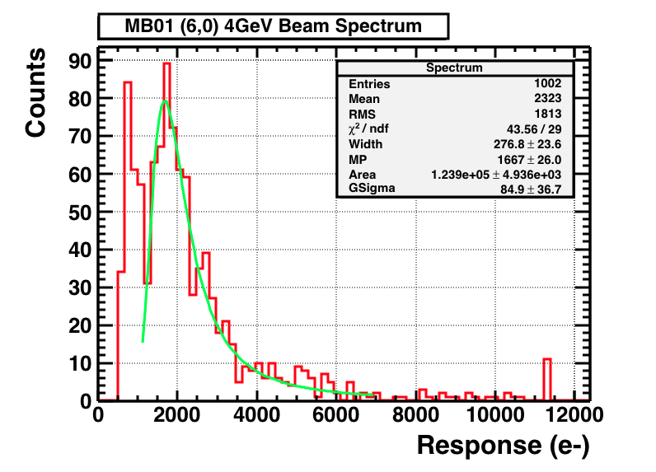
DESY fitted distribution to landau

Slide 17
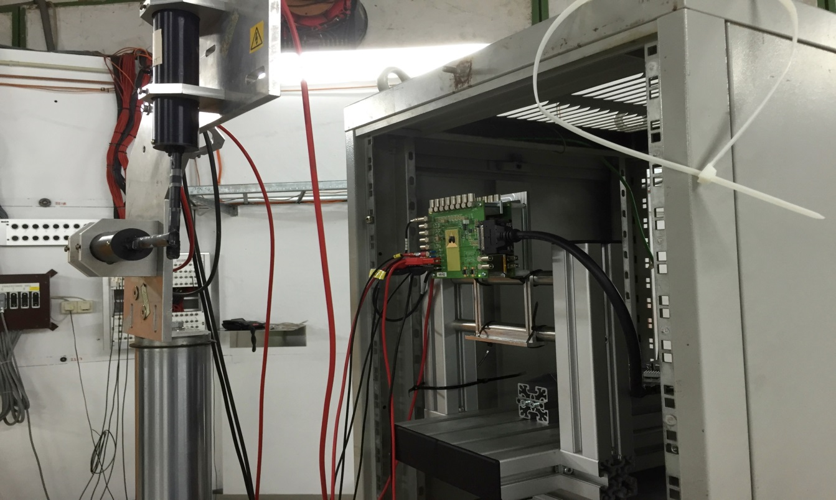
Re-arrangement of the Setup
MB06
HV = -60V
Beam Direction
Scintillators
MB02
Next step was to re-arrange the setup so that DAQ would be triggered by coincidence signal of two scintillators
The objective was partially achieved after multiple alignment with the beam attempts
Trigger rate was very slow (231 events in ≈ 12h)

Slide 18
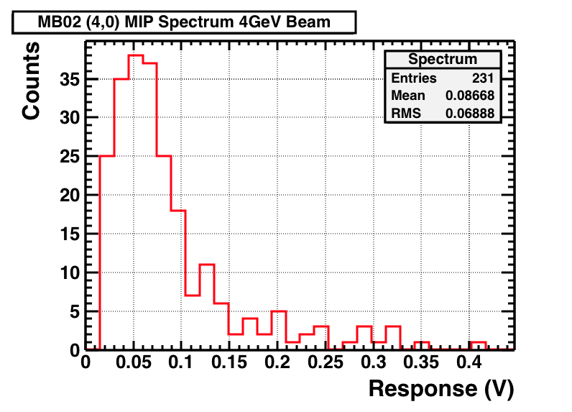
@DESY - Triggered DAQ results
Pixel (4,0) was selected for data acquisition
Events of interest were selected within LabView VI
Threshold of 25mV was still applied for analogue output

Slide 19
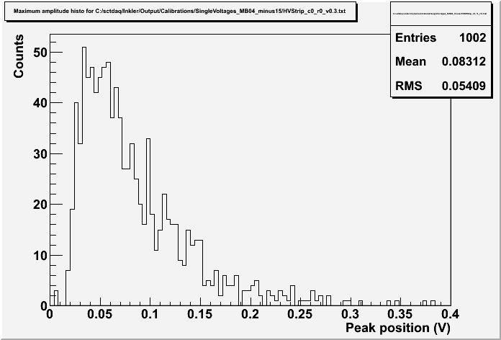
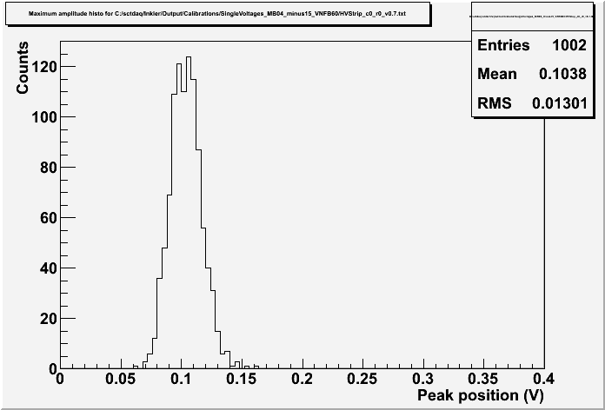
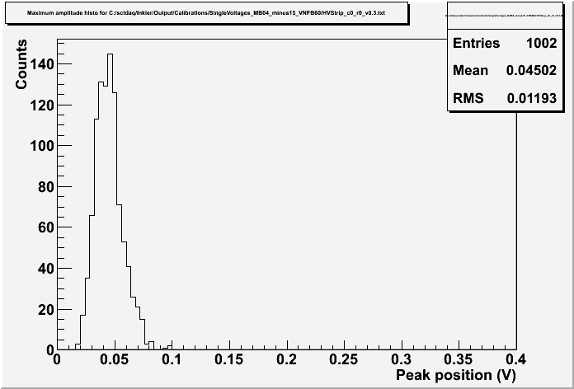
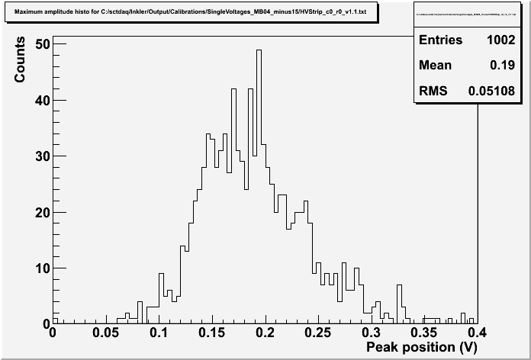
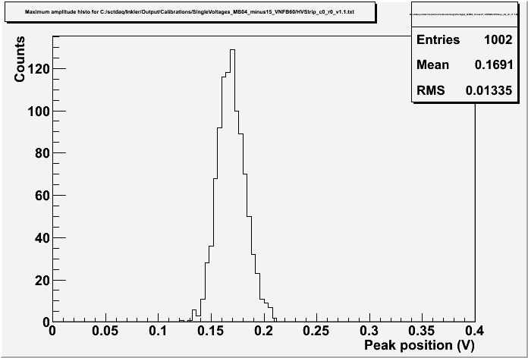
Direct comparison – MB04 (charge injection = 60mV)
Significant decrease in noise!

