Slide 1
Status of test kit 31 March 2015
J. J. John with help from many others

Slide 2
HVStripV1 hardware distribution
Status
The distribution is tracked on the ATLAS TWiki here: https://twiki.cern.ch/twiki/bin/viewauth/Atlas/HardwareListUK#HVStripV1_Motherboard
At the moment, 3 chips are not working (DB 03, DB07, DB11), 1 motherboard is to be tested (MB10) and one to be allocated to waiting groups (MB06 or MB12).
Once all repairs and tests are done, that will give 5 motherboards.
Next step is more bonding of daughterboards at RAL.
4 institutes need a motherboard: Karlsruhe, Argonne (repair), RAL (repair), QMUL.
Irradiation campaign for statistics
We discussed irradiating many HVStripV1 chips to gain failure statistics.
We should decide how many daughterboards we need for this, then how many motherboards.

Slide 3
CHESS-1 hardware design
AMS-CHESS-1 daughterboard
Layout nearly complete – see next slide.
Current dimensions: 37mm x 43mm (will grow a bit)
Have been reviewing footprint iteratively with UCSC
AMS-CHESS-1 motherboard
Working on parts and schematics.

Slide 4
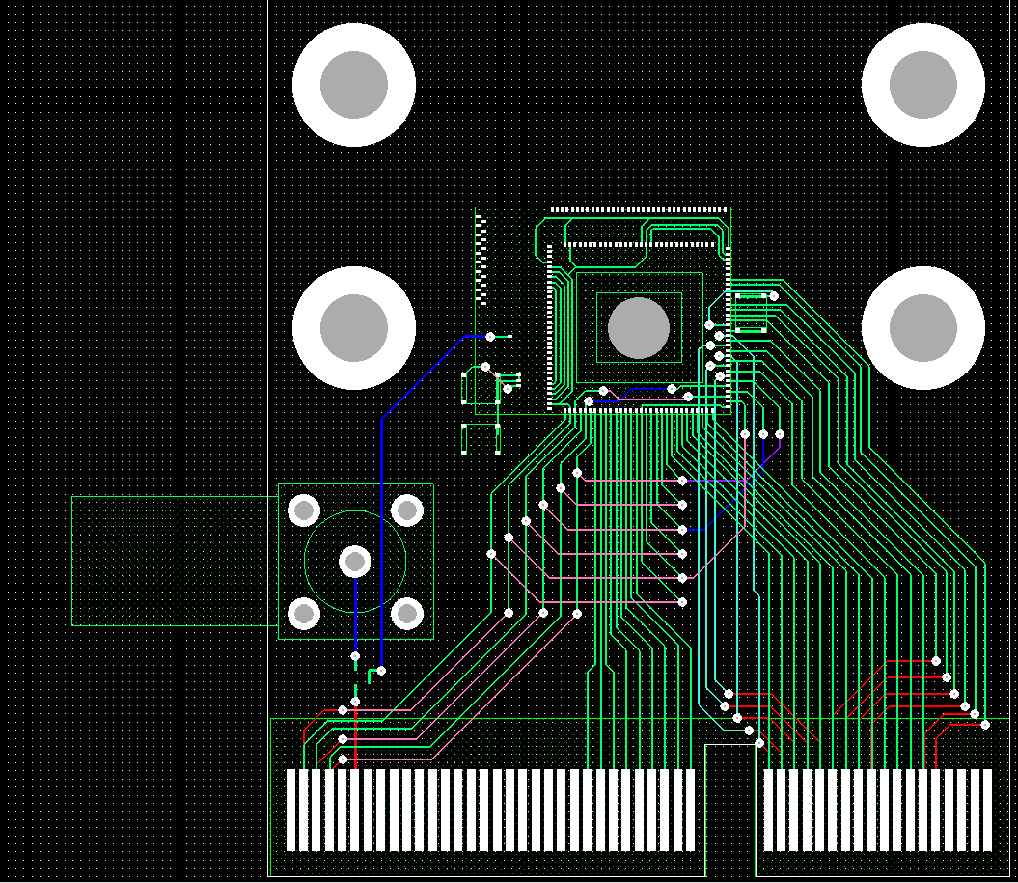
AMS-CHESS-1 daughterboard
AMS-CHESS-1
Capacitor
Capacitors
Lemo footprint
(HV back-up)
Edge connector (fits Samtec MEC6 100-pin connectors)

