Slide 1
Time allocation to commissioning of x-ray systems with beam (2017-2018)
COM Meeting
Hamburg, April 08, 2015
Thomas Tschentscher for European XFEL
thomas.tschentscher@xfel.eu
Notes:
How to edit the title slide
Upper area: Title of your talk, max. 2 rows of the defined size (55 pt)
Lower area (subtitle): Conference/meeting/workshop, location, date, your name and affiliation, max. 4 rows of the defined size (32 pt)
Change the partner logos or add others in the last row.

Slide 2
DISCLAIMER:
VERY first thoughts !
Not yet cross-checked with anyone !
Only using early time estimates and known deliverables.
Basis for discussion !

Slide 3
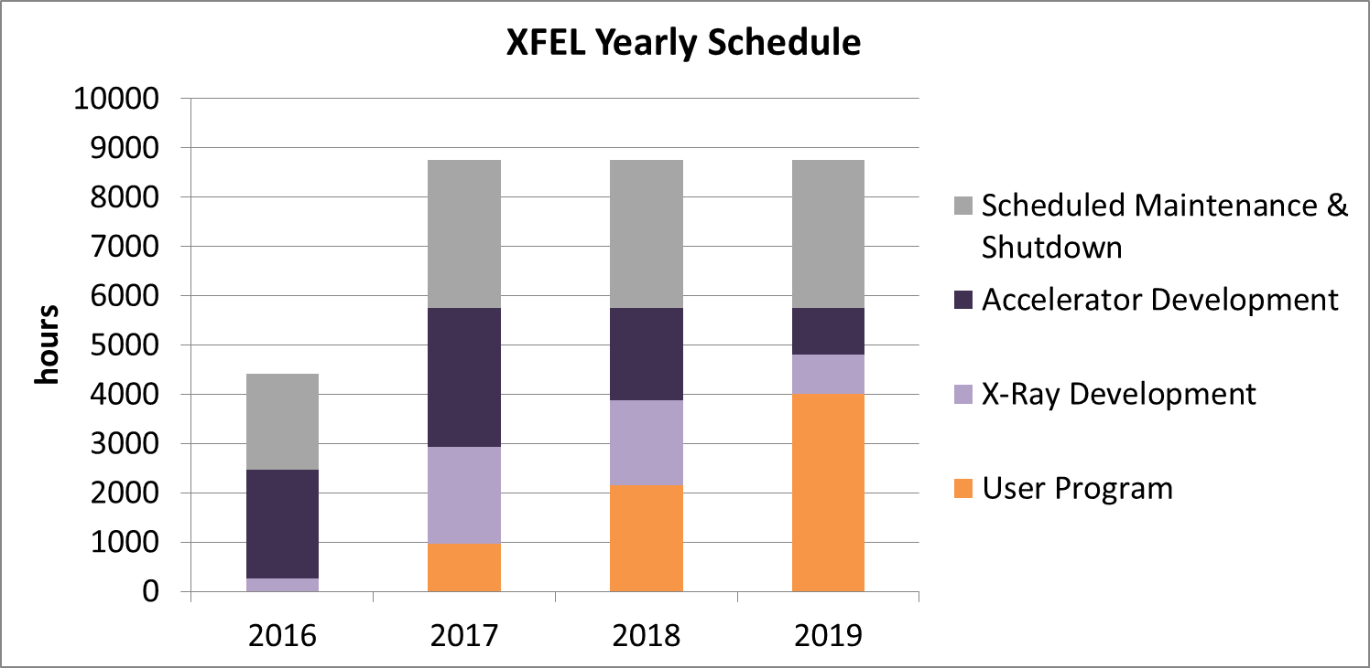
Context
hrs | 2016 | 2017 | 2018 | >2018
Accelerator | ~2500 | 5600 | 5600 | 5600
X-ray delivery | <200 | 2800 | 3900 | 4800
Users ΣU_{NNN} | 0 | 1000 | 2000 | 4000

Slide 4
From commissioning to operation
Commissioning aims
Commissioning of electron beam to generate hard x-ray SASE FEL radiation as soon as possible
Commissioning of x-ray instrumentation to launch early user program
Continue development of e⁻-beam and instruments for ~1 ½ yrs to reach extended electron and x-ray beam delivery
Early user operation
Starts 14 weeks after first SASE and includes all instruments after 7.5 months
Full user program
Provide full number of user hours when reaching the milestone of extended electron and x-ray beam delivery
First SASE FEL
SASE1
Start accelerator
com.
Early user ops.
SASE1
Early user ops.
All instruments
Extended beam
delivery
2016
2017
2018

Slide 5
Ramp-up of experiments
SPB & FXE (SASE1)
First beam end 2016
Early user operation from May 2017
SQS & SCS (SASE3)
First beam Feb 2017
Early user operation from June 2017
MID & HED (SASE2)
First beam Apr 2017
Early user operation from August 2017

Slide 6
User operation
Dedicated operation of accelerator/undulator/x-ray beam transport to deliver x-ray beam of defined quality to a science instrument. Typically to only one science instrument per FEL, parasitic use by a 2nd instrument is discarded in the following considerations.
Early User Operation (May 2017 – fall 2018)
Desireable to get started with user program and to perform real exps.
Accept first user experiments (based on peer-review) to be performed while only a sub-set of ACC/FEL/x-ray/instrument capabilities is available. These capabilities will change and improve over the duration of Early User Operation, but shall in any case be defined in the call for proposals.
It has to be made clear to Early Users that this period includes learning to operate European XFEL. Failures and loss of experiment time has to be considered.
Full User Operation (>fall 2018)
Full performance of ACC/FEL/x-ray/instrument shall be reached. User proposals can assume that these capabilities are available to them.

Slide 7
Early User Operation
Reduction of ACC/FEL/x-ray/instrument capabilities can/will include:
Accelerator performance
Bunch repetition rate
Availability of shortest and longest (most intense) x-ray pulses
Stability (position, pointing, intensity/saturation)
Switching between beam lines and modes
…
FEL
Fixing source point (distance to experiment)
Gap tuning
X-ray delivery
Stability and heat-load compensation
Single-shot photon diagnostics
…
Instruments
Availability and performance of equipment
Software, detectors, OL laser (schemes), …

Slide 8
How to get there ?
Commissioning accelerator (sub-systems) → W. Decking/T. Limberg
Commissioning x-ray systems
FEL undulators
X-ray delivery (beam transport, diagnostics)
Science instruments
Determine priorities
Establish fundamental (critical) parameters/performance (first delivery !)
Work towards parameters/performance required for early user operation
Develop parameters/performance such as to enable full performance
Requirements
Installations & instrumentation (incl. software) available/complete
Technical commissioning (comm. w/o beam) completed

Slide 9
Time allocation for comm. of x-ray systems
2016 - <200 hrs
The current plan foresees that the accelerator is ready for x-ray delivery by the end of 2016. This means that 0 hrs are available for x-ray system comm. with beam.
However, the x-ray systems (SASE1 & SASE3) should be readily installed and commissioned without beam.
Opportunities to use electron beam parasitically to be found out.

Slide 10
Time allocation for comm. of x-ray systems
2017 – 1800 hrs
First x-ray beam delivery to XHEXP1 (all SASEs; actually end of tunnel)
Close undulator,
verify beam position (screens),
transport through beamline,
measure x-ray beam properties (intensity, …),
verify initial function of equipment protection system (beam loss monitors),
optimize delivery at the tunnel end.
This ‘procedure’ should be fairly straightforward (old est.: 2 days/FEL)
First x-ray beam delivery to science instruments (all instrum.; to beam stop)
Open front-end
verify beam position (screens),
transport through instrument to beam stop,
perform radiation safety measurements,
measure x-ray beam properties (intensity, …).
This ‘procedure’ should be fairly straightforward (maybe 2 days/Instrument)
Total request: ~430 hrs (18 days)

Slide 11
Time allocation for comm. of x-ray systems
2017 – 1800 hrs
Optimize x-ray beam delivery to XHEXP1 (all SASEs; actually end of tunnel)
Optimize undulator settings in order to improve SASE FEL radiation,
Use of electron and/or photon beam diagnostics (→ comm w. beam)
Learn setting the undulator gap
Optimize x-ray transport through beamline(s),
Detailed measurement of x-ray beam properties (intensity, spectrum, …),
Show full functionality of equipment protection system (beam loss monitors),
Start to take additional ‘optics’ in tunnel sections into operation.
Each of these activities will require dedicated time w. beam and needs to be repeated for each FEL/x-ray beamline. In addition, some measurements may benefit from parasitic use of x-ray beam.
Total 480 hrs (20 days)

Slide 12
Time allocation for comm. of x-ray systems
2017 – 1800 hrs
Optimize instrument functionality (all instruments)
Verify functionality of all x-ray devices in detail (includes calibration, parameter setting, software verification, …)
Start operation of focussing devices; check performance
Complete integration of x-ray detectors
Test first ‘standard’ samples on main instrument component
Intermediate radiation safety tests.
Each of these activities will require dedicated time w. beam and needs to be repeated for each science instrument. In addition, some measurements may benefit from parasitic use of x-ray beam.
Some additional time as simultanuou delivery to SASE1 and SASE3 may occur during at least part of this time.
Total 900 hrs (~38 days) – means ~150 hrs (6 days)/instrument !!!

Slide 13
Time allocation for comm. of x-ray systems
2018 – 1900 hrs
Optimize FEL operation (all SASEs)
Optimize x-ray delivery (all SASEs)
Optimize instrument performance (all instruments)
Additional functionality of accelerator (repetition rate, special modes, …).
Each of these activities will require dedicated time w. beam and needs to be repeated for each FEL/x-ray beamline/instrument.
In 2018 simultanuous delivery of electrons to two electron beamlines shall occur.
In addition, some measurements may benefit from parasitic use of x-ray beam.
Share to be determined: 300/400/1200 hrs ????

Slide 14
Radiation safety measurements
PANDORA system for surveillance of accelerator operation
Continuous on-line measurement
Verification of x-ray hutches
Initial measurements when receiving 1st beam (small intensity)
Intermediate measurement for early user operation parameters
Final checks for full performance (max. # of delivered x-rays)

Slide 15
2017 – The most critical year
First delivery to instruments
Required to start using x-rays
Optimize FEL/x-ray/instrument performance
Essential commissioning step
Required to enable early user experiments
Early user experiments
Requires two previous steps to be completed
Task | Jan | Feb | Mar | Apr | May | Jun | Jul | Aug | Sep | Oct | Nov | Dec | Σ
SASE1 | 2/2/2 | 2/1/1 | 2/2/2 | 1/2/2 | 0 | 1/1/1 | 1/1/1 | 0 | 1/1/1 | 0 | 0 | 0 | 30
SASE3 | - | 2/2/2 | 2/1/1 | 2/2/2 | 1/2/2 | 0 | 1/1/1 | 0 | 1/1/1 | 1/1/1 | 0 | 0 | 30
SASE2 | - | - | - | 2/2/2 | 2/1/1 | 2/2/2 | 1/2/2 | 0 | 0 | 1/1/1 | 1/1/1 | 1/1/1 | 30
Total | 6 | 10 | 11 | 17 | 9+UM | 9+UM | 11 | 0 | 6+UM | 6+UM | 3+UM | 3+UM | ~90
Too much !!! (available: 75)

Slide 16
Conclusion / discussion
Time allocation for 2017 & 2018 for x-ray systems required, at least in a 1st version
2017 is a critical year with many required achievements for the x-ray systems
Detailed planning needs to include phasing of instruments
Start of early user experiments in May could be very tricky, as before this time only very limited time is available for the commissioning of the respective and required x-ray systems for the SASE1 instruments
To be continued

