Slide 1
Status of test kit 14 April 2015
J. J. John with help from many others

Slide 2
HVStripV1 hardware distribution
Status
The distribution is tracked on the ATLAS TWiki here: https://twiki.cern.ch/twiki/bin/viewauth/Atlas/HardwareListUK#HVStripV1_Motherboard
At the moment, 3 chips are not working (DB03, DB07, DB11).
We have new daughterboards in hand to replace these.
Next step = bond daughterboards to motherboards at RAL.
Irradiation campaign for statistics
We discussed irradiating several HVStripV1 chips to gain failure statistics.
After the last fortnightly meeting, we bonded 10 more daughterboards to cover the 3 repairs and some statistics.

Slide 3
CHESS-1 hardware design
AMS-CHESS-1 daughterboard
Layout in final stages – see next slide.
Dimensions: 42.9mm x 43.2mm
8 layer board
Will have provision for 6 capacitors: VDD x 3, iN, iNSF, iFB
AMS-CHESS-1 motherboard
Schematics in progress – using these parts:
TI DAC128s085 – octal voltage DAC + LM4132 voltage reference
Will use voltage DACs for all biases (agreed with chip designers)
ADG714 octal analogue switch
provides 8:1 concentration of outputs, down from O(80 outputs) to 10.
Will be possible to test neighbouring outputs for cross-talk
-3dB bandwidth: 155MHz

Slide 4
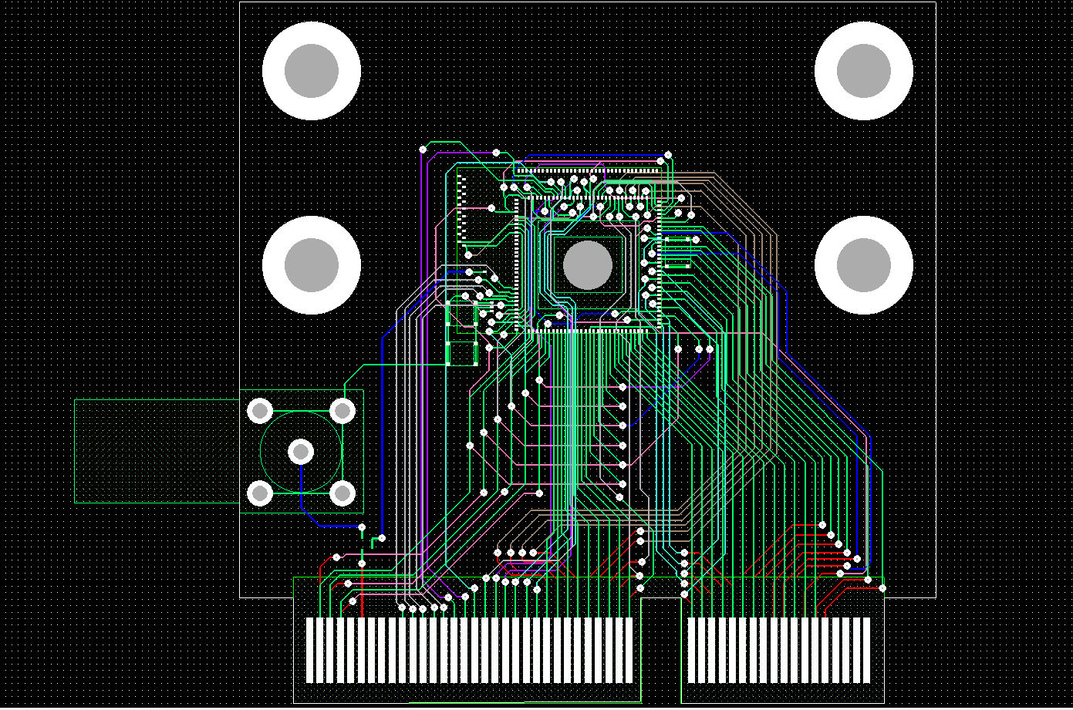
AMS-CHESS-1 daughterboard
AMS-CHESS-1
Capacitor
Capacitors
Lemo footprint
(HV back-up)
Edge connector (fits Samtec MEC6 100-pin connectors)

Slide 5
CHESS-1 hardware design, continued
TJ-CHESS-1 daughterboards
Meeting with wire-bonding expert (Paul Booker), chip designer (Dipayan Das) and Jens tomorrow at RAL to optimise footprint to ease wire-bonding.
Another Oxford electronics technician will work on these daughterboards to gain parallel efforts.
TJ-CHESS-1 spec update
See updated spec from Dipayan. I’ve attached the new spec to this meeting’s materials and will upload it to the ATLAS TWiki.

