Slide 1
Comparator

Slide 2
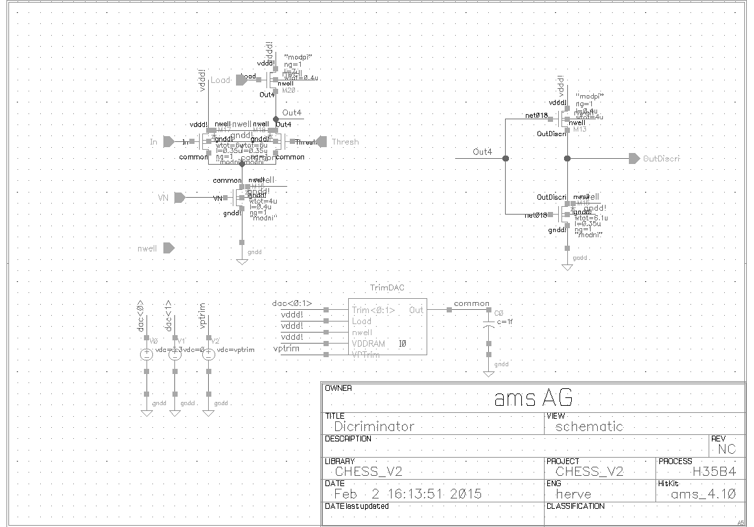
Comparator schematic
At periphery
Inverter At periphery
Differential pair
with load at perifery
PMOS trim DAC in pixel

Slide 3
Comparator bias lines
Power supply | Vdd dig. 3.3
Digital Ground | Gnd 3.3
Threshold | Vcasc – DAC + Ext.
Comparator current | VNComp – DAC

Slide 4
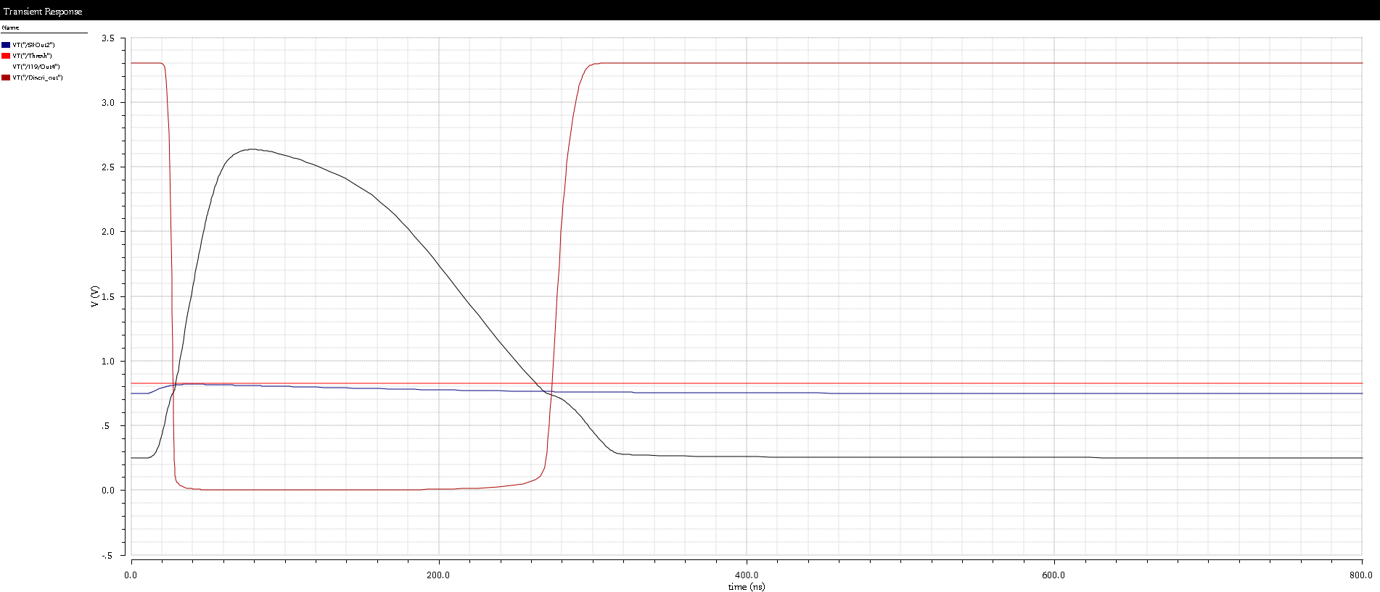
Comparator response
Asymmetrical response due to the load asymmetry.
Input dynamic matched using a CR filter.
Very small design thanks to the deported load
Very high gain – single stage sufficient.

Slide 5
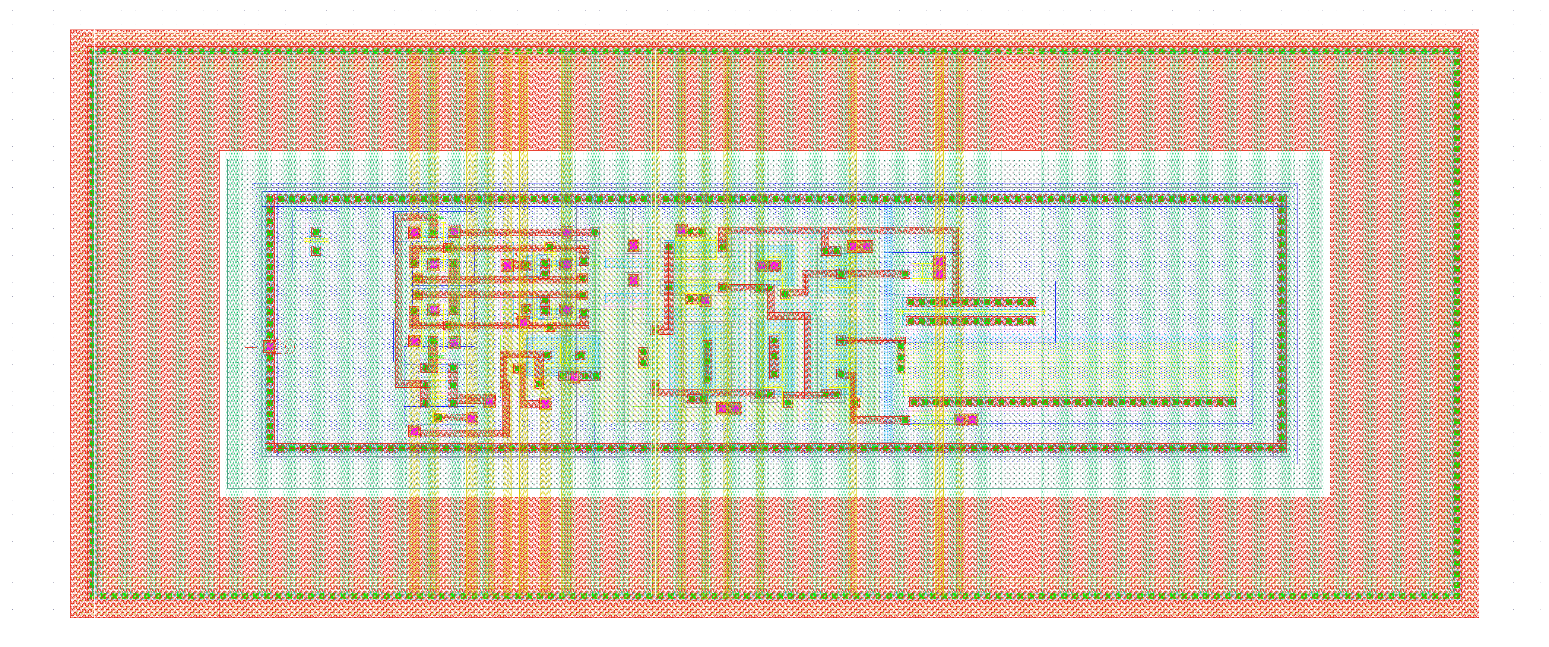
Comparator + TRIM DAC layout
Comparator + TRIM DAC layout
15µm
25µm
100µm

