Slide 1
Where are we?

Slide 2
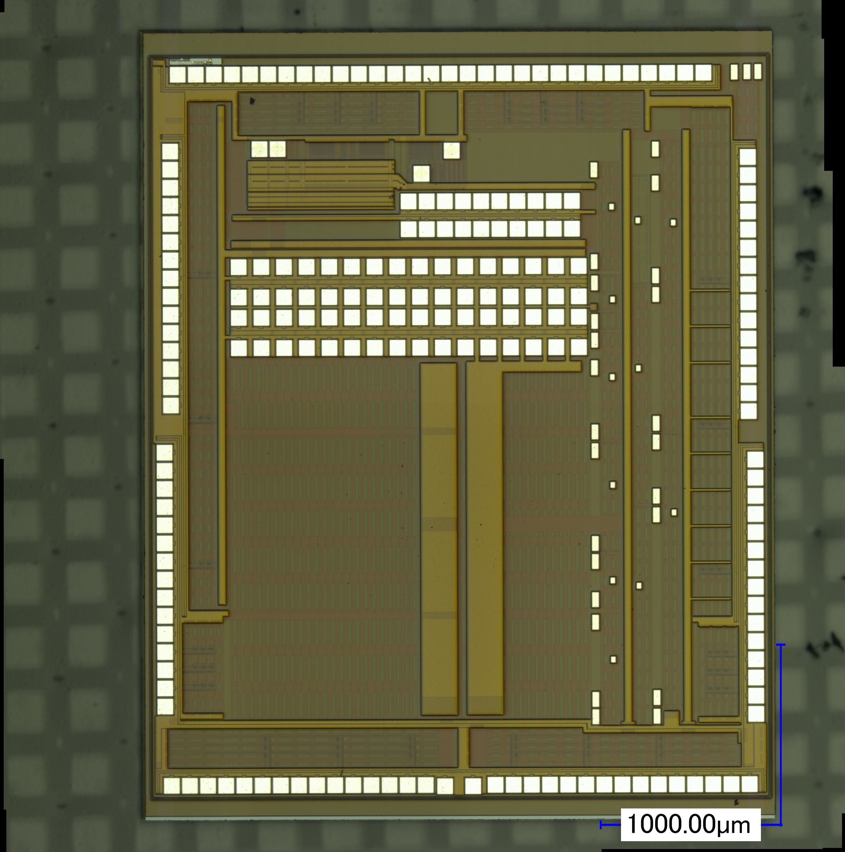
CHESS-1
Multiple active and passive pixel matrices
Allows to measure capacitance/resistance
Response signal, even for low signals (i.e. real particles)
Large array to allow for charge deposition measurement (depletion depth, 2x2[mm] in size)
Small passive array to support edge-TCT (Laser)
Component array to study radiation defects in transistors/caps/diodes

Slide 3
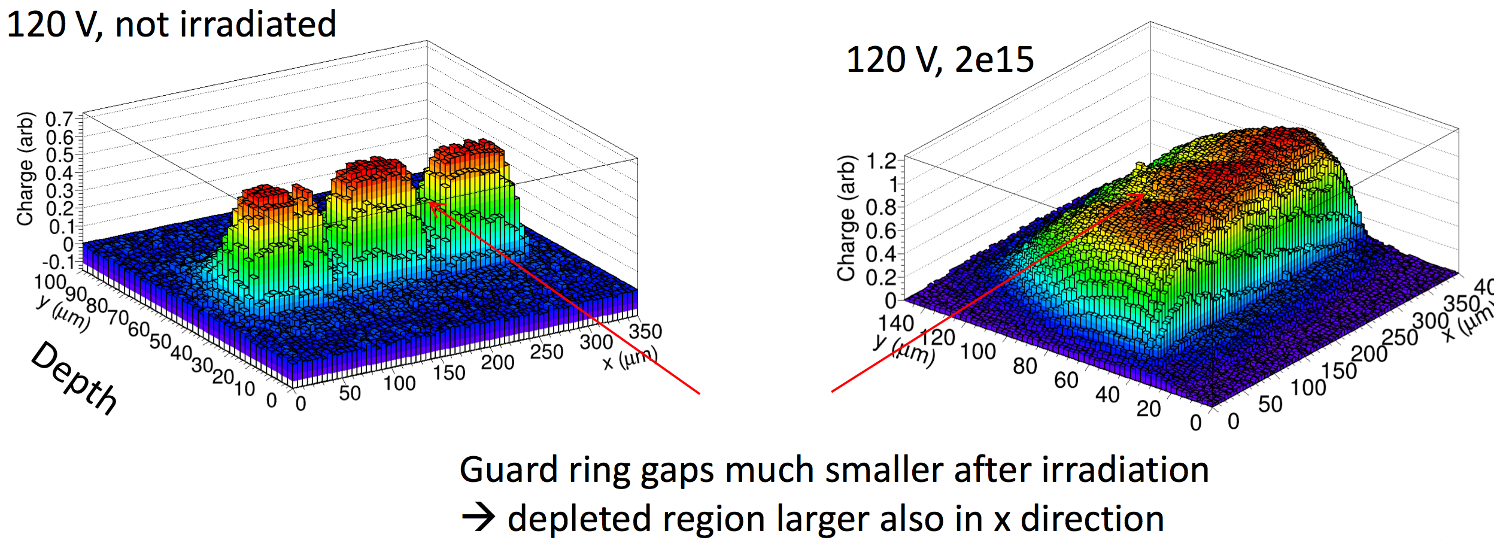
Results so far:
AMS prototype shows good results, in particular post irradiation
Depletion depth goes up due to acceptor removal
Slow diffusion component disappears after initial NIEL dose is acquired (~2e14 neq)
Measurements
by I. Mandic, Ljubiliana

Slide 4
Lessons learnt
Substrate contact – what we thought:
Substrate contact – what is done:
Explains very good isolation when no contact
-HV
p+
Deep nwell
depletion
p sub
-HV
p+
Deep nwell
depletion
p sub

Slide 5
Reticle
Information direct from AMS.
We can’t get 25mm x 20mm
20 x 23.76
18.41 x 25

Slide 6
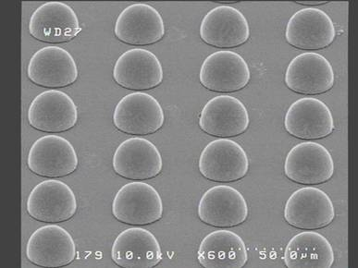
Rest of AMS infos
We can obtain some doping concentration number for Julie’s TCAD simulation.
Backside contact could be possible – need to figure out how to do high temp annealing for p+ (bad for aluminum).
C4NP bump possible
Can skip polyimide on top
80 and 200 ~ 300 Ohms wafers can be ordered. 1k min order 1k units.

