Slide 1
Amplifier

Slide 2
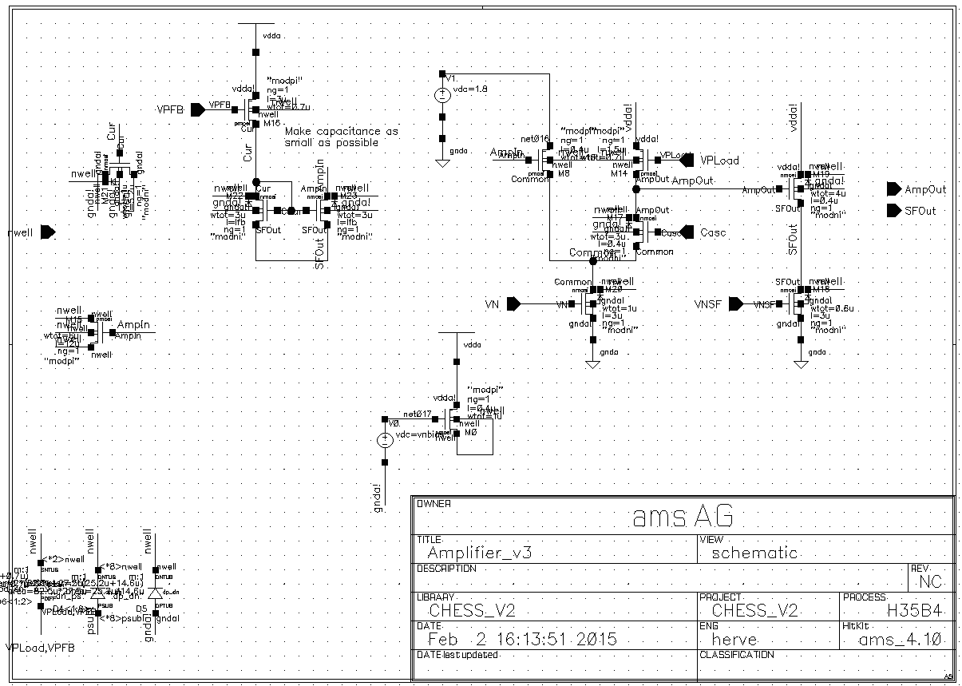
Amplifier schematic
1.8V bias on Input branch
Feedback
from SFOut
Simplified Nwell bias. Ok??

Slide 3
Amplifier bias lines
Power supply | Vdd 3.3
Input branch power | Vdd 1.8
Analog Ground | Gnd 3.3
Cascode bias | Vcasc – DAC
Nwell bias | VNBias – DAC
Amplifier current | VN – DAC
Source follower | VNSF – DAC
Cascode load | VPLoad – DAC
Feedback current control | VNFB – DAC

Slide 4
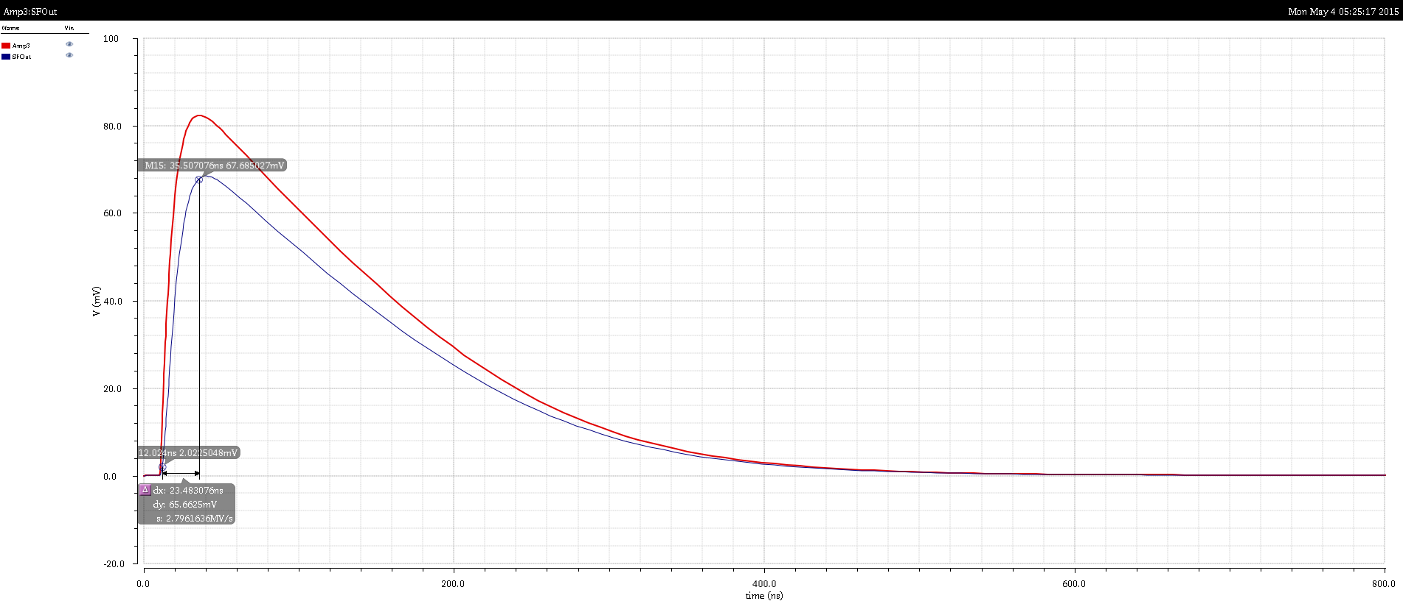
Amplifier MIP response
Simulate 700e- = 112nA during 1ns.
17µA @ 1.8V = 30µW (we have 60µW available).
~25ns peaking time. Set by Amp_out node capacitance – will change after layout.

Slide 5
Amplifier Signal to Noise
Noise level: 13mV = 117e of noise.
  SNR = 6 for 700e signal
  SNR = 12 for 1400e signal
Will improve with high res substrate.

Slide 6
Amplifier dispersion

Slide 7
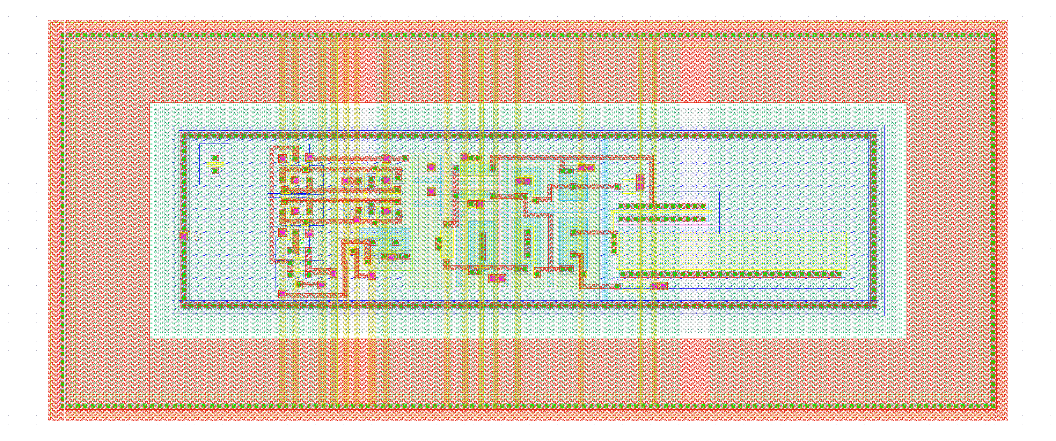
Amplifier layout
Amplifier layout
15µm
45µm
100µm

