Slide 1
CHESS2 Top level

Slide 2
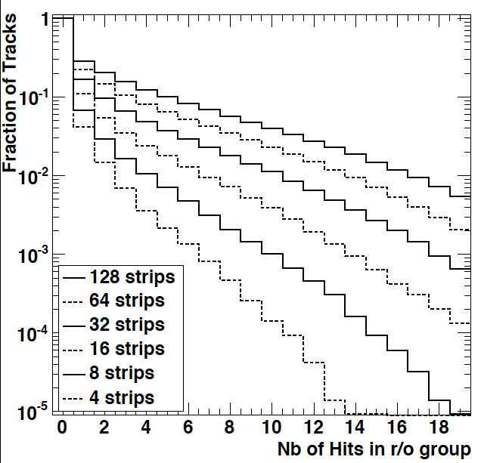
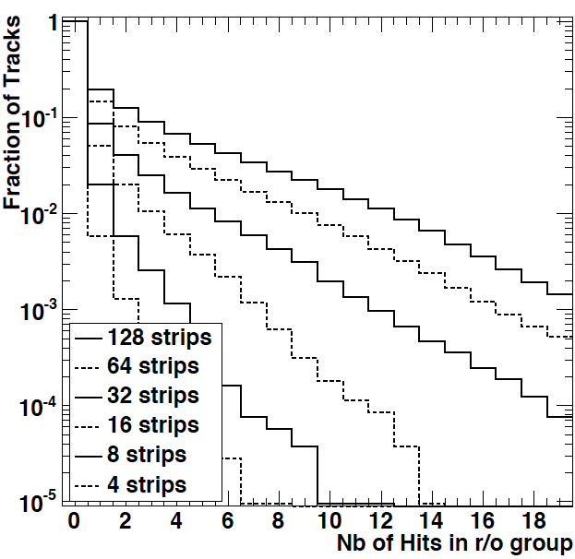
Physics specs
Sim. Marco Battaglia
[high pT H ➝ bb jets]
First strip layer
Fifth strip layer
Outdated
Consistent with simulation by Nick Edwards:
Groups of strips
ITk week
2

Slide 3
Objectives
Const.
delay
25ns
HIT & HIT LOCATION
-HV
Drift
Nwell
-
+
-
+
+
-
depletion
-
+
+
-
-
+
p sub
3
3

Slide 4
Power consumption
From Richard:
“A barrel stave (10cm x 1.3m) can sink 600W 'sensibly' and the cooling capability in the forward direction is roughly the same by area. The power consumption therefore needs to be in the ball park of 0.5W//cm^2”
Dedicating ½ of this power to CHESS2 = 2mW/strip

Slide 5
Specs
 | Specifications
Size of the chip | 0.6cm x 24480µm
Pixel size | 40µm x ~800µm
Number of strips | 127
Number of pixels per strip | 32
Readout speed | 320MHz
Output buffers | LVDS with tunable signal amplitude
Maximum number of hit per strip | 1 + overflow flag
Maximum number of hits in strip array | 8
Size of data output | 13 bits
Format of data output | 5 + 1+ 7 bits
Wafer resistivity | 20 | 80 | 200 ~ 300

Slide 6
Technology
AMS H35 120V – 20ohm p substrate.
~20µm depletion depth.
1ns drift collection time.
MIP most probable charge 1500e-.
Signal amplification in NWELL.
-HV
3.3V
Drift
Deep nwell
-
+
-
+
+
-
depletion
-
+
+
-
-
+
p sub
6

Slide 7
Strip design
Segment
Strip
-HV contact
…
…
Active nwell
p sub

Slide 8
Crude pixel description
Active amplifier in each pixel.
Discriminator front and trimming in pixel or at the periphery
25ns windowing to avoid multiple triggering in case of wide pulse.
Hot pixels masking.
Injection of calibration signal.
In pixel
Pixel or periphery
Periphery
Cal.
Amplifier
Discri.
Latch
25ns Ck
Threshold
trimming

Slide 9
Architecture
Strips
Strips
Strip encoding
Hit encoding
SPI interface
LVDS interface
Masking, Threshold
and Calibration

Slide 10
Architecture – Data out
Strips
Strips
Strip encoding
Hit encoding
SPI interface
LVDS interface
Masking, Threshold
and Calibration

Slide 11
Architecture – Config.
Strips
Strips
Strip encoding
Hit encoding
SPI interface
LVDS interface
Masking, Threshold
and Calibration

Slide 12
Strip Hit Encoding
Single hit in the strip
Encoded position of the first hit
Double or multiple hits in the strip
Encoded position of the first hit + Flag
The first hit in the strip is encoded on 5bits
Additional hit Flag is raised in case of multiple hits.
Flag provides loose information on the position of the additional hits.
During strip encoding an internal bit is also raised when the strip is hit.
0b00111
0b00111
+

Slide 13
Strip encoding
Done in parallel for all 512 strips
Chain of OR cells.
Simulated to work in less than 25ns.
Flag raising is done independently using a current comparator scheme.

Slide 14
Hit encoding
Sum across 16 groups of 8 strips
hit
000
hit
carry
hit nb
Pixel adr
Strip adr
13bit bus x8
1
+
000
1
0
00000+f
0000001
0
+
sum
0
0
Group of 8 strips
0
+
0
0
0
+
store
0
0
1
+
001
1
0
0
0
0
Sum of hit
= 010
+
010
0
+
0
0
0
+
0
0
0
+
0
0
Hit nb decoding
1
+
010
1
0
01101+f
0001100
1
+
011
1
0
0
0
0
= 010
+
100
More than 8 hits
overflow
1
110
1
1
1
+
111
1
1
1
+
000
1
1
1
001
1
1

Slide 15
Output data format
127 strip = 7bits
32 segments = 5bits +
127 strips
5 +1 bits
7 bits
1 0 1 1 0 0 1 0 1 0 1 0 0
Strip & Flag
127 group
2x 13 pads + 2 synch

