Slide 1
MIP Setup at Glasgow
R. Bates, C. Buttar, K. Kanisauskas, D. Maneuski
ATLAS Strip CMOS Regular Meeting
April 28, 2015

Slide 2
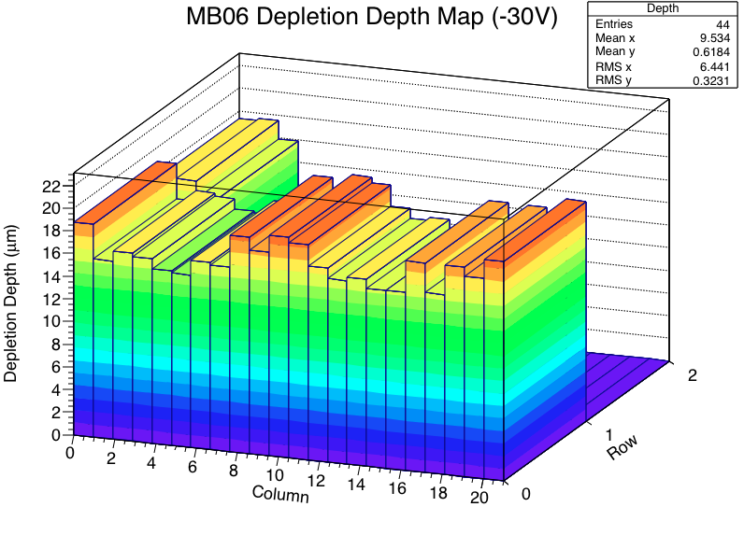
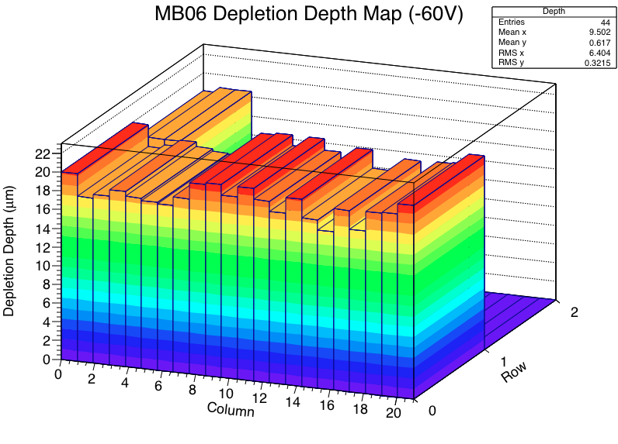
Depletion Depth Maps (1)
MPV values extracted from MIP spectra fitting for each pixel and conversion factor of 85e⁻/μm for MIPS was used
In addition to the results presented previously, equivalent dataset was taken at -30V bias
Average increase in depletion depth correspond to 1.8μm
The full scan was not done due to time limitations
What is resistivity of epi layer?

Slide 3
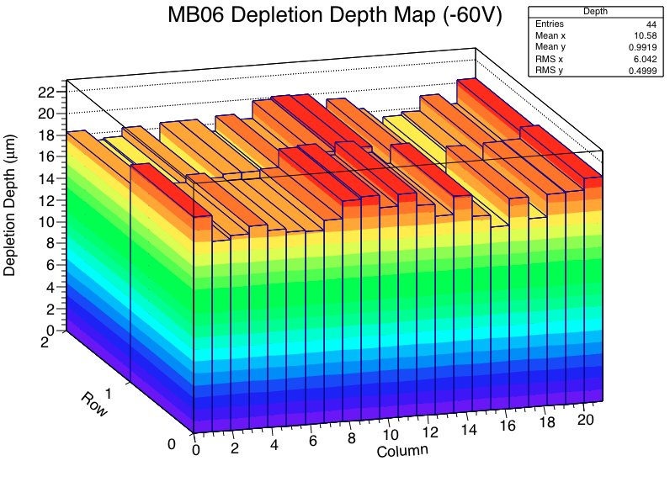
Depletion Depth Maps (2)
Full map was produced at -60V bias,
Average depletion depth corresponds to 18.7μm
Individual values are not too far from the expected depletion depth

Slide 4
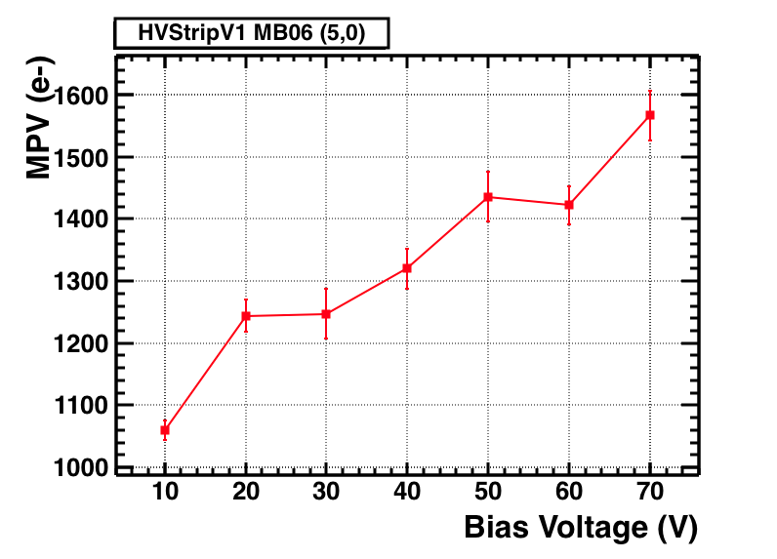
Bias Sweep (1)
MIP spectrum was acquired for a single pixel (5,0) at several bias voltages (300ns PMT Gate, i.e. [-150ns,+150ns] from AmpOut trigger position)
Extracted MPV values were plotted against bias voltage

Slide 5
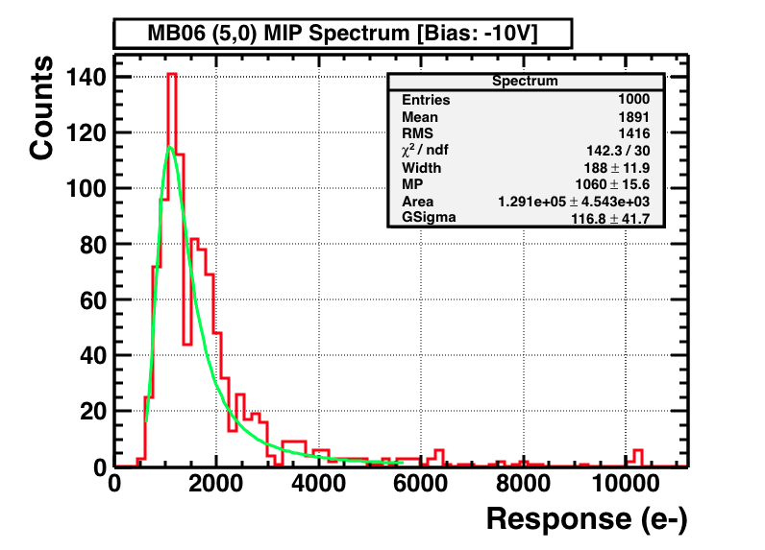
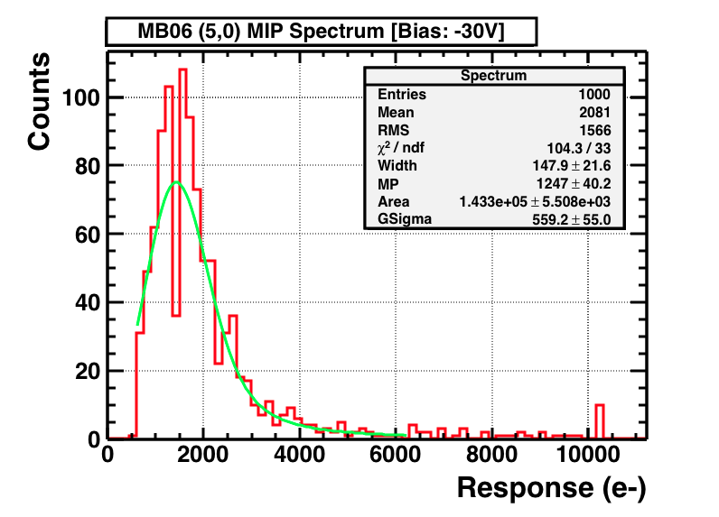
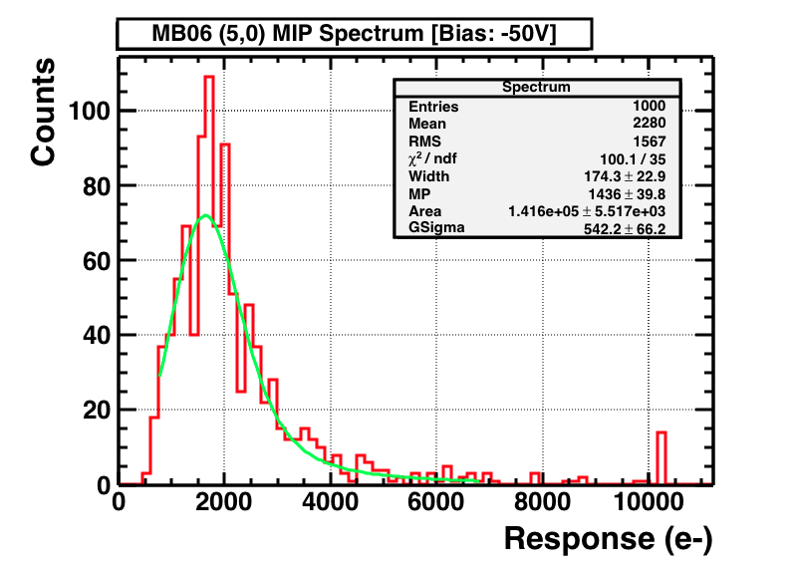
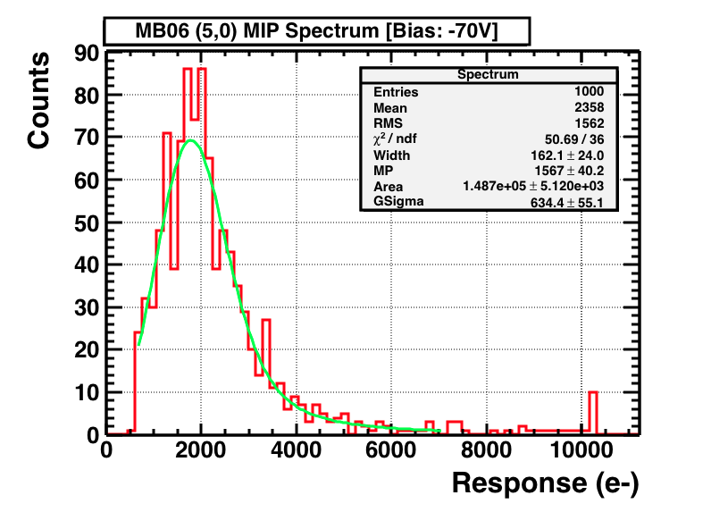
Bias Sweep (2)

Slide 6
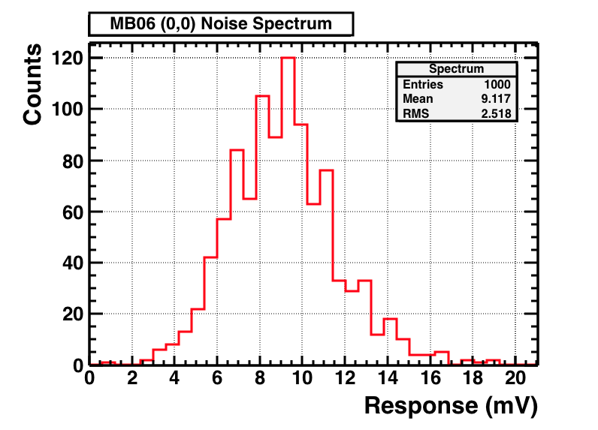
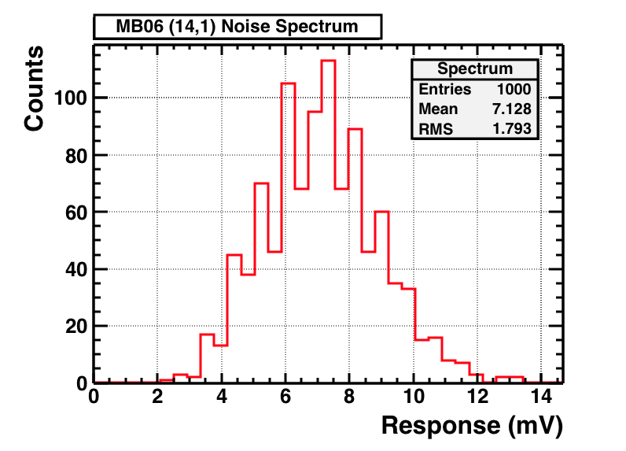
Noise Measurements (1)
Noise measurements were taken at 20°C and -60V bias
Continuous acquisition of waveforms from AmpOut channel for each pixel
Average value in mV was converted to e⁻ using Fe-55 data
Baseline correction was also applied (an offset calculated by averaging individual waveforms)
The AmpOut trigger used in MIP setup is 25mV and is way above noise (about 3σ, depending on the pixel)

Slide 7
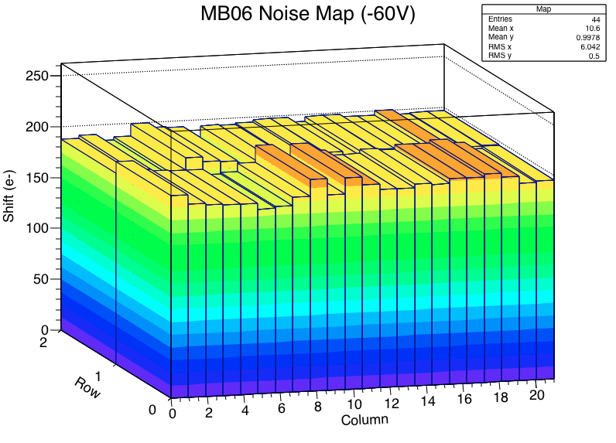
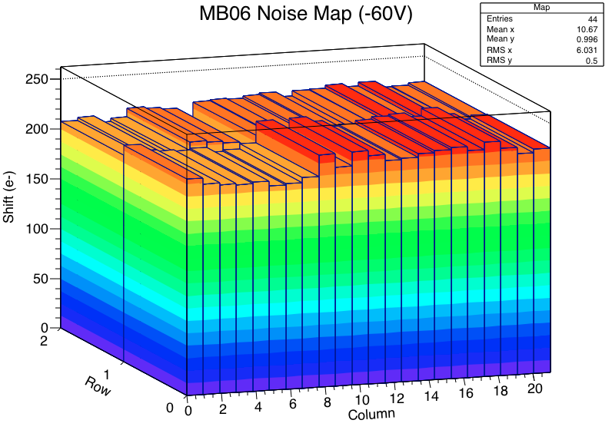
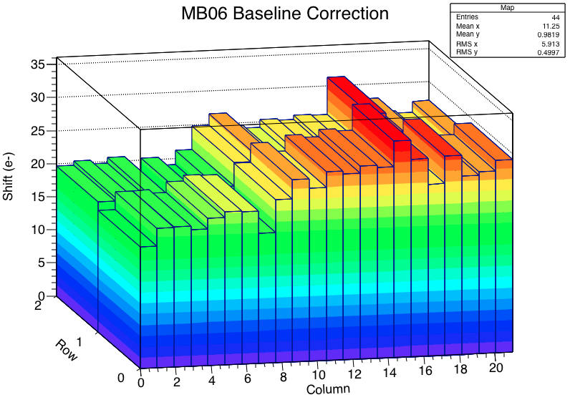
Noise Measurements (2)
Average noise is 220e⁻, while individual values vary from 203e⁻ to 235e⁻
Maximum baseline correction corresponds to 33e⁻
Both plots with and without baseline correction show somewhat uniform distribution

Slide 8
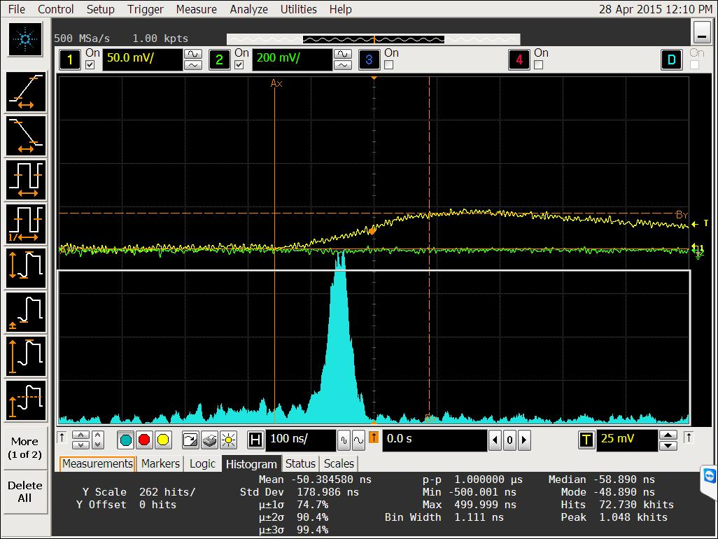
PMT Gate Resolved (1)
300ns gate
AmpOut
AmpOut trigger
PMT Output
After many trial & error attempts it was discovered that trigger rate increases significantly within narrow time window set for PMT (as in fact it should be the case)
Data taken previously is still valid since most of the triggers are related to MIPS (see example above)

Slide 9
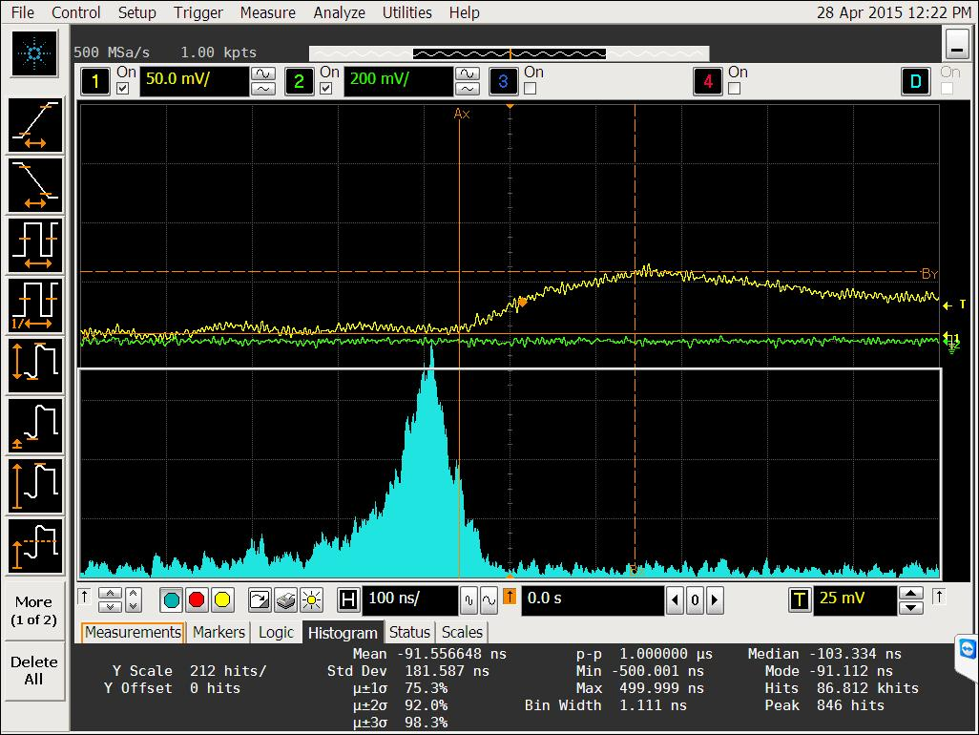
PMT Gate Resolved (2)
200ns
AmpOut
AmpOut trigger
200ns
PMT Output
-60V Bias
No Bias
New time window is chosen to be 200ns, and although it is still relatively wide range, it is optimal value for measurements at different bias voltages
Spread in PMT output distribution is partly cause by timewalk effect (the smaller AmpOut pulse height the longer time it takes for it reach the same threshold)

Slide 10
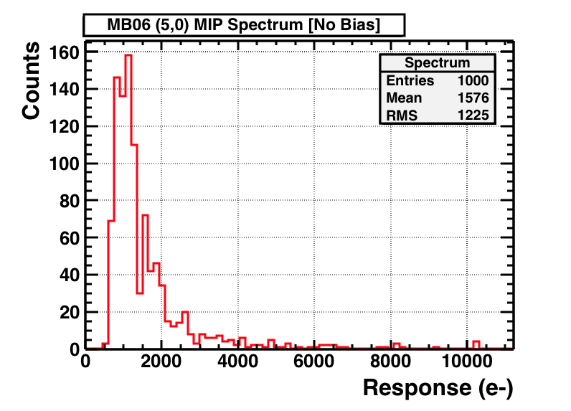
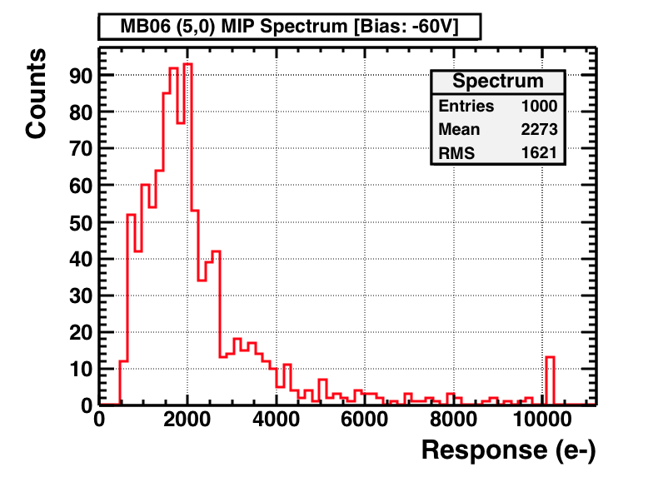
First Results Using 200ns Gate
Shift in peak with the bias voltage can be clearly seen
Slightly more non-MIP signal is observed for -60V data as expected (especially at the far end of the plot)

Slide 11
Next steps
Bias sweep measurements for more pixel within newly determined PMT gate
Measurements at lower temperature
Measure AmpOut pulse rise time as a function of pulse height

