Slide 1
Status of test kit 28 April 2015
J. J. John with help from many others

Slide 2
HVStripV1 hardware distribution
Status
Repairing two motherboards at the moment at RAL.

Slide 3
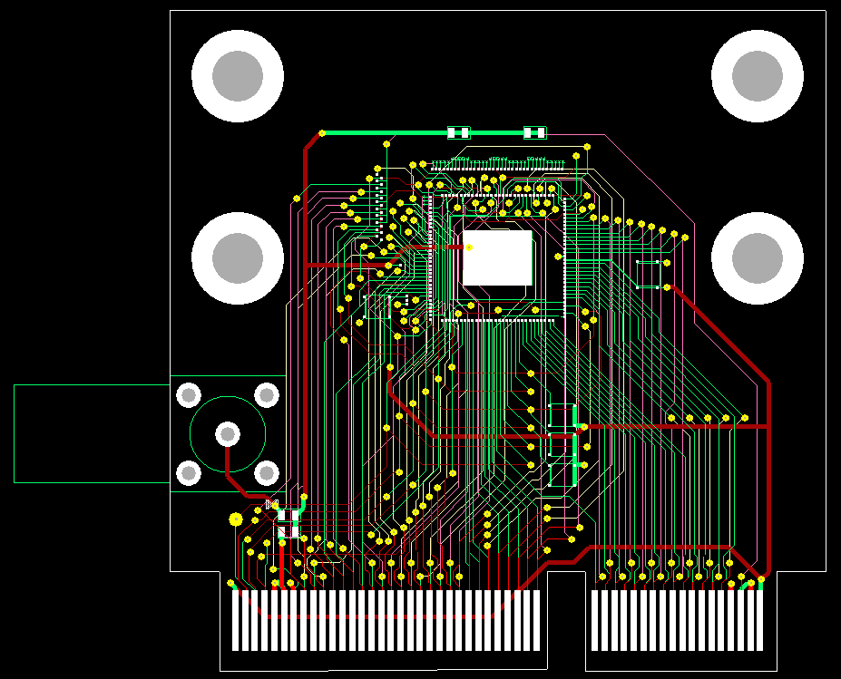
CHESS-1 hardware design
AMS-CHESS-1 daughterboard
Layout complete. Reviewed in Oxford today.
Needs some changes to improve bias distribution.
Goal is to finish by tomorrow night and get out to the collaboration for review.
Please let me know if you are keen to review the layout -- by e-mail -- small group favoured.

Slide 4
CHESS-1 hardware design
TJ-CHESS-1 daughterboard
Met with Paul Booker (wire-bonding expert) and Jens to ensure footprint design is wire-bondable. Approved by Dipayan and Renato since then.
Footprints for PonP and PonN finalised – please see Footprint slides, also attached to this meeting, for details.
This permits bonding out a subset of the available devices
7 device groups on PonP (out of 16 active pixel and amplifier groups)
8 device groups on PonN (out of 27 active pixel and amplifier groups)
Renato expects PonP devices back first, so working on this first
PonP daughterboard schematics complete and layout underway in parallel

