Slide 1
PZ16M status and plans
2015 MSK collaboration workshop
Julien Branlard
PZ16M status and plans
ISE, Warsaw, 12.06.2015

Slide 2
Last slide from last year’s PZ16M presentation
DONE
DONE
PAID
DONE
ON GOING

Slide 3
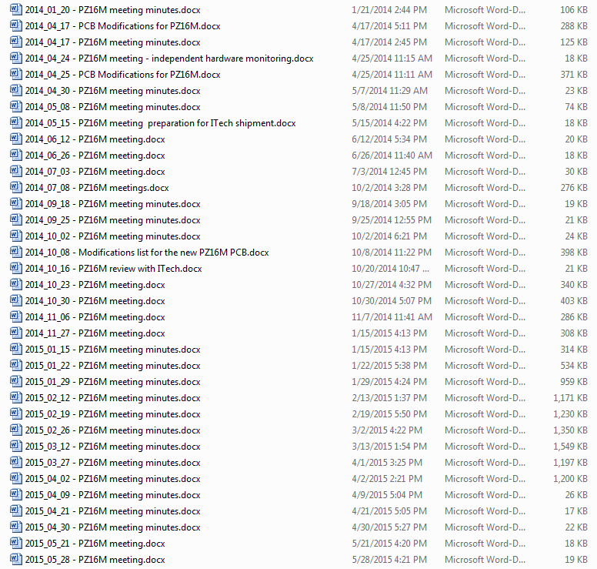
WORK DONE IN THE LAST YEAR: meetings…
The PZ16M team
Marcin Chojnacki
Marius Grecki
Konrad Przygoda
Henning Weddig
Julien Branlard
with reviewing help from Michael Fenner

Slide 4
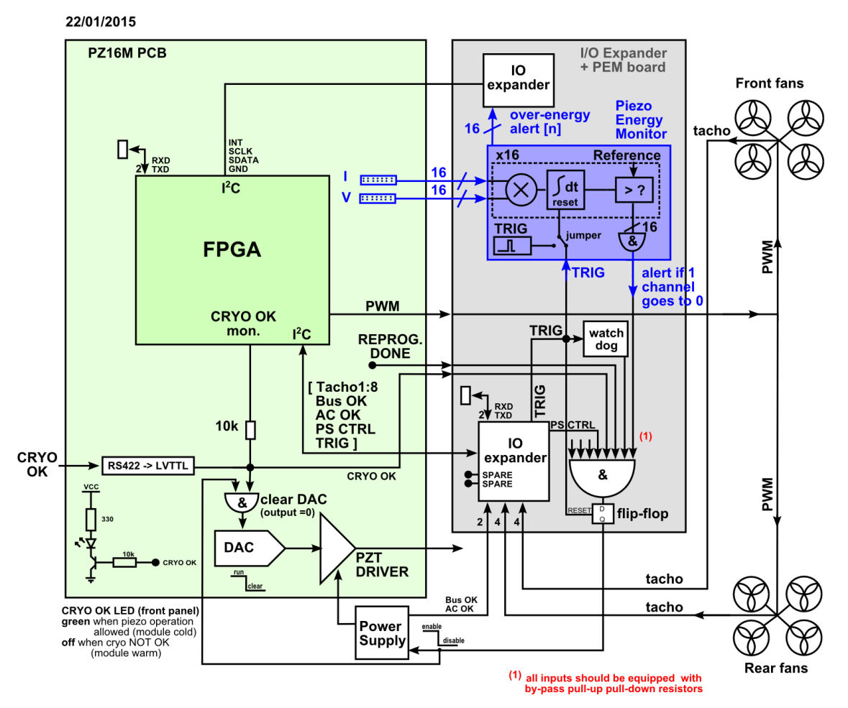
WORK DONE IN THE LAST YEAR: PEM
Piezo Energy Monitoring (PEM) board

Slide 5
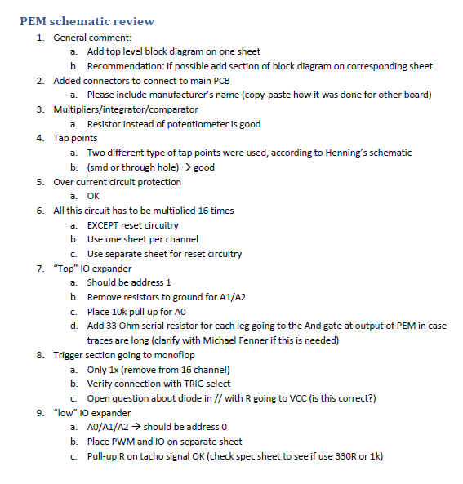
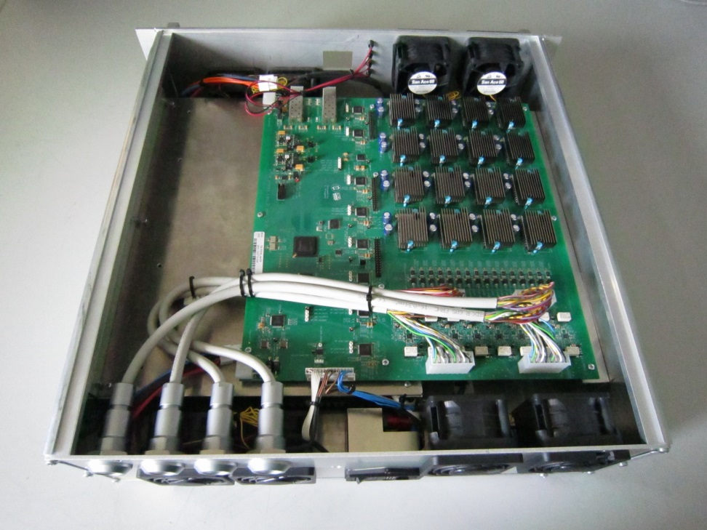
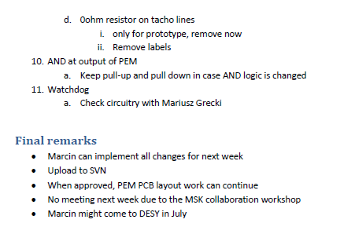
WORK DONE IN THE LAST YEAR: PEM
Schematic reviewed done
PCB layout (2-3 weeks)
PCB review in July
Production and tests after September
PEM

Slide 6
WORK DONE IN THE LAST YEAR: main PCB
PZ16M main PCB

Slide 7
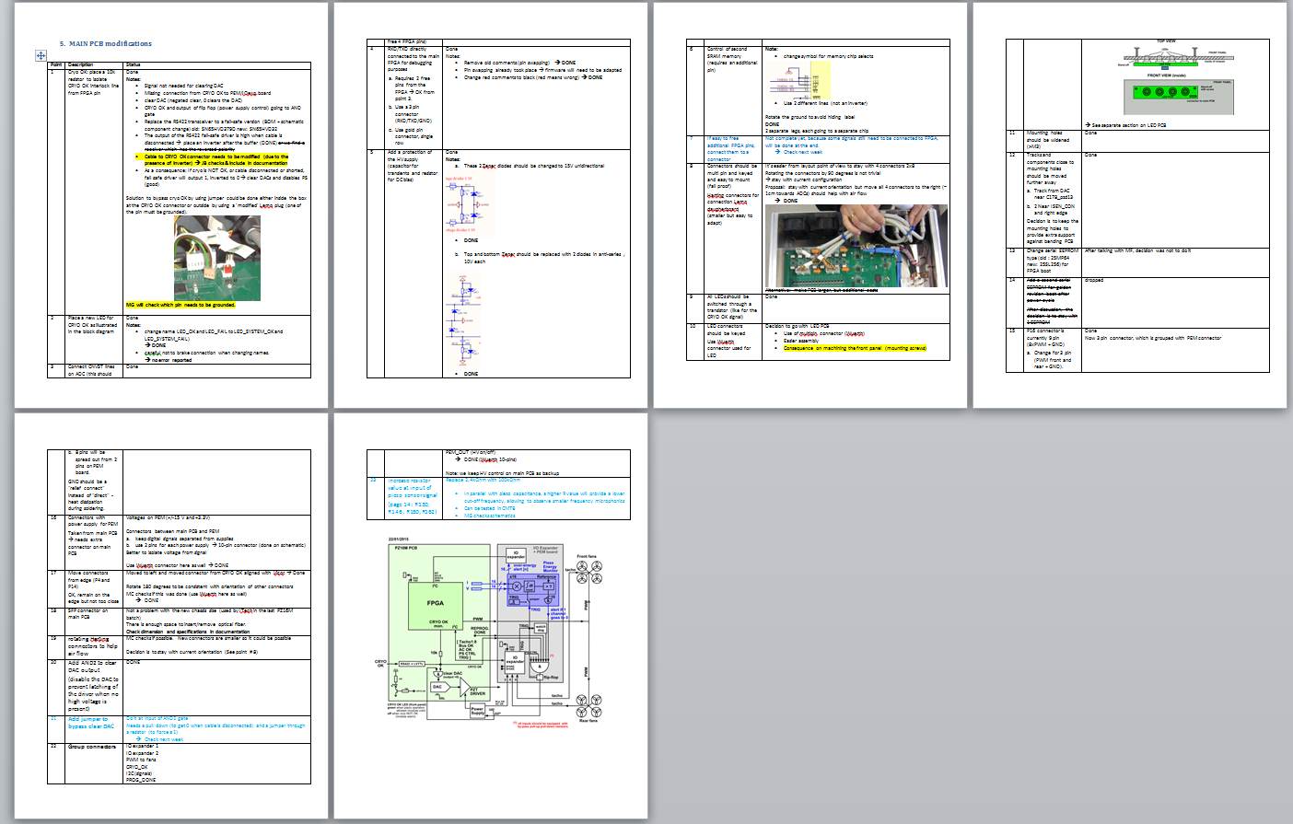
WORK DONE IN THE LAST YEAR: main PCB
Main PCB update
22 points corrected and reviewed
Final review pending
Production of 1-2 prototypes
Tests
Revision ?
Launch call for tender

Slide 8
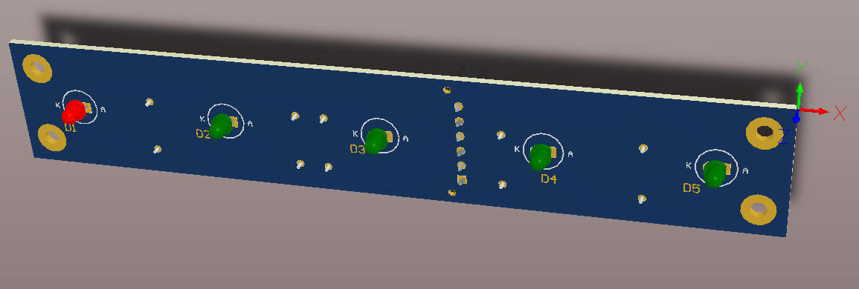
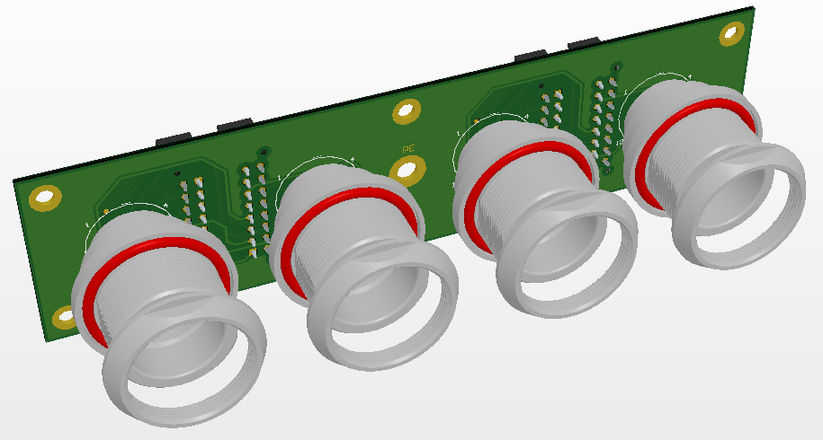

Slide 9
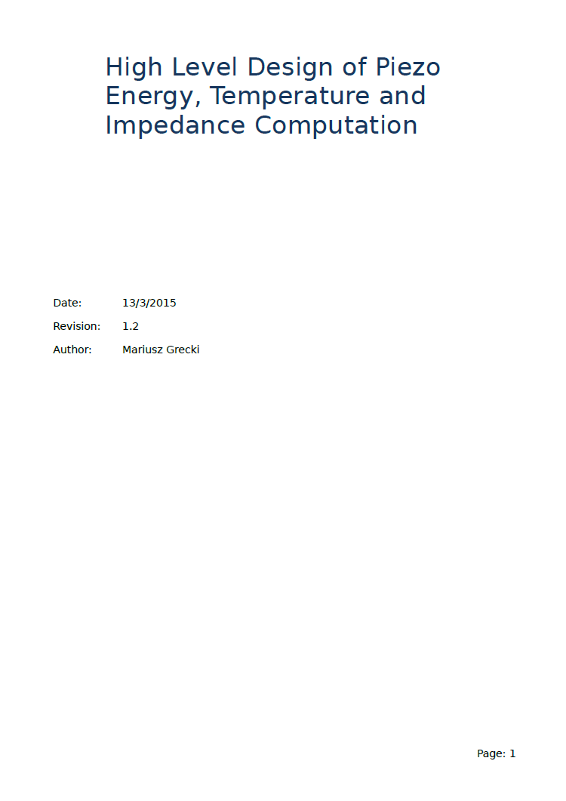
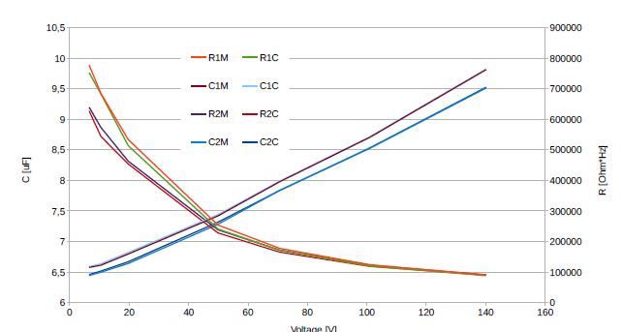
WORK DONE IN THE LAST YEAR: firmware
Mariusz Grecki,
Bin Yang,
Lukasz Butkowski,
Julien Branlard

Slide 10
NEXT STEPS (what we did wrong / where we need to improve)
Careful review of BOM
Careful review of production data
Mechanical integration
Created problems during the last production batch with ITech
No 3D model, no accurate 2D plans
Do we try production without ? → man power issue
Schedule
Sep. 15: Production of next version PZ16M prototype (PZ16M version2)
Dec. 15: Deadline for validation of PZ16M-v2
Jan.-Jun.16: Purchasing, production of PZ16M
July 16: Installation/commissioning of PZ16M (too late!)
Optimistic: small margin to get it done in time
Pessimistic: we are already too late, we might have to install PZ16M after cool down
THANK YOU!

