Slide 1
DAMC-DS800 Status and ToDos
Michael Fenner
Warsaw, 10.06.2014

Slide 2
Current state
No activity since Samer left
Schematics reviewed and simplified
Lower hierarchy levels → changed digital power distribution
CPLD JTAG chain simplified (4 CPLDs)
PCB under review
Many issues left
Rule set was not clear; different minimum clearances on different layers
Biggest problem: Low number of GND vias
Routing of RF traces are sub-optimal
Clock distribution in discussion
Discussion with Manufacturer
Ilfa sais they will not manufacture this technology anymore (had problems)

Slide 3
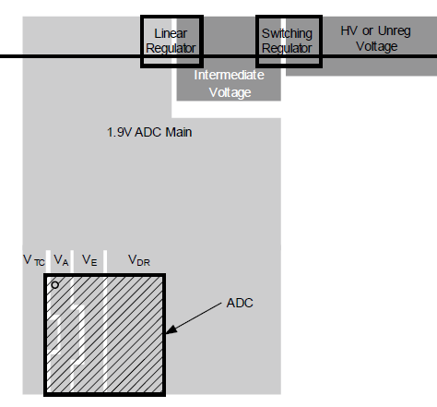
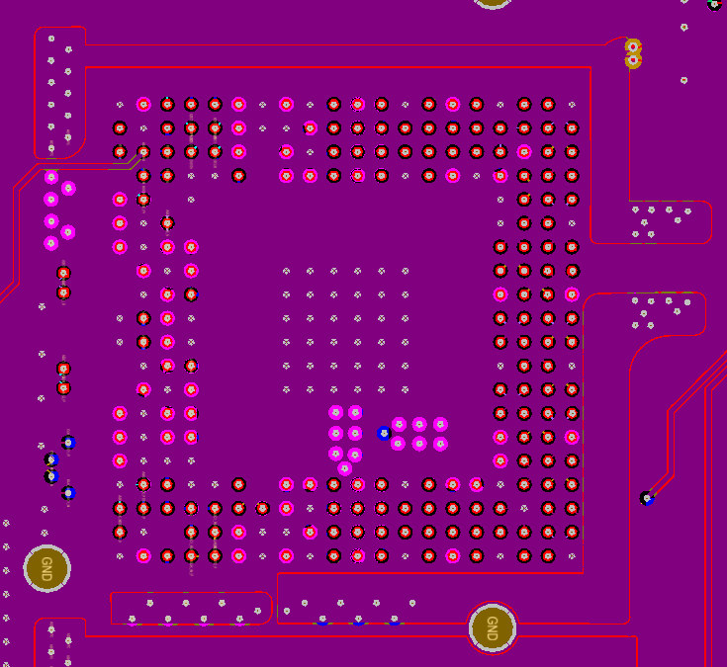
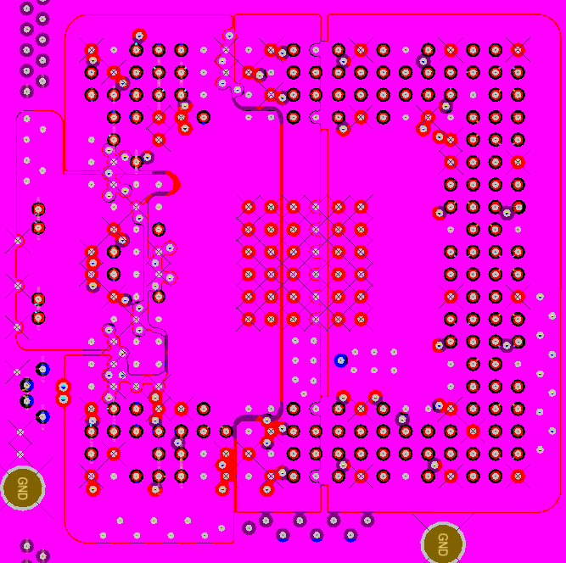
ADC Power Planes

Slide 4
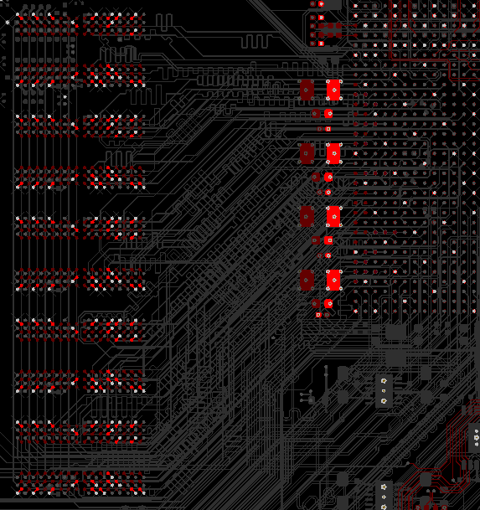
RF Signals and Grounding

Slide 5
Place for Heat Sink

Slide 6
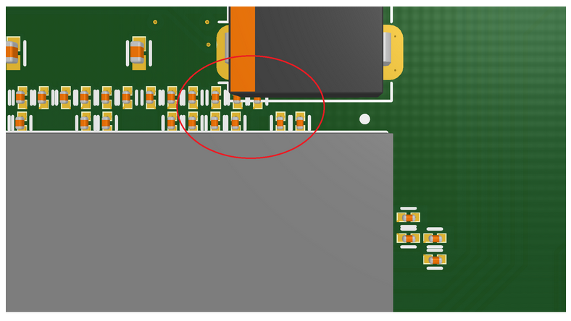
Component Collisions

Slide 7
PCB comments from DM
Copper rings of some pads of vias/plated holes too small ~3 mil
Clearance between Zone 3 mechanical key holes and planes too small (~0.2 mm), the pin of the mechanical key must be pressed into the substrate
DDR addresses are on layers SIG6 and SIG7 without any GND - crosstalk, no good reference GND plane
MGT links on Sig9 are too close, impedance problems, cross-talk,
PCIe lanes on SIG6 and SIG7 has no reference GND plane on SIG6, if there is plane it is not solid = big problem.
Components are too close to FPGA → Collistion, Heat sink?
DDR chips are placed very close, assuming that 3D models Limits us to only one memory manufacturer.
Too small distance between oval hole 12 at left-top corner of PCB. The AMC hot-plug part have sharp edge that will got to PCB substrate and make shortcuts.

Slide 8
Clocking Performance with AD9516
AD9516 performance not optimal
The aperture jitter of the ADC is 200fs. = -55 dB = 9 bits
AD9516 limites to 900 MHz IF input.
Above this we start losing bits.
Recommendation is to change to HMC987

Slide 9
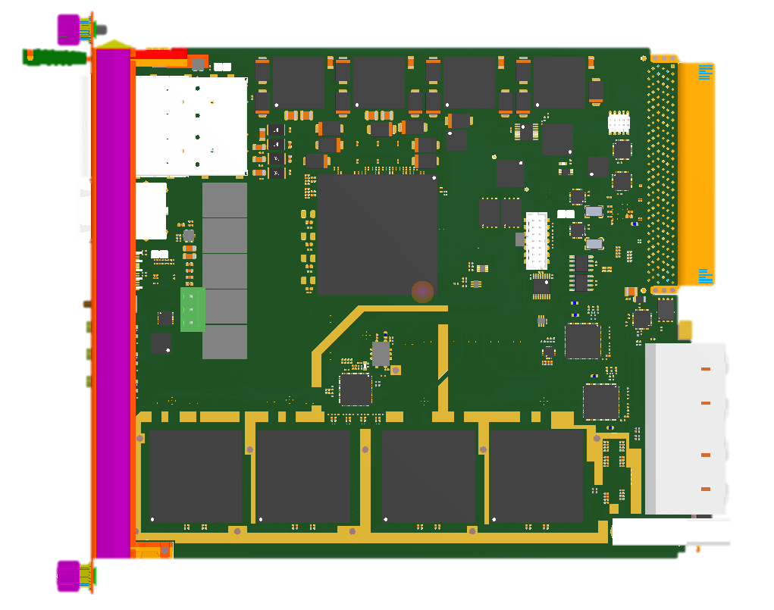
Creating space for RF signals

