Slide 1
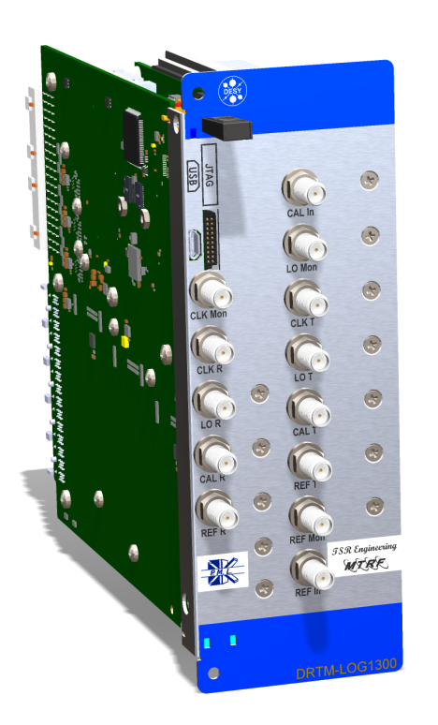
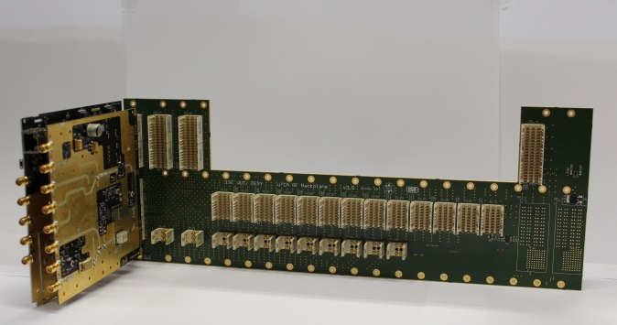
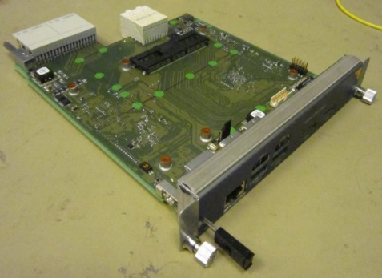
Integration Tests of the uRF-Backplane, Backplane Manager and uLOG.
Michael Fenner, DESY
Tomasz Leśniak, DESY
Uroš Mavrič, DESY
Warsaw, 11.06.2015

Slide 2
Current Status.
uRF Backplane
Final version was produced and is available. Most of the functionalities have been tested.
RTM Backplane Manager
Ver 1 produced and main functionality tested at NAT. The NAT part of the board has been verified the DESY part of the board is under testing -> DMCS.
uLOG
Final version produced. Most of the functions have been tested.
Integration tests
uRF Backplane + uLOG
Performance tests in a fully loaded crate, spurs characterization, CLK reset, basic RF transmission -> A6M, A6S running application.
uRF Backplane + BM + uLOG
So far no successful test of BM connected to uLOG over RF backplane -> activities ongoing at NAT and DMCS. The work has been defined and people have been assigned.

Slide 3
Open Points.
Rear management:
NAT is working on the implementation of the management of the rear power supply.
Application:
Zynq programming over SPI rechecking -> DMCS
Zynq FW development -> DMCS
uLOG ARM SW development -> DMCS
PCB for PCIe connection of the Zynq to the front PCIe switch -> DMCS
DOOCS server development for uLOG -> (not defined yet)
Power consumption of the BM -> affects the uLOG production and operation.

Slide 4
Testing.
So far integration testing was part of:
uLOG testing
XFEL installation setup (L3 stations)
RESET -> X2 timer RTM gets in a state where it resets randomly the CLKs. This was noticed on one station. Tests ongoing.
CLK rotation by 180 deg in respect to LOGM stations -> we have a configurable FW which is being tested.
Bad soldering of some uLOG chips -> after 10 days of operation.
Damaged CU, CPU and PM in the same crate (A7M) -> no investigation started yet -> first station out of 10.
The final integration tests have been defined and will be carried out by Tomasz L. when individual modules are ready.
Main findings so far…

Slide 5
Testing II.
RPM-PSC vs. Front-PM Testing
More than 10 times lower RMS noise in case of WIENER in comparison with NAT power module.
NAT is working on implementing a better filter. No PCB changes needed.

Slide 6
Documentation.
Problems are tracked via redmine:
FW development
LLRF system installations
Hardware
Document describing systematic tests is missing.
Document specs for the uLOG DOOCS server is missing.

Slide 7
Schedule.
NAT management development -> 50/75% done, 2-3 more weeks, NAT
Zynq HW debugging (2 mwks), Zynq app. FW development (1 mwk), trans. PCB (2 mwks), mapping of regs. (6 mwks) -> 11 mwks, DMCS
uLOG server development -> 8 mwks, TBD
Integration tests -> 2 mwks, Tomasz L.
Production of the ~ 70 units can start.

