Slide 1
DCM1300 Production Status
Jan Piekarski – WUT
Frank Ludwig – DESY
Uros Mavric – DESY
Tomasz Lezniak - WUT
Christian Schmidt – DESY
Lukasz Butkowski - DESY
Daniel Kühn – DESY
Günter Möller - DESY
for the LLRF Team
Notes:
How to edit the title slide
Upper area: Title of your talk, max. 2 rows of the defined size (55 pt)
Lower area (subtitle): Conference/meeting/workshop, location, date, your name and affiliation, max. 4 rows of the defined size (32 pt)
Change the partner logos or add others in the last row.

Slide 2
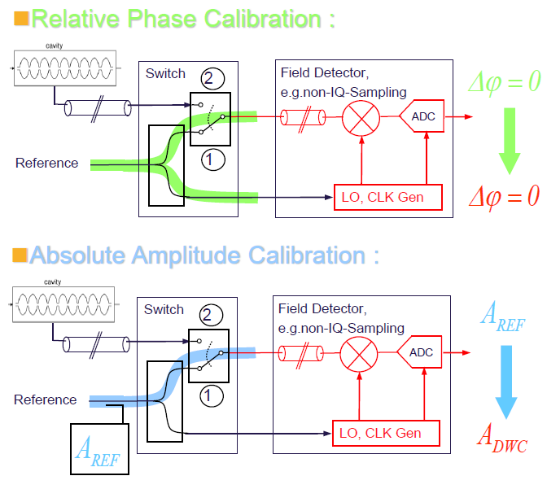
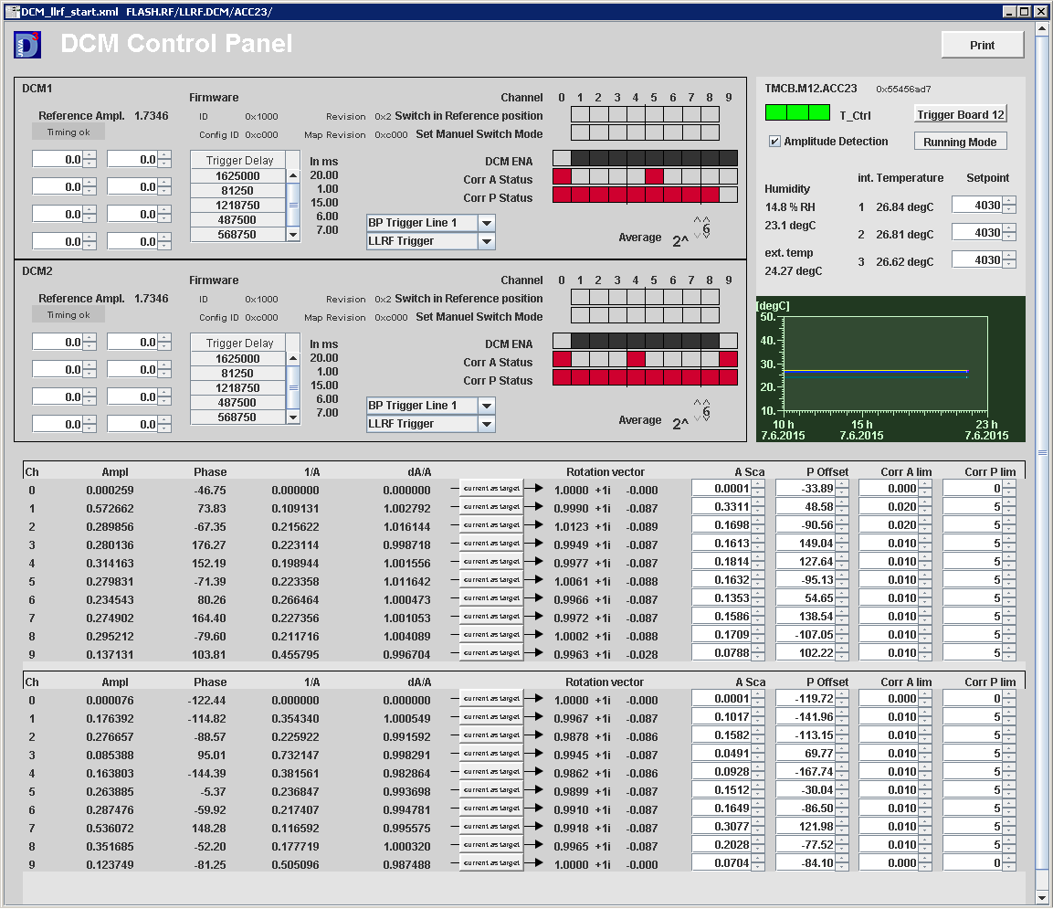
Drift Calibration Module (DCM)
Reference injection
FLASH Operation (DCMv2)
Notes:
Before you start editing the slides of your talk change to the Master Slide view: Menu button “View”, Master, Slide Master:
Edit the following 2 items in the 1st slide: 1) 1st row in the violet header: Delete the existent text and write the title of your talk into this text field 2) The 2 rows in the footer area: Delete the text and write the information regarding your talk (same as on the Title Slide) into this text field.
If you want to use more partner logos position them left beside the DESY logo in the footer area Close Master View

Slide 3
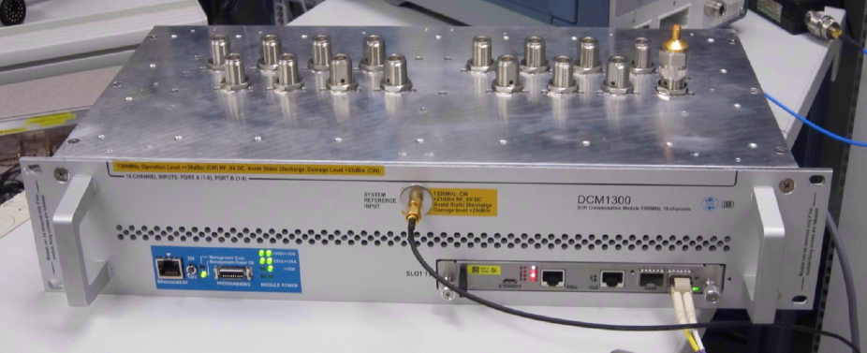
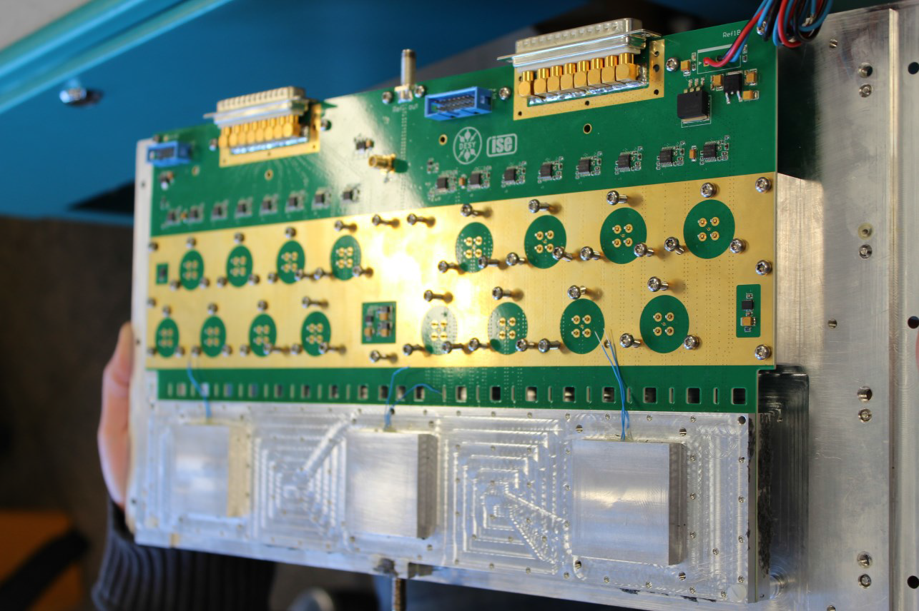
DCMv2: 2U 19“ Module
Front- , Rear, Inner- View
Notes:
Before you start editing the slides of your talk change to the Master Slide view: Menu button “View”, Master, Slide Master:
Edit the following 2 items in the 1st slide: 1) 1st row in the violet header: Delete the existent text and write the title of your talk into this text field 2) The 2 rows in the footer area: Delete the text and write the information regarding your talk (same as on the Title Slide) into this text field.
If you want to use more partner logos position them left beside the DESY logo in the footer area Close Master View

Slide 4
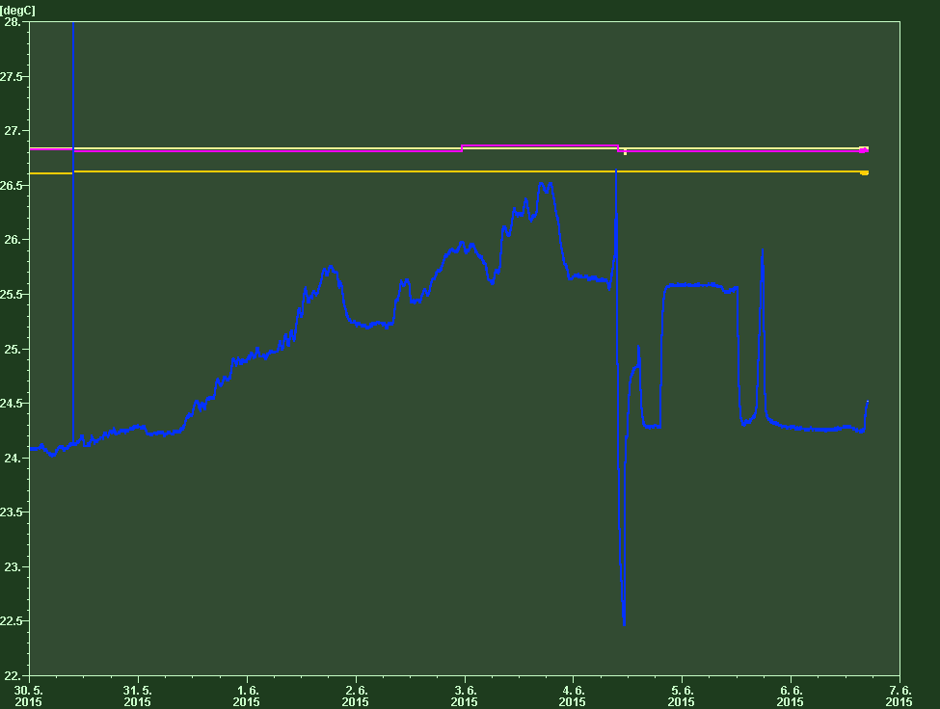
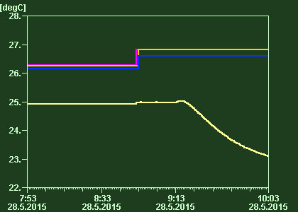
DCMv2: FLASH ACC23 Operation
Arrival time at 4DBC3 with DCM on/off
Temperature Stability :
ok, except a single event
[Courtesy of C.Schmidt]
10K range, -4K cooling, +6K heating
Start of a temperature jump
~ 800 fs
Temperature jump reset
Notes:
Before you start editing the slides of your talk change to the Master Slide view: Menu button “View”, Master, Slide Master:
Edit the following 2 items in the 1st slide: 1) 1st row in the violet header: Delete the existent text and write the title of your talk into this text field 2) The 2 rows in the footer area: Delete the text and write the information regarding your talk (same as on the Title Slide) into this text field.
If you want to use more partner logos position them left beside the DESY logo in the footer area Close Master View

Slide 5
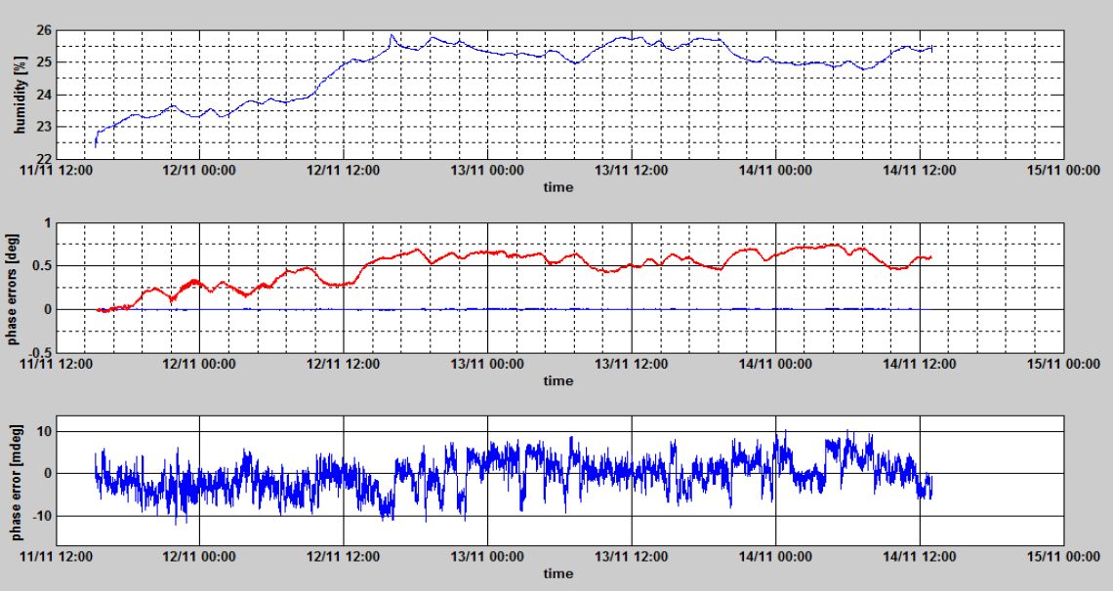
DCMv2: FLASH Injector Hutch Operation
Phase calibrated with DCM sealed module
[Courtesy of J. Piekarski]
Notes:
Before you start editing the slides of your talk change to the Master Slide view: Menu button “View”, Master, Slide Master:
Edit the following 2 items in the 1st slide: 1) 1st row in the violet header: Delete the existent text and write the title of your talk into this text field 2) The 2 rows in the footer area: Delete the text and write the information regarding your talk (same as on the Title Slide) into this text field.
If you want to use more partner logos position them left beside the DESY logo in the footer area Close Master View

Slide 6
DCMv2: Production Status / Open Issues
DCM PCB functional tests
DCM set to -0dB and cavity state after powering up, no TMCB – OK
DCM set to -0dB and cavity state after powering up, with TMCB – TBD
Attenuator control – OK
Switch control – OK
Amplitude detector – OK
Switch control for ADC offset drift of amplitude correction – OK
I2C Sensors readout – OK
Add humidity sensor on the PCB or in the PCB chamber – TBD, 1 week, (TL)
DCM temperature controller functional tests
Remote enable/disable – OK
DAC setting, limited range [3000, 5000] – TBD, 3 days, (TL)
Temperature range 10K, -4K cooling,+6K heating for [21deg,31deg], 0.4A other Peltier – TBD, 2 days, tests
Lock-status readout – TBD, 2 weeks, (TO)
Peltier current readout – TBD, see above
In-loop sensor readout – TBD, see above
FRED3 functional tests
TMCB2 hotplug – TBD, 1 week, BS
19” module hotplug – TBD, see above
Digital polution from IU-sensors removed ? – TBD, see above
Notes:
Before you start editing the slides of your talk change to the Master Slide view: Menu button “View”, Master, Slide Master:
Edit the following 2 items in the 1st slide: 1) 1st row in the violet header: Delete the existent text and write the title of your talk into this text field 2) The 2 rows in the footer area: Delete the text and write the information regarding your talk (same as on the Title Slide) into this text field.
If you want to use more partner logos position them left beside the DESY logo in the footer area Close Master View

Slide 7
DCMv2: Production Status / Open Issues
DCM RF performance @1.3GHz tests
RF connectors matching <-20dB – OK
REF input matching -10dB (SMT splitters limited) – OK
FBM outputs matching <-18dB – OK
Crosstalks<-85dB – OK
RF channel initial losses:-20dB – OK
REF input->FBM output transmission: -24dB – OK
DCM Long-term performance tests
Temperature reduction factor >50 for dT< 3deg, <50m deg – OK
Internal amplitude detector stability <0.01% – OK
Phase stability humidity (unsealed DCM) 0.008 deg / % RH – OK
Phase stability humidity ( sealed DCM) in the injector hutch <+-0.01deg, no correlation – OK
Phase stability temperature coeffcient in test-rack – TBD, 1 week (GM)
Humidity sensor inside / outside reduction factor in the test-rack – TBD, 1 week (GM)
Module sealing test – TBD, 2 days (DK)
DCM Improvements for production to be decided
Common MSK FP, RP design – OK
Simplify mechanics and sealing CAD – OK
Simplify cable-management, break-out board, cable metal guiding – TBD, 3 week (RM)
Choice of TC, TEC1091, FMC (TC), FMC (TMCB) based Controller – to be decided
Sealing the complete inner PCB simplifies the production, major change – to be decided
Notes:
Before you start editing the slides of your talk change to the Master Slide view: Menu button “View”, Master, Slide Master:
Edit the following 2 items in the 1st slide: 1) 1st row in the violet header: Delete the existent text and write the title of your talk into this text field 2) The 2 rows in the footer area: Delete the text and write the information regarding your talk (same as on the Title Slide) into this text field.
If you want to use more partner logos position them left beside the DESY logo in the footer area Close Master View

Slide 8
DCMv2: Production Status / Open Issues
DCM Update of documentation – TBD, 2 weeks
Update assembly & production documents
Perform CE certification
Production check documents
DCM Provide production test software & hardare – TBD, ? weeks
Power consumption
Attenuator control
Switch control
Voltage / Current consumption / Used rear fuse value
Powering up initial state attenuator and switch state
ADRS readout check
Temperature controller function
Fan controller function
Module sealing test
Test documentation, check lists and setup test systems – TBD, 1 week (FL, DK)
Notes:
Before you start editing the slides of your talk change to the Master Slide view: Menu button “View”, Master, Slide Master:
Edit the following 2 items in the 1st slide: 1) 1st row in the violet header: Delete the existent text and write the title of your talk into this text field 2) The 2 rows in the footer area: Delete the text and write the information regarding your talk (same as on the Title Slide) into this text field.
If you want to use more partner logos position them left beside the DESY logo in the footer area Close Master View

Slide 9
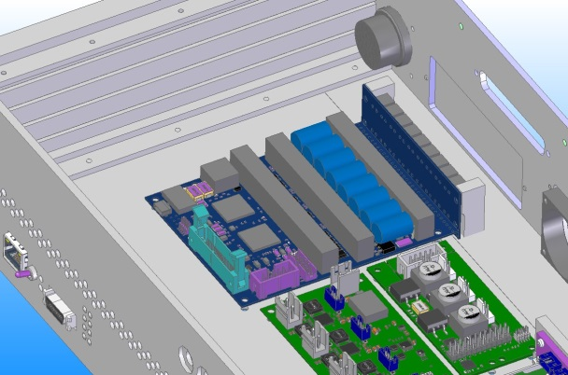
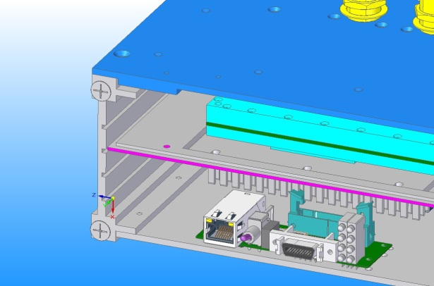
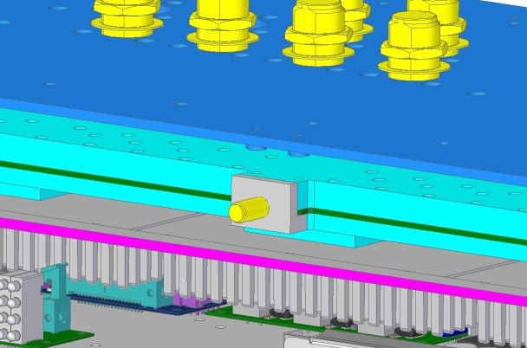
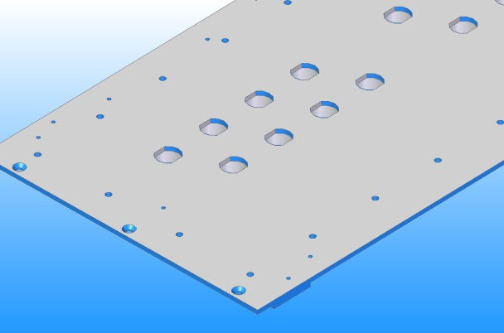
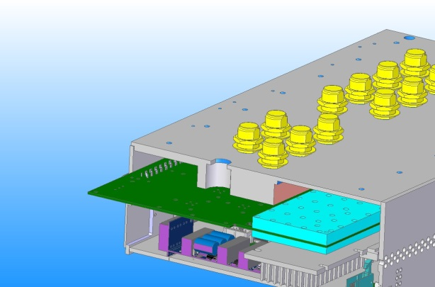
DCMv2: Simplify the production
Mechanical and sealing improvements
FRED2 -> FRED3
Sealing line for silicon
REF Amplitude detector closed
Open issues (DK,FL):
- Front SMA sealing
- Front SMA sealing
- FBM fixtures
- Sealing test connection
N-type „Verdrehschutz“
„Sacklöcher“ to minimize the # of feed-through holes
Notes:
Before you start editing the slides of your talk change to the Master Slide view: Menu button “View”, Master, Slide Master:
Edit the following 2 items in the 1st slide: 1) 1st row in the violet header: Delete the existent text and write the title of your talk into this text field 2) The 2 rows in the footer area: Delete the text and write the information regarding your talk (same as on the Title Slide) into this text field.
If you want to use more partner logos position them left beside the DESY logo in the footer area Close Master View

Slide 10
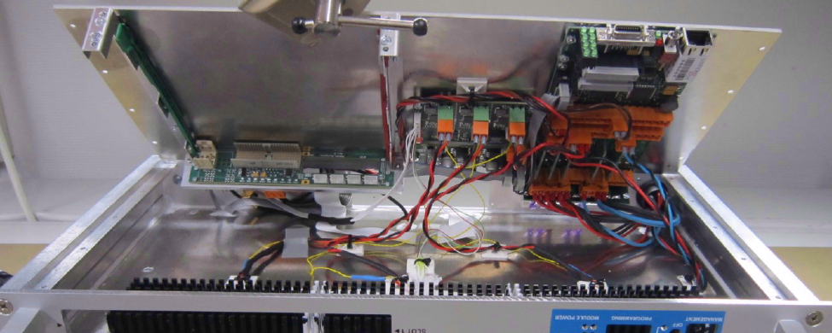
Changes for production : Cable management
Break-out board for all 1:1 ribbon-cables, extension to TC
Cable metal guiding near fan battery
More homogeneous air distribution ?
Notes:
Before you start editing the slides of your talk change to the Master Slide view: Menu button “View”, Master, Slide Master:
Edit the following 2 items in the 1st slide: 1) 1st row in the violet header: Delete the existent text and write the title of your talk into this text field 2) The 2 rows in the footer area: Delete the text and write the information regarding your talk (same as on the Title Slide) into this text field.
If you want to use more partner logos position them left beside the DESY logo in the footer area Close Master View

Slide 11
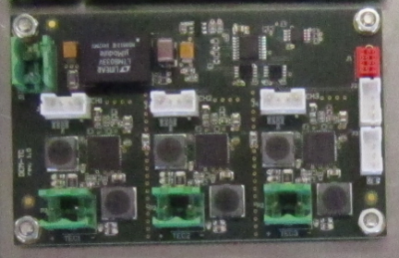
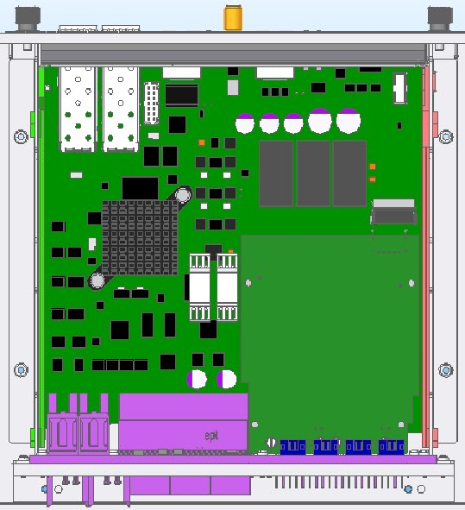
TC, TEC1091, FMC(TC) or FMC (TMCB2)
(No maintenance)
TC (existing solution):
Needs one PCB bug-fix revision
(Full maintenance)
FMC based :
Define, design & test pluggable Interface, +2 weeks
Intermediate step (TC on FMC), +4 weeks
Final stage, Peltier driver and NTCs on FMC
(TMCB2 controller, original plan, 3 months R&D)
3xTEC1091 :
Commercial, total 35,-k€ more costs
Excellent diagnostic and operation range
More assembly work
“nice to have”
Depending on schedule TC or FMC(TC) is the option -> TBD
Notes:
Before you start editing the slides of your talk change to the Master Slide view: Menu button “View”, Master, Slide Master:
Edit the following 2 items in the 1st slide: 1) 1st row in the violet header: Delete the existent text and write the title of your talk into this text field 2) The 2 rows in the footer area: Delete the text and write the information regarding your talk (same as on the Title Slide) into this text field.
If you want to use more partner logos position them left beside the DESY logo in the footer area Close Master View

Slide 12
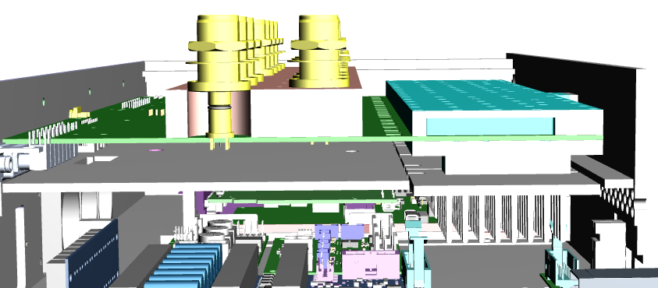
DCMv2: Simplify the sealing and costs
Long-long stable operation needs a sealing the complete PCB : Future iteration
Temperature regulated area
Humidity enclosure
Isolation barrier
Peltier drop
Uncompensated PCB
approx. 24fs/10cm/K
requires +2 months redesign
Notes:
Before you start editing the slides of your talk change to the Master Slide view: Menu button “View”, Master, Slide Master:
Edit the following 2 items in the 1st slide: 1) 1st row in the violet header: Delete the existent text and write the title of your talk into this text field 2) The 2 rows in the footer area: Delete the text and write the information regarding your talk (same as on the Title Slide) into this text field.
If you want to use more partner logos position them left beside the DESY logo in the footer area Close Master View

Slide 13
DCM Summary
Summary and Decisions :
DCM operated so far reliable, function and performance
A humidity sensor has to add to PCB or the PCB chamber
FRED3, FRED FAN is fully tested
Is the operating range at [21deg,32deg] with [-4K,+6K] sufficient
TC needs better diagnostic, + 2 weeks
A cable break-out board as an extension to TC is needed
It has to be decided if FMC (TC) is an option now
A complete PCB sealed DCM is desired for add. 3 months
YES NO
Notes:
Before you start editing the slides of your talk change to the Master Slide view: Menu button “View”, Master, Slide Master:
Edit the following 2 items in the 1st slide: 1) 1st row in the violet header: Delete the existent text and write the title of your talk into this text field 2) The 2 rows in the footer area: Delete the text and write the information regarding your talk (same as on the Title Slide) into this text field.
If you want to use more partner logos position them left beside the DESY logo in the footer area Close Master View

Slide 14
Thanks for your attention!
Notes:
Before you start editing the slides of your talk change to the Master Slide view: Menu button “View”, Master, Slide Master:
Edit the following 2 items in the 1st slide: 1) 1st row in the violet header: Delete the existent text and write the title of your talk into this text field 2) The 2 rows in the footer area: Delete the text and write the information regarding your talk (same as on the Title Slide) into this text field.
If you want to use more partner logos position them left beside the DESY logo in the footer area Close Master View

Slide 15
Backup Slides
Notes:
Before you start editing the slides of your talk change to the Master Slide view: Menu button “View”, Master, Slide Master:
Edit the following 2 items in the 1st slide: 1) 1st row in the violet header: Delete the existent text and write the title of your talk into this text field 2) The 2 rows in the footer area: Delete the text and write the information regarding your talk (same as on the Title Slide) into this text field.
If you want to use more partner logos position them left beside the DESY logo in the footer area Close Master View

Slide 16
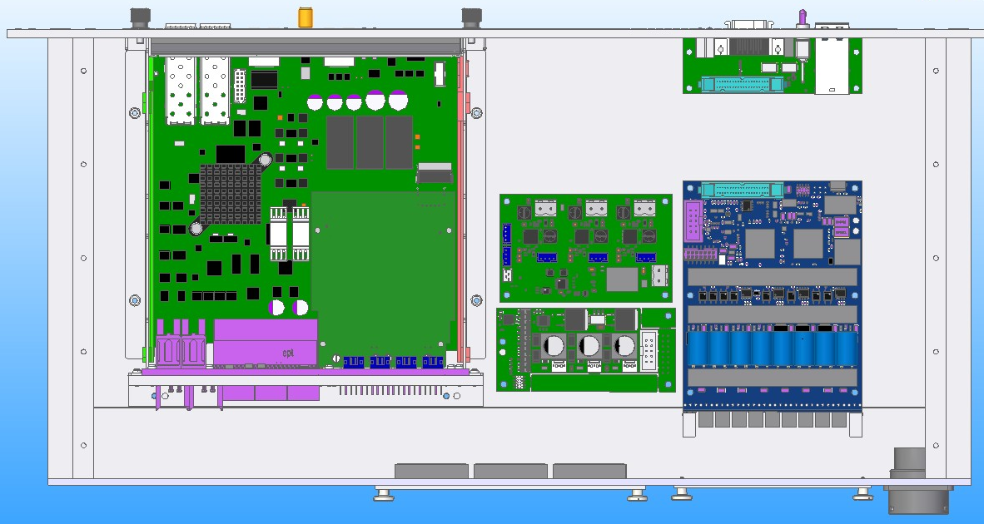
DCMv2: Simplify the production
Overview
Notes:
Before you start editing the slides of your talk change to the Master Slide view: Menu button “View”, Master, Slide Master:
Edit the following 2 items in the 1st slide: 1) 1st row in the violet header: Delete the existent text and write the title of your talk into this text field 2) The 2 rows in the footer area: Delete the text and write the information regarding your talk (same as on the Title Slide) into this text field.
If you want to use more partner logos position them left beside the DESY logo in the footer area Close Master View

Slide 17
DCMv2: Temperature Stability
Lession learned from laboratory and rack tests:
In-loop sensors and regulation are fine (TEC1091 <5mKpp, TC <3mKpp)
PCB temperature stability is influenced by PCB bridge
Placing in-loop sensors onto the bottom metal compared to top is better
To compensate a remaining temp gradient in y-direction, 3 regulations are needed
Fan ventilation have no influence on the out-of loop temperature stability, but heat-sink temperature
bottom metal
Notes:
Before you start editing the slides of your talk change to the Master Slide view: Menu button “View”, Master, Slide Master:
Edit the following 2 items in the 1st slide: 1) 1st row in the violet header: Delete the existent text and write the title of your talk into this text field 2) The 2 rows in the footer area: Delete the text and write the information regarding your talk (same as on the Title Slide) into this text field.
If you want to use more partner logos position them left beside the DESY logo in the footer area Close Master View

Slide 18
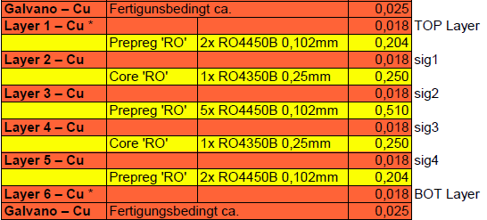
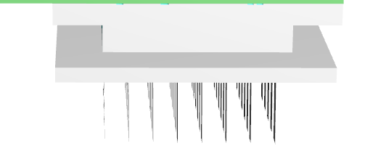
DCMv2: Temperature Stability
Simplified thermal modeling for an infinite struture
$$T_{S}$$
$$T_{O}$$
$$T_{A}$$
$$∆T$$
$$R_{T}$$
$$R_{B}$$
$$R_{S}$$
$$R_{I}$$
$$R_{H}$$
$${∆ε}_{T}$$
$$T_{A}$$
: In-loop sensor
: Out-of-loop sensor
: Ambient temperature
: Peltier drive
: Top layer half
: Bottom layer half
: Screws
: Isolation
: Heat-sink coupling
: Detection error top side
$$R_{I}$$
$$T_{A}$$
$$T_{A}$$
$$R_{T}$$
$$T_{O}$$
$$T_{A}$$
$$R_{S}$$
$$R_{A}$$
$$R_{B}$$
$$T_{S}=const.$$
(perfect regulation)
$$∆T$$
$$R_{H}$$
$$T_{A}$$
$${∆ε}_{T}=T_{S}−T_{O}$$
${∆ε}_{T}=\left(\frac{R_{T}}{R_{S}}\right)$ $\left(T_{A}−T_{S}\right) \left(1−\frac{1}{1−k_{1}k_{2}}\right)$
$∀ k_{1}= \left(\frac{R_{S}}{R_{S}+R_{T}}\right) ; k_{2}= \left(\frac{R_{B′}}{R_{B′}+R_{A}}\right) ; R_{B′}$=($R_{S}$+$R_{T}$) || $R_{B}$
$${∆ε}_{T}=\left(T_{A}−T_{S}\right)/k$$
$${∆ε}_{T}=50mK, k>40, \left(T_{A}−T_{S}\right)=±1℃$$
Set-point feed-forward
Notes:
Before you start editing the slides of your talk change to the Master Slide view: Menu button “View”, Master, Slide Master:
Edit the following 2 items in the 1st slide: 1) 1st row in the violet header: Delete the existent text and write the title of your talk into this text field 2) The 2 rows in the footer area: Delete the text and write the information regarding your talk (same as on the Title Slide) into this text field.
If you want to use more partner logos position them left beside the DESY logo in the footer area Close Master View

Slide 19
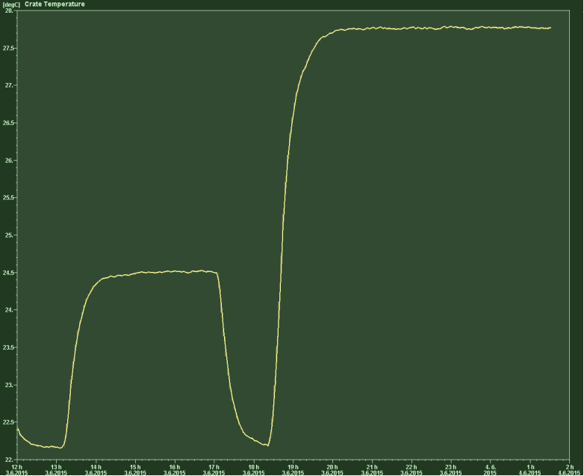
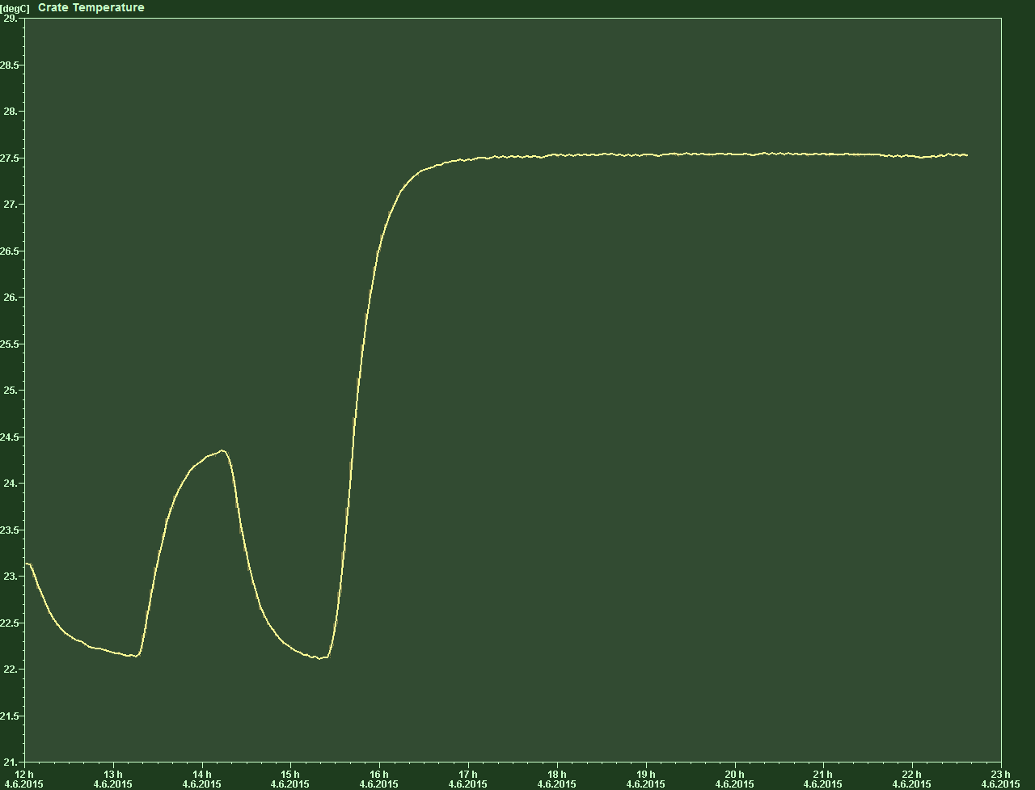
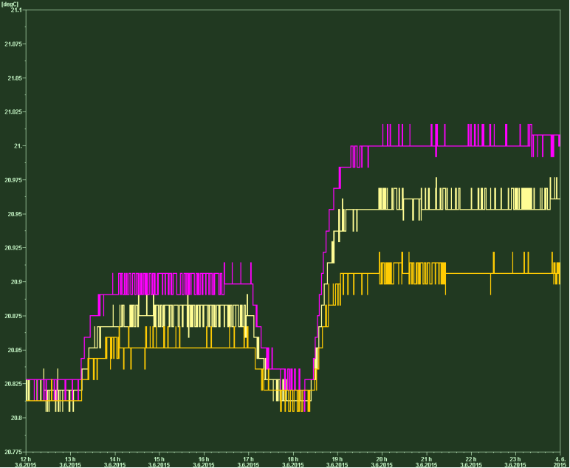
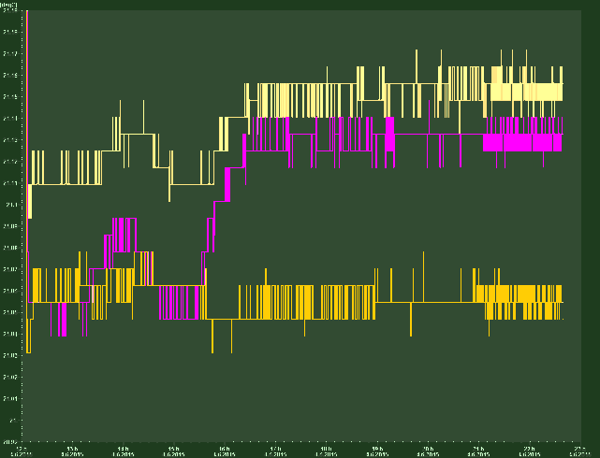
DCM Temperature Stability in the Testrack
TEC1091: Rack temp jumps
dT1=2.25K -> <0.075K, factor 30
dT2=5.50K -> <0.175K, factor 31
TC: Rack temp jump
dT1=2.1K -> <0.040K, factor 52, also see TL
dT2=5.25K -> <0.075K, factor 70
Notes:
Before you start editing the slides of your talk change to the Master Slide view: Menu button “View”, Master, Slide Master:
Edit the following 2 items in the 1st slide: 1) 1st row in the violet header: Delete the existent text and write the title of your talk into this text field 2) The 2 rows in the footer area: Delete the text and write the information regarding your talk (same as on the Title Slide) into this text field.
If you want to use more partner logos position them left beside the DESY logo in the footer area Close Master View

Slide 20
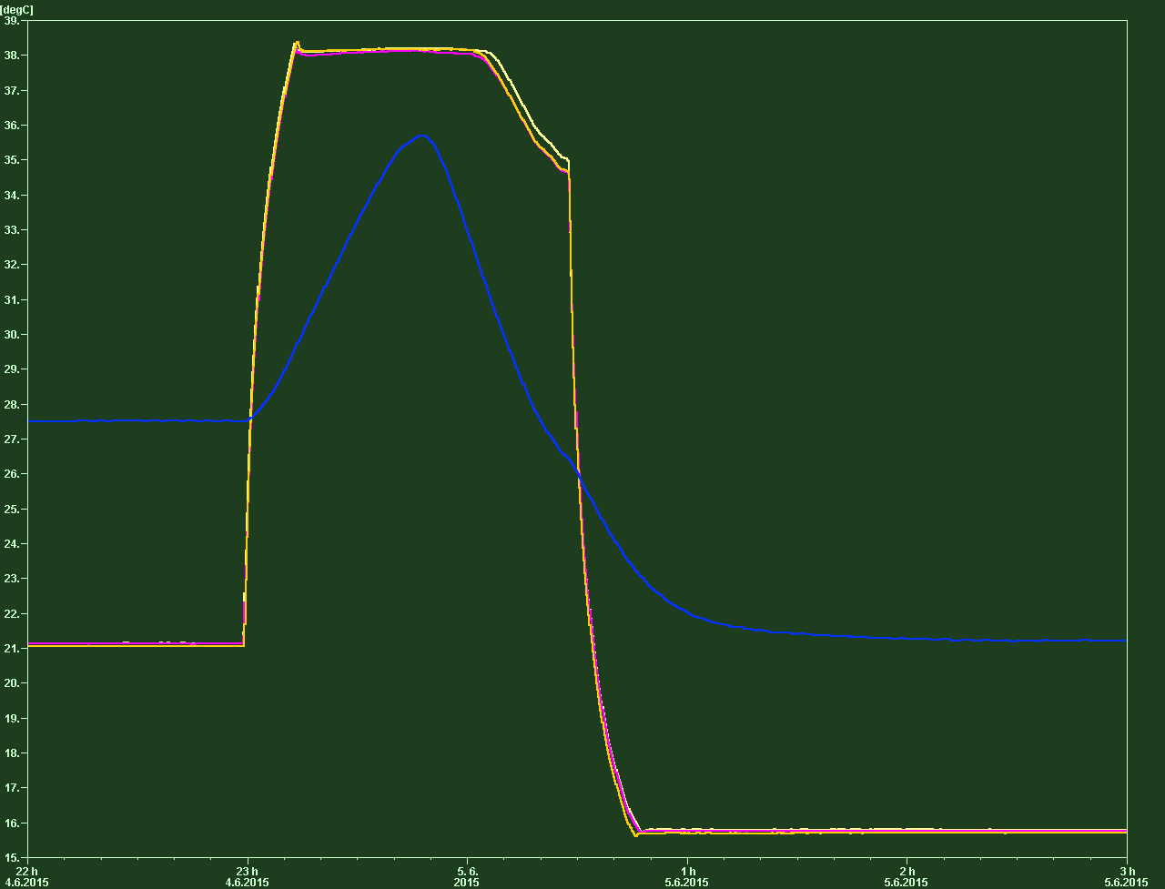
DCMv2: Temperature Operation Range
Worst case temperture operating range
Regulation break-down out of [-4K,8K]:
Peltier full current limited to
400mA for the existing Peltier,
TC Board limit 2.4A/3=800mA
-> Different choice of Peltier if needed
-> Regulation status missing
-> Peltier current missing
Worst case operating range:
10K range,
-4K cooling, +6K heating
for ambient temperatures of
[21 deg, 32 deg]
External
29 deg
Set-Point
21 deg
External
38 deg
Set-Point
38 deg
External
21 deg
Set-Point
38 deg
External
21 deg
Set-Point
16 deg
Notes:
Before you start editing the slides of your talk change to the Master Slide view: Menu button “View”, Master, Slide Master:
Edit the following 2 items in the 1st slide: 1) 1st row in the violet header: Delete the existent text and write the title of your talk into this text field 2) The 2 rows in the footer area: Delete the text and write the information regarding your talk (same as on the Title Slide) into this text field.
If you want to use more partner logos position them left beside the DESY logo in the footer area Close Master View

