Slide 1
LLRF module production for XFEL
2015 MSK collaboration workshop
Julien Branlard
LLRF module production for XFEL
ISE, Warsaw, 11.6.2015

Slide 2
What deserves our attention (a.k.a. what keeps me up at night)
REFM
REFM-OPT production (1st dummy) + tests
REFM chassis mechanical design
Bridge the installation gap
Production strategy, quality control, installation
Support modules (TMCB/FRED)
TMCB + backplane fully tested
FRED production and compatibility
DCM:
Finalizing product (temp. controller)
Production strategy (ZE?)
Test procedure + setup + report
PSM
System integration
Increase production rate
HOM and KLM
Board development, production, testing
DS800
KLM-RTM
HOM-RTM
MO
1 channel generation
Redundancy controller and switch
Software
PZ16M
Speed up development
Test PEM
Finalize test stand

Slide 3
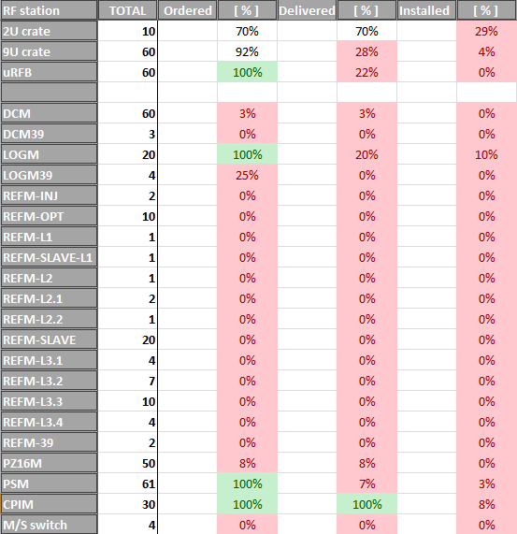
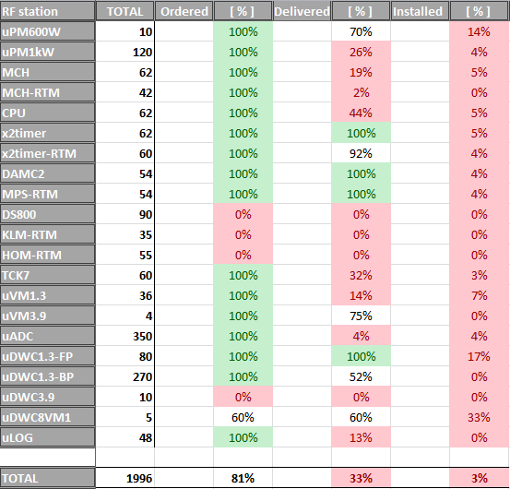
The RED list
+ MO
+ cables

Slide 4
Injector Installation
Rack installation for 1.3 GHz in July
DCM13 (2x)
REFM-OPT (1x)
REFM-INJ (1x)
PZ16M (1x)
M/S switch (2x)
Rack installation of 3.9 GHz in August/September
DCM39 (1x)
LOGM39 (2x)
REFM39 (1x)
VM39 (2x)
DWC39 (6x)
PLAN B?

Slide 5
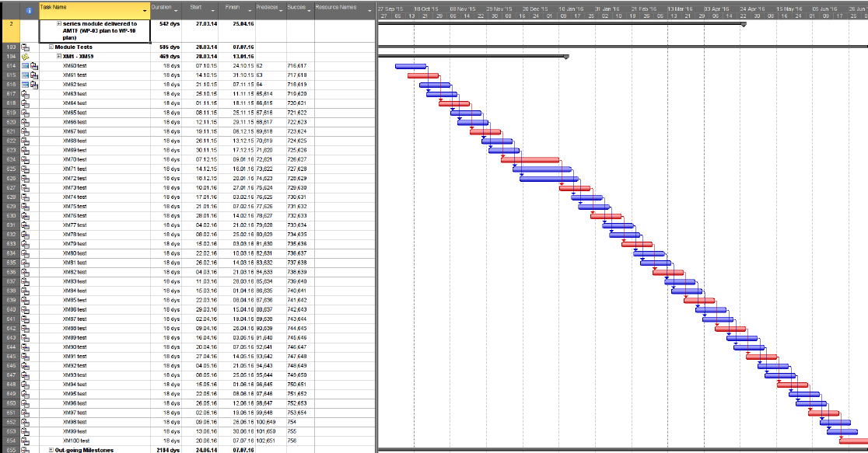
Accelerated cryomodule production

Slide 6
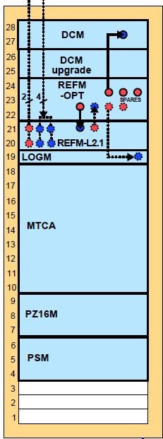
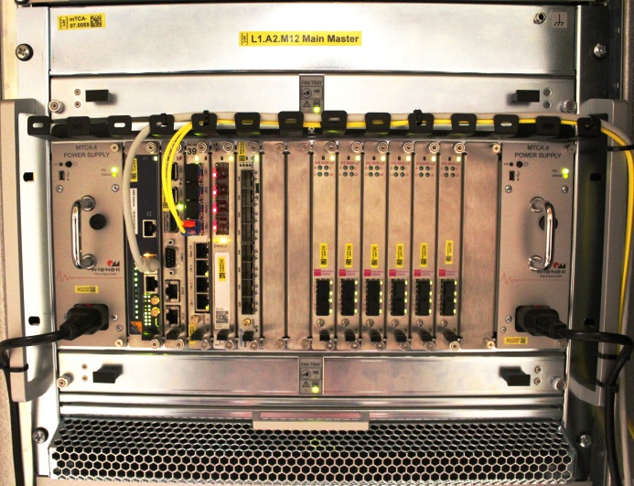
Typical XTL LLRF rack
19” modules
1x DCM
1x REFM
1x LOGM (INJ, L1, L2 only)
1x PSM
1x PZ16M
MTCA system
2x uPM
CPU / MCH (MCH-RTM)
1x x2timer / timer-RTM
1x TCK7 / VM (CLK-FT)
1x DAMC02(radmon) / MPS-RTM
1x DS800 / HOM-RTM
1x DS800 / KLM-RTM
6x uADC / uDWC
1x uLOG (L3 only)
x50

Slide 7
XTL installation
DCM
60x
All produced before end of year, need first modules now (6)
Daniel should be freed from DCM as soon as possible to support REFM
Problem of immediate module availability (until mass production starts)
Special case of DCM39 (2x) → dummy
Order 10 DCMs from ZM to release time pressure
DS800 / KLM-RTM / HOM-RTM
→ session tomorrow
uLOG / RFB / MCH-RTM
→ this session

