Slide 1
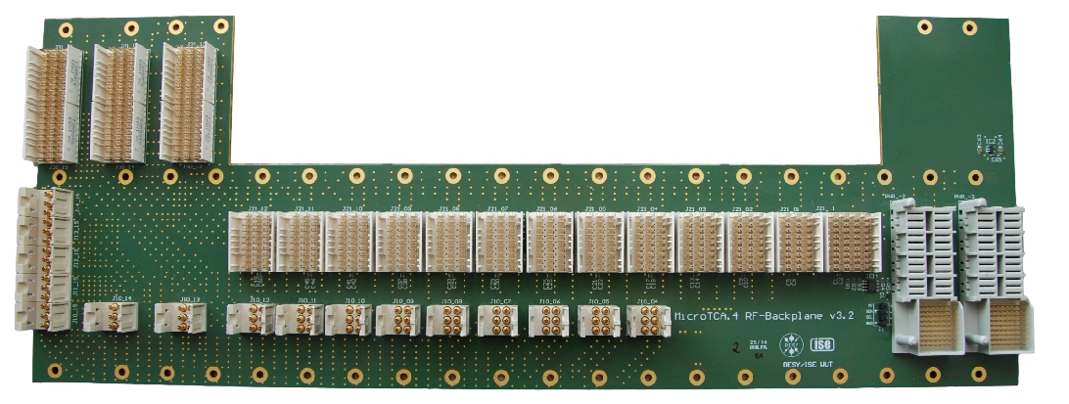
RF-Backplane status update (ELMA/SCHROFF).
Tomasz Leśniak
Warsaw University of Technology
Institute of Electronic Systems
tomasz.lesniak@desy.de
MSK Collaboration Workshop
Warsaw, 11.06.2015

Slide 2
Current Status.
Final phase of development (current revision 3.2 is final one)
Proper selection of MTCA crate for XFEL done (Schroff is official supplier, ELMA crates are also supported)
No mechanical issues
Backplane was well characterized in terms of:
S-parameters for RF channels (worst cases at 1.3GHz: |S11| < -18dB, |S21| > 3.1dB)
RF and CLK to RF channel-to-channel isolation (better than 82dB at 1.3GHz)
Phase stability over temperature and humidity (82fs/ºC and 2fs/%RH for the longest RF channel)
No issues regarding performance

Slide 3
Open Points.
Management scheme:
NAT is working on the implementation of final management functionality
It should support the front MCH, MCH-RTM-BM, RPM-PSC and uLOG
Procedure for full integration tests to be defined
Any else?

Slide 4
Documentation.
Datasheet
Specification – one more revision expected due to minor changes requested so far from NAT side + possible changes after integration tests
Manual (if needed)
Final test reports (VNA&TDR characterization, phase drifts versus temperature and humidity, isolation)

Slide 5
Mass production status.
Mass production carried out by Schroff
3 prototypes produced by SCC in China have been evaluated, no mechanical or electrical problems found
50 pcs manufactured, they are still unpopulated since they are waiting for our approval -> delayed because of too big holes for press-fit ERNI connectors (according to Julien’s email)
Schroff has checked durability of these connectors under typical removal forces and they do not see real issue (according to Julien’s email)
ELMA as alternative supplier on the market
3 prototypes delivered, the same PCB manufacturer used as for Schroff prototypes
brief evaluation planned soon

Slide 6
Quality assurance for mass production.
Quality assurance guaranteed by supplier -> Schroff
Checking PCB against net list + impedance verification carried out by PCB fabricator (SCC in China) + visual inspection
post-assembly electrical tests (connector pin to connector pin) + sanity check of EEPROM memory carried out by Schroff using automated test stand

Slide 7
Schedule.
NAT management development finalization
Integration tests with uLOG, MCH-RTM-BM and RPM-PSC
Update of specification

