Slide 1
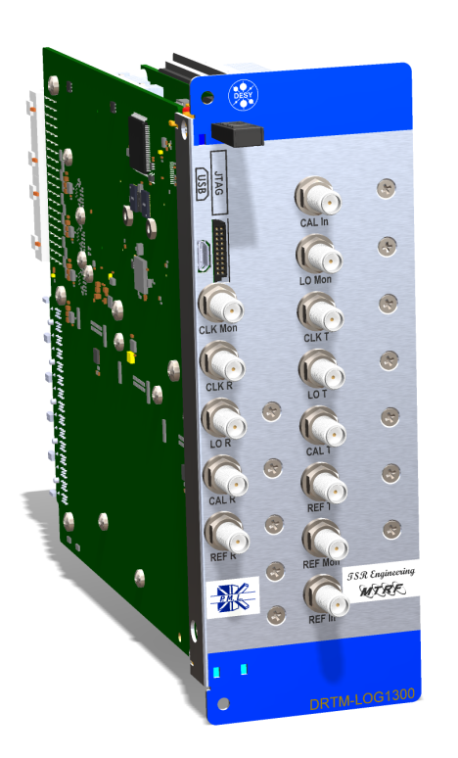
uLOG Status Update.
Uroš Mavrič, DESY
Tony Rohlev Dynamique - TSR Engineering
Warsaw, 11.06.2015

Slide 2
Current Status.
6 full units have been delivered -> mechanics unassembled and untested.
Two weeks of tests -> 3 units have been tested (not fully).
DESY
Dynamique
Full characterization of the unit. -> golden unit used as a reference for the acceptance.
RF board layout and schematics changes -> if needed.
Contract and ordering activities ongoing -> got first questions from V4 for further justifications.
Development of testing tools and organization of the testing environment
Installation of the units
Modification of Altium and mechanics documents (except the RF board Altium file)
Organizational work with Sanmina PCB House.
Organizational work with Alfa EMS assembly house.
Organization of production of mechanical components.
Shipping/delivery
Final mechanical assembly
Testing of all the 48 units

Slide 3
Open Points.
RF Board:
Adjustment of RF power delivered over the RF backplane to the DWC. Fine adjustments.
Carrier:
SPI/UART communication with the BM has never been tested. The task is being taken care by Dariusz and his colleagues.
TEC:
Testing of the temperature regulation.
Settings of the PID values for the XFEL tunnel.
What are the best fan speed settings?
Is there enough power coming over the BM?
Testing process:
Based on the “2-weeks” experience the testing process might be an issue.
Production:
New PCB manufacturer-> no experience with uLOG but with good reputation.
Components:
All potential “long-lead-time” components have been ordered.

Slide 4
Testing.
The testing protocol has been defined and agreed by both parties.
The testing process is split in:
Reduced testing -> includes only relevant measurements such as power, basic transmission of all channels, sensors, switches etc.
Full testing -> long and detailed testing which is performed on 10 randomly selected modules. It includes all the reduced testing + special measurements such as S11, residual phase noise, isolation, full S-parameter matrix etc.
The organization of the test process is left to the company. DESY will provide testing equipment and laboratory space.
Matlab scripts, MMC FW, application FW will be provided by DESY.

Slide 5
Documentation.
Specs, manual and datasheet on N drive.
Rev C and D committed to SVN. Rev A and B on N drive.
Test results on N drive.

Slide 6
Schedule.
The release/start of production is foreseen in the next 1,2 weeks:
Pushed by:
Beginning of August we need the first uLOG from the new batch.
Start of production has to happen before Tony arrives to DESY (for the testing of the 6 units) -> 18th of June.
Pulled by:
Release of the first part of the contract money -> contract issues solved.
Full testing of a unit (the three points marked with a red rectangle).
Recent issues with bad soldering..needs more investigation.

Slide 7
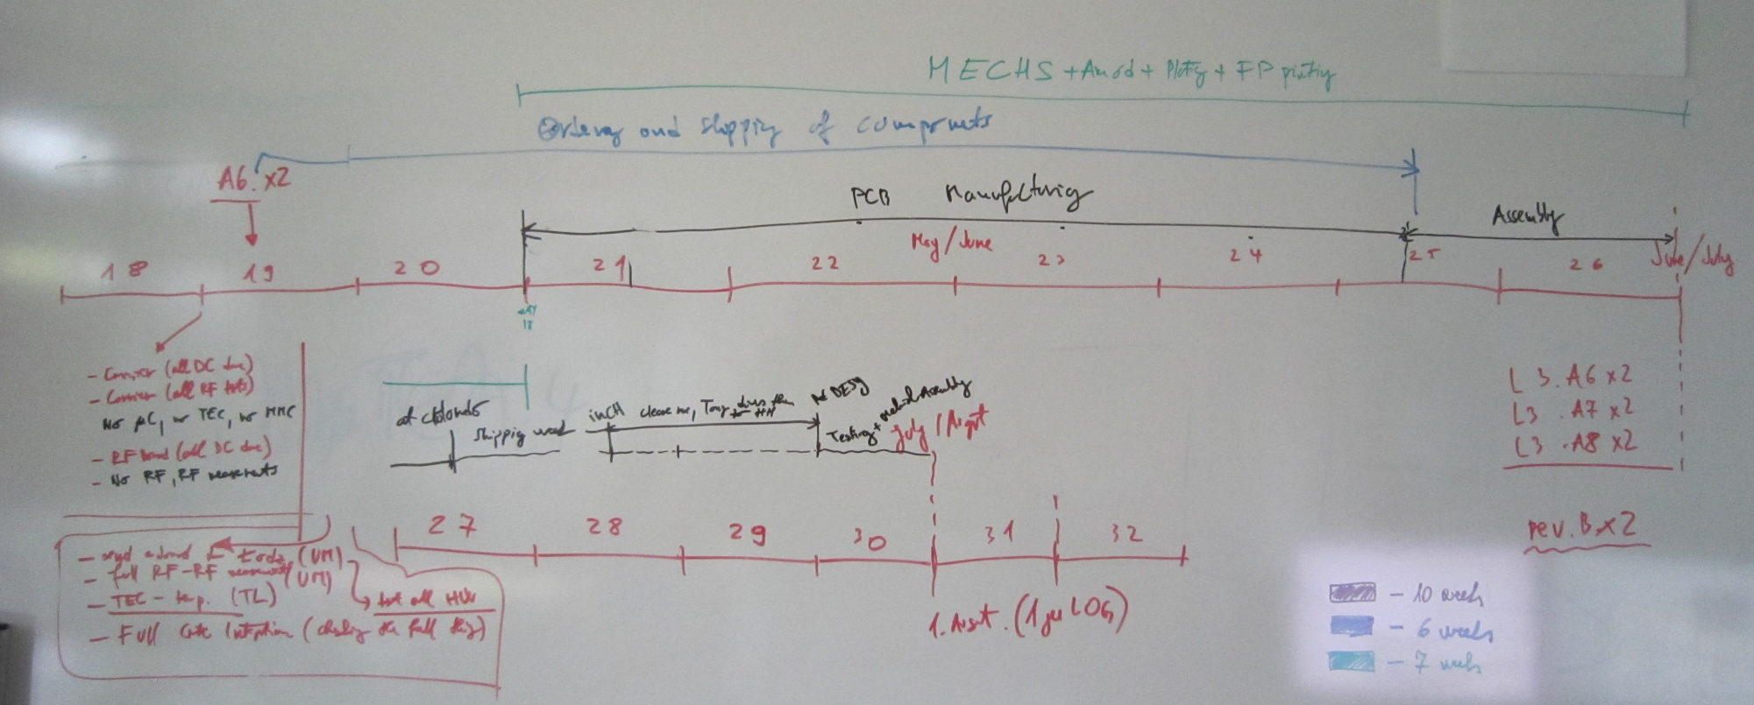
Time plan.
Mechanicals
Order of comp.
PCB Manu + assembly+ custom + shipping + testing
10 weeks
US->CH->EU Custom
6 weeks
7 weeks
Shipping
Mechanical assembly
+ testing of the 1st unit

Slide 8
Back-up slides.

Slide 9
No conference talks
Give status reports
Only top level descriptions
Max. 1-2 slides with results of tests or operation
Show problems and open points, without the technicality but the concepts and consequences
Steps and schedule toward mass production or finishing the project
Test plans - show if they are ready, or must be prepared
Availability of documentation, what is ready, what is missing!
Estimated date of finishing the project
No long talks. (10-12 slides max)
Leave time for discussion

Slide 10
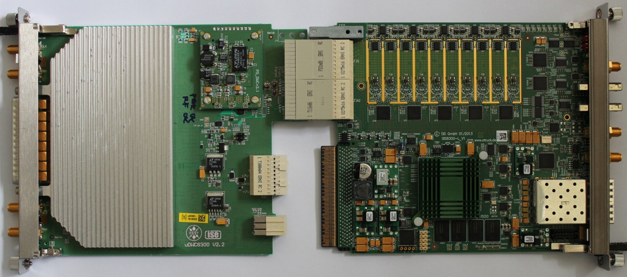
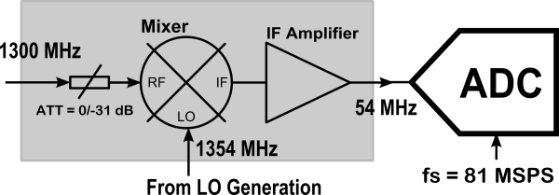
Motivation.
The RF field detection scheme for the XFEL low-level RF system uses the down-conversion of 1.3 GHz pulsed RF. The frequency translation is performed through a mixer which mixes the LO (1.354 GHz) and the RF (1.3 GHz) down to IF (54 MHz).
The IF (54 MHz) is sampled in a fast ADC with Fs = 81.25 MHZ.
RF
IF
Front-panel
LO
RF Backplane
25 RF stations
50 MTCA.4 Crates (master and slave)
9 LO and 9 CLK tap points per crate
450 LO tap-points and 450 CLK tap points

Slide 11
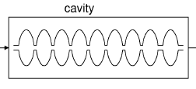
Specifications for LO and CLK Signals.
Specs for additive noise are derived from the noise contributions of other subsystems (RF front –end and ADC).
2 fs (1 mdeg at 1.3 GHz ) [10 Hz - 10 MHz]
Long term stability
0.2 ps_pp [forever – 10Hz]
Isolation on all ports
< -80 dBc
CLK additive noise
< -160 dBc/Hz floor for white noise
LO Output : 1 W at 1.354 GHz
Single Channel Receiver
AM
Front-End <-150dBc/Hz
ADC+ DDC -147dBc/Hz
BPF
DDC
CIC Filter
Calibration
LNA
ADC
Reference
CLK
Intermediate frequency [10MHz, 50MHz]:
PM
-150dBc/Hz
LO and CLK Generation
-150dBc/Hz – 10log10(8) = -160dBc/Hz
Mixer:
Vector sum processing gain
LO:

Slide 12
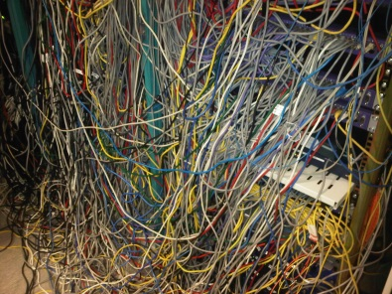
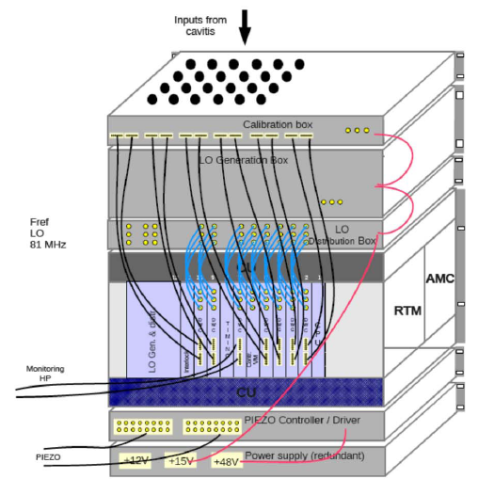
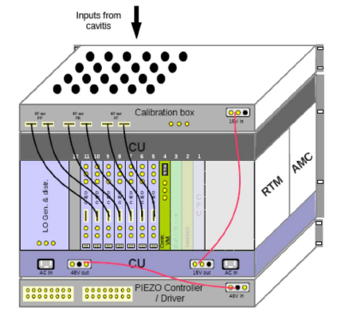
Cable vs. Backplane LO and CLK Distribution.
Introduction of the new concept of integrating the LO and CLK distribution into the MTCA.4 crate.
External LO and CLK modules allow for better performance of the generated signals.
Better Temperature and humidity control of the distribution system (cables).
No external cables needed
Compact system
Ext. LO and CLK
Integrated LO and CLK
generation

Slide 13
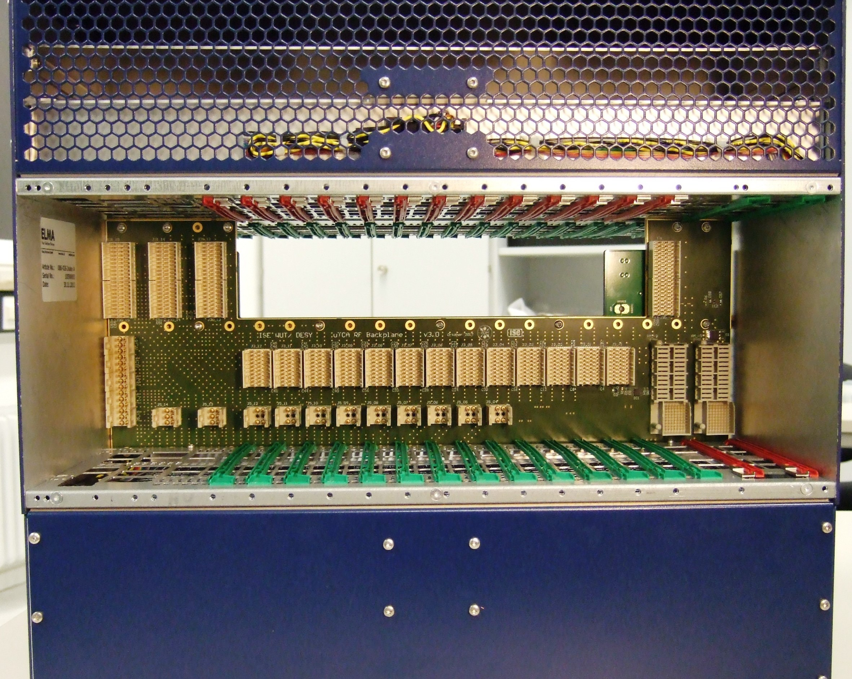
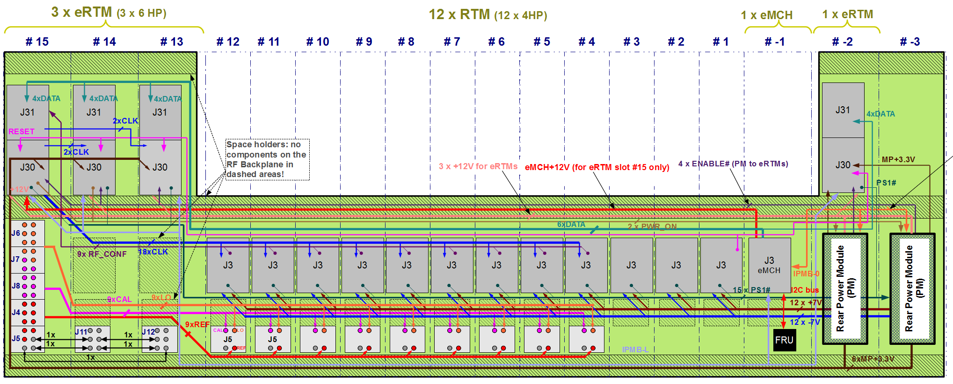
uRF-Backplane.
The uRF-backplane is used for the distribution of the LO, CLK and calibration signals.
The uRF-Backplane includes also other comm. signals such as I2C to modules, power lines, dedicated LVDS conn. etc.
From the point of view of MTCA.4 management it can be treated as an extension of the front AMC backplane.
It can accept 2 power modules that comply with MTCA.4 power specifications.
It can accept 4 eRTM modules.
DRTM-LOG1300 is an eRTM sitting in slot 15 in the rear.

Slide 14
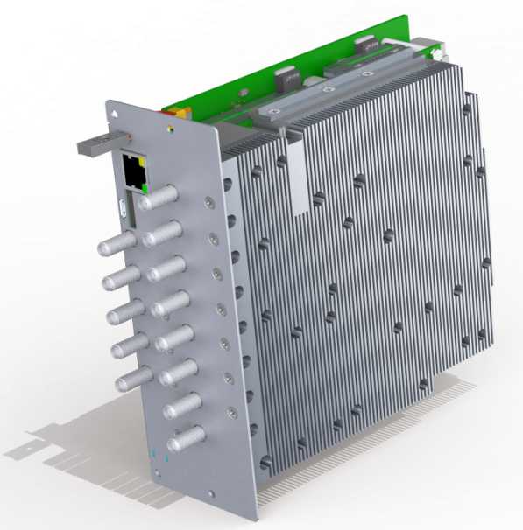
DeRTM-LOG1300.
Double-width, double full-size (12HP) module
Composed of several sub-modules
RF daughter card
Carrier mezz. + RF distribution mezz.
DC/DC mezz.
TEC mezz.

Slide 15
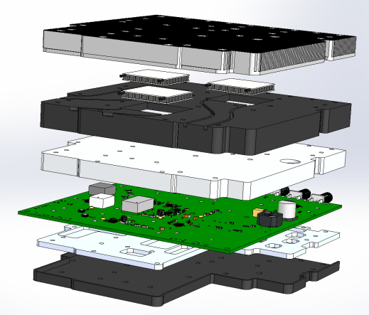
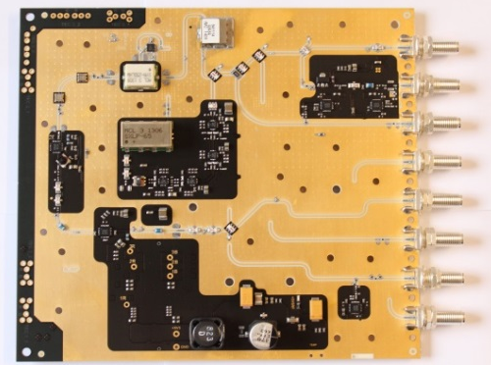
DeRTM-LOG1300 - RF.
Need to use small surface mount components because of compactness -> performance is deteriorated.
LO generated from REF via dividers
Features:
Variable LO output power by -3dB
High resolution temperature sensor (24 bit ADC with NTC Thermistor)
Dividers in the range from 1 to 64
2 variants (IF=54 MHz, IF=36 MHz) – assembly defined
Can cover RF/LO frequency range from 720 MHz To 3 GHz – assembly variant
3 Peltier modules for temperature regulation
All voltages on all chips are monitored
Heat-sink
Peltier Modules
Insulation - Top
RF Shield - Top
PCB
RF Shield - Bottom
Insulation - Bottom

Slide 16
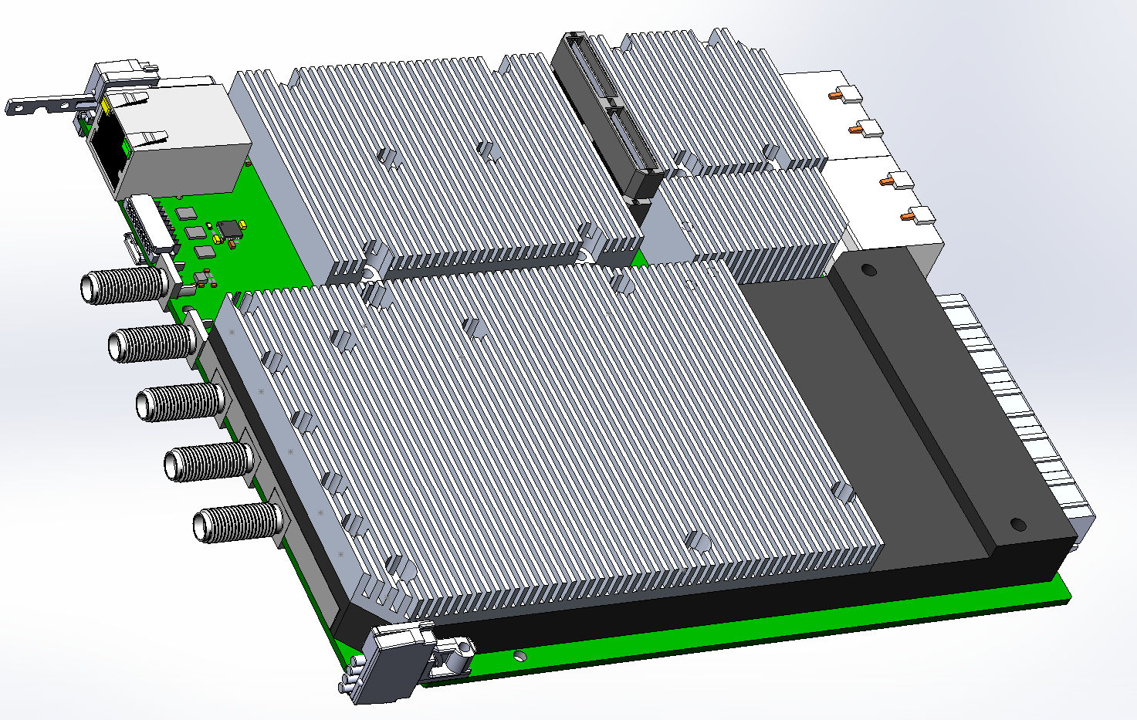
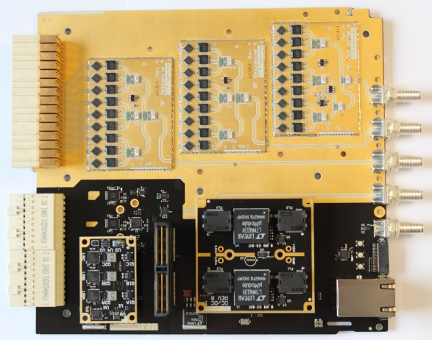
DeRTM-LOG1300 - Carrier.
Module that splits the RF, CLK signals and interconnects to the uRF-backplane.
Features:
9 x LO/REF/Pilot outputs on Radiall connectors
22 Diff. LVPECL CLK outputs on ERNI connectors
Switching OFF/ON each individual CLK, LO, REF and Pilot Output
Monitoring of the main voltages and currents
Temperature and humidity measurements
MMC 1.0 compliant
Application microcontroller
Connectivity to the ext. world
Heat-sink
Insulation - Top
PCB

Slide 17
Other Mezzanine Modules.
DC/DC power converter mezzanine
+12V into +5.9V and +5.4 V
RF splitting mezzanines
For splitting the REF, LO and calibration signal
Temperature controller mezzanine
Integrated 3 temperature controllers
DC/DC Converters
Temperature Controllers
9 x RF Outputs
RF Input
RF switches

Slide 18
Res. Phase Noise Analysis.
2 DUT measurements of residual phase noise of individual subsystems.
Test setup 1.3 fs [10 Hz – 10 MHz]
Main limitations:
Dividers – 3.2 fs
Pre-amp – 3.4 fs
Overall system res. jitter = 4.3 fs (2.7 fs with de-embedded setup)
[10 Hz – 10 MHz]
1.3 fs [10 Hz-10 MHz]
Overall Res. Phase Noise
4.3 fs [10 Hz-10 MHz]
Other spurs:
54 MHz - unshielded setup
1 kHz - unknown
Other spurs come from the test setup
3.2 fs [10 Hz-10 MHz]
3.4 fs [10 Hz-10 MHz]

Slide 19
Measurements I.
Return Loss
RF daughter board:
Isolation between channels
Return loss at connector
Harmonic content in output signals
Output power
The RF daughter card consumes 11 W
Reflection at [GHz]: | S11 [dB] – Measured-Shield
Ref In (1.3) | -24
Ref Aux Out (1.3) | -27
Ref Out (1.3) | -26
Cal Out (1.3) | -29
LO Out (1.354) | -26
CLK Out (1.3) | -23
LO Mon Out (1.354) | -32
CAL In (1.3) | -29
Output Power
Isolation between Ch.
Power out | Power [dBm] - Expected | Power [dBm] - Measured
Ref Aux Out (1.3) | 26.2 | 25.8
Ref Out (1.3) | 13 | 14.7
LO Out (1.354) | 31.0 | 30.2
CLK Out (1.3) | 9.2 | 10.0
LO Mon Out (1.354) | 14 | 16.5
Power out | Shielded [dBc]
Ref Aux Out (1.3) | < -80
Ref Out (1.3) | < -80
LO Out (1.354) | < -80
CLK Out (1.3) | < -80
LO Mon Out (1.354) | < -80
Pilot | < -80
Harmonic Content
Power out | 2nd [dBc] | 3rd [dBc]
Ref Aux Out (1.3) | <-80 | <-80
LO Out (1.354) | <-80 | <-80
CLK Out (1.3) | <-80 | <-80
REF (1.3) | <-80 | <-80

Slide 20
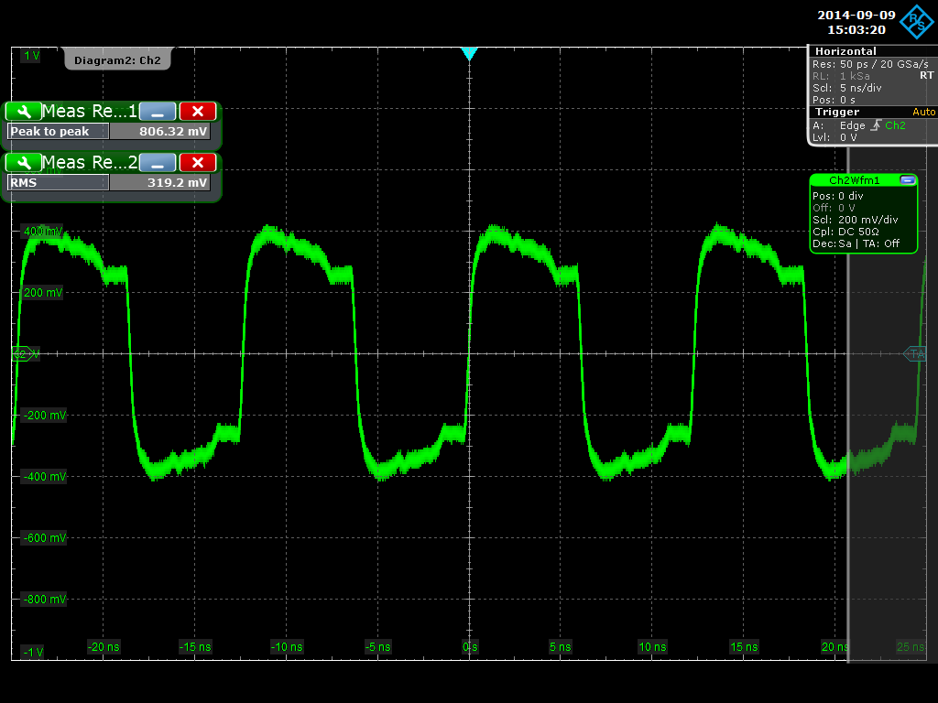
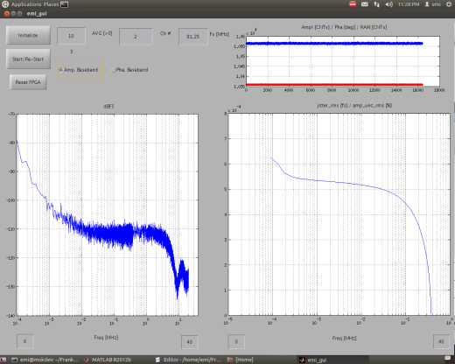
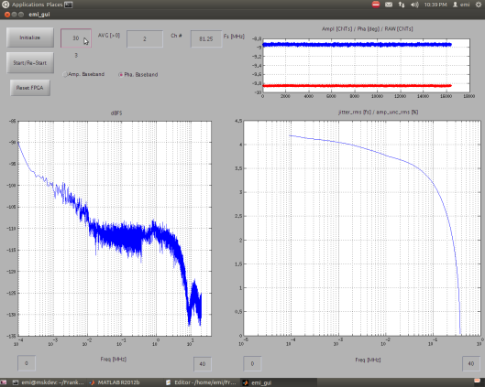
Measurements II.
S parameters of the splitting section:
S21 = LO -16 dB (spread = 0.4 dB), CAL -16 dB (spread = 0.5 dB)
S11 = < -22 dB
Isolation = mostly < -80 dB, some specific channels -65 dB
LO and CLK Distribution over the uRF-Backplane:
CLK distributed over the RF backplane
to slot 4 (long. distance).
Sampling of signals with CLKs that were distributed over the uRF-backplane. No additional spurs were visible.
Amp
Pha

Slide 21
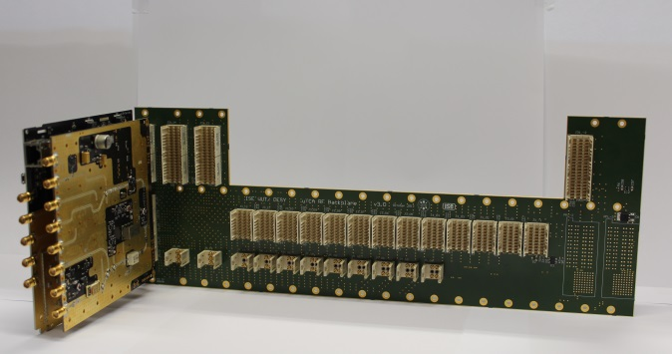
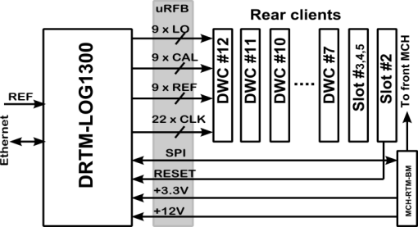
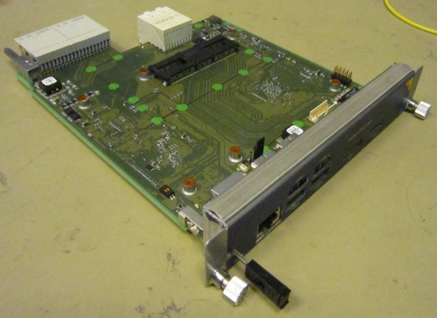
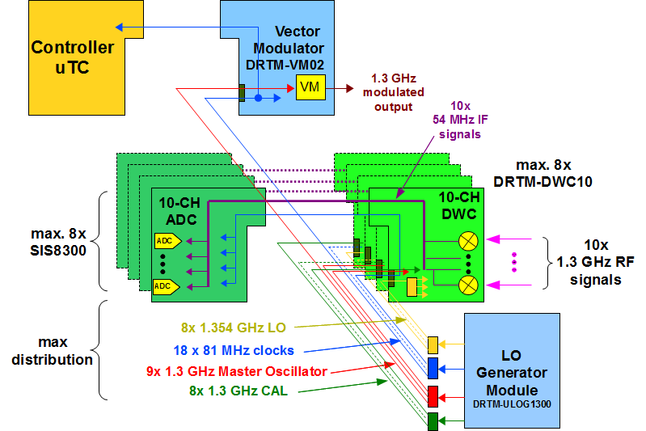
System Integration.
Subsystems Involved:
DRTM-LOG1300
uRF-Backplane
9U Chassis
NAT-MCH-BM or Rear Power module
End-Users (RTMs)

Slide 22
Thank you for your attention!

