Slide 1
Current status and future developments for the LLRF control server
Adam Piotrowski
MSK Collaboration Workshop 2015
10-12 June 2015, WUT Warsaw

Slide 2
Server Minor Changes
Continuous adjustments of server to new firmware and user requirements
User requests
  Change of properties names
  Move properties between locations
  Add/remove history for selected properties
  Small functionality modifications
Bugfixing
  Correction of parameters init after server restart
  Correction of limiters and VS for channels 0 and 9
Special requests for shift

Slide 3
Server Major Changes
Run-time configuration of DMA buffers
Support for mapp files
Support for FLASH1/FLASH2 with new functionality of timing system
Update of OVR – not tested yet

Slide 4
Server Major Changes
New approach to long archiver
Return to build-in D_spectrum class
Changelog file added to source code structure
DRIVER LEVEL: solution for NO DMA INTERRUPT problem

Slide 5
Board/FW Functionality Separation
Initial assumption
  One board -> one firmware -> one functionality
  DMA buffers configuration depends only on board type
Current requirements
  One board -> multiple versions of firmware -> multiple functionality
  DMA buffers configuration depends on firmware functionality

Slide 6
Board/FW Functionality Separation
Initial assumption
  One location per board – SIS board, UTC board, TCK7 board, SISL board
  RTM functionality included into board location
Current requirements
  One location per board but only with hardware specific functionality
  One location per RTM but only with hardware specific functionality
  High level functionality moved to existing locations

Slide 7
Board/FW Functionality Separation
DMA buffer configuration moved to run-time and stored into server conf file:
  eq_fct_info: <PDMA_CH_NR>16</PDMA_CH_NR><SDMA_CH_NR>8</SDMA_CH_NR><PDMA_CH_IN_USE>11</PDMA_CH_IN_USE><SDMA_CH_IN_USE>8</SDMA_CH_IN_USE><PDMA_SAMPLES_PER_CH>16384</PDMA_SAMPLES_PER_CH><SDMA_SAMPLES_PER_CH>147456</SDMA_SAMPLES_PER_CH><PDMA_SCALE_FACTOR>4</PDMA_SCALE_FACTOR><SDMA_SCALE_FACTOR>1</SDMA_SCALE_FACTOR><PDMA_CH_OFFSET>0</PDMA_CH_OFFSET><SDMA_CH_OFFSET>0</SDMA_CH_OFFSET>„
  eq_fct_info: "<PZ>OFF</PZ><DMA_SAMPLES_PER_CH>16384</DMA_SAMPLES_PER_CH><PIEZO_SAMPLES_PER_CH>2000</PIEZO_SAMPLES_PER_CH><PIEZO_FF_SAMPLES_PER_CH>1024</PIEZO_FF_SAMPLES_PER_CH>"

Slide 8
PITZ Server Problem
Server crashes with following message
segfault at 8 ip 00007f16753f3588 sp 00007f165dff93f0 error 4 in libEqServer.so.18.10.1-precise1[7f1675307000+12d000]
DOOCSHashtable::HashSearch(char const*, int)
/doocs/doocssvr1/nightly_builds/release_Ubuntu-12.04-x86_64_18.10.1/library/common/serverlib/DOOCShash.cc:462
Available coredump files:
[Thread debugging using libthread_db enabled]
Using host libthread_db library "/lib/x86_64-linux-gnu/libthread_db.so.1".
Core was generated by `/export/doocs/server/llrfCtrl_server/llrfCtrl_server‚.
Program terminated with signal 11, Segmentation fault.
#0 0x00007f42b0c20588 in DOOCSHashtable::HashSearch
(this=0x5a52450, aSearchString=0x7f42a0435e00 "FF_AMPL.TD", aType=1)
at /doocs/doocssvr1/nightly_builds/release_Ubuntu-12.04-x86_64_18.10.1/library/common/serverlib/DOOCShash.cc:462462)
(gdb)

Slide 9
PITZ Server Problem
No correlation with operators actions
Problem cannot be reproduced in known environment (gdb, valgrind)
Problem cannot be reproduced on test machine in PITZ (different firmware version)
Problem was visible at FLASH ACC23 with installed incorrect version of driver
No problem with FLASH RF Gun

Slide 10
PITZ Server Problem
MCS group informed – ticket assigned to Olaf Hensler
Problem visible on different doocs libraries
Problem appears in PITZ after 1 week of operation
Problem appears in REGAE after server update – no major update in code

Slide 11

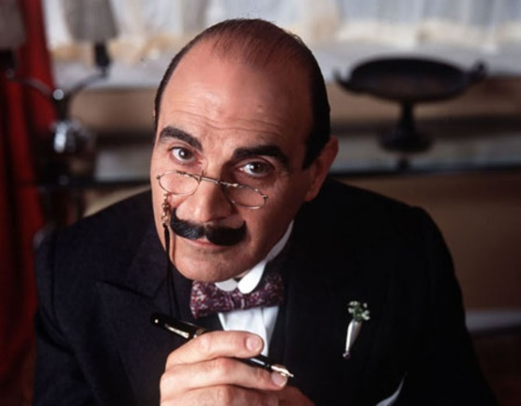
PITZ Server Problem
All suggestions, ideas, questions are welcome

Slide 12
Future work
Properties names unification
Properties cleanup
Properties description, values limitation
Updates of server due to bug fixing
Updates of server due to user requirements
Updates of server due to hardware modifications
Integration with MTCA4U framework

Slide 13
Thank You
FastLogic Sp. z o.o.
Al. T. Kościuszki 123/324
90-441 Łódź, POLAND
www.fastlogic.pl
office@fastlogic.pl

