Slide 1
Summary of AMTF
An overview and assessment
Mathieu Omet (for the LLRF team)
Warsaw, 10.06.2015

Slide 2
Contents
Introduction
Status of Hardware
LLRF Tests
LLRF Test Reports
Evaluation of Test Reports
Self Assessment / Restrictions
Summary / Outlook

Slide 3
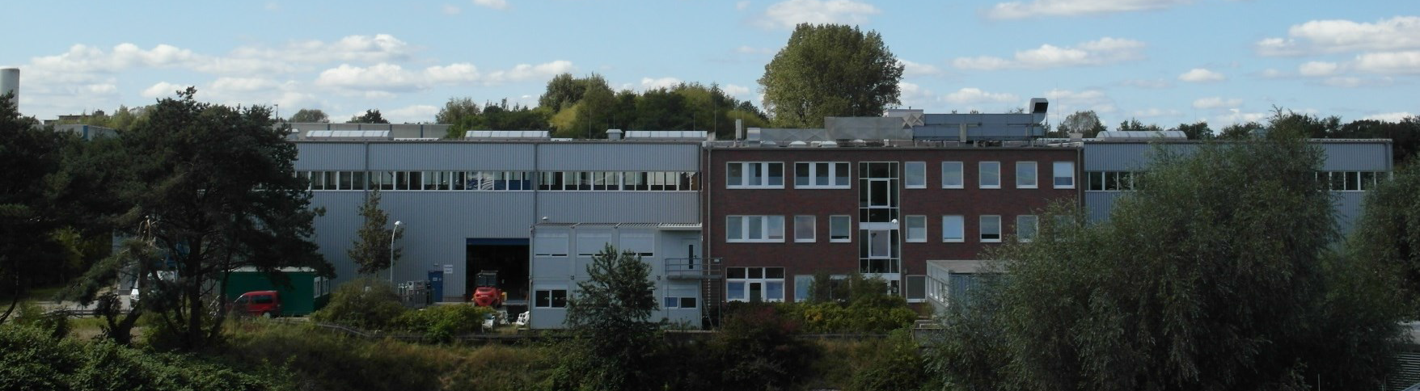
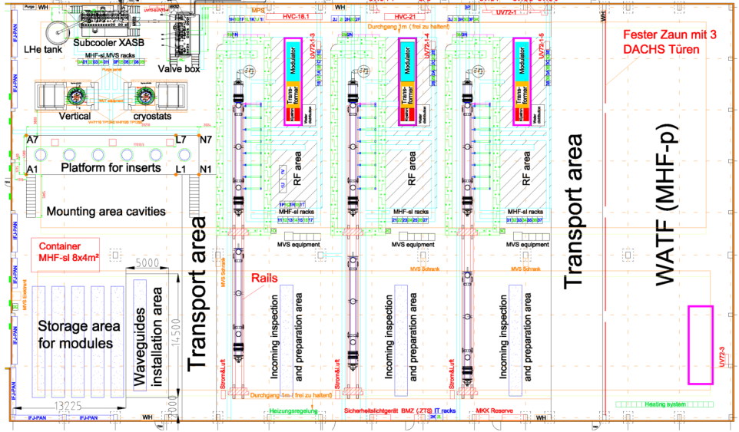
Introduction
Picture with courtesy of Jacek Swierblewski
XATB1
AMTF1
AMTF39
XATB2
AMTF2
XATB3
AMTF3
Picture with courtesy of Jacek Swierblewski

Slide 4
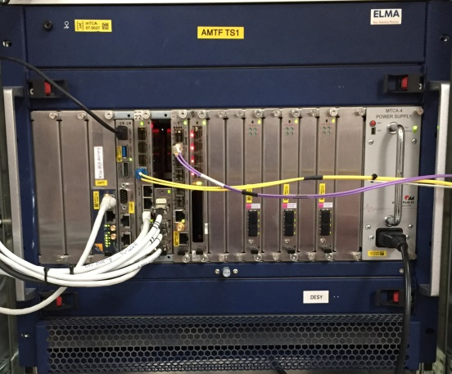
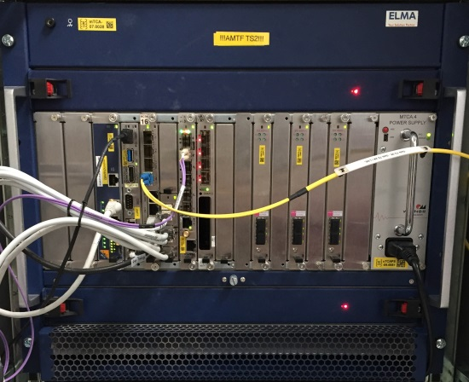
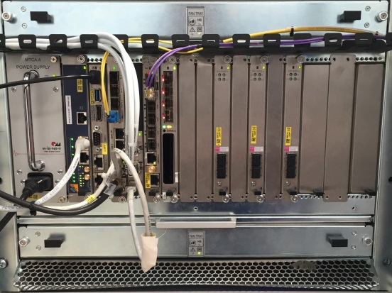
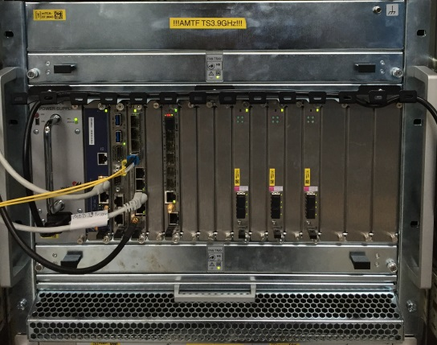
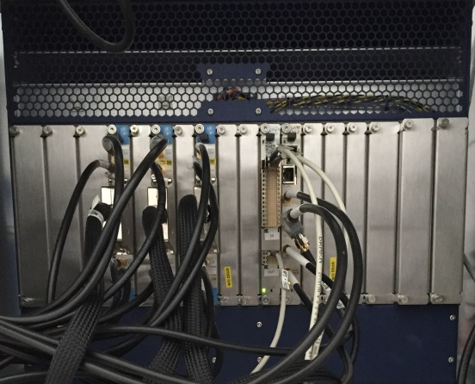
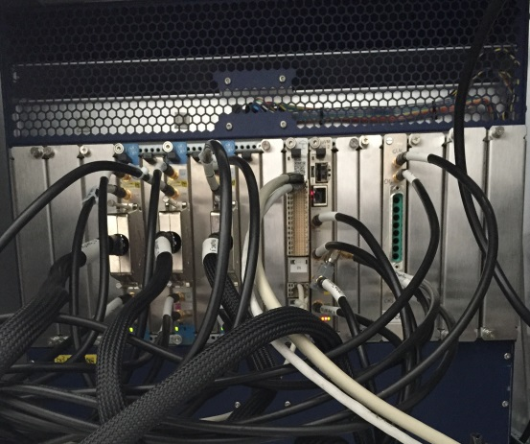
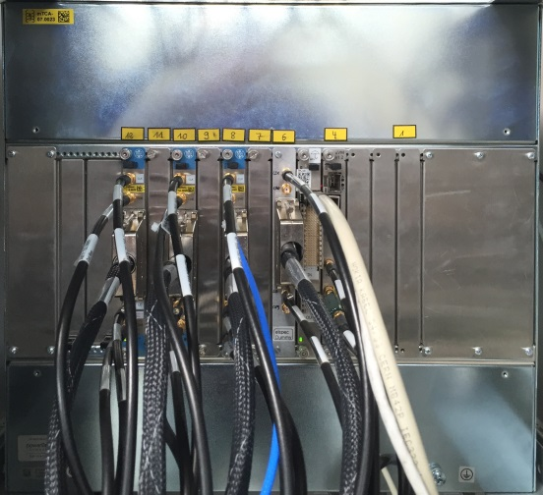
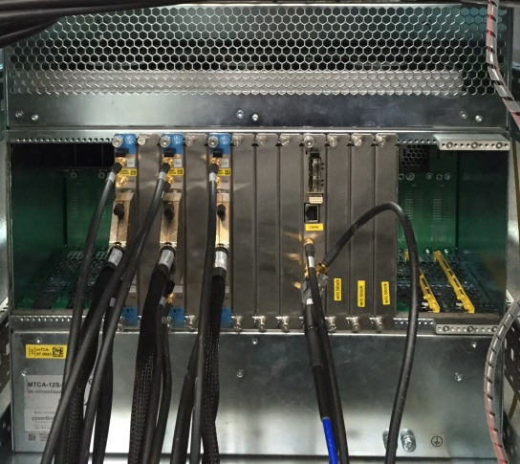
Status of Hardware
FRONT
AMTF1 | AMTF2 | AMTF3 | AMTF39
BACK
AMTF1 | AMTF2 | AMTF3 | AMTF39

Slide 5
Status of Hardware
AMTF1 | AMTF2 | AMTF3 | AMTF39
ELMA crate | ELMA crate | Schroff crate | Schroff crate
NAT-MCH 0b03 V3.4, R120725 Firmware V2.14.1 | NAT-MCH 0b23 V1.2, R130401 Firmware V2.14.1 | NAT-MCH 0b23 V1.2, R130401 Firmware V2.14.1 | NAT-MCH 0b23 V1.2, R130401 Firmware V2.14.1
Concurrent Technologies AM 900/412 781-6011-00 | Concurrent Technologies AM 900/412 781-6011-10 | Concurrent Technologies AM 900/412 781-6011-10 | Concurrent Technologies AM 900/412 781-6011-13
Stockholm University X2TIMER 021-02 Rev0.2.1.d | Stockholm University X2TIMER 021-02 Rev0.2.1.d | Stockholm University X2TIMER 021-02 Rev0.2.1.d | Stockholm University X2TIMER 021-02 Rev0.2.1.d
esd AMC-ADIO24 U.1001.01 01 | esd AMC-ADIO24 U.1001.01 01 | esd AMC-ADIO24 U.1001.01 01
DMCS uTC 1.0 1.31 | DMCS uTC 1.0 1.31 | DMCS uTC 1.0 1.31 | DMCS uTC 1.0 1.31
DESY DAMC2V2 8423-02 | DESY DAMC2V2 8423-02 | DESY DAMC2V2 8423-02
Struck SIS8300L v1.0 | Struck SIS8300L v1.0 | Struck SIS8300L v1.0 | Struck SIS8300L v1.0
Struck SIS8300L v1.0 | Struck SIS8300L v1.0 | Struck SIS8300L v1.0 | Struck SIS8300L v1.0
Struck SIS8300L v1.0 | Struck SIS8300L v1.0 | Struck SIS8300L v1.0 | Struck SIS8300L v1.0
Elma xTCA CU 040-378 Ind E | Elma xTCA CU 040-378 Ind.C | Schroff uTCA Cooling 21890080 AB | Schroff uTCA Cooling 21890096 AB
Elma xTCA CU 040-378 Ind E | Elma xTCA CU 040-378 Ind C | Schroff uTCA Cooling 21890080 AB | Schroff uTCA Cooling 21890096 AB
Wiener/NAT MTCA PS 800W 0400.TCA0 V1.2 | Wiener/NAT MTCA PS 800W 0400.TCA0 V1.2 | Wiener MTCA PS (?) | Wiener/NAT MTCA PS 800W 0400.TCA0 V1.2
NAT-MCH-CLK-PHYS 0b0a V1.0 | NAT-MCH-CLK-PHYS 0b0a V1.0 | NAT-MCH-CLK-PHYS 0b0a V1.0 | NAT-MCH-CLK-PHYS 0b0a V1.0
NAT PCIe Hub Module 0b07 V2.2 | NAT PCIe Hub Module 0b07 V2.3 | NAT PCIe Hub Module 0b07 V2.3 | NAT PCIe Hub Module 0b07 V2.3
ATP MPS-RTM1 8694-00 00 | ATP MPS-RTM1 8694-00 00 | ATP MPS-RTM1 8694-00 00
Struck RTM-DWC 8618-01ML v1.0 | Struck RTM-DWC 8618-01ML v1.0 | Struck RTM-DWC 8618-01ML v1.0 | ? (presumably Struck RTM-DWC 8618-01ML v1.0)
Struck RTM-DWC 8618-01ML v1.0 | Struck RTM-DWC 8618-01ML v1.0 | Struck RTM-DWC 8618-01ML v1.0 | Struck RTM-DWC 8618-01ML v1.0
Struck RTM-DWC 8618-01ML v1.0 | Struck RTM-DWC 8618-01ML v1.0 | Struck RTM-DWC 8618-01ML v1.0 | ? (presumably Struck RTM-DWC 8618-01ML v1.0)

Slide 6
Status of Hardware
AMTF1 | AMTF2 | AMTF3 | XFEL L1.A2 Master
ELMA crate | ELMA crate | Schroff crate | Schroff crate
NAT-MCH 0b03 V3.4, R120725 Firmware V2.14.1 | NAT-MCH 0b23 V1.2, R130401 Firmware V2.14.1 | NAT-MCH 0b23 V1.2, R130401 Firmware V2.14.1 | NAT-MCH 0b23 V2.0, R141024 Firmware V2.16.1
Concurrent Technologies AM 900/412 781-6011-00 | Concurrent Technologies AM 900/412 781-6011-10 | Concurrent Technologies AM 900/412 781-6011-10 | Concurrent Technologies AM900/412 781-6011-13
Stockholm University X2TIMER 021-02 Rev0.2.1.d | Stockholm University X2TIMER 021-02 Rev0.2.1.d | Stockholm University X2TIMER 021-02 Rev0.2.1.d | Stockholm University X2TIMER 021-02 Rev0.2.1.d
esd AMC-ADIO24 U.1001.01 01 | esd AMC-ADIO24 U.1001.01 01 | esd AMC-ADIO24 U.1001.01 01
DMCS uTC 1.0 1.31 | DMCS uTC 1.0 1.31 | DMCS uTC 1.0 1.31 | Vadatech DAMC-TCK7 1.0
DESY DAMC2V2 8423-02 | DESY DAMC2V2 8423-02 | DESY DAMC2V2 8423-02 | DESY DAMC2v3 8423-04
Struck SIS8300L v1.0 | Struck SIS8300L v1.0 | Struck SIS8300L v1.0 | Struck SIS8300L2 v1.0
 |  |  | Struck SIS8300L2 v1.0
Struck SIS8300L v1.0 | Struck SIS8300L v1.0 | Struck SIS8300L v1.0 | Struck SIS8300L2 v1.0
 |  |  | Struck SIS8300L2 v1.0
Struck SIS8300L v1.0 | Struck SIS8300L v1.0 | Struck SIS8300L v1.0 | Struck SIS8300L2 v1.0
 |  |  | Struck SIS8300L2 v1.0
Elma xTCA CU 040-378 Ind E | Elma xTCA CU 040-378 Ind.C | Schroff uTCA Cooling 21890080 AB | Schroff uTCA Cooling 21890096 AB
Elma xTCA CU 040-378 Ind E | Elma xTCA CU 040-378 Ind C | Schroff uTCA Cooling 21890080 AB | Schroff uTCA Cooling 21890096 AB
Wiener/NAT MTCA PS 800W 0400.TCA0 V1.2 | Wiener/NAT MTCA PS 800W 0400.TCA0 V1.2 | ? | Wiener/NAT MTCA PS 1000W 0400.TCA0 03.00
 |  |  | Wiener/NAT MTCA PS 1000W 0400.TCA0 02.00
NAT-MCH-CLK-PHYS 0b0a V1.0 | NAT-MCH-CLK-PHYS 0b0a V1.0 | NAT-MCH-CLK-PHYS 0b0a V1.0 | NAT-MCH-CLK-PHYS 0b0a V1.0
NAT PCIe Hub Module 0b07 V2.2 | NAT PCIe Hub Module 0b07 V2.3 | NAT PCIe Hub Module 0b07 V2.3 | NAT PCIe Hub Module 1144 V1.0
 |  |  | Stokholm University RTM_Trg2 021 00 Rev.0.2.1a
ATP MPS-RTM1 8694-00 00 | ATP MPS-RTM1 8694-00 00 | ATP MPS-RTM1 8694-00 00 | ATP MPS-RTM1 8694-00 00
Struck RTM-DWC 8618-01ML v1.0 | Struck RTM-DWC 8618-01ML v1.0 | Struck RTM-DWC 8618-01ML v1.0 | Struck RTM-DWC 8618-01ML v1.0
 |  |  | Struck RTM-DWC 8618-01ML v1.0
Struck RTM-DWC 8618-01ML v1.0 | Struck RTM-DWC 8618-01ML v1.0 | Struck RTM-DWC 8618-01ML v1.0 | Struck RTM-DWC 8618-01ML v1.0
 |  |  | Struck RTM-DWC 8618-01ML v1.0
Struck RTM-DWC 8618-01ML v1.0 | Struck RTM-DWC 8618-01ML v1.0 | Struck RTM-DWC 8618-01ML v1.0 | Struck RTM-DWC 8618-01ML v1.0
 |  |  | Struck RTM-DWC 8618-01ML v1.0

Slide 7
Status of Hardware
More and more disconnected from XFEL
System aging (hardware / firmware)
E.g. firmware changes implemented only for latest hardware → new features are not availiable
Lack of spare parts
If e.g. a uTC will break, new hardware (TCK7) has to be installed → recommissioning of the whole LLRF system

Slide 8
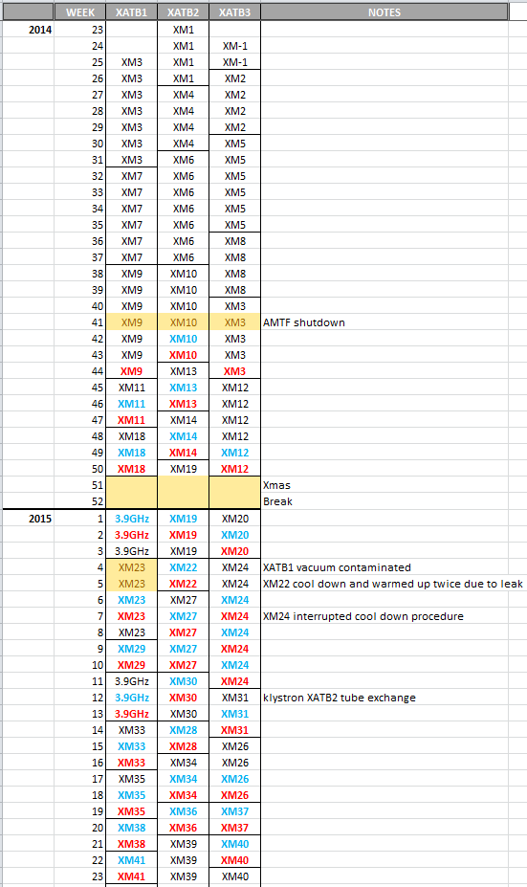
Testing Performance at AMTF
Modules tested so far ~40
Test rate 1/week
Downtime [hrs]
In 2014 mainly due to server related issues
In 2015 due to automation, server and firmware issues
Year | AMTF1 | AMTF2 | AMTF3 | Total
2014 | 2.2 | 3.1 | 1.25 | 6.55
2015 | 0 | 0.55 | 1.3 | 1.85

Slide 9
LLRF Tests Performed at AMTF
Piezo capacitance
Coupler motor characterization
Piezo DC Scan
Tuner motor characterization
Lorentz force detuning coefficient
Lorentz force detuning compensation
Cavity fundamental modes
Closed-loop operation

Slide 10
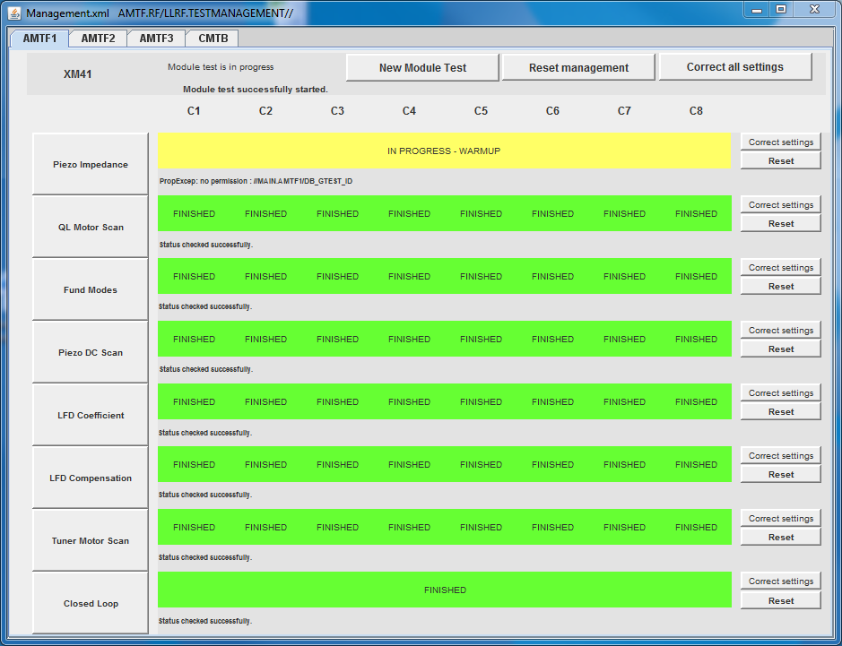
LLRF Tests Performed at AMTF
All tests automated and performed by AMTF operators except FB
Management server to provide overview of test status

Slide 11
Closed-loop (Feedback) Operation Test
AMTF LLRF
data base

Slide 12
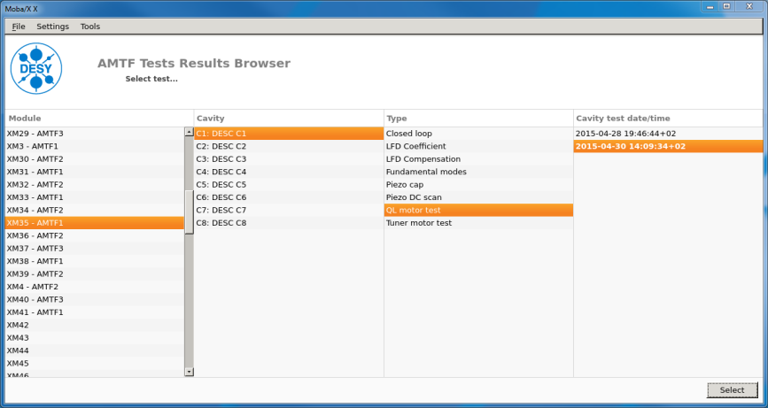
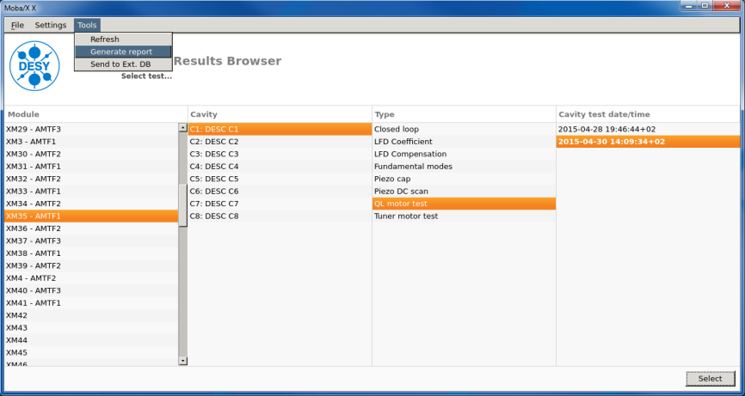
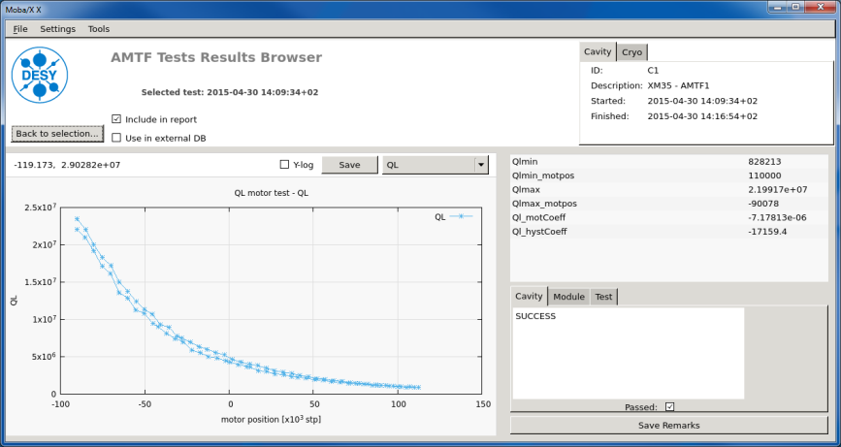
Creation of Cryomodule LLRF Test Reports
Generate LaTeX file of report
Compile and convert to pdf
Generate in Word a cover page including a summary
Merge pdf files in order to generate the final report
AMTF Tests Results Browser
View data / select data for the report write comments / pass or fail a test
Selected data is transfered to the XFEL data base
AMTF LLRF
data base

Slide 13
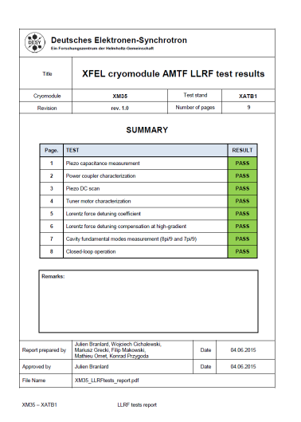
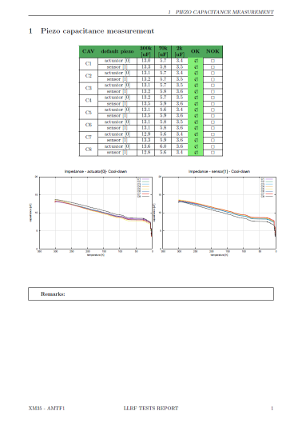
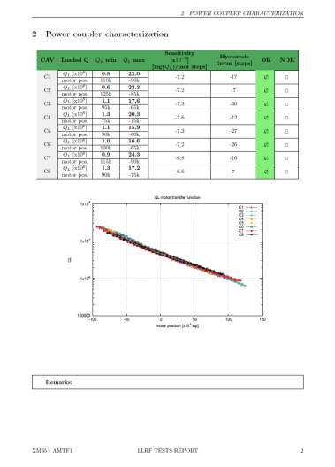
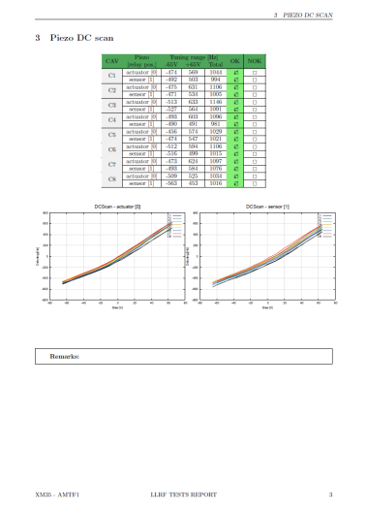
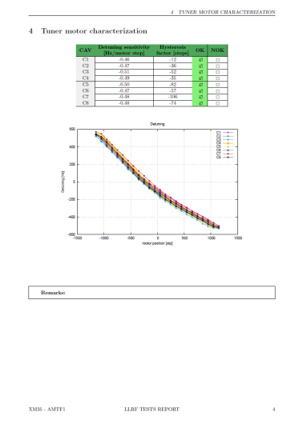
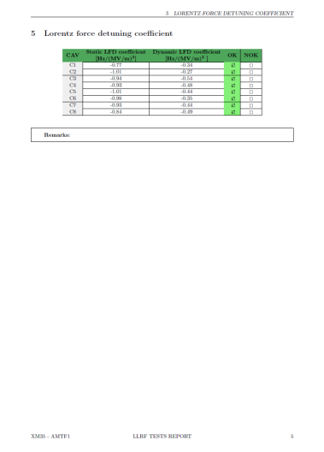
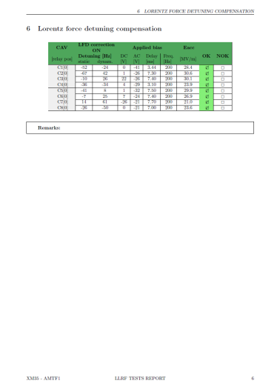
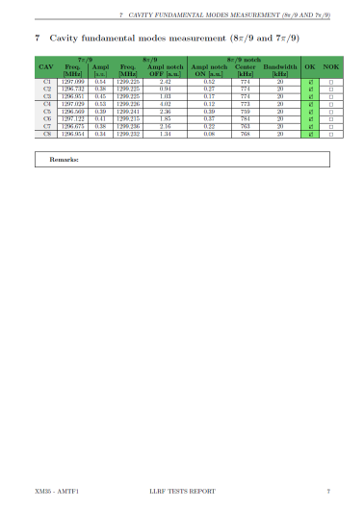
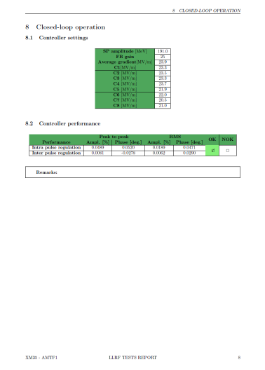
Cryomodule LLRF Test Report
Can be found here: N:\4all\public\MSK_Projekte\XFEL\AMTF\1300MHzTestStands\Tests Reports

Slide 14
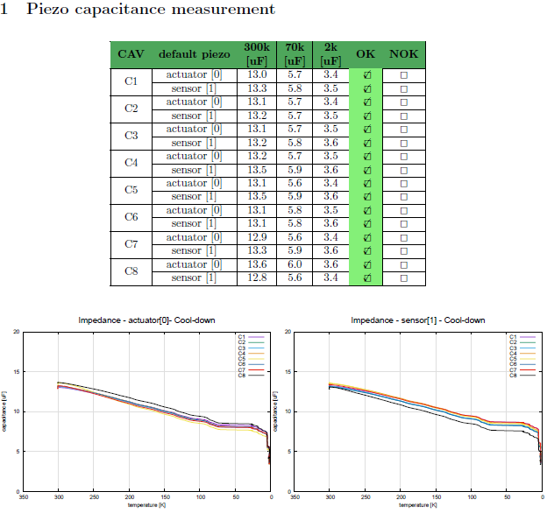
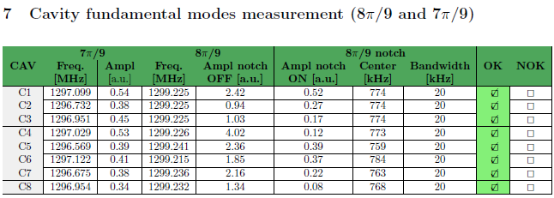
What data can be used later?
Piezo capacitance for temperature estimation
Notch filter settings for suppression of 8π/9 modes
Script for data read out and setting during XFEL commissioning?

Slide 15
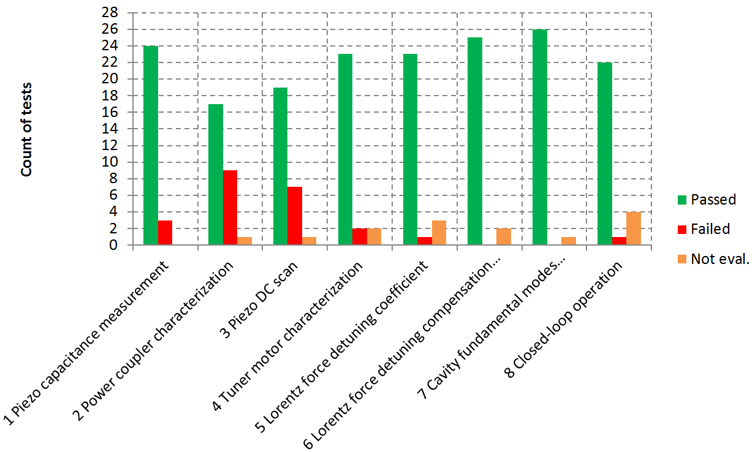
Evaluation of Test Reports
Typical fails and problems / usually no problem
Statistics for 27 CMs
1. Short in the cable
2. Power coupler stuck, wrong setting of end points
3. Wrong polarity, too small tuning range for sensor and actuator
4. Too large hysteresis
5. LFD coefficients not optimized by operator
6. -
7. -
8. Stability could not be reached due to problems with klystron tube

Slide 16
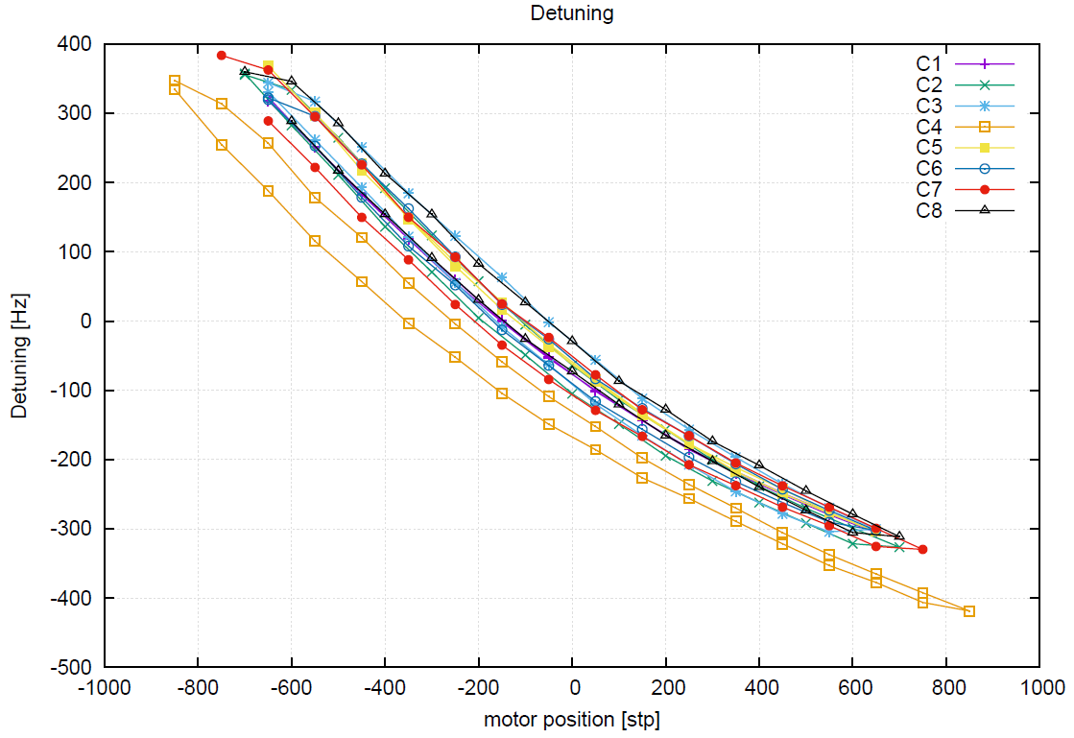
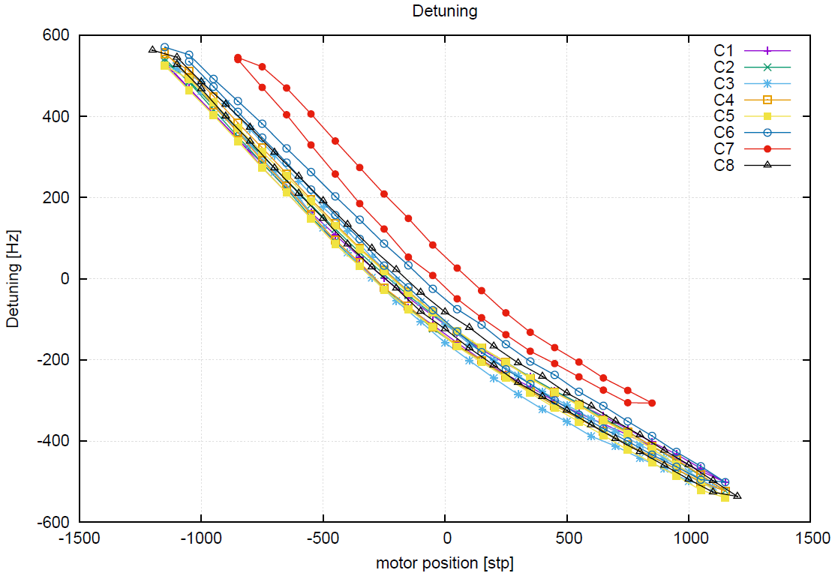
Evaluation of Test Reports
Detuning vs motor position scan irregularities
XATB2 XATB3
XM6, XM10, XM13, XM14 XM12, XM20, XM24, XM26, XM31 XM37
4/8 tests at XATB2 6/8 tests at XATB3

Slide 17
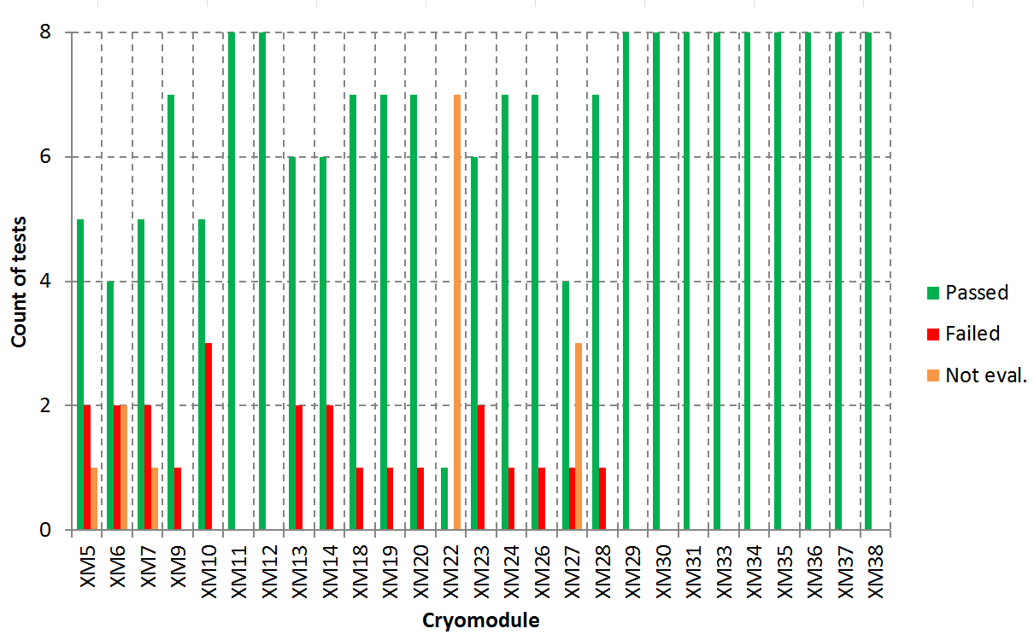
Evaluation of Test Reports
Evaluation over time / cryomodule

Slide 18
Self Assessment
What doesn‘t work well
LFD compensation → pace of operators to fast to use ‚slow‘ algorithm
Piezo capacitance mesurement, stopped before piezo reached equilibrium → discontinuity
What we didn‘t do yet
Automated calibration → rely on simple script, which is not precise (not optimized ADC range)
Where we could improve
One button solution for FB operation
Train few more people for performing FB operation
Cool down warm up
Cool down warm up

Slide 19
Restrictions
Speeding up of testing
Testing duration per cryo module reduced to 14 days
XFEL tunnel closing will be July 2016
Until now all LLRF test are continued, but…
Coarser tuner scans to minimize the impact on the allowed tuner budget
FB operation at equal power distribution rather than maximal power per cavity
If cold tests were discontinued, no LLRF tests could be performed
Piezo capacitance/temperature monitoring not possible → higher risk to break a piezo
Unknown Q_{L} range → boundary conditions for possible Q_{L} optimization not known
Piezo functionality and polarity not checked
Notch filter setting unknown → addtional commissoning time
Not known, if required amplitude and phase stabilities can be reached in FB operation

Slide 20
AMTF39
2 cavities have been tested
1 pre-series cavity, test not successful since cavity was vented during test
1 series cavity, test successful, cavity is now assembled into the CM for I1
1 more cavity will be tested for I2

Slide 21
Summary / Outlook
Hardware status at AMTF
More and more disconnected to XFEL, no spare parts
Testing rate 1 cryomodule per week (aim is 1.5)
Already low downtime could be reduced
LLRF Test Reports
Creation
Evaluation
We know the reasons why tests (e.g. LFD compensation, piezo capacitance mesurement) are not performed well
We know what and how we can improve
More and more experience is gained, quality of modules improves, less problems, less tests fail
Test reports will allow easy access to important data in order to know specialities of modules, which is especially important during XFEL commissioning

Slide 22
Questions?
Thank you very much for your attention!

