Slide 1
DAMC-AMCTEST II
Fully DESY Analog Class A1.1 compliant
10 analog channels AC(5-3000 MHz) or DC (DC-1000 MHz) coupled
6 x 250 MSPS DAC (5 outputs to ZONE3, 1 to SMA)
FPGA module: Enclustra Mercury KX1
  Kintex 7 FPGA: XC7K160T-1FBG676C
  1024 MB DDR3
  Ethernet and PCI-e x1 connection to AMC backplane
Universal clock distribution
  External clock input
  Clock input from RTM
  All clock outputs from RTM can be distributed to SMA connectors
USB connectivity
Possible out of crate operation

Slide 2
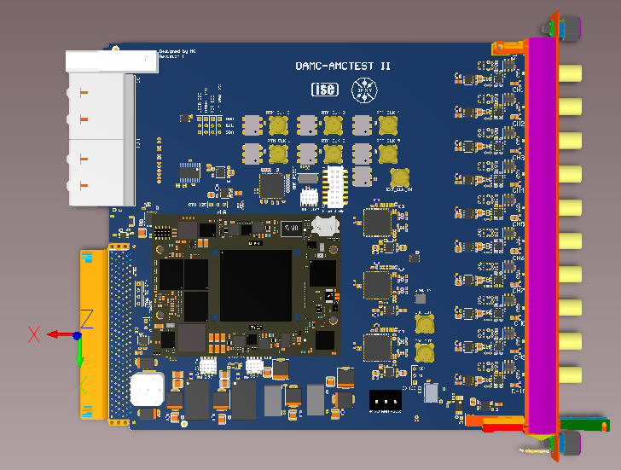
DAMC-AMCTEST II

