Slide 1
MCH-RTM-BM Status
Michael Fenner
Warsaw, 10.06.2014

Slide 2
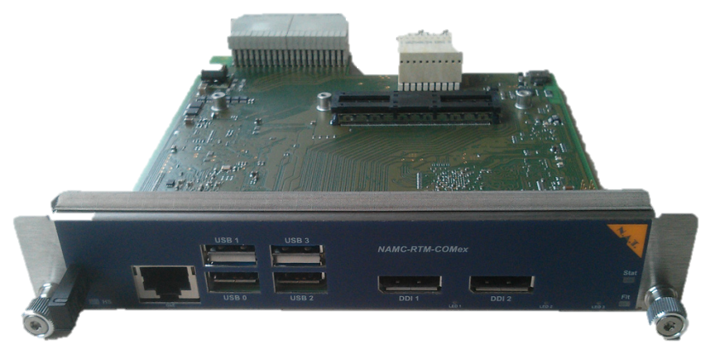
MCH-RTM-BM Status
Passed tests, general
Power supply via Zone3 (MCH) and power supply via Zone2 (RPM)
Programming of Atmel, NAT-MachXO, Ethernet Controller
ComExpess module ok
USB, Display Port, Ethernet interfaces at face plate
PCIe to Ethernet controller, Ethernet link via Ethernet controller
Temperature reporting via I2C - OS
Boot via SATA connection
Passed Tests, ZYNQ:
Programing of MachXO via programming connector
Programming via MCH firmware does not work → Redesign v1.1
Output voltage range of Zynq related DC-DC converters
I2C Buffer and pull resistors for RF Backplane are switched on
DRAM Test
Open:
Firmware integration on MCH side
Missing: System Integration – nobody responsible
Board is broken and sent to repair (0.5mm Pitch BGA)
Boot from SPI Flash did not work yet
PM functionality for eRTM15: - Not tested!
Furher work now happening on „MicroZed Board“

