Slide 1
An update on measurements
with irradiated CHESS-1 chip
I. Mandić et al.,
Jožef Stefan Institute, Ljubljana, Slovenia

Slide 2
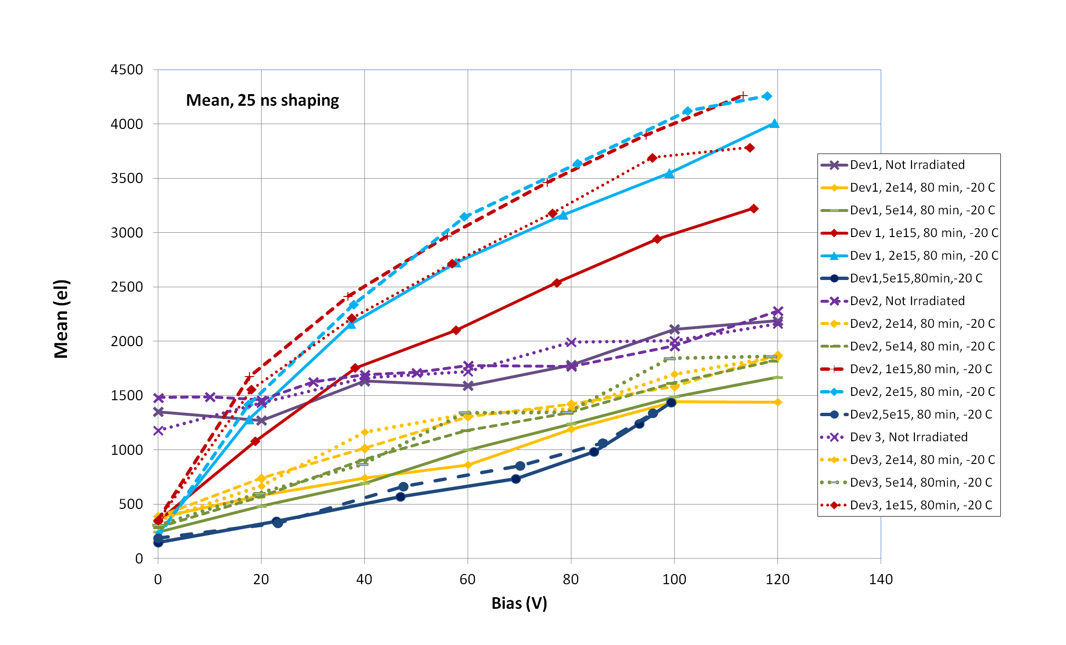
CC, Sr90, large passive array
3 devices
max. neutron fluences: Device 1 - 5e15, Device 2 - 5e15, Device 3 - 1e15
2e15
5e15
Large drop of collected charge after 5e15 n/cm2

Slide 3
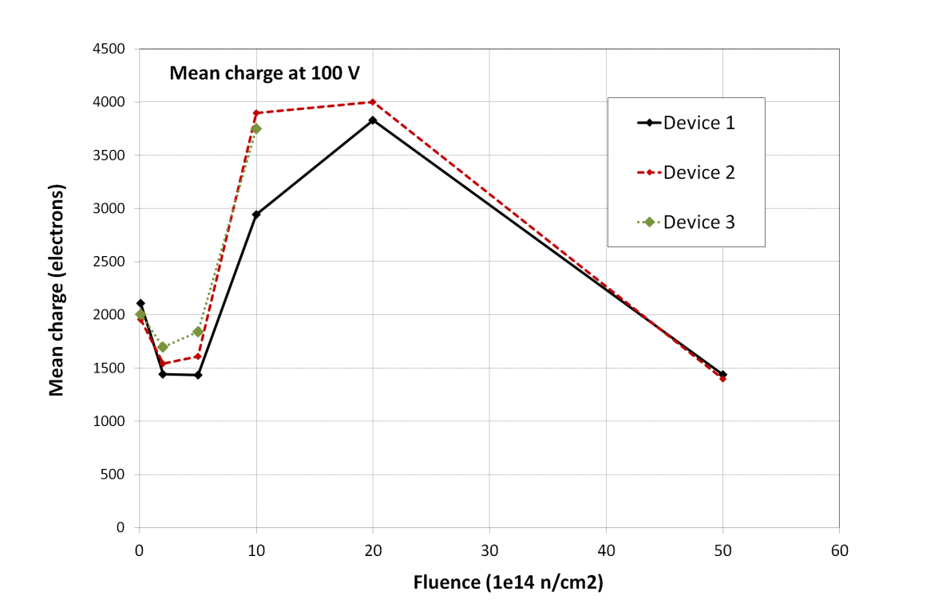
CC, Sr90, large passive array
Mean charge at 100 V vs fluence for 3 devices

Slide 4
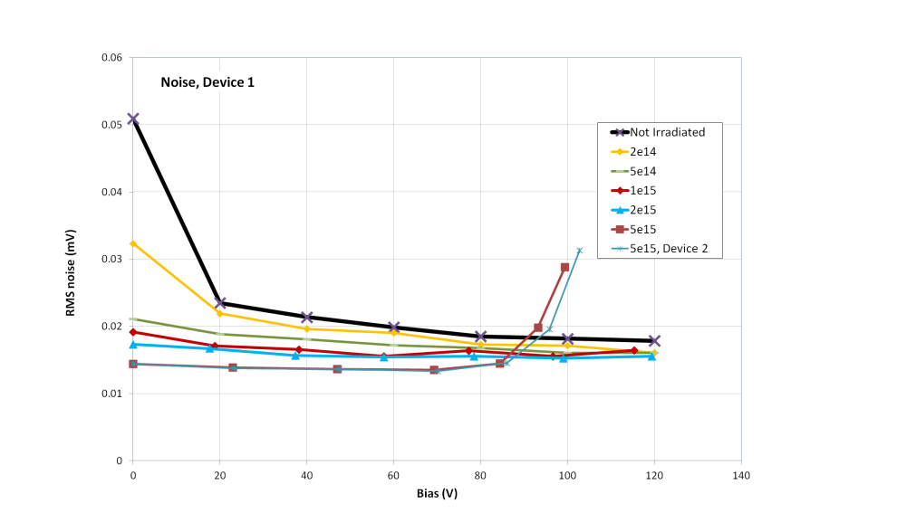
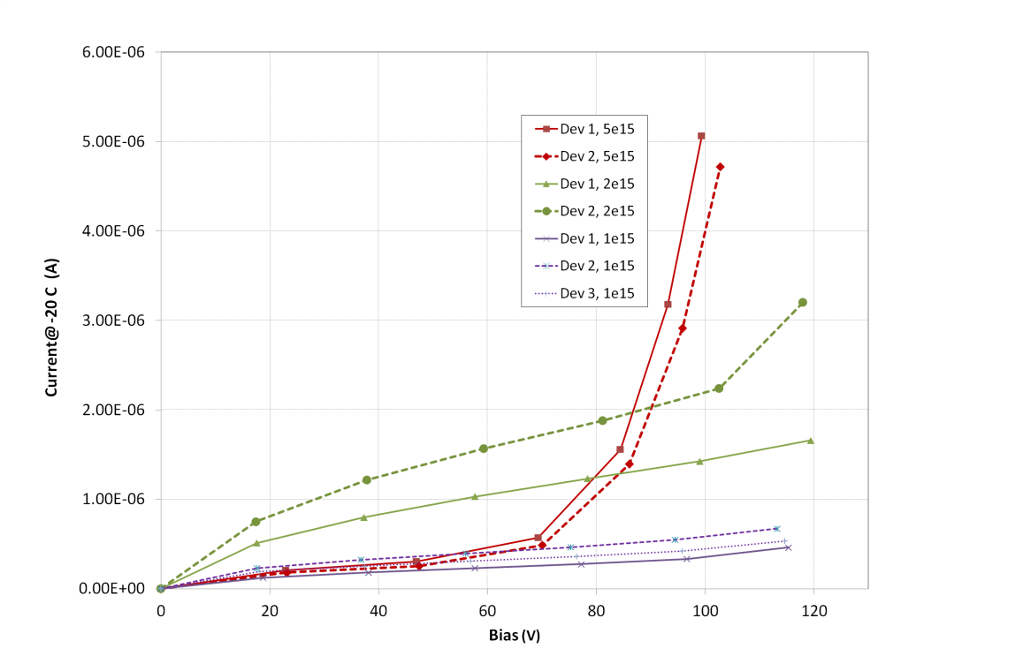
CC, Sr90, large passive array
Current vs. bias
5e15
T = -20 C
2e15
1e15
Low current at low bias for 5e15
Large increase of current and noise above ~ 80 V
breakdown
low noise at lower bias
→ what is the capacitance of the pixel array
when substrate material has high resistance?

Slide 5
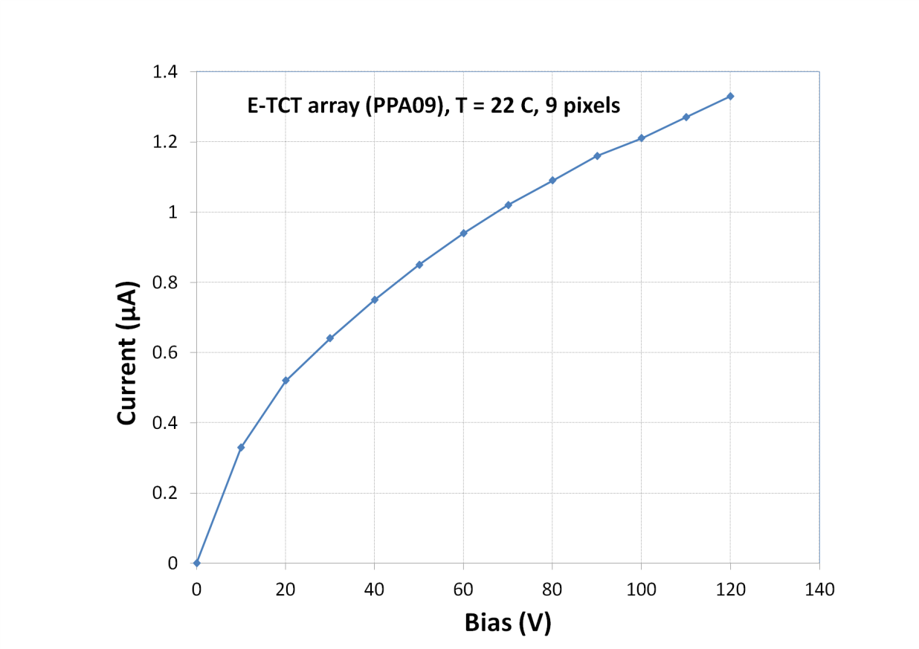
Edge TCT
I-V for PPA09 (9 pixels, 45 um x 100 um) irradiated to 5e15
→ no breakdown
→ different than large passive array
Φ = 5e15

Slide 6
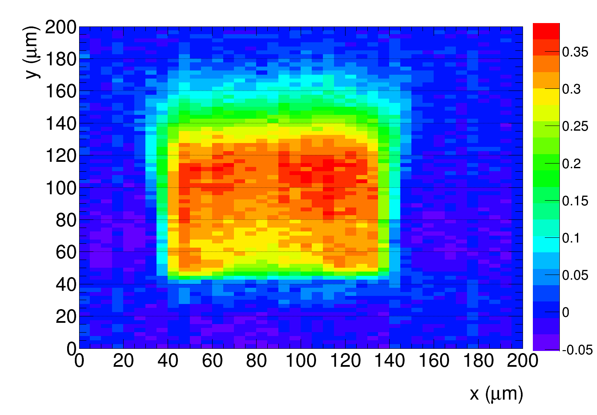
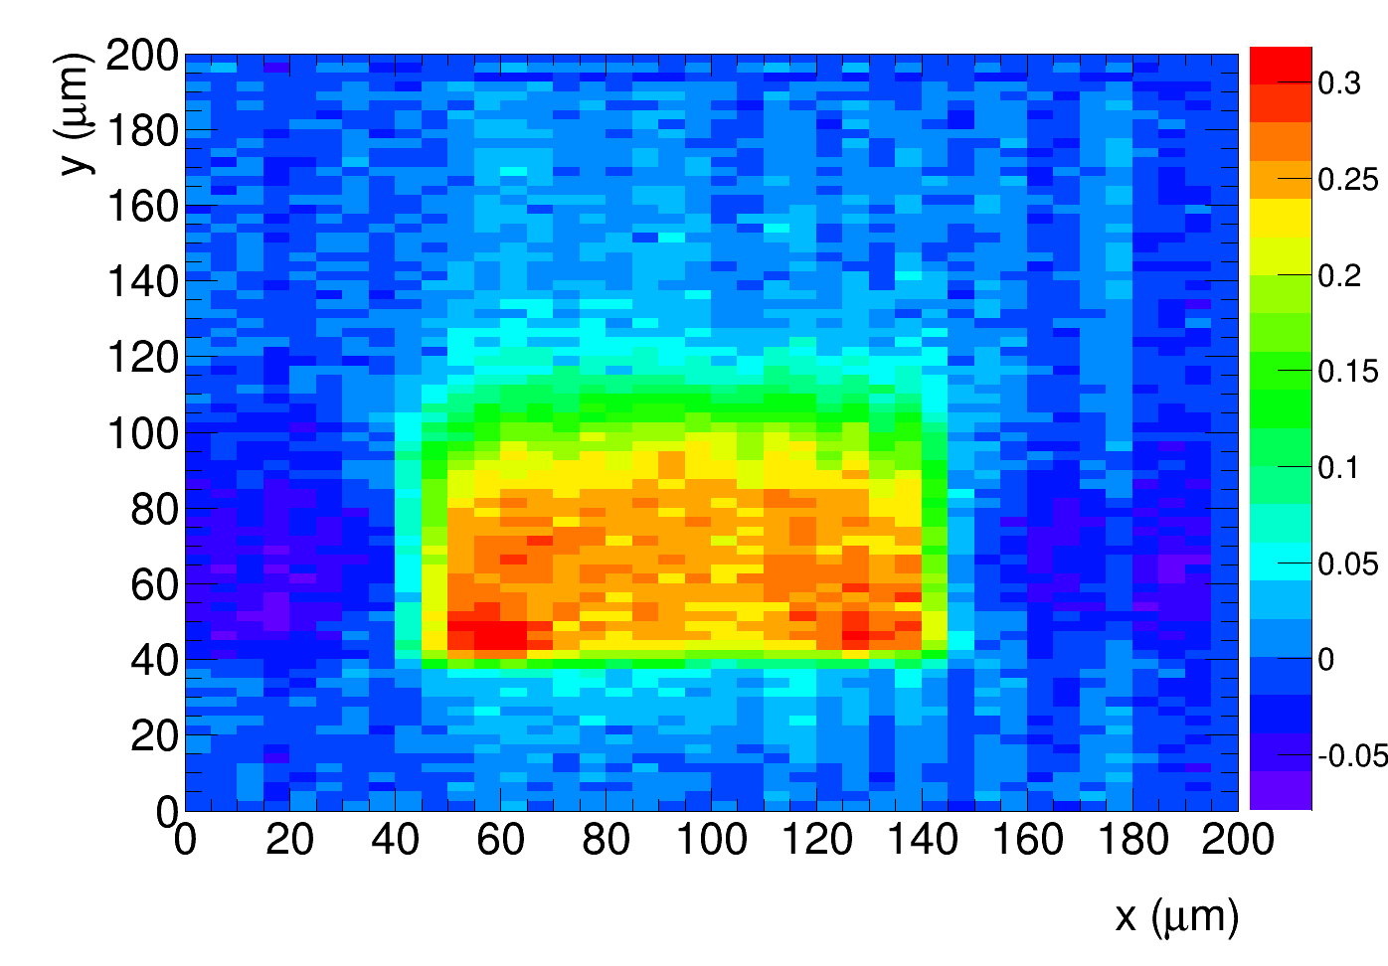
Edge TCT
Charge, bias = 120 V
2e15
5e15
Depth
Beam direction
Active depth smaller at 5e15 then at 2e15
→ acceptor removal finished
→ N_{eff} starts to increase with fluence

Slide 7
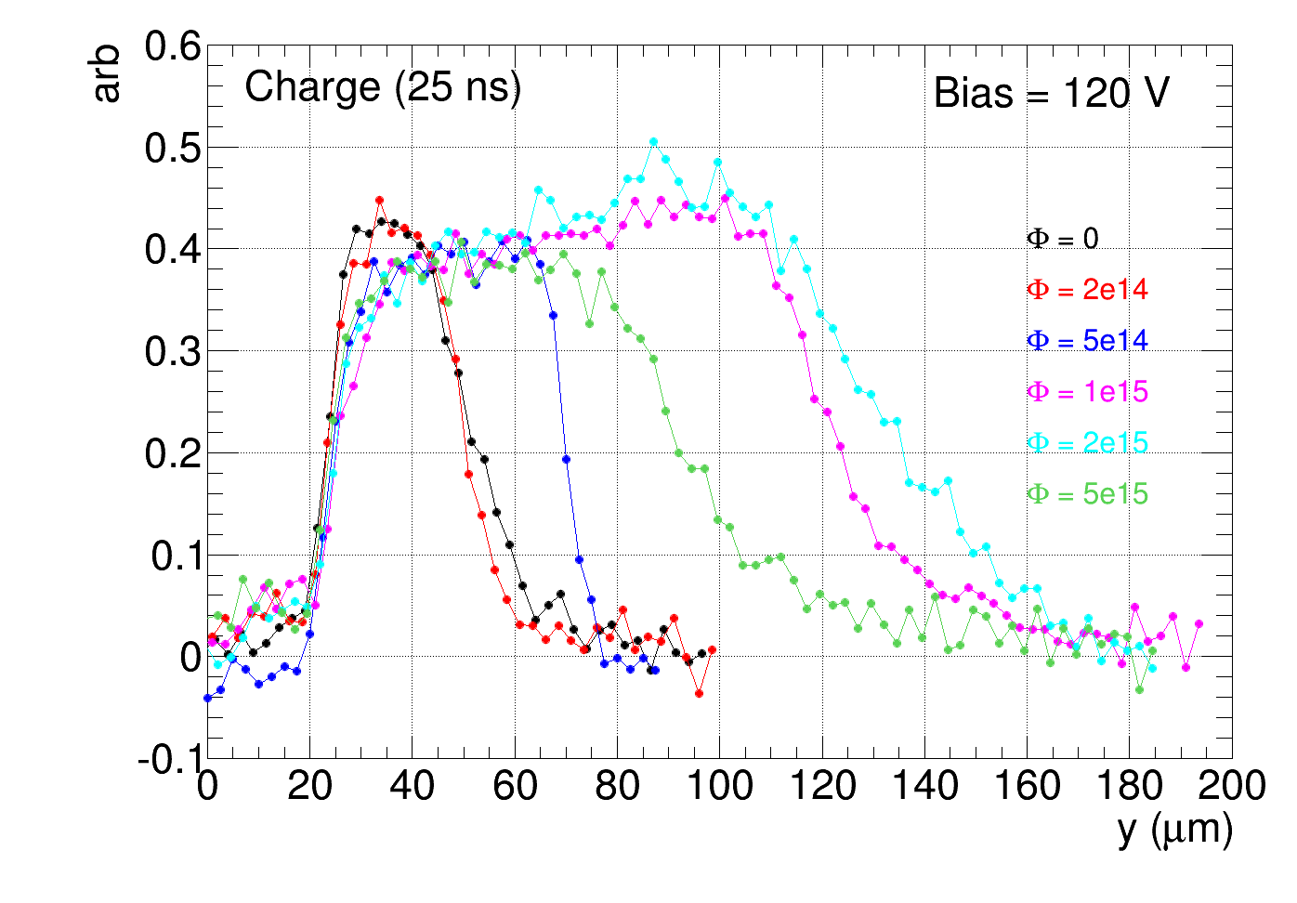
Edge TCT
Scan across the centre of the pixel
Charge collection region narrower after 5e15 than after 2e15
→ difference between 2e15 and 5e15 not as dramatic as in Sr-90 measurement

Slide 8
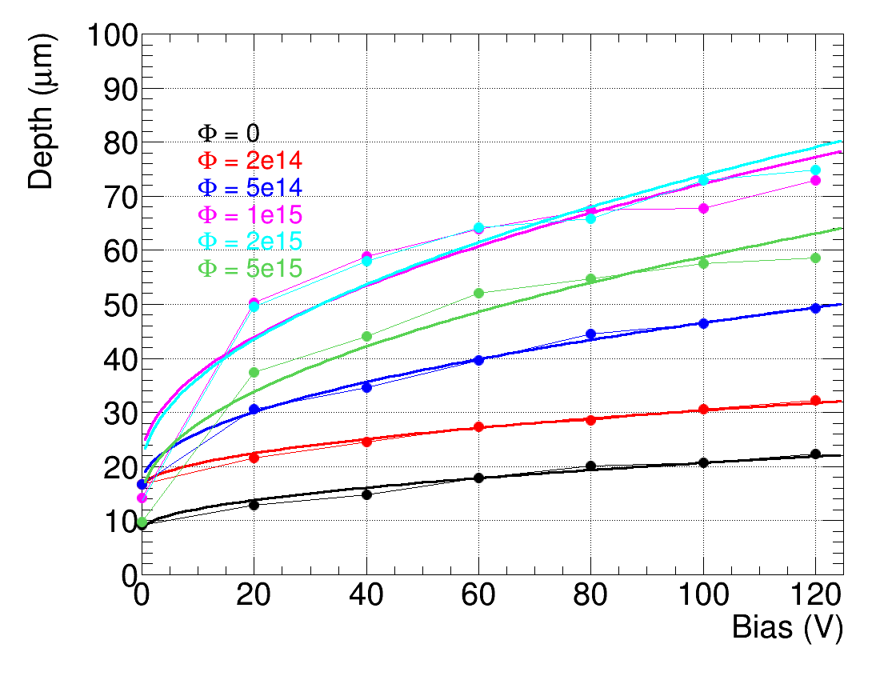
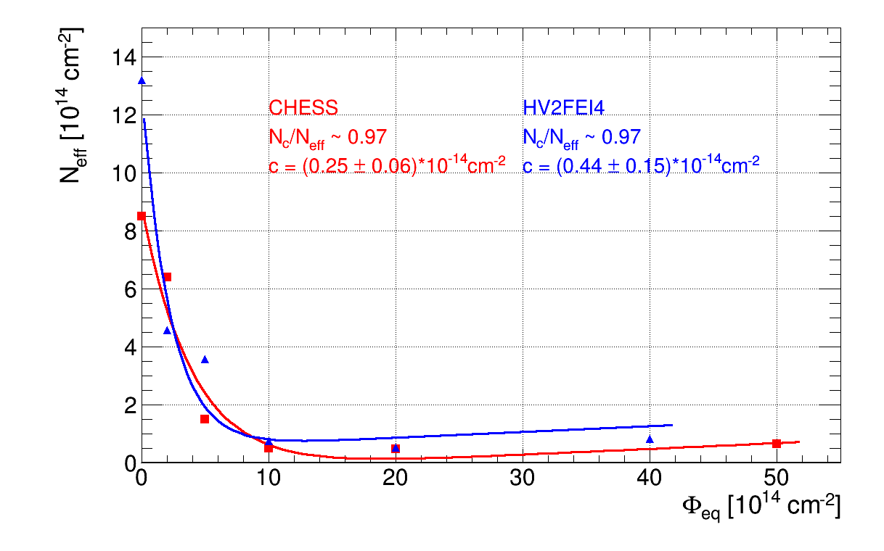
Edge TCT
N_{eff} from depleted depth estimated from velocity or charge profiles
→ more details in:
10th Trento workshop: http://indico.cern.ch/event/351695/session/4/contribution/4/material/slides/0.pdf
presentation at AUW: https://indico.cern.ch/event/387391/contribution/7/material/slides/
N_{eff} - effective acceptor concentration
free parameter
Initial acceptor
removal
acceptor removal finished at about 2e15. N_{eff} increases at higher fluence
good agreement with E-TCT on HV2FEI4 (by G. Kramberger)
Radiation introduced
deep acceptors:
g ~ 0.02 cm⁻¹

Slide 9
Conclusions:
CC and E-TCT measurements with passive pixels irradiated with neutrons to 5e15
CC with Sr-90:
→ large drop of collected charge in the fluence step between 2e15 and 5e15
→ large increase of current and noise at high bias voltage
→ but low current and low noise at low voltages
E-TCT:
→ clearly see that depleted region gets smaller in the step between 2e15 and 5e15
→ acceptor removal finished at ~ 2e15 for this material
→ good agreement with E-TCT on HV2FEI4
→ no large increase in I-V observed in PPA9 (E-TCT) pixel array
drop of CC in Sr-90 measurement is larger than expected from E-TCT
→ weighting field after such high fluence (high resistance substrate)?
→ some other differences in PPA09 and large passive array?

