Slide 1
Status of test kit 12 May 2015
J. J. John with help from many others

Slide 2
CHESS-1 hardware design
AMS-CHESS-1 daughterboard
Bias distribution revised following review – somewhat time-consuming.
We felt it best to be quite careful with revising the layout, due to the limited number of chips available.
The board will go out for quoting tomorrow and I will send it to Dima, Jens, Todd, Hervé and Forest (UCSC) for a last check.

Slide 3
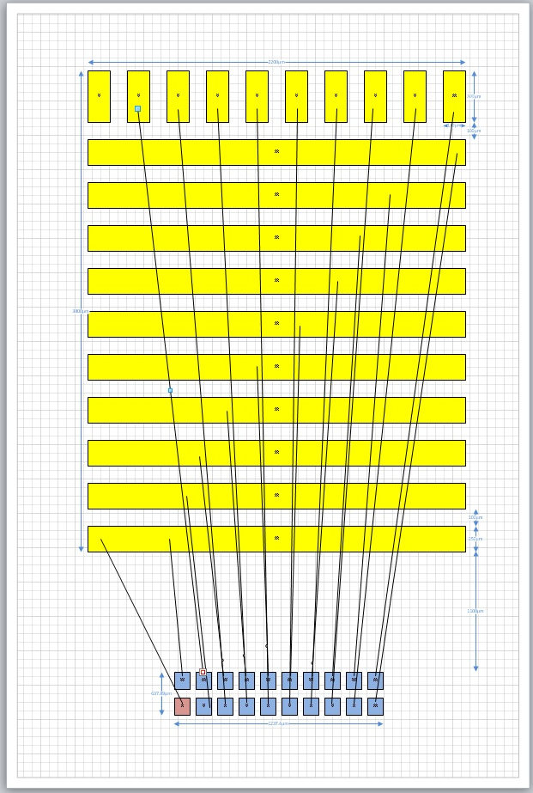
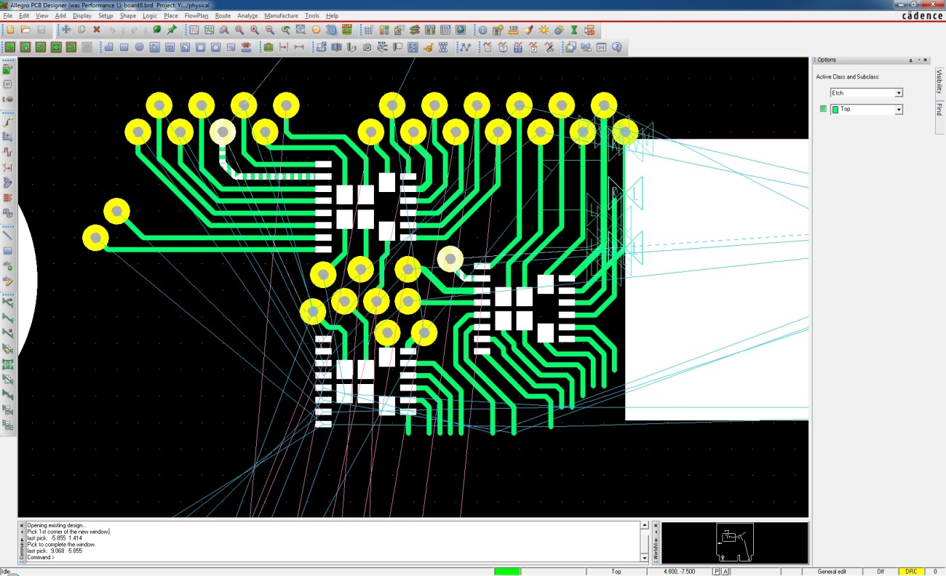
CHESS-1 hardware design
TJ-CHESS-1 daughterboard
PonP layout in progress.
Initial footprint was not feasible to track out. Ok in isolation but not when all pads present.
Working on new footprint using continuous “bars” of bond pad, for ground, power supplies and biases.

Slide 4
CHESS-1 hardware design
Motherboard
Schematics in progress. See block diagram on next slide.
Draft attached to DESY Indico page for today.

Slide 5
CHESS-1 motherboard block diagram
4
SPI
+7V in
-7V in
ground
Samtec MEC6-150-02-L-D-RA1
100 position socket for edge connector
= interface to 3 variants of daughterboard
ADG714
octal switch #1
LMH6559
Buffer #1
8
1
SMA #1
LP3964EMP-1.8
1.8V regulator
(4mm sockets)
4
SPI
Molex 71430-0013
68 position VHDCI receptacle
= interface to DAQ = Digilent Atlys FPGA board
analogue outputs
4
SPI
ADG714
octal switch #2
LMH6559
Buffer #2
LP3964EMP-3.3
3.3V regulator
1
SMA #2
8
LP3964EMP-5
5V regulator
4
SPI
analogue outputs
4
SPI
LT1964-5
-5V regulator
ADG714
octal switch #10
LMH6559
Buffer #10
8
1
SMA #10
DAC128s085
octal voltage DAC
SMA #11
analogue input
4
SPI
LM4132
voltage reference
7
4
voltage
biases
SPI

