Slide 1
Status of test kit 26 May 2015
J. J. John with help from many others

Slide 2
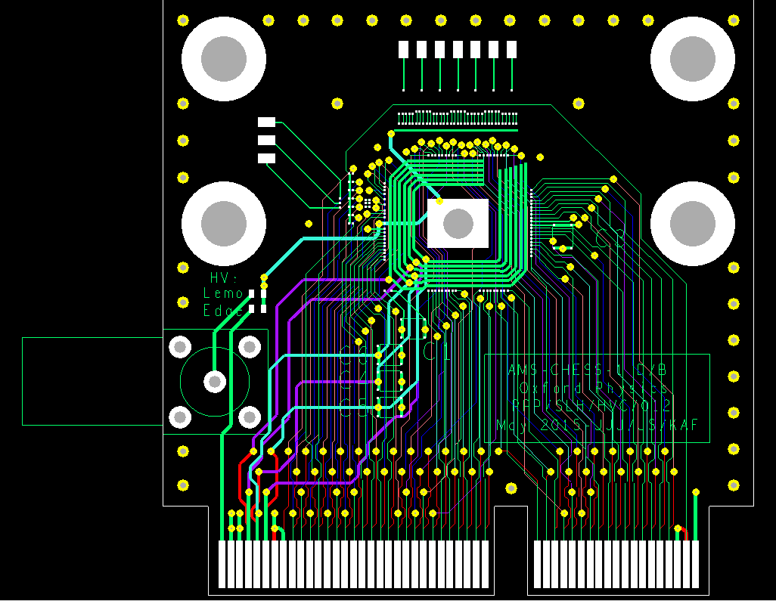
CHESS-1 hardware design
AMS-CHESS-1 daughterboard
Reviewed by e-mail – thank you to reviewers.
Board finalised at end of week before last.
Delayed with suppliers quoting – could only get 5-day turnaround.
Order placed on SSC system last Friday.
Waiting for confirmation, but we expect boards ~next Wednesday-Thursday
Then will bond.
42.9mm x 43.2mm
Large pads added to help with passive pixel testing including edge TCT pixels.

Slide 3
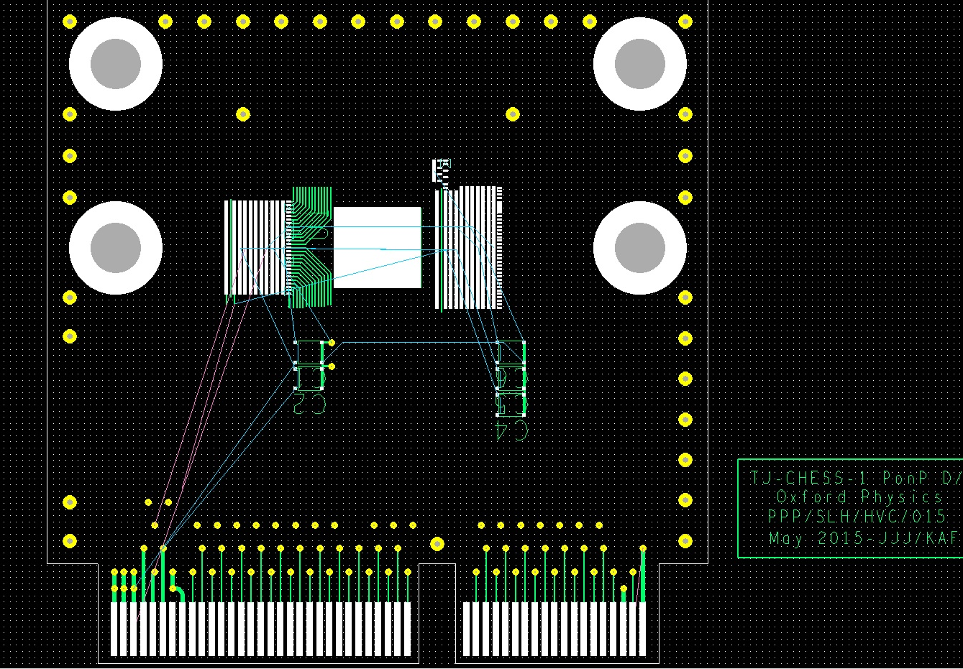
CHESS-1 hardware design
TJ-CHESS-1 PonP daughterboard
PonP footprint revised, as outlined at last meeting.
Iterated with Paul Booker (wire-bonding expert at RAL) to ensure bondable and trackable.
Schematics updated.
Layout in progress – “hard part” done and pushing to finish this week.

Slide 4
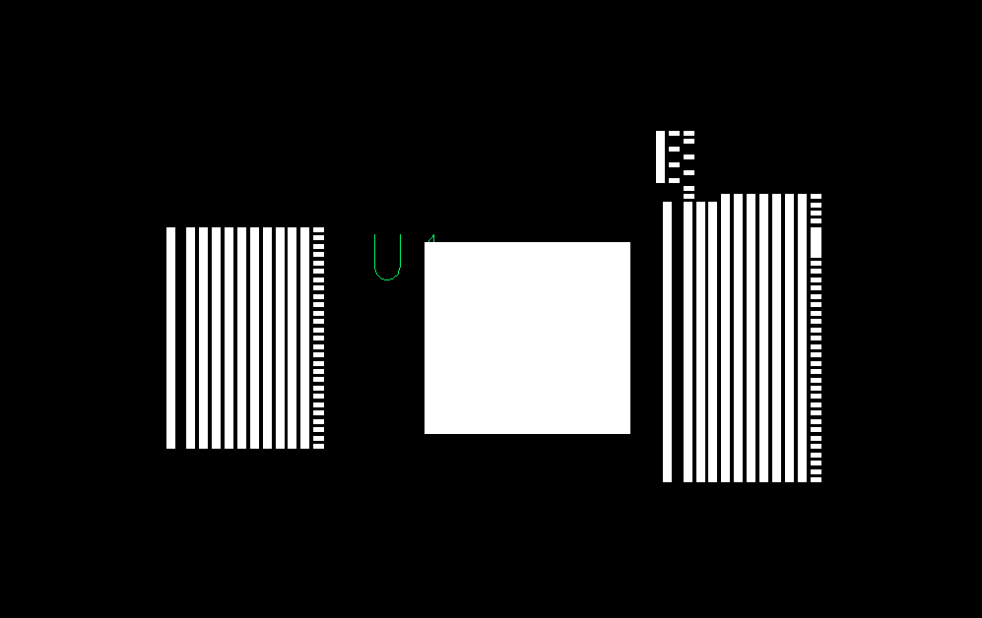
PonP updated footprint
Output pads for 3 device groups
Passive pixels
Pads for amplifiers
Digital reset
PonP chip pad
Output pads for 3 device groups
Bias, Gnd,
Power
Digital reset
Bias, Gnd,
Power

Slide 5
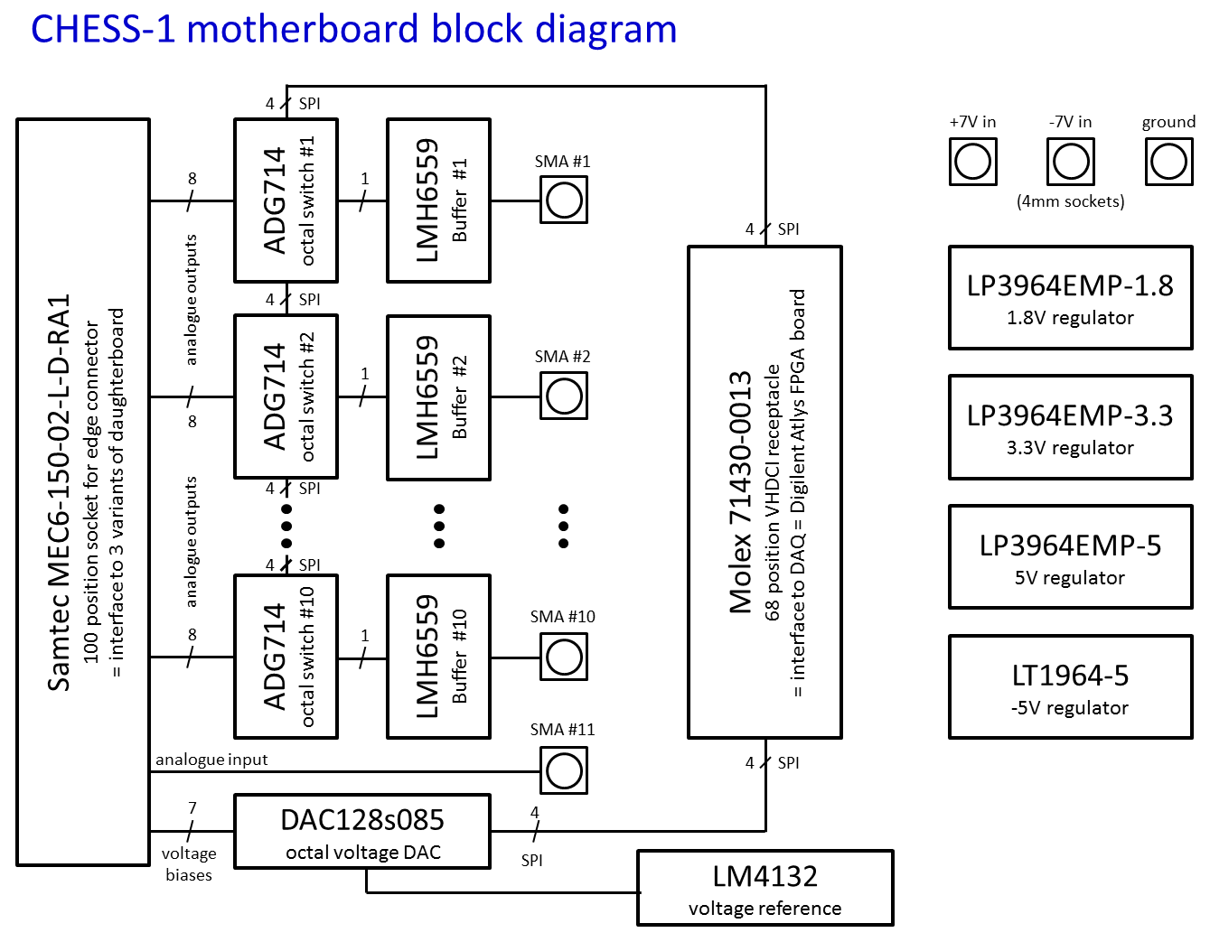
CHESS-1 hardware design
Motherboard
Schematics: doing final checks and updates
Expected to complete Thursday.
Then layout ~1 week, manufacturing boards ~1 week, assembly ~1 week.

Slide 6
Hardware needed by groups?
Need to plan quantities.
Could institutes please let me know:
Your needs for CHESS motherboards
Do you plan to test AMS-CHESS-1?
Do you plan to test TJ-CHESS-1?

