Slide 1
Passive pixel arrays on CHESS1
PPA # | Pixel width | Pixel length | Diode Area Fraction | Metal opening ratio | Extra circuitry
PPA01 | 45μm | 100μm | 30% | 13.0%
PPA02 | 45μm | 100μm | 50.4% | 34.5%
PPA03 | 45μm | 200μm | 30% | 22.7%
PPA04 | 45μm | 200μm | 50.4% | 44.0%
PPA05 | 45μm | 400μm | 30% | 27.4%
PPA06 | 45μm | 400μm | 50.4% | 48.7%
PPA07 | 45μm | 800μm | 30% | 29.8%
PPA08 | 45μm | 800μm | 50.4% | 51.0%
PPA09 | 45μm | 100μm | 30% | 13.0% | Special bond pads for E-TCT
PPA10 | 45μm | 200µm | 30% | 22.7% | Without contact ring around each pixel, but with contact ring around the entire array having a separate pad
PPA11 | 45μm | 200µm | 30% | 22.7% | With contact ring around each pixel that violates the design rules by having a symmetric width. NOTE this pixel was added twice
PPA12 | 45μm | 200µm | 30% | 22.7% | With contact ring around each pixel that violates the design rules by having a symmetric width. NOTE this pixel was added twice

Slide 2
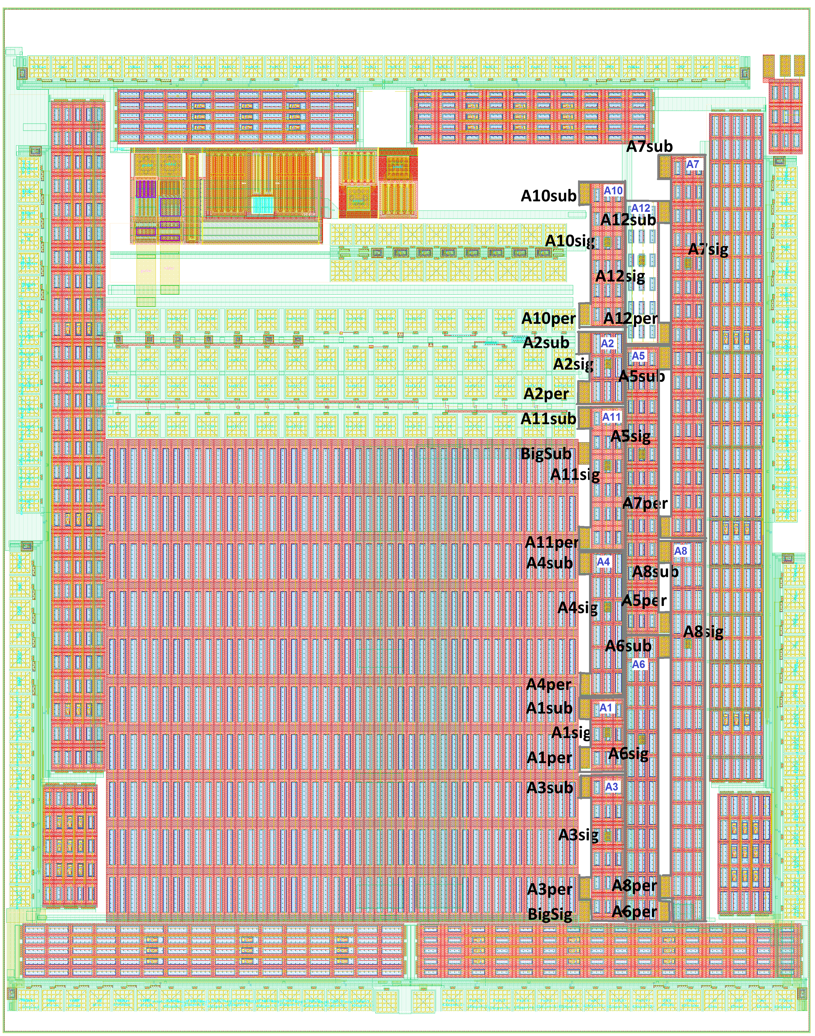

Slide 3
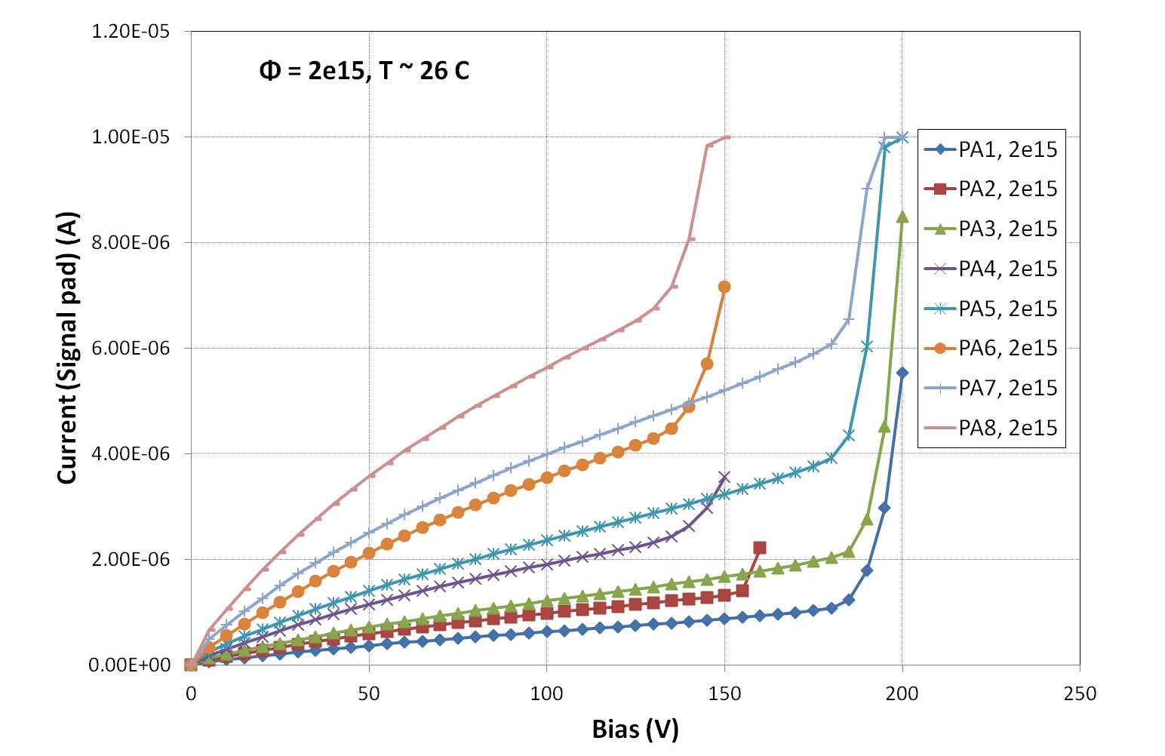
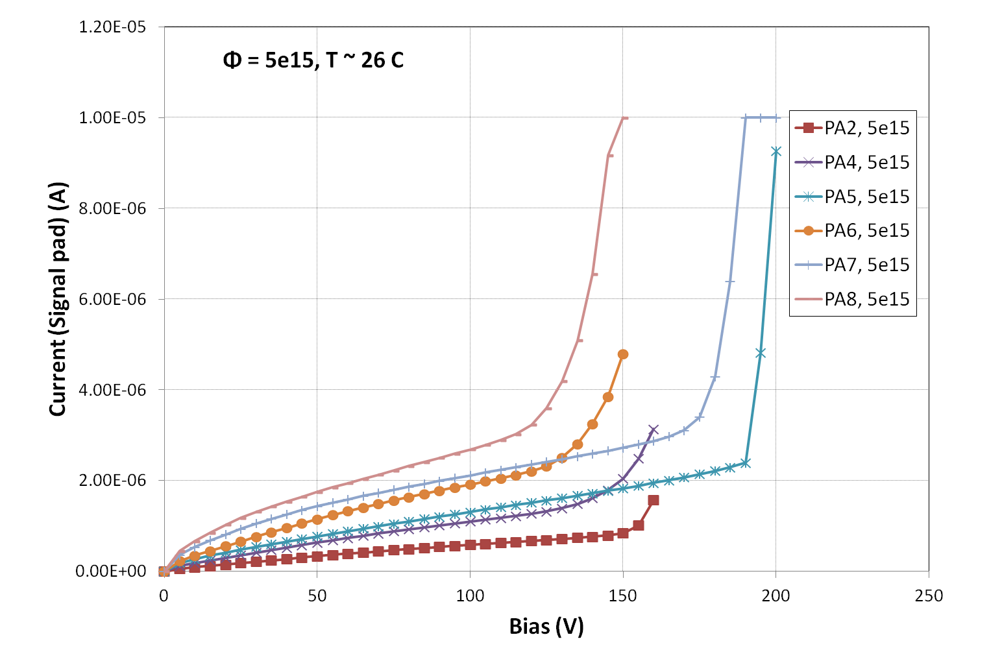
Annealed for 80 min at 60 C,
Only signal pad connected
Diode area fraction 30%:
PA1, PA3, PA5, PA7
Breakdown (start of fast current
increase) at ~ 180 V
Diode area fraction 50.4%
PA2, PA4, PA6, PA8
→ breakdown at ~ 130 to 150 V
breakdown voltage drops
slightly with device number (size)
(large passive array:
breakdown at ~ 80 V after 5e15)
smaller current for same device
at 5e15 than at 2e15
➔ smaller depleted volume at
same bias voltage because
of higher N_{eff}
and voltage drop on highly resistive
substrate?

Slide 4
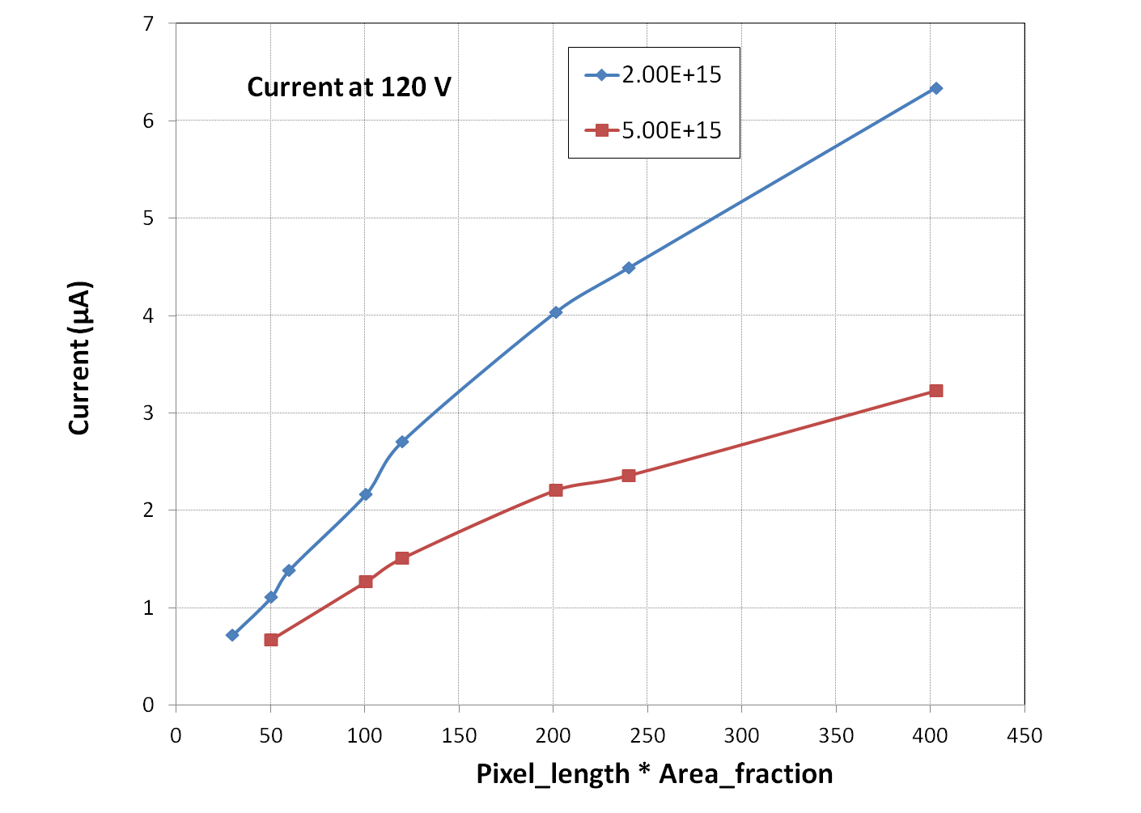
Naively, if only depletion depth is taken into account,
(and if there are no initial acceptors) current should increase with fluence:

