Slide 1
Pre-Irradiation HVStripV1 Testing
R. Bates, C. Buttar, K. Kanisauskas, D. Maneuski
ATLAS Strip CMOS Regular Meeting
June 9, 2015

Slide 2
List of tests done so far
MB06
Fe-55 scan at -60V bias for all pixels
Fe-55 scan for pixels (5,0) and (12,0) at bias voltages from -10V to -70V in steps of -10V
MIP measurements for pixels (5,0) and (12,0) at bias voltages from -10V to -70V in steps of -10V
Noise measurements for all pixels at -60V bias
MB12
Fe-55 scan at -60V bias for all pixels
Fe-55 scan for pixels (5,0) and (17,0) at bias voltages from -10V to -70V in steps of -10V
MIP measurements for pixels (5,0) and (17,0) at bias voltages from -10V to -70V in steps of -10V
Noise measurements for all pixels at -60V bias
All measurements were done in environmental chamber at +20°C

Slide 3
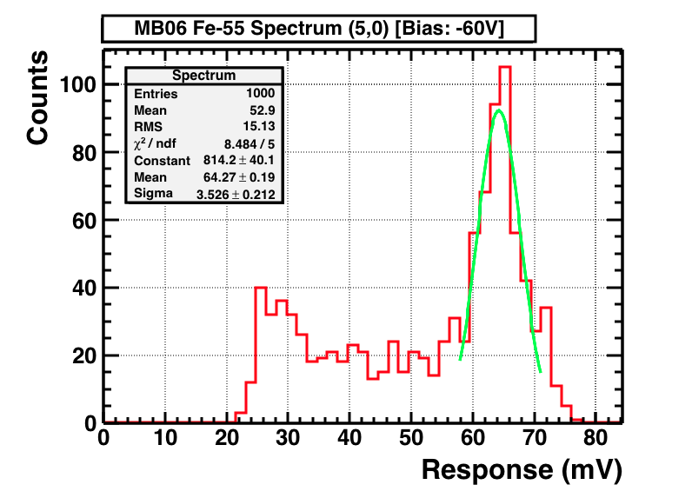
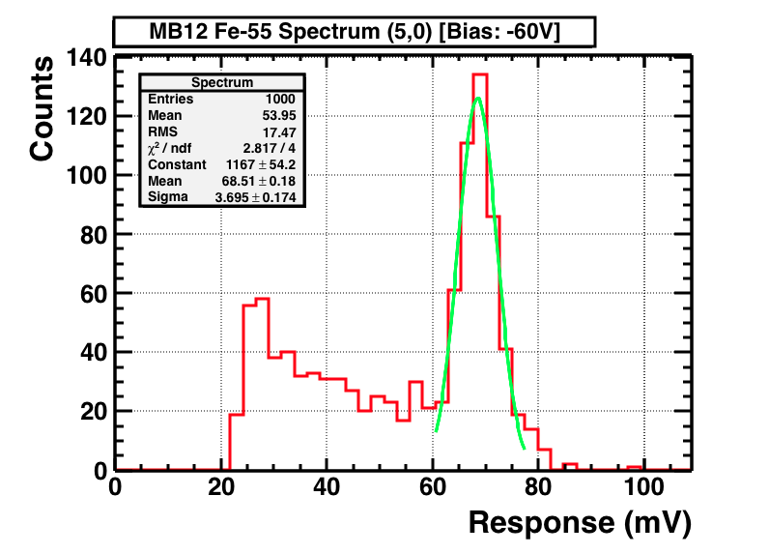
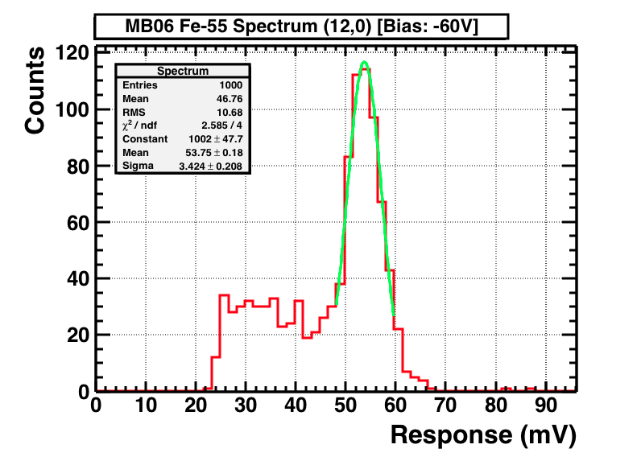
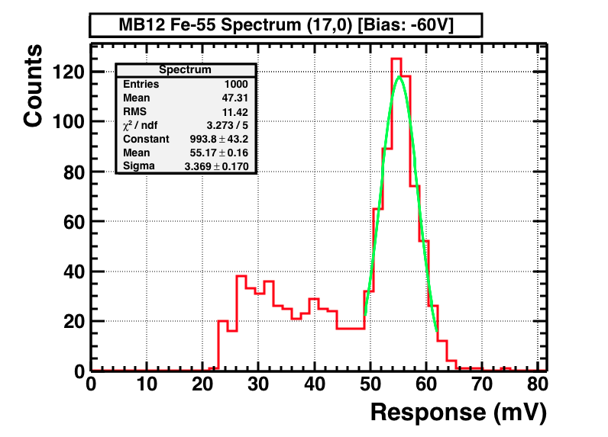
Fe-55 Spectra

Slide 4
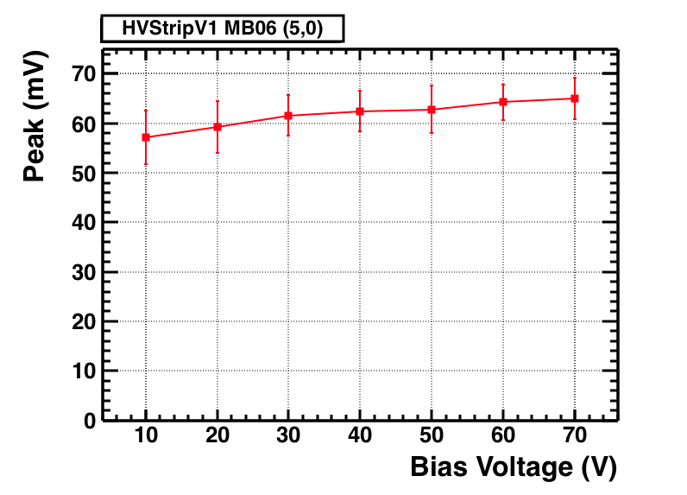
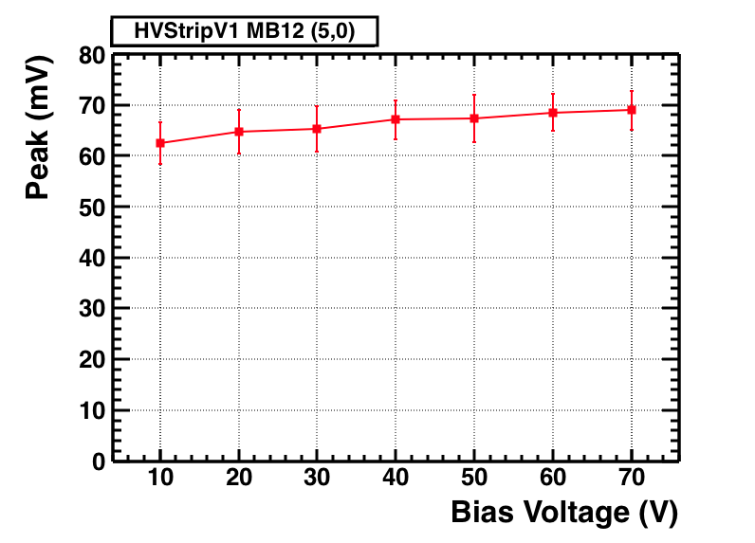
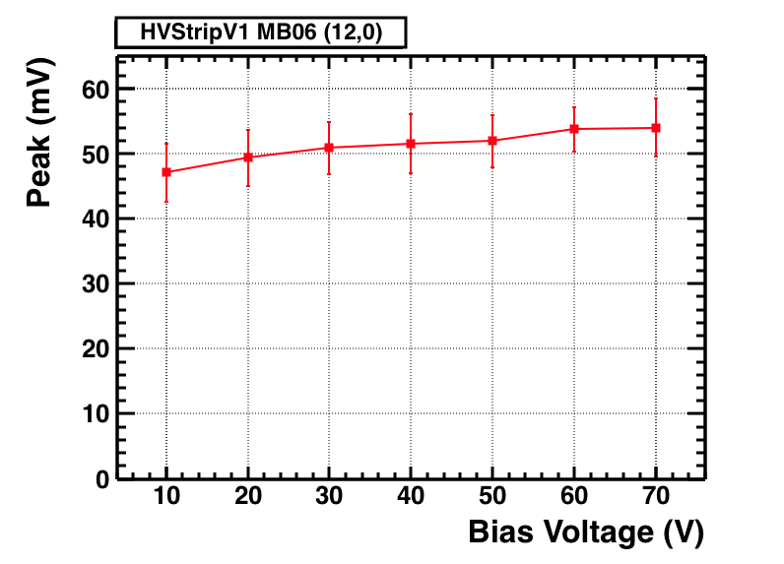
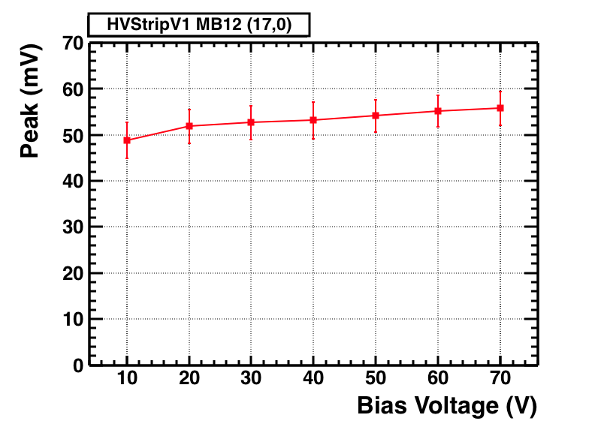
Fe-55 Peak vs. Bias

Slide 5
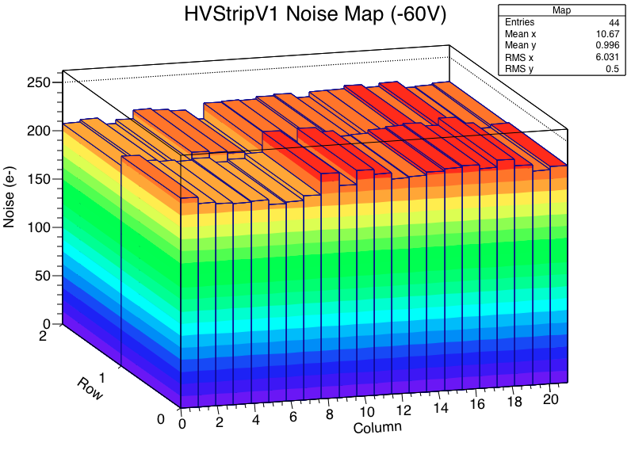
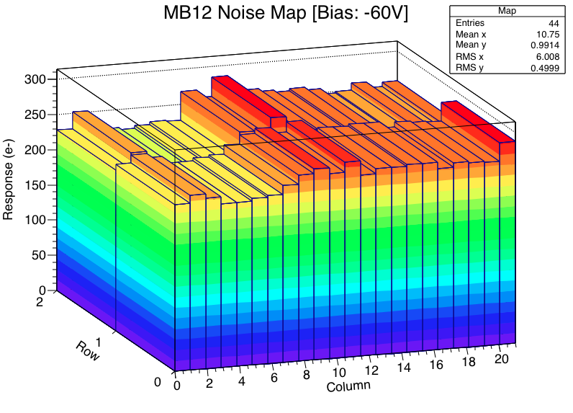
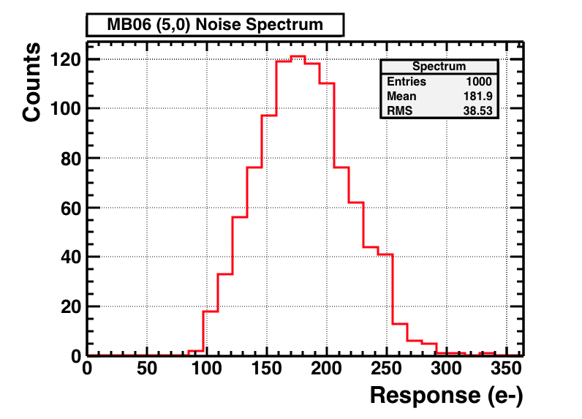
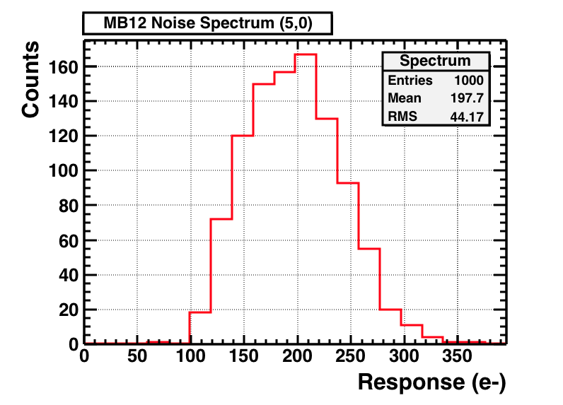
Noise Distribution

Slide 6
Further Steps
Fe-55 measurements being done at -20°C for one high gain and one low gain pixel
Capacitors to be replaced for MB06 and MB12 which would allow to test devices at higher voltages
LabView VI to be developed to log leakage currents of both HVStripV1 chips during irradiation

