Slide 1
Status of test kit 9 June 2015
J. J. John with help from many colleagues

Slide 2
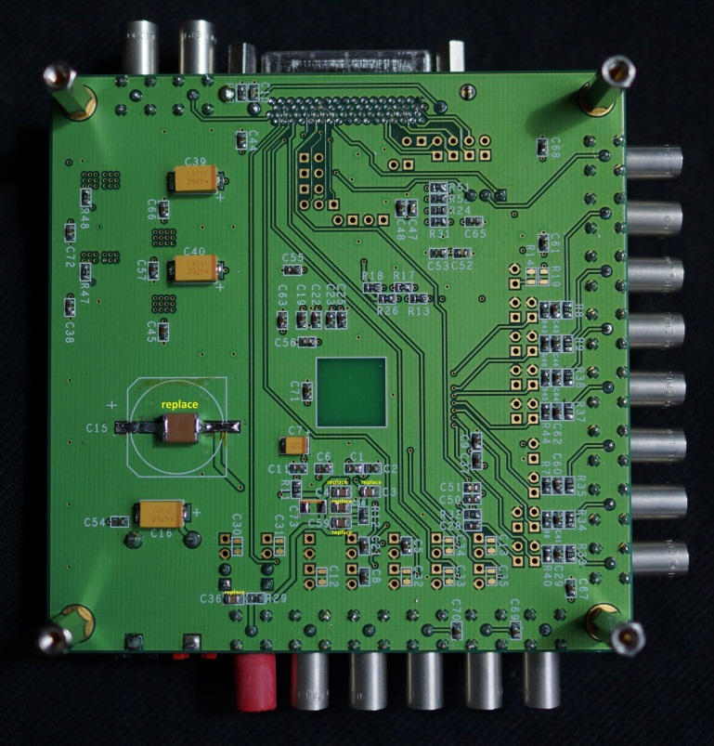
HVStripV1 update
Higher voltage rated capacitors
We have revised the HV capacitors to 250V rating. Conservatively this allows testing at -120V bias.
This changes the main capacitor from 100µF to 2.2µF
If you have an HVStripV1 motherboard and would like to modify your capacitors, let me know (can send you some capacitors or the order details).
Modified motherboard (bottom)
Distribution
This got slowed down due to repairs and testing following irradiation.
For any institute that would still like to receive an HVStripV1 motherboard and daughterboard, please let me know so I can arrange that.

Slide 3
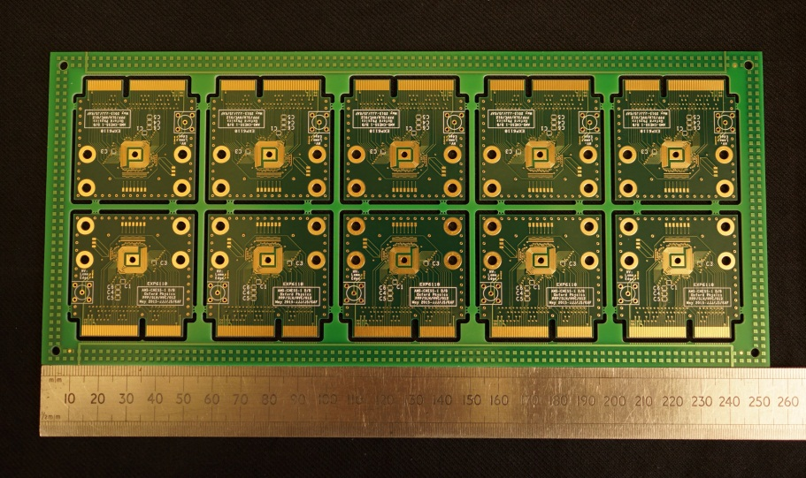
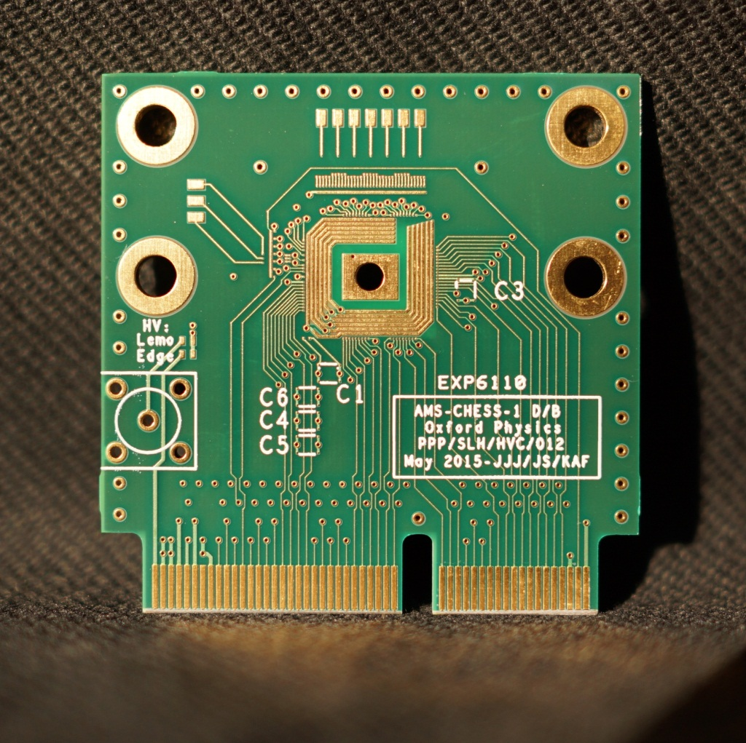
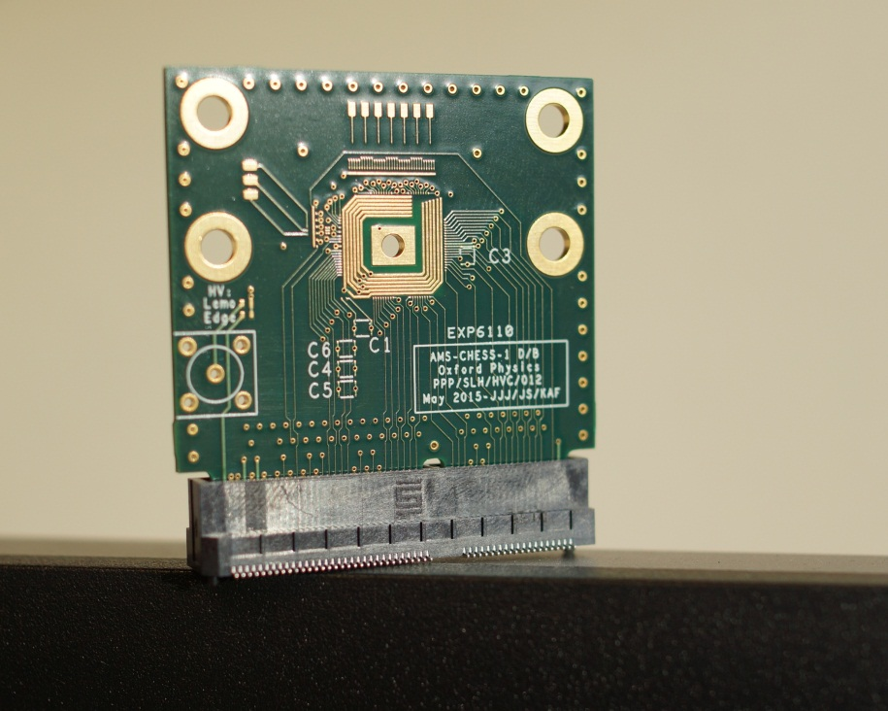
AMS-CHESS-1 daughterboard
Received boards 5 June in the end.
Next step = bonding at RAL and SCIPP

Slide 4
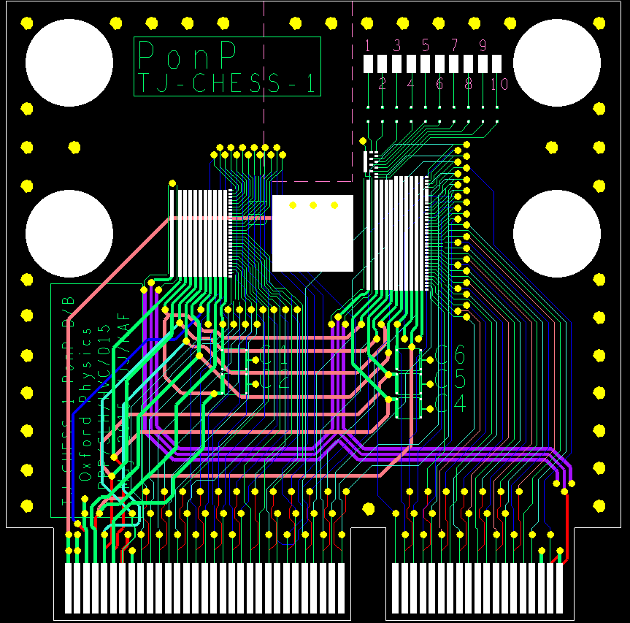
TJ-CHESS-1 PonP daughterboard
Design completed last week.
Reviewed by e-mail this week – thank you to reviewers (Dipayan, Dima, Igor, Jens and Todd).
Doing final checks on wire bonds now.
Outcome = a few revisions agreed, ~2 days of work.
Including wire bond checking, we should get this out for quoting Thursday-Friday, then will order (5 day turnaround).
PonP design, as reviewed
Same size as AMS-CHESS-1 d/b

Slide 5
TJ-CHESS-1 PonN daughterboard
Design will follow on from PonP daughterboard, very similar.
Two aspects will need checking, compared to PonP:
Some wire-bonds will be longer than on PonP, as there are more output pads, so more signals to track out in between pads and chip.
We will draft this, then review with Paul Booker, Jens and Dipayan.
The cutout for edge TCT may be less straightforward.
I will draft the possibilities and review with Igor, Gregor and Richard P.
If anyone else is interested in these initial sketches, let me know.

Slide 6
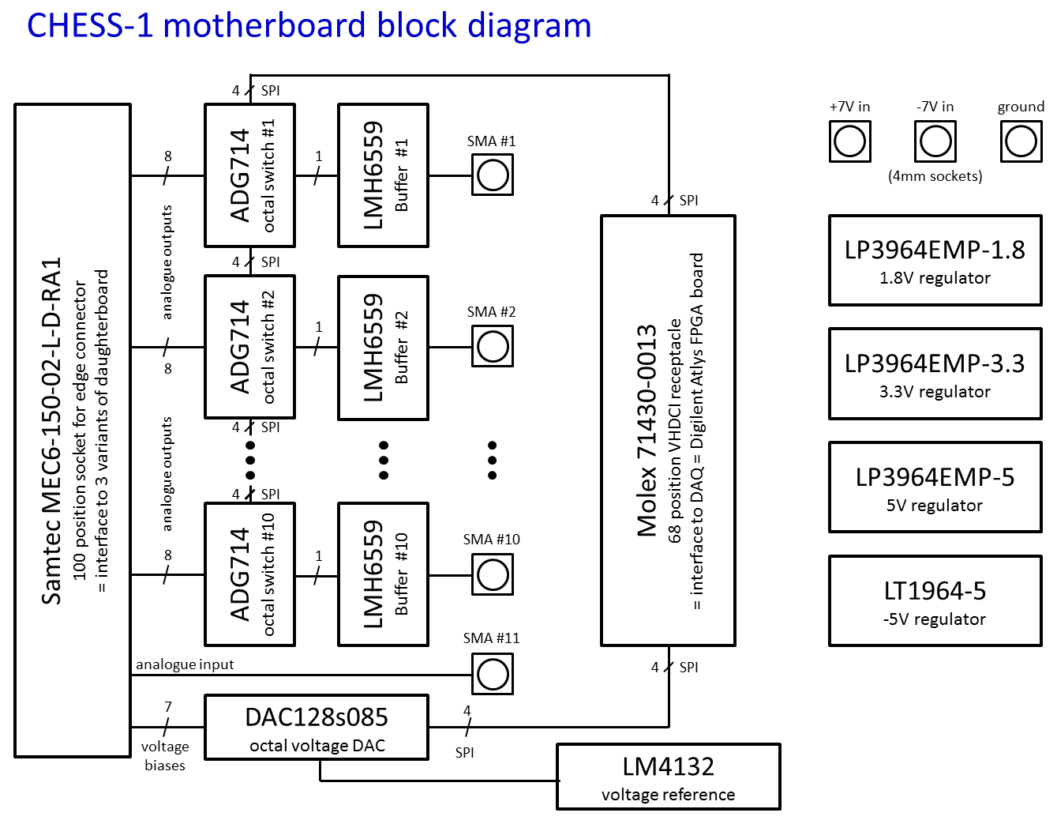
CHESS-1 motherboard
Schematics: finalising, expected to complete Thursday.
Then layout ~1 week, manufacturing boards ~1 week, assembly ~1 week.
DAQ: signal connections to Atlys DAQ reviewed with Matt Warren

Slide 7
CHESS hardware needs?
Planning quantities now. Have heard from:
Argonne, DESY, Glasgow, Ljubljana, Oxford, RAL (PPD and TD), SCIPP
Do any other institutes plan to test AMS-CHESS-1 or TJ-CHESS-1 chips?
Please let me know, thanks.

