Slide 1
Optimizing the built-in amplifier in HV-CMOS CHESS1
Vitaliy Fadeyev, Zach Galloway , Herve Grabas
Alexander Grillo , Zhijun Liang , Abe Seiden
Jennifer Volk, Forest Martinez-Mckinney
University of California, Santa Cruz

Slide 2
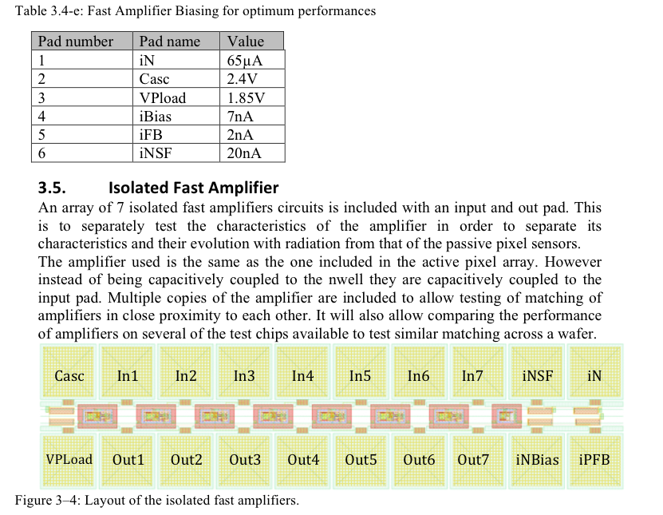
Isolated amplifier in CHESS1 chip
HV-CMOS CHESS1 chip has built-in isolated amplifiers
designed to optimize amplifier performance
Six amplifier biasing control
Optimization can be done with pulser, without using laser injection or beta source.
Change its gain and output signal shape by changing biasing control
Try to study the amplifier performance as input to CHESS2 design

Slide 3
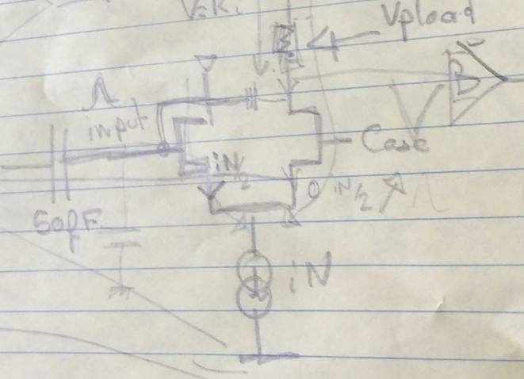
Amplifier Biasing
Casc -Cascode bias
iNSF – Source Follower Bias
iN – Amplifier current source bias
VPLoad – Amplifier Resistive Load bias
iNBias – Nwell resistive path bias
iPFB – Feedback current bias
Vpload
iFB
INSF
Casc
iN

Slide 4
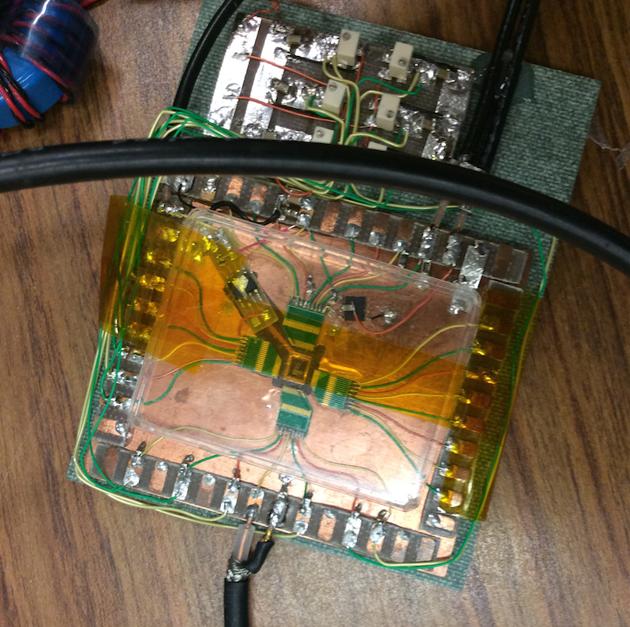
Setup to test amplifier performance
Home grown test board Forest built
To test CHESS1 chip
Input to amplifier
iN
output
iBias
Casc
Vpload
iFB
iNSF
Chess1 chip

Slide 5
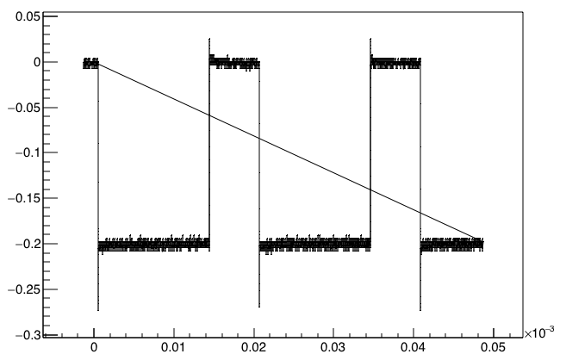
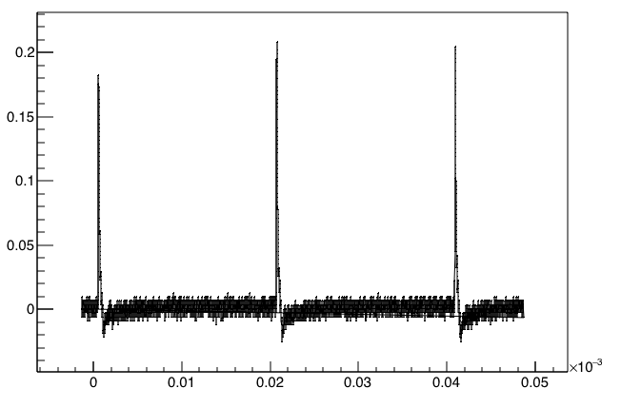
Setup to test amplifier performance
Voltage (V)
Pulser
Voltage source
Input pulse
50fF coupling capacitance
Isolated Amplifier on CHESS1 chip
3.3V bias for amplifier
Amplifier output
Falling edge
Voltage (V)
Source follower
Scope
Time (s)

Slide 6
4 configuration of amplifier setting
Keep iBias,Cacs, Vpload, iN constant
iBias=0.34V. Cacs =2.6V, Vpload=2.1V, iN=1.4
Varying iFB and iNSF to optimize the performance
Config1:
iFB=2.664V, iNSF=0.569V
Config 2
iFB=2.597V,iNSF=0.576V
Config 3
iFB=2.71V,iNSF=0.766V
Config 4
iFB=2.682V,iNSF=0.566V

Slide 7
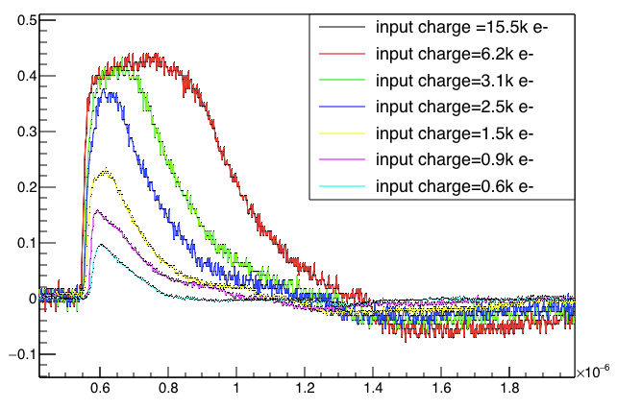
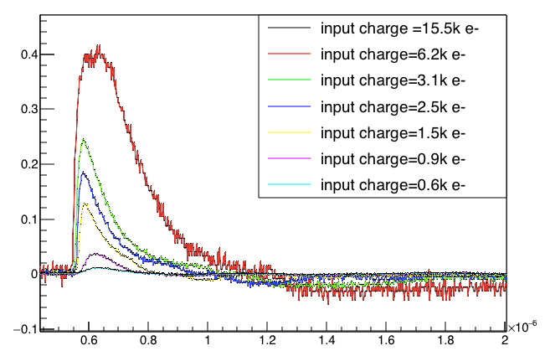
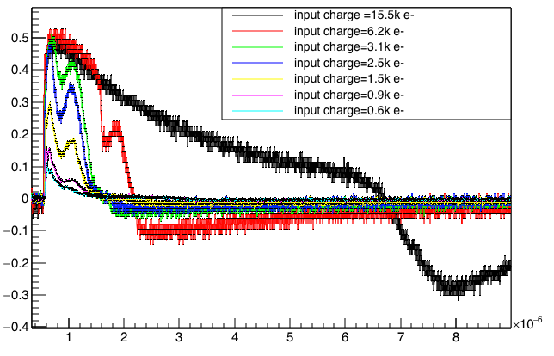
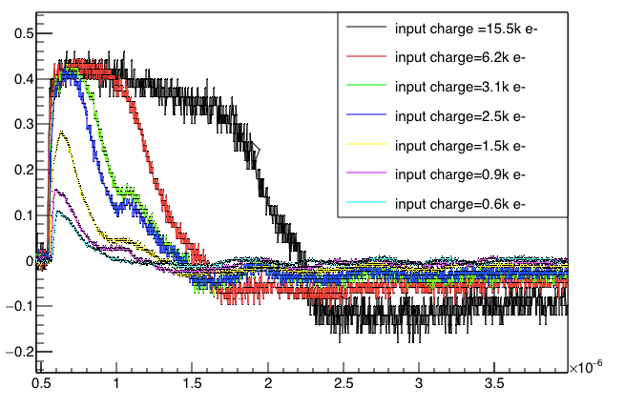
Output pulse Vs input charge
Output (V)
config1
Output (V)
config2
Time (s)
Output (V)
config3
Time (s)
Output (V)
config4
Time (s)
Time (s)

Slide 8
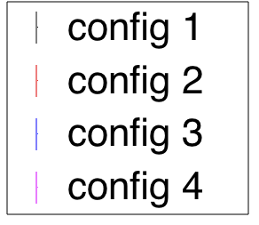
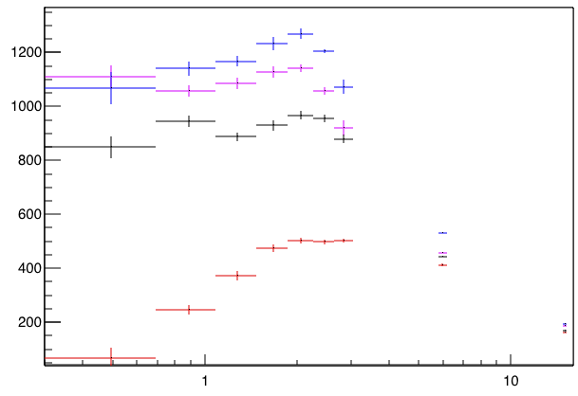
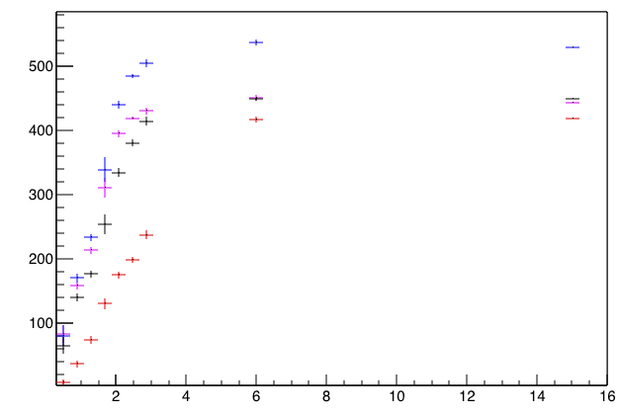
Gain Vs signal size
Assuming Gain=V_out/Q_in
gain is designed to be 500 mV/fC
Measured gain is higher
Config 2 is bad for small signal
Gain (mV/fC)
Output (mV)
Input charge ( k e-)
Input charge ( k e-)

Slide 9
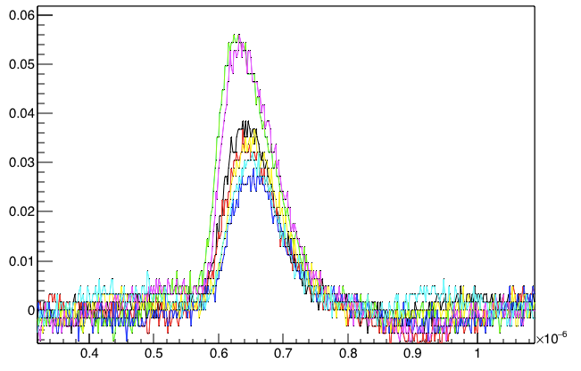
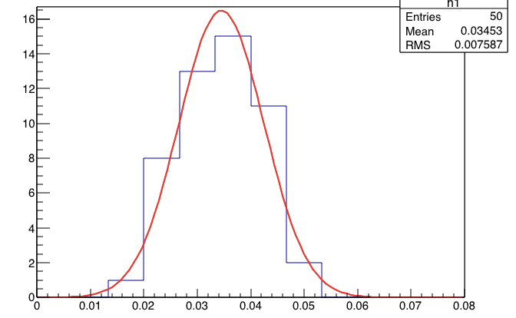
Amplifier Noise
Noise of the amplifier (upper limit) can be estimated by measuring the event-by-event variation in signal peak
8mV output noise
750 mV/fc measured gain for 1mV signal
66.5 e- measured input noise
<100 e- input noise expected
Different color is
From different events
Output (V)
Input =1mV
Charge ?
Config 1
count
Time (s)
Output at peak (V)

Slide 10
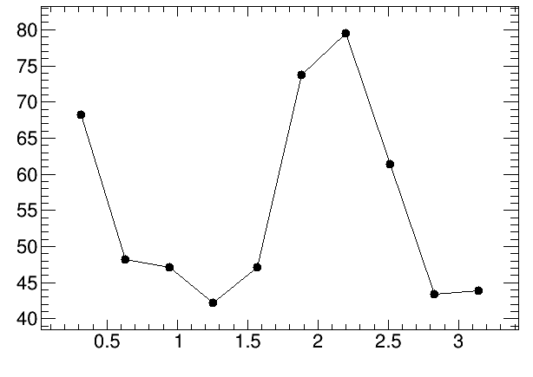
Amplifier Noise
Input Noise : 40~80 e- (<100 e- expected)
Input Noise (e-)
Input charge (k e-)

Slide 11
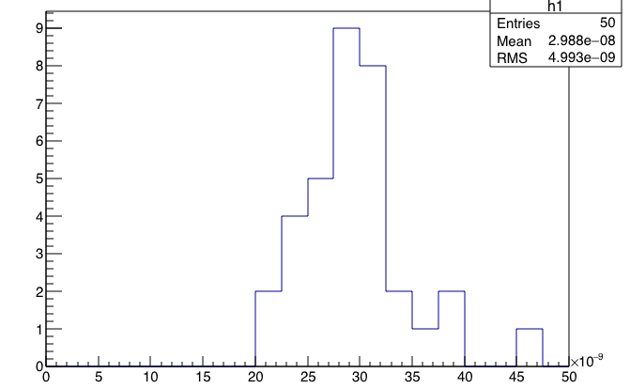
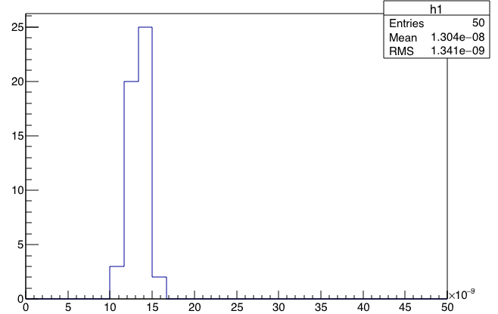
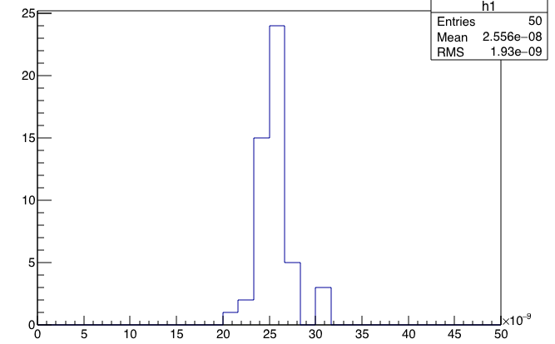
Amplifier output signal rise time
Pulser input signal has 9ns rise time
Amplifier output Rise time (10%-90%) vary between 13ns – 30ns
Depending on the input signal amplitude
Input =0.3k e-
Config 1
Rise time =30ns
Input =1.5k e-
Config 1
Rise time =13ns
Input =3.1k e-
Config 1
Rise=25ns
Output signal rise time(s)
Output signal rise time(s)
Output signal rise time(s)

Slide 12
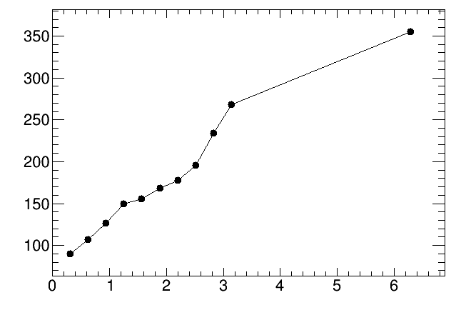
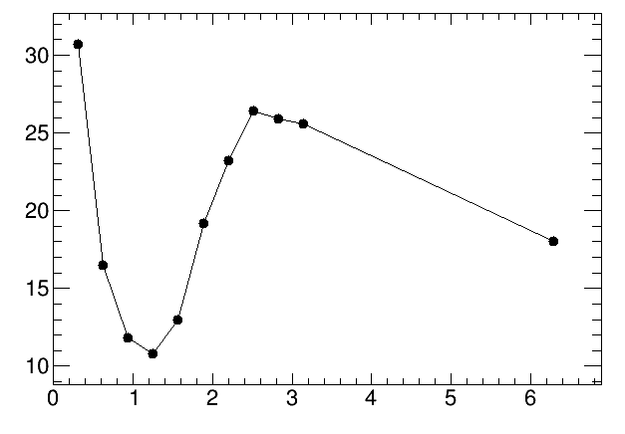
Amplifier output signal rise time
Rise time : 10~30 ns depending on signal size
Full width at half maximum is from 80ns ~360ns depending on signal size.
Rise time (ns)
FWHM(ns)
Config 1
Config 1
Input charge (k e-)
Input charge (k e-)

Slide 13
Summary
first exercise on optimizing the built-in CMOS based amplifier in CHESS1 chip
As input to CHESS2 active array design
Measured Amplifier performance
Gain : 500 ~ 1300mV/fC ( 500 mV/fc is expected)
Input Noise : 40~80 e- (<100 e- expected)
Input noise is good
But It is measured in isolated amplifier without sensor
It may be nosier in real detector
Rise time : 10~30 ns depending on signal size (15ns expected)
Full width at half maximum is from 80ns ~360ns depending on signal size.
Configuration 1 gave the best performance
Best balance between gain and output signal shape.
iBias=0.34V. Cacs =2.6V, Vpload=2.1V, iN=1.4
iFB=2.664V, iNSF=0.569V
Next steps:
Try to reduce power consumption by reducing Amplifier current source bias(iN)
Study signal to noise using laser injection in active pixel array

