Slide 1
Irradiation at Birmingham
R. Bates, C. Buttar, T. Huffman, J.J John, K. Kanisauskas, D. Maneuski, R. Plackett, L. Vigani
Special thanks to J. Wilson, K. Parker, P. Dervan
ATLAS Strip CMOS Regular Meeting
June 23, 2015

Slide 2
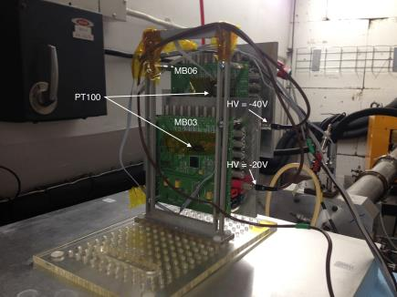
Irradiation Procedure
Two HVStripV1 (MB03 and MB06) samples were irradiated with 27 MeV proton beam at MC40 cyclotron facility at the University of Birmingham
The irradiation consisted of five 1000s rounds for each chip, therefore, the fluences should exceed 5×10¹⁵ n_{eq}/cm²
During irradiation the chips were cooled down to -50°C and biased to -20V (MB03) and -40V (MB06)
Leakage currents and temperatures were logged every 3s

Slide 3
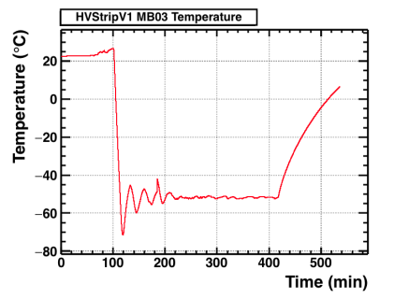
Temperatures
Temperature log plots are nearly identical for both chips
During irradiation i.e. between t≈100min and t≈400min the average temperatures were -52.00°C and -52.42°C for MB03 and MB06 respectively
The increase in temperature seen after t≈400min correspond to the time period given for the chips to warm up in nitrogen atmosphere

Slide 4
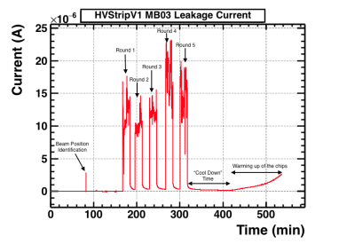
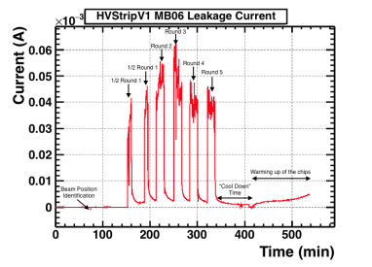
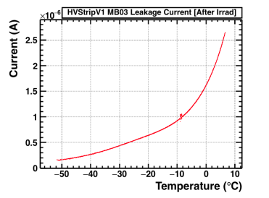
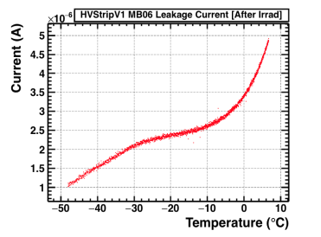
Leakage Currents

Slide 5
Summary
HVStripV1 samples were successfully irradiated
Distinct behavior of leakage current as a function of temperature between the chips was observed after irradiation (possibly due to different bias)
Still need to hear from Birmingham about the actual fluences and when the chips can be shipped back to Oxford and Glasgow

