Slide 1
HV-CMOS Update
The properties device (HVStripV1) we just irradiated @ Birmingham
B. Todd Huffman
23/06/2015

Slide 2
MB03 – Response to Fe⁵⁵ γ’s
Channel 2, Row 1
Biased @ -40 volts
Biased @ -80 volts!!
MB03
MB01

Slide 3
MB03 – Response to Fe⁵⁵ γ’s
Channel 16, Row 0
Biased @ -40 volts
Biased @ -80 volts!!
MB01
MB03
Unfortunately; Appears MB03 is a less performant device.

Slide 4
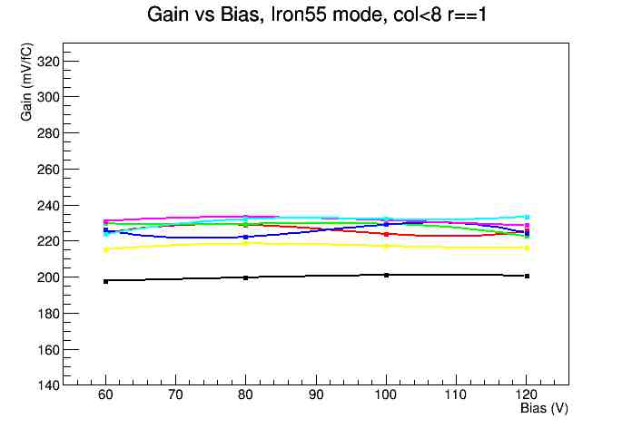
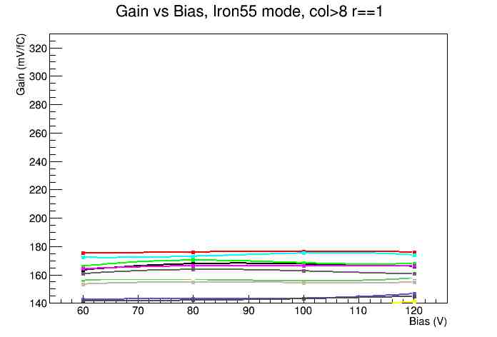
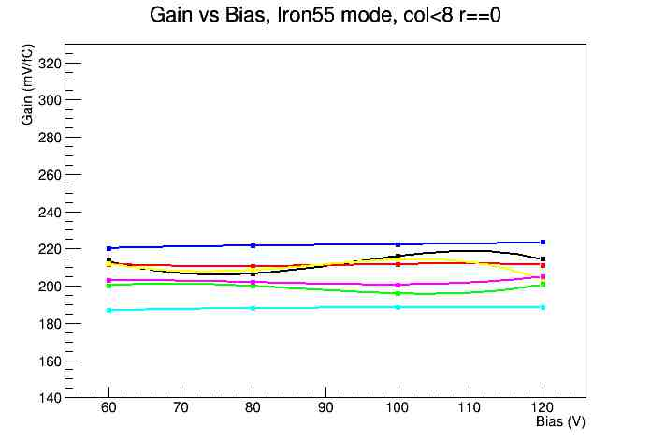
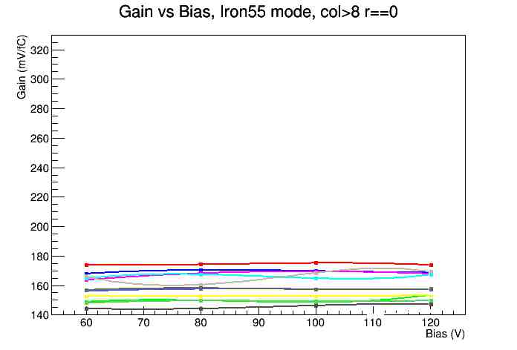
MB01 – Pulse Inj. (from Luigi V. earlier)
Bias-dependent gain

Slide 5
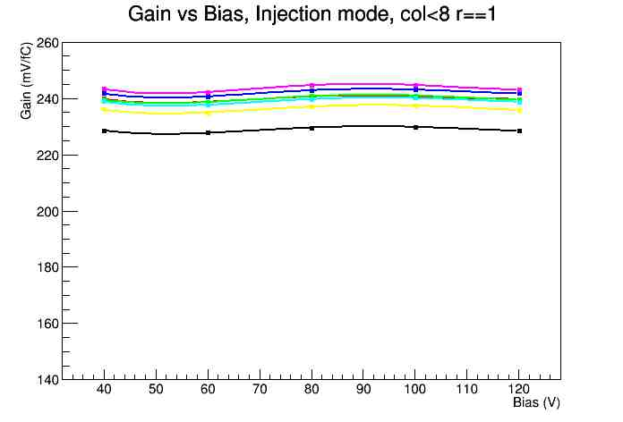
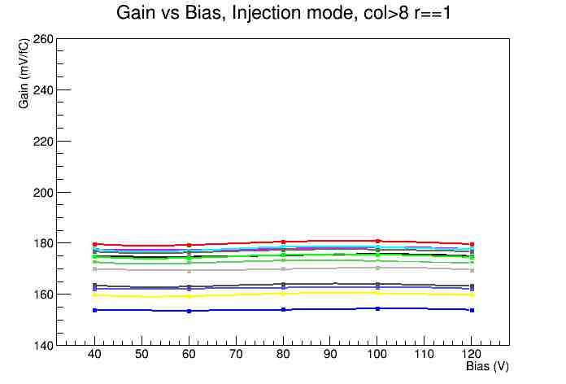
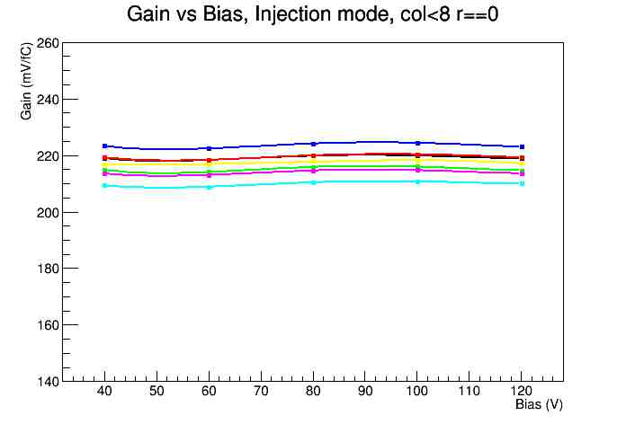
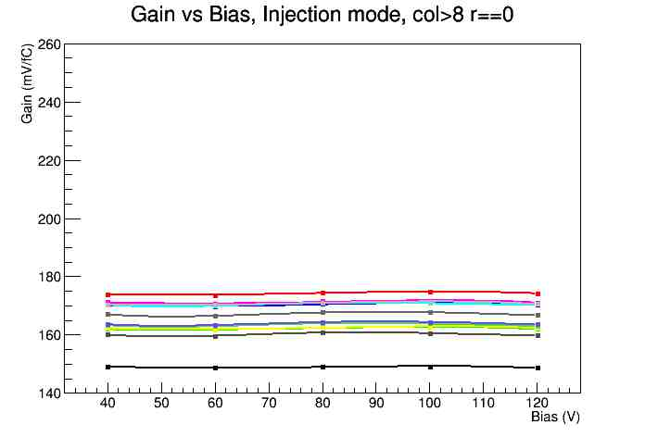
MB03 – Pulse Inj. (Luigi V.)
Bias-dependent gain

Slide 6
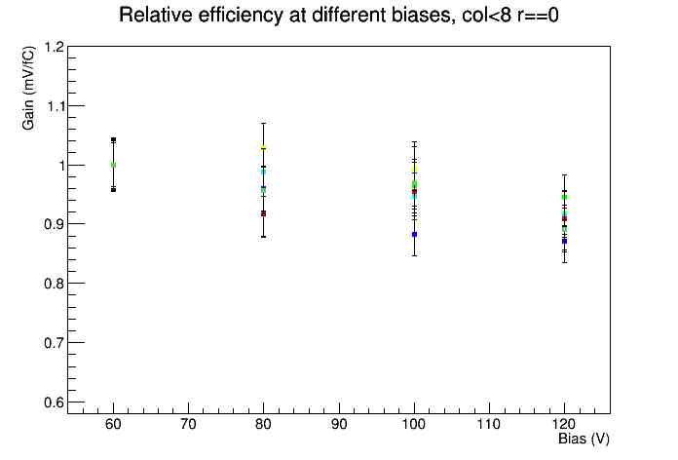
MB03 – Fe⁵⁵ (Luigi V.)
Relative efficiency vs. Bias

Slide 7
(Inj. – Fe⁵⁵)/Inj.
Bias = -80 volts
Histogram of all channels
comparing difference between gain found using Fe55 or just injecting charge into the input capacitor.
A measure of the input capacitor.

Slide 8
Status and Plans
MB03 part of successful proton beam run last week
27 MeV Protons at B’ham
Currently in dry freezer (2 weeks)
Many more test chips arrive soon!
AMS CHESS-1
Chips in hand but small numbers, some irradiated
TJ CHESS-1
Two flavors; several different wafer resistivities
Daughter boards on order – Mother board design nearly complete
Basic chips – Sensor+Amp
Faster amp
Several different sensor sizes
Architectural device - final design review July 1
Full digital processing, 128 ch., 2 cm long 50 μm wide

Slide 9
Futher quick Slides
Just More slides

Slide 10
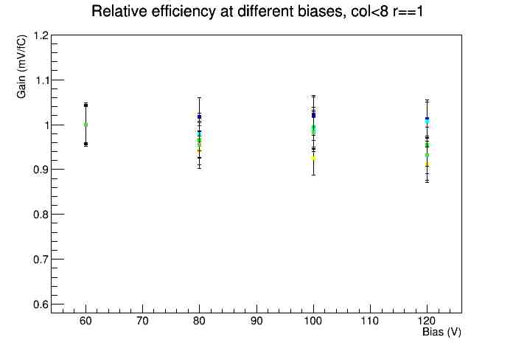
MB03 – Fe⁵⁵ (Luigi V.)
Relative efficiency vs. Bias

Slide 11
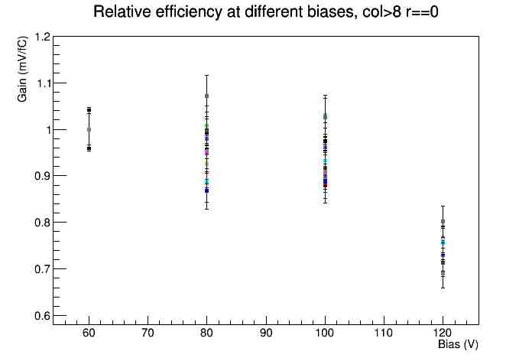
MB03 – Fe⁵⁵ (Luigi V.)
Relative efficiency vs. Bias

Slide 12
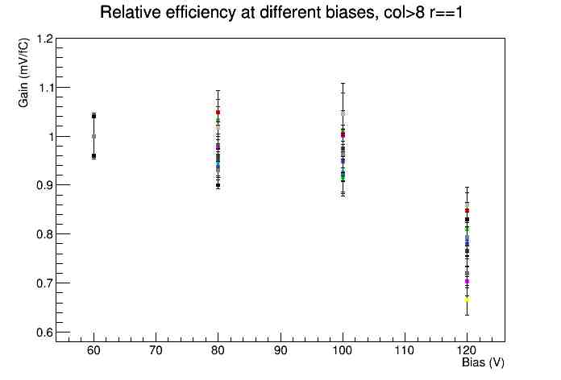
MB03 – Fe⁵⁵ (Luigi V.)
Relative efficiency vs. Bias

